Slide 1


01
Microsoft Power BI User Group
-
DAX Training
24th May, 2018

Slide 2




www.linkedin.com/in/steverein
www.linkedin.com/in/steverein
Steve Rein
Sr. BI Developer & Self-Employed Power BI Consultant
More than 7 Years Experience with Power BI & DAX
Prev. Roles
BI Consultant
Application Engineer
Business Analyst
Controller
IT-Systemadministrator
www.linkedin.com/in/steverein
02
srein@creacia.de
Projects
Controlling
eCommerce
Fashion
Retail
Manufacturing
Printmedia Industry
IT

Slide 3
Agenda
24.05
DAX Introduction
DAX for Beginners
Tbd
DAX Intermediate
DAX Advanced

Slide 4
Chapter one
DAX Introduction
03
001

Slide 5
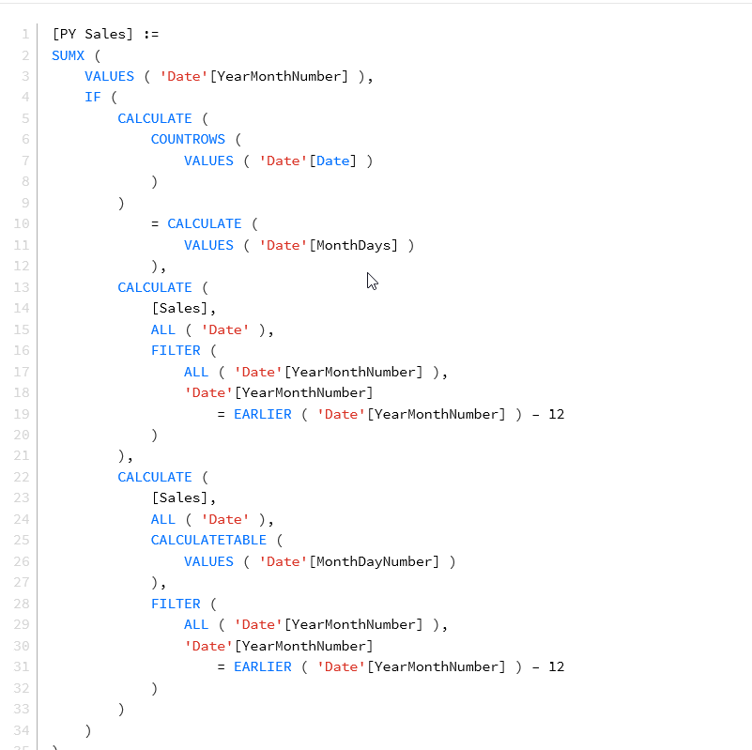


General
DAX is a programming language for SSAS and „Power Pivot for Excel“*
DAX = Data Analysis Expression
Defines the Calculations and Queries of a tabular model
Power Pivot and SSAS Tabular
Syntax is based on Excel Expressions
*It was created in 2010 and PowerPivot was spelled without the Space
Notes:
DAX is designed to compute business formulas over a data model

Slide 6
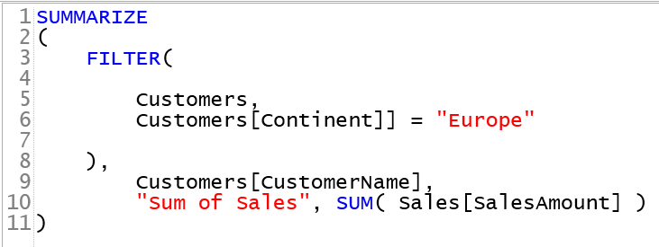
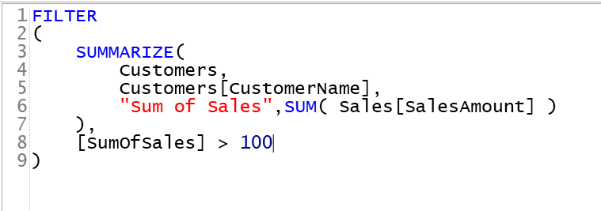
How does it work
DAX is a functional language
In DAX everything is a expression and every expression calls a function
Parameters can also be a Function
The Order, the kind of function and in which way you nest functions have a big impact
Final Result
Performance of the Engine

Slide 7
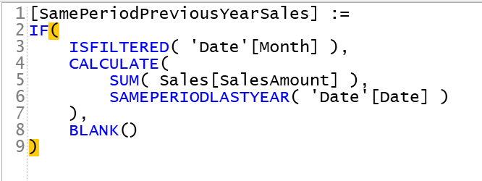
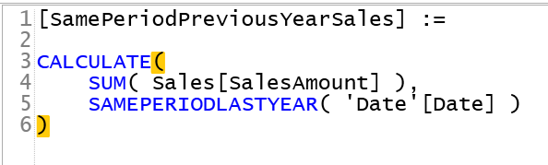
How does it work
DAX as a programming & query language
DAX functions manipulate tables and can return tables
DAX creates calculated columns and defines measures
DAX is used to receive data from SSAS tabular models
Notes:
DAX makes no distinction between querying and programming
Normally you learn DAX as a programming functions and you will know eversthing about it to use it as a query language
The FILTER function is a good example in this case

Slide 8

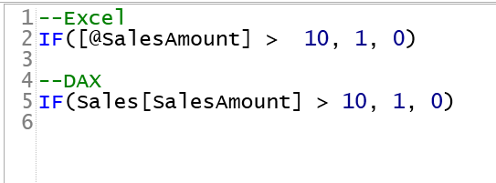
DAX for Excel User
The roots of DAX are in „ Power Pivot for Excel“
DAX and Excel are both functional languages
Every expresion is a function call
DAX works only on tables and columns
Excel: Can work with Cells and coordinates (E4*F4)
DAX refers natively to the entire column
Excel: Omit the @ to refer the entire column
Notes:
The development Team tried to keep the two languages similar
Neither in Excel nor in DAX is there a concept of statements, loops and jumps whch are common to many programming languages
In DAX there is no difference between using a column to grab ist values for a specific row and using the column as a whole.

Slide 9
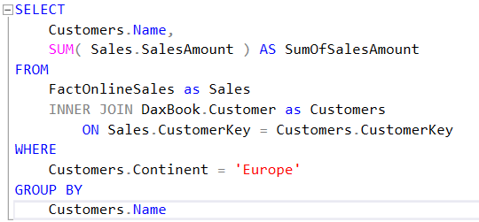
DAX for SQL Developer
DAX is about querying tables joined by relationships and aggregating values
DAX is a functional language vs. SQL is a declarative language
DAX: Every Expression is a function
SQL: Define what you need by declaring a set of data using SELECT statement
DAX Relationships are part of the model and are all LEFT OUTER JOINS
SQL: Set foreign keys between tables and using different Join conditions in queries
Notes:
DAX makes no distinction between querying and programming
Normally you learn DAX as a programming functions and you will know eversthing about it to use it as a query language
The FILTER function is a good example in this case

Slide 10
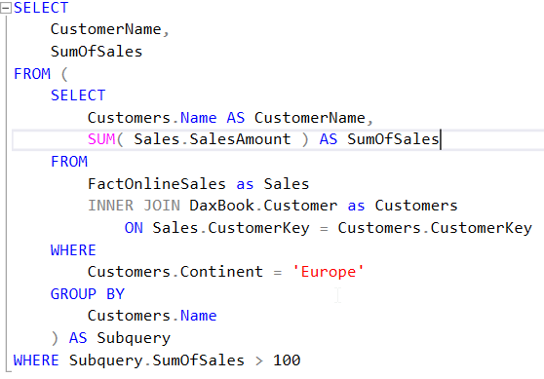
DAX for SQL Developer
DAX makes virtually no distinction between querying and programming
SQL makes a clear distinction between querying and programming
Sets of Instructions to create
Stored Procedures
Views
DAX has subqueries just like SQL
Notes:
DAX makes no distinction between querying and programming
Normally you learn DAX as a programming functions and you will know eversthing about it to use it as a query language
The FILTER function is a good example in this case

Slide 11
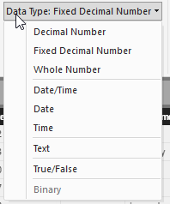
DAX Syntax
DAX expression returns a table or a scalar value
Tables of or in a DAX expression must contains at least one column
DAX datatypes
Integer
Real
Currency
Date stored as a decimal number
1 = 30.12.1899
1+1/86399 = 30.12.1899 00:00:01
TRUE/FALSE (Boolean)
String
BLOB (binary large object)

Slide 12
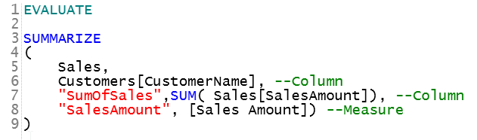
DAX Values
Scalar Values: „Literals“ („USA“, 0)
Value of a column:
‘Table Name‘[Column Name]
Best Practice:
Referencing a column:
Specifying the table name
Referencing a measure:
Omitting the table name

Slide 13
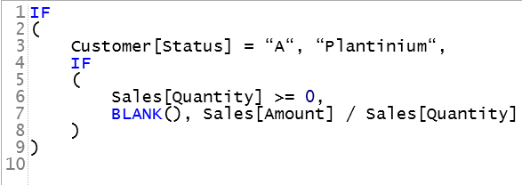
Logical functions
IF(<<condition>>, <<true>>, <<false>>)
AND (&&), OR (||), NOT
ISBLANK(), ISERROR()
IFERROR()
SWITCH (
Customer[Status] ,
“A“, “Plantinium“,
“B“, “Gold“,
“C“,“Silver“,
“D“, “White“,
“None“
)

Slide 14
DAX Operators
Nesting: ()
Arithmetic operators: +, -, *, /
Comparsions: =, <>, >, >=, <, <=
Linking texts: &
Logical operators: &&, ||

Slide 15
Information functions
Give information about DAX expressions
ISBLANK
ISNUMBER
ISTEXT
ISNOTEXT
ISERROR

Slide 16
Empty or missing values - BLANK
BLANK() = Empty or missing value
Only useful as a result of a DAX expression
Example:
BLANK() + BLANK() = BLANK()
10 * BLANK() = BLANK()
BLANK() / 3 = BLANK()
BLANK() / BLANK() = BLANK()
BLANK() || BLANK() = FALSE
BLANK() && BLANK() = FALSE
BLANK() – 10 = -10
18 + BLANK() = 18
4 / BLANK() = Infinity
0 / BLANK() = NaN
FALSE || BLANK() = FALSE

Slide 17
Chapter two
„DAX for Starters“
05
002

Slide 18
Aggregation-Functions
Aggregation of ONE column
AVERAGE, AVERAGEA
MAX, MAXA
MIN, MINA
STDEV.S, STDEV.P
SUM
VAR.S, VAR.P
Aggregations are only possible on numeric columns
DEMONSTRATION
Notes:
DAX makes no distinction between querying and programming
Normally you learn DAX as a programming functions and you will know eversthing about it to use it as a query language
The FILTER function is a good example in this case

Slide 19
DIVIDE function
DIVIDE handles the division by zero
DIVIDE ([GrossMargin];[Sales Amount];0)
Old Way
If( [Sales Amount] <> 0, [GrossMargin]/[Sales Amount];0)
DEMONSTRATION
Notes:
DAX makes no distinction between querying and programming
Normally you learn DAX as a programming functions and you will know eversthing about it to use it as a query language
The FILTER function is a good example in this case

Slide 20
Counting of values
DAX functions – Counting of values:
COUNT (counts numeric values)
COUNTA (counts everything except blank values)
COUNTX, COUNTAX
COUNTBLANK (only blank values)
COUNTROWS (counts rows in a table)
DISTINCTCOUNT (counts only the distinct values of a column)
With COUNTA you can count all not-“blank“ rows of a column independent of the datatype
DEMONSTRATION
Notes:
DAX makes no distinction between querying and programming
Normally you learn DAX as a programming functions and you will know eversthing about it to use it as a query language
The FILTER function is a good example in this case

Slide 21
Mathematical functions
Works like in EXCEL
ABS
EXP
FACT
LN
LOG
LOG10
MOD
PI
POWER
QUOTIENT
SIGN
SQRT
Notes:
DAX makes no distinction between querying and programming
Normally you learn DAX as a programming functions and you will know eversthing about it to use it as a query language
The FILTER function is a good example in this case

Slide 22
Text functions
Similar to in Excel
CONCATENATE, CONCATENATEX
FIND, FIXED, FORMAT
LEFT, LEN, LOWER, MID
REPLACE, REPT, RIGHT
SEARCH, SUBSTITUTE, TRIM
UPPER, VALUE, EXACT
DEMONSTRATION
Notes:
DAX makes no distinction between querying and programming
Normally you learn DAX as a programming functions and you will know eversthing about it to use it as a query language
The FILTER function is a good example in this case

Slide 23
Date & Time functions
DATE
DATEVALUE
DAY
EDATE
EOMONTH
HOUR
MINUTE
MONTH
NOW
SECOND
TIME
TIMEVALUE
TODAY
WEEKY
WEEKNUM
YEAR,
YEARFRAC
Notes:
DAX makes no distinction between querying and programming
Normally you learn DAX as a programming functions and you will know eversthing about it to use it as a query language
The FILTER function is a good example in this case

Slide 24
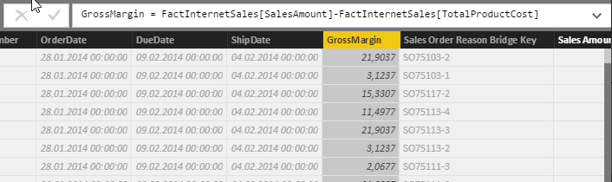
Calculated columns
Adding a new column to an existing table in your data model
Execution of the expression for every row of the table (row context)
Changes the table data structure-> Evaluation of all calculated columns (-> RAM)
The column name needs to be unique for the table
Notes:
DAX makes no distinction between querying and programming
Normally you learn DAX as a programming functions and you will know eversthing about it to use it as a query language
The FILTER function is a good example in this case

Slide 25
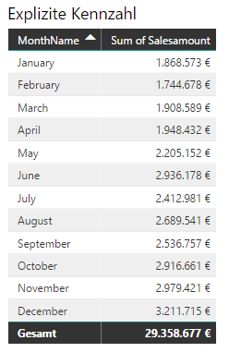
Measure
Adding a new column to an existing table in your datamodel
Execution of the expression for every row of the table (row context)
Changes the table data structure-> Evaluation of all calculated columns (-> RAM)
The column name is unique for the table
Notes:
DAX makes no distinction between querying and programming
Normally you learn DAX as a programming functions and you will know eversthing about it to use it as a query language
The FILTER function is a good example in this case

Slide 26
Measure vs. Caluclated column
Calculated Columns
Calculated columns are fixed and saved in the data model
Needs RAM
Use calculated columns if you want
Need the value as a slicer or filter content
The calculation is very complex
For fixed values like, z.B. Revenue = Amount of Products * Productprice
Measures
Measures will be calculated to the query runtime
No row context
Needs CPU time
Use measures if you want
Calculations of relative contents (Percentage of revenue)
Prozente errechnen wollen
Complex calculations
Dynamic calculations
Notes:
DAX makes no distinction between querying and programming
Normally you learn DAX as a programming functions and you will know eversthing about it to use it as a query language
The FILTER function is a good example in this case

Slide 27
Exercise – First Steps in DAX
Create a measure of the sum (Sum of Sales Amount) and the average(Avg Sales Amount) of Sales Amount
Create a calculated column„GrossMargin“(Sales Amount-TotalProductCost)
What‘s the value of the GrossMargin in 2007?
Create a measure (GrossMargin measure) which have the same total value like the calculated column
Create a calculated column which divides SalesAmt through TotalProductCost. If the quotient is smaller than 2 the cell will show „Low“ if it‘s bigger than 2 show „High“.
How much High and Low transactions appeared in February?
Create a measure (Avg Sales Amount with Sold Qty > 2000). The measure returns the SalesAmt if the amount if sold products (OrderQuantity) is higher than 2000.
What is the average revenue of black products with the condition >4000?
Divide the sum of Sales Amount through Avg Sales Amount with Sold Qty > 4000
Is the Avg Sales Amount with Sold Qty > 4000 then returns blank else returns -1.

Slide 28


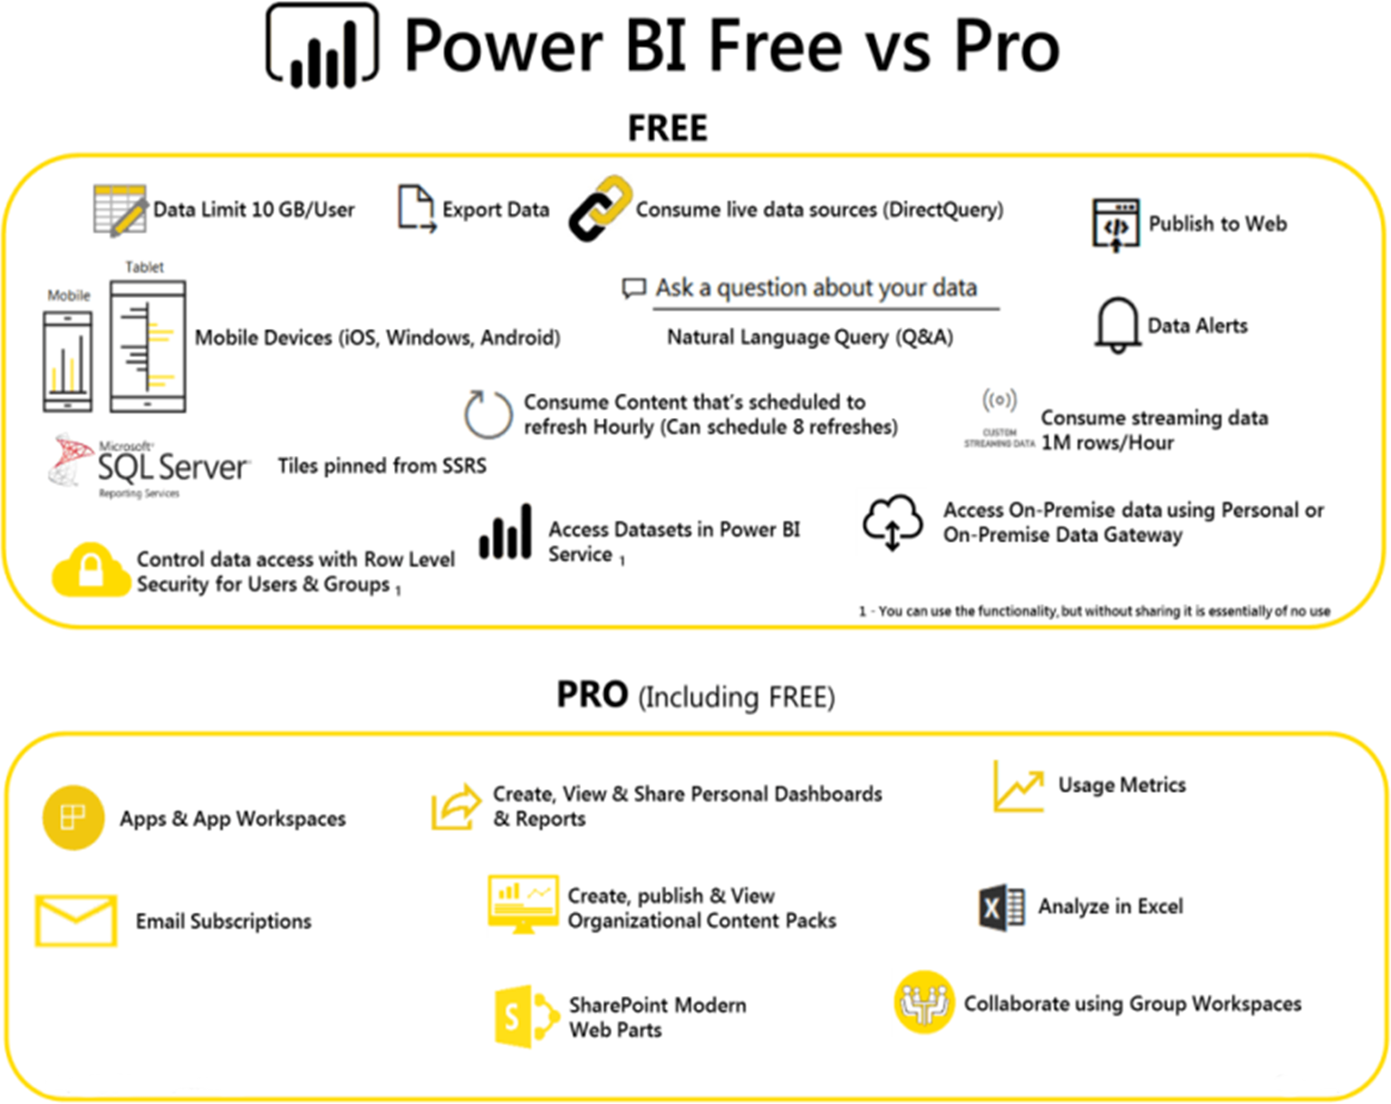
Power BI – Pro & Free Features
028
Public Relations Worldwide

Slide 29
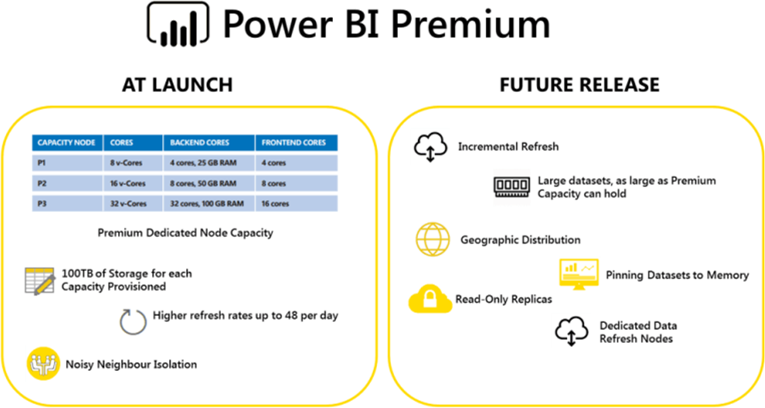
Power BI – Premium Features
029
Public Relations Worldwide

Slide 30
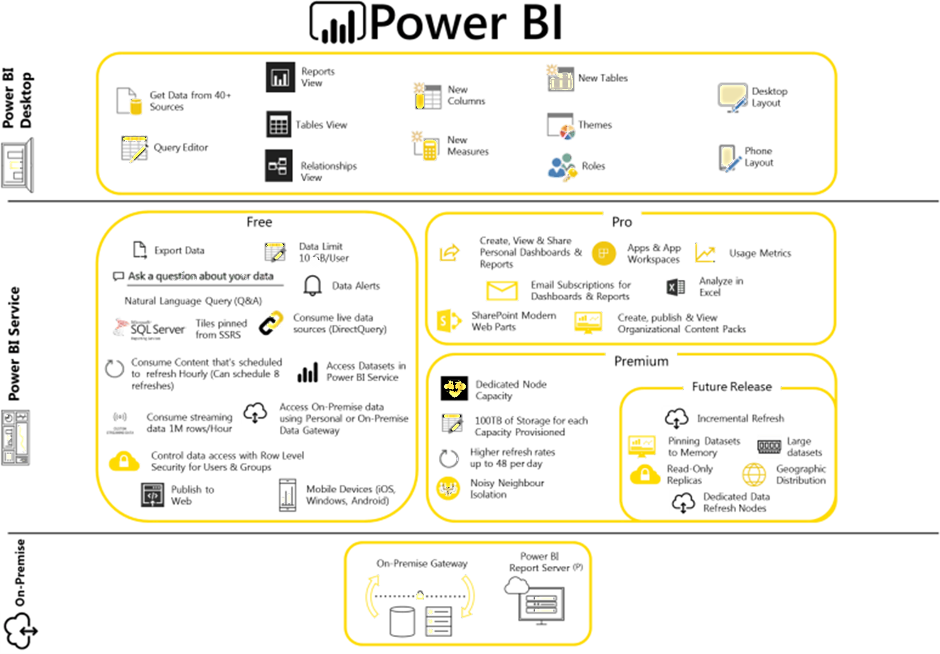
Power BI Stack
With Power BI you gain a complete Stack to serve your self-services BI & Analytics needs

