Slide 1
CS4221/CS5421 Tutorial 6: eXist-db & MongoDB Hands-on
Mark Meng Huasong
Windows platform is used in my demonstration. The installation of both DB systems is slightly different from Mac ones.
For Mac users, please refer to Zemmy’s session recording if you’ve encountered any technique issue.

Slide 2
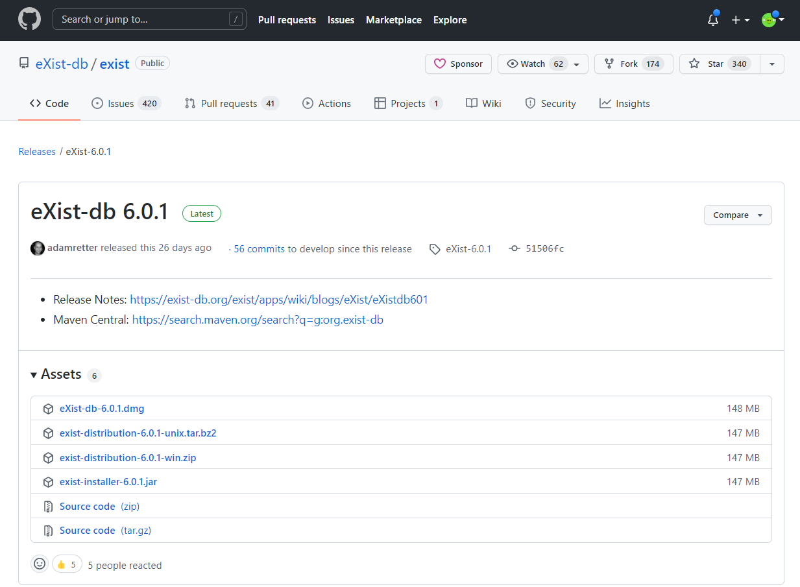
eXist-db
Go to official website and download the installation package
You will be redirected to the latest release page on GitHub.
You can download either 5.x or 6.x. Both are latest versions.
To install on Windows, click the installer JAR file (!!! Not the zip file).
You can just double click to start installation if you have the Java properly installed.

Slide 3
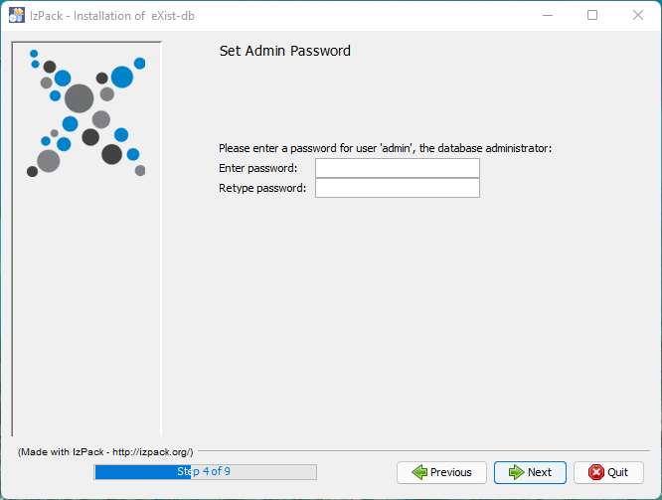
eXist-db
Install the JAR package
You will be given a chance to set your admin password here.
You can leave them blank as by default the password is empty.

Slide 4
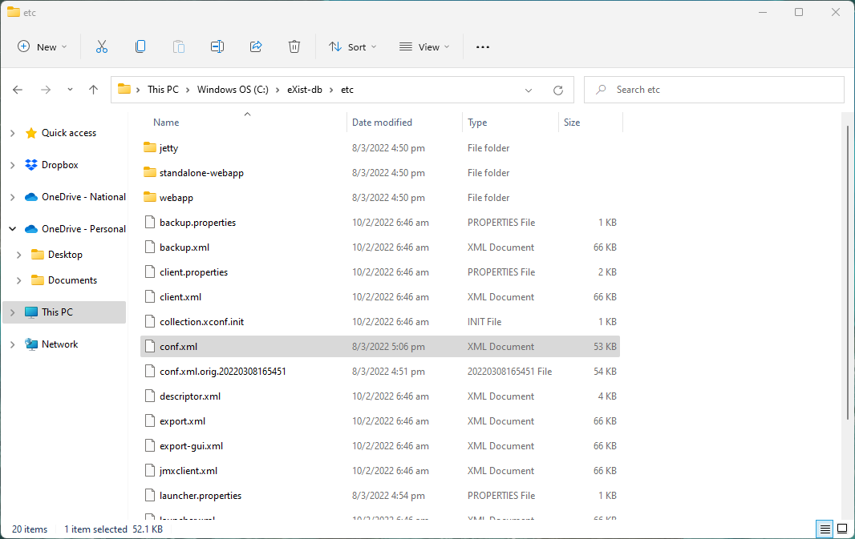
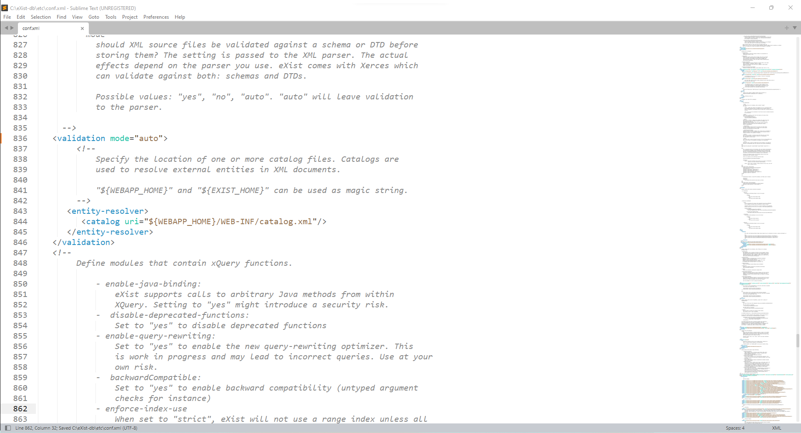
eXist-db
Enable validation mode (DTD, to be covered in the upcoming lecture)
Go to the directory of installation, find the etc/conf.xml file. Search the text “validation mode”, change from “no” to “auto”, then save it.
https://exist-db.org/exist/apps/doc/validation

Slide 5
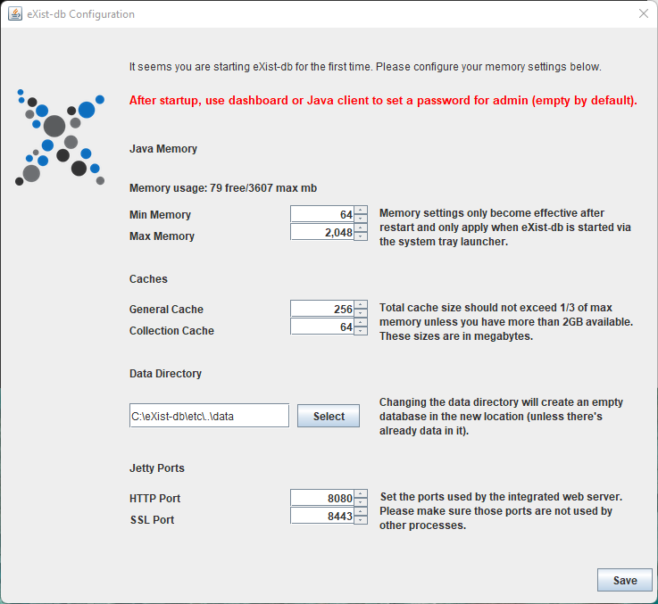
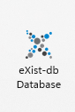
eXist-db
Launch eXist-db
Once installed it, you’ll have to manually launch the “eXist-db Database” as an app on Windows.
You can see a configuration window popped up. There is no need to change the settings.

Slide 6

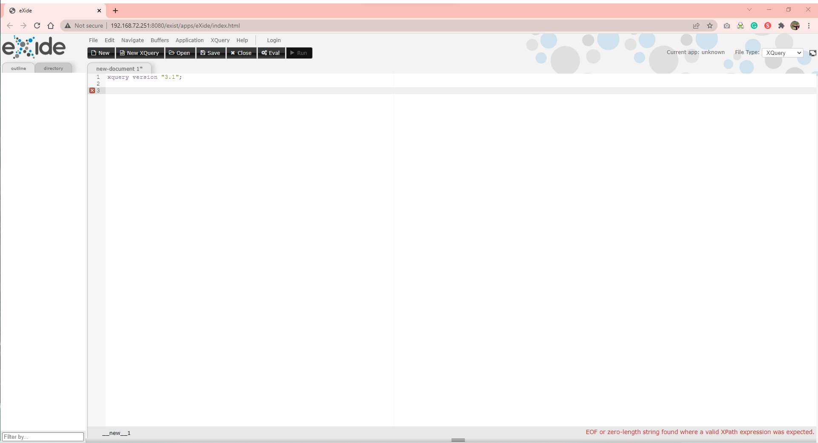
eXist-db
Open the eXide through your browser
You should see the exist-db is active now from the status bar.
Right click it and click “open eXide”.
You will be directed to localhost:8080 on your browser.
If your browser display an XML (not a webpage), refresh it.

Slide 7
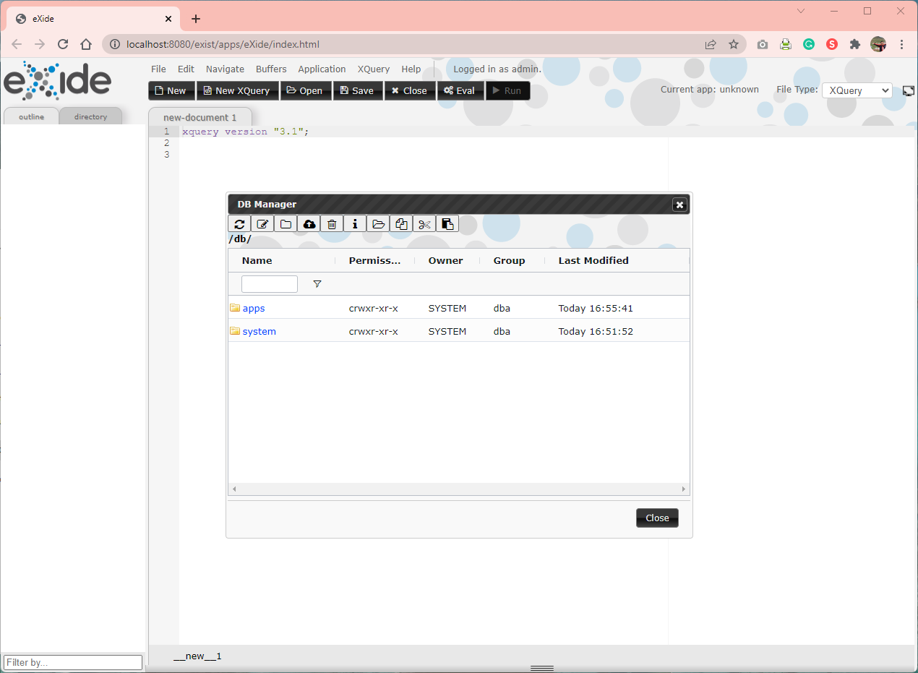
eXist-db
Create a collection (database)
Click “File” on the menu bar, then click “DB Manager”.
You will be prompted to type in user and password (user “admin” with empty password by default).
Click “Create Collection” (as shown in red box), with you preferred name (e.g., “cs4221”)

Slide 8
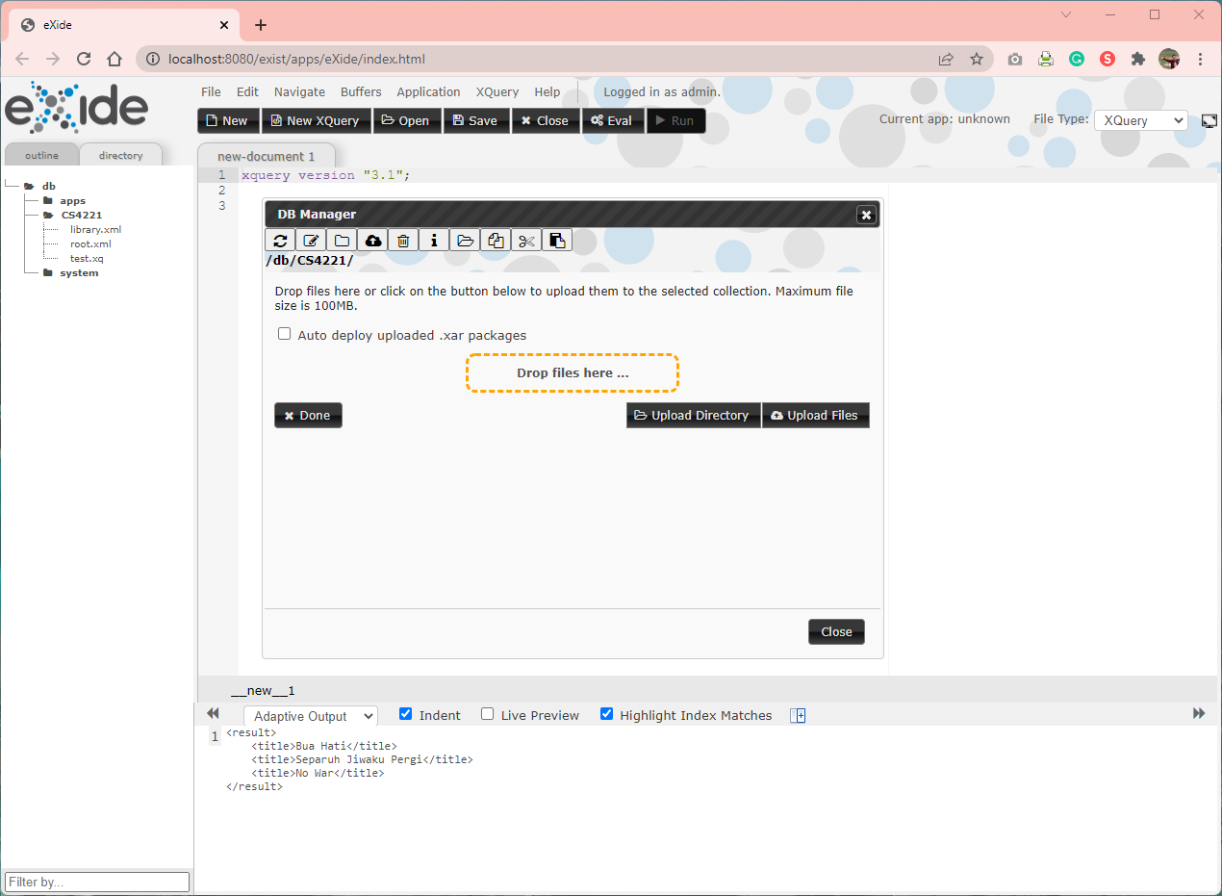
eXist-db
Import from XML
Click “File” on the menu bar, then click “DB Manager”.
Click “Upload Files”, upload the music library file “library.xml” (find on Luminus).

Slide 9
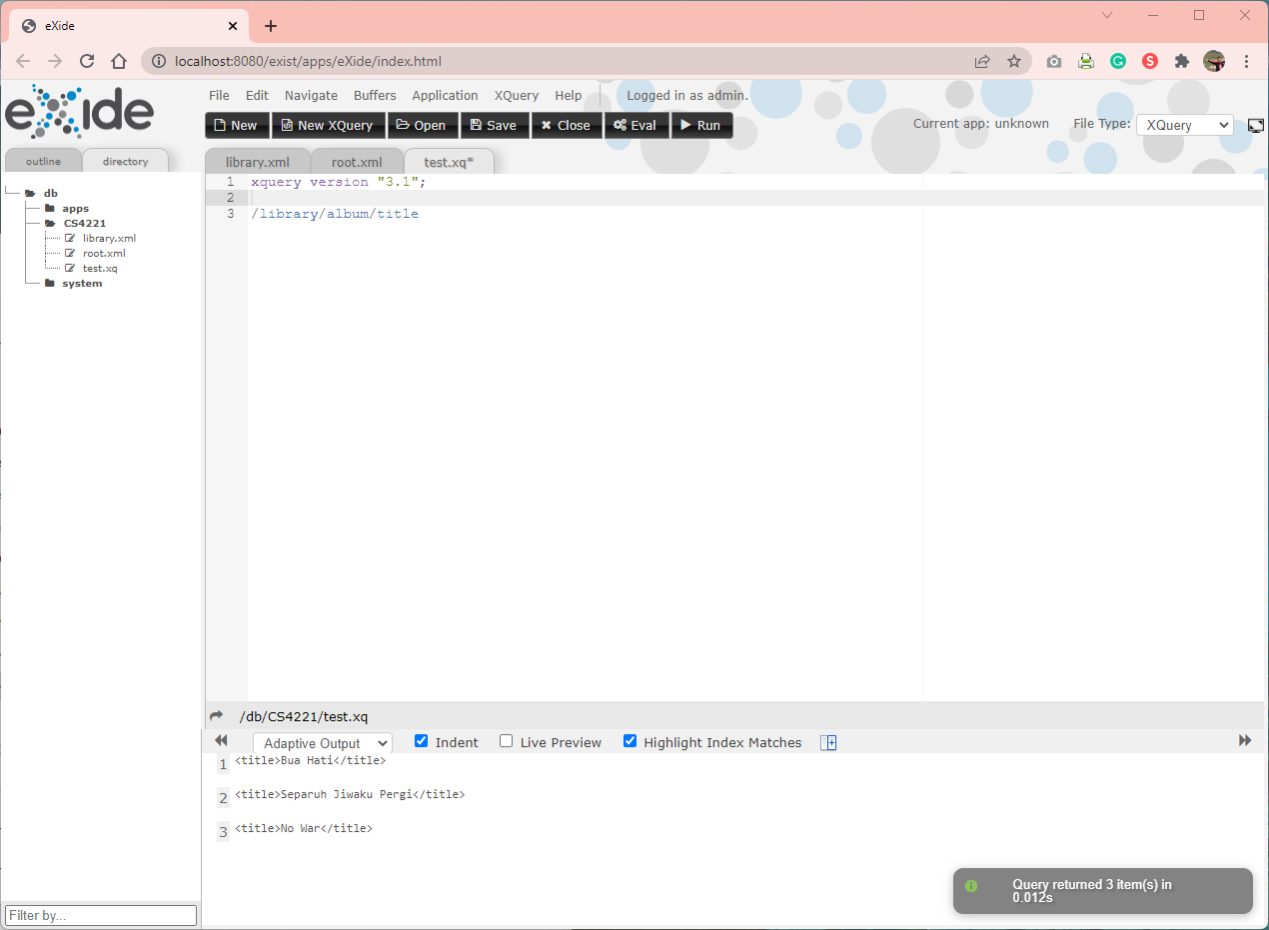
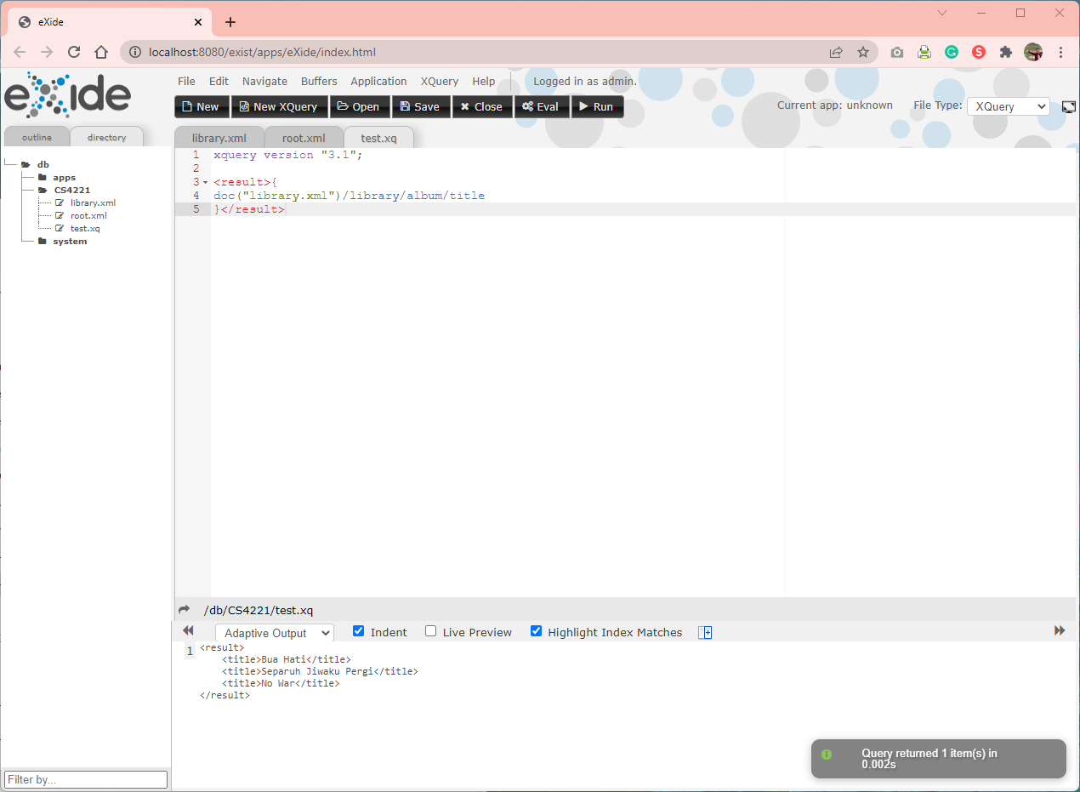
eXist-db
XPath & XQuery
You can create an “.xq” file to query data. (Left: XPath, Right: XQuery (multiple lines))

Slide 10
eXist-db
Demonstration

Slide 11
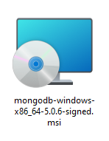
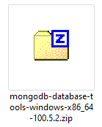
mongoDB*
Go to official website and download the installation package
You need to download MongoDB (Windows Installer) and MongoDB Database Tools (to use mongoimport).
* MongoDB is not examined, just for you to explore.

Slide 12
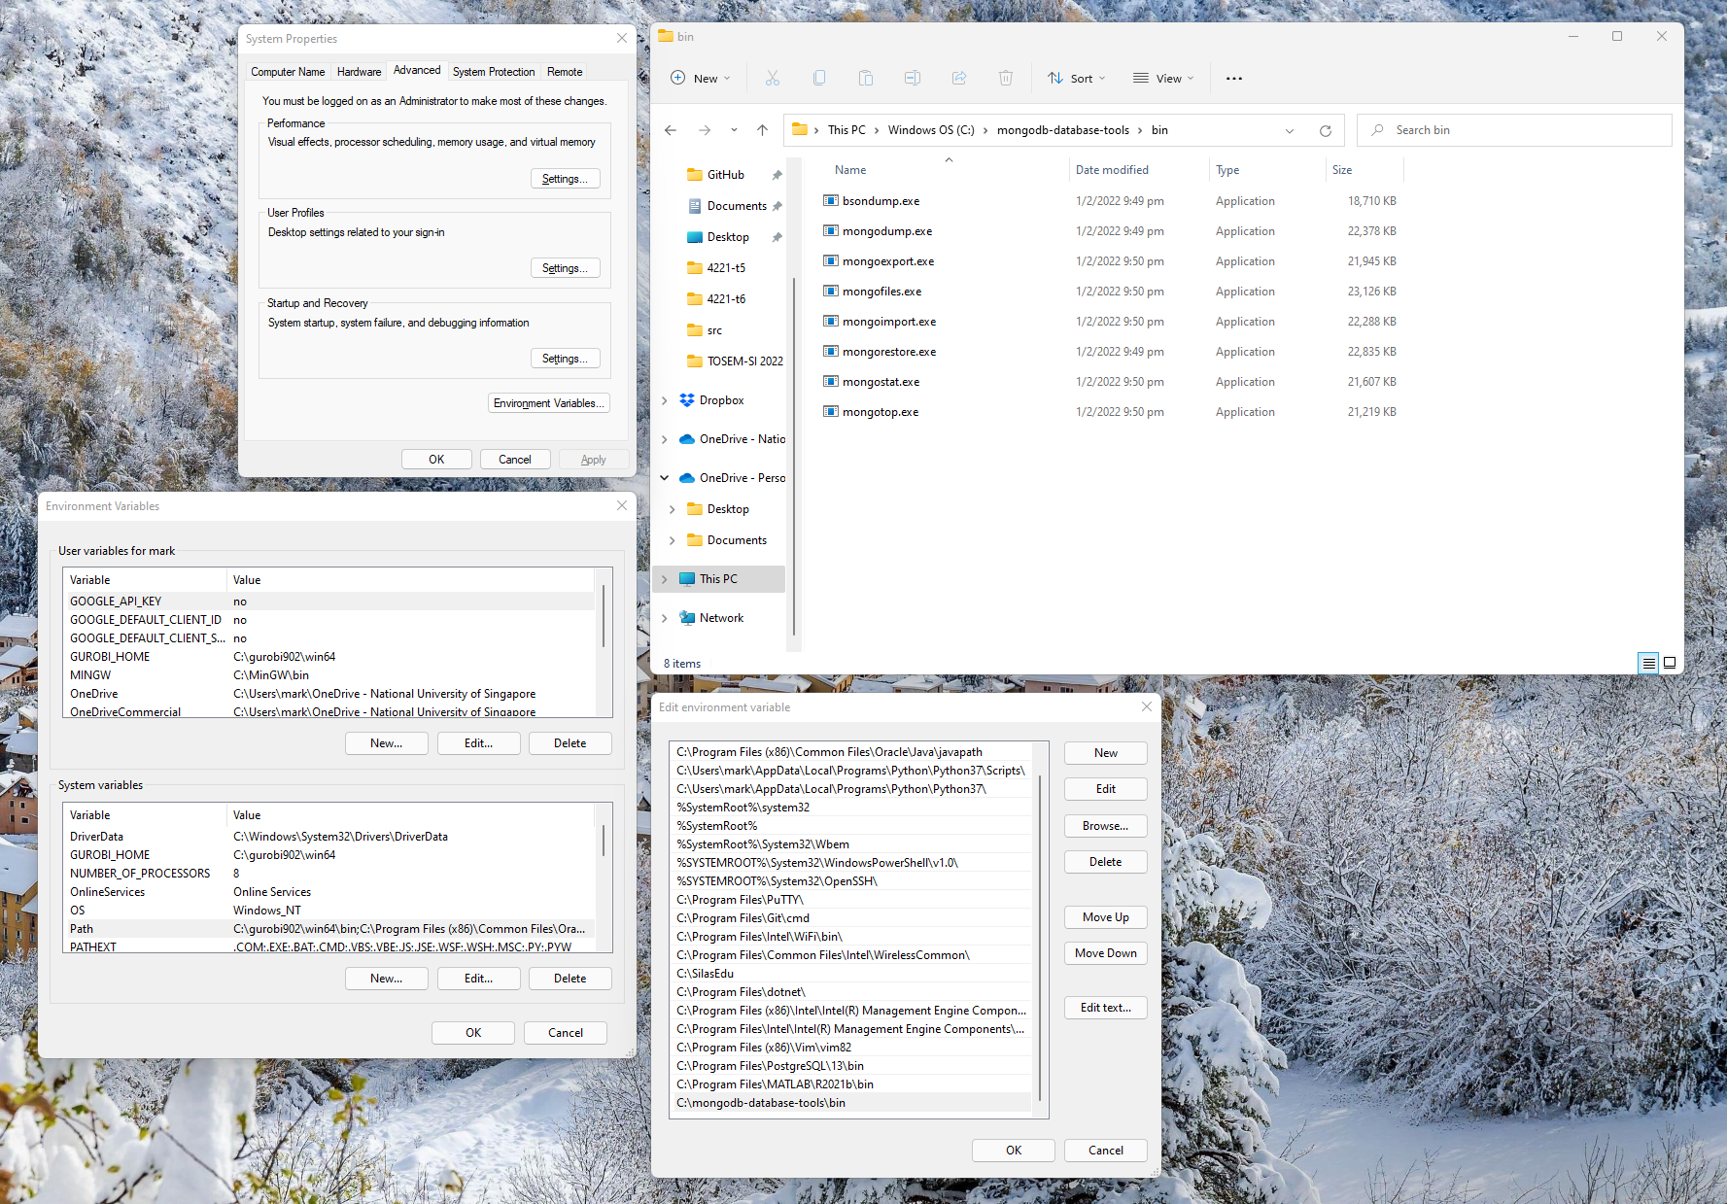
mongoDB
Configure system environment to use mongoimport
Extract the zip file (database tools) to your local directory and add them to the PATH.

Slide 13
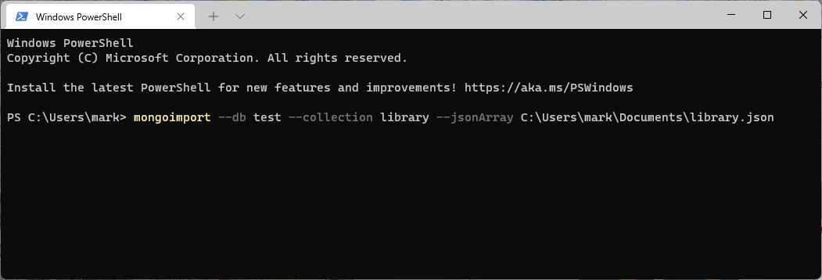
mongoDB
Import from .json file
Open terminal (terminal) and execute the command below.
mongoimport --db test --collection library --jsonArray <path_of_json_file>

Slide 14
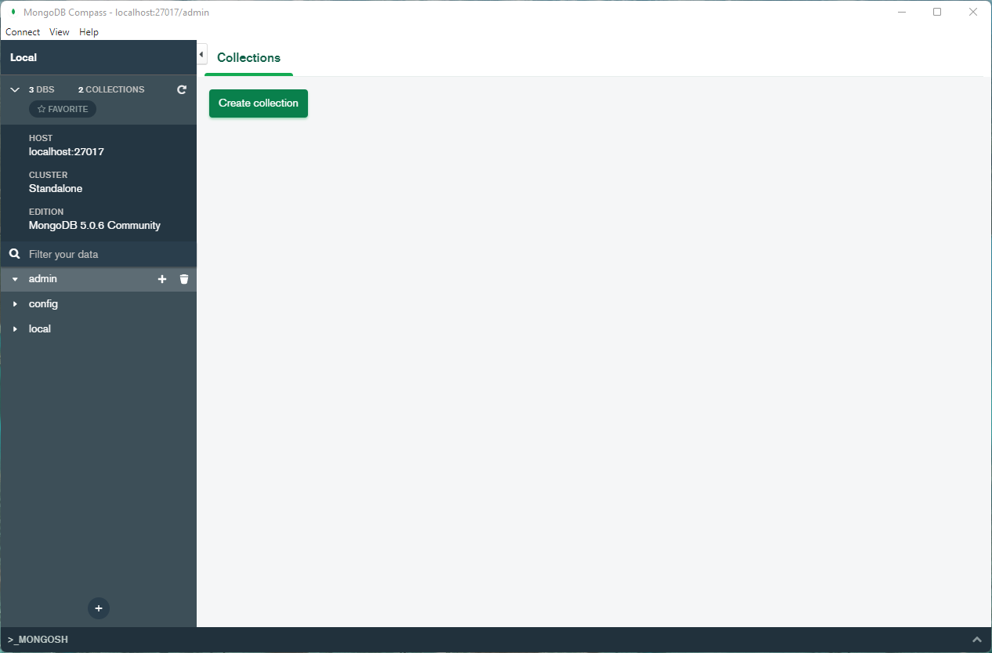
mongoDB
Otherwise, you can also import data from GUI (mongoDB Compass)
Open mongoDB Compass.
Click “Connect” to have the GUI as shown on the right.
Click “+” to create a database named “test”

Slide 15
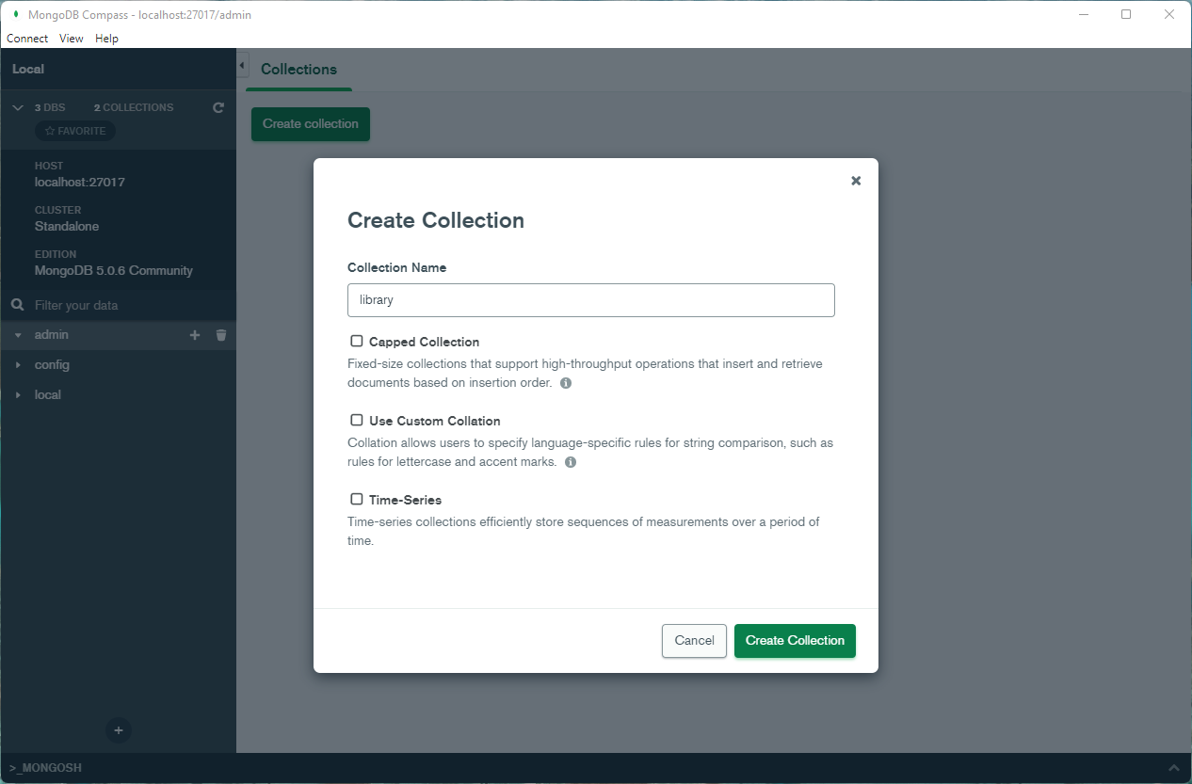
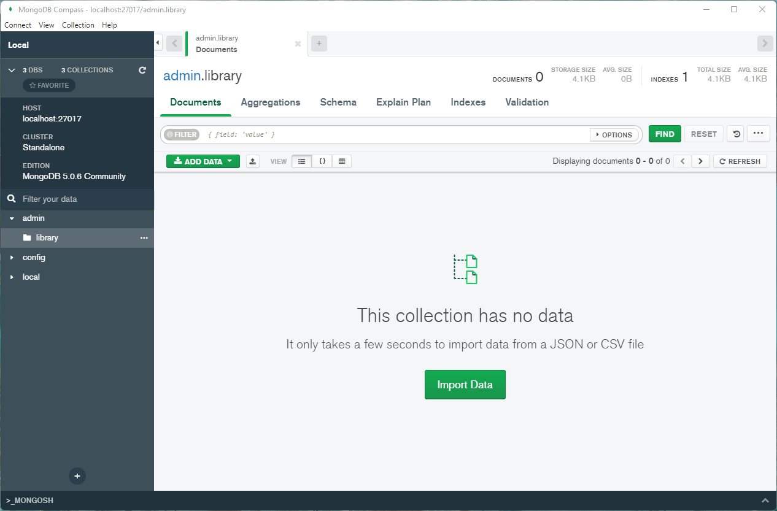
mongoDB
Otherwise, you can also import data from GUI (mongoDB Compass)
Create a collection (database) named “library” and then import data.

Slide 16
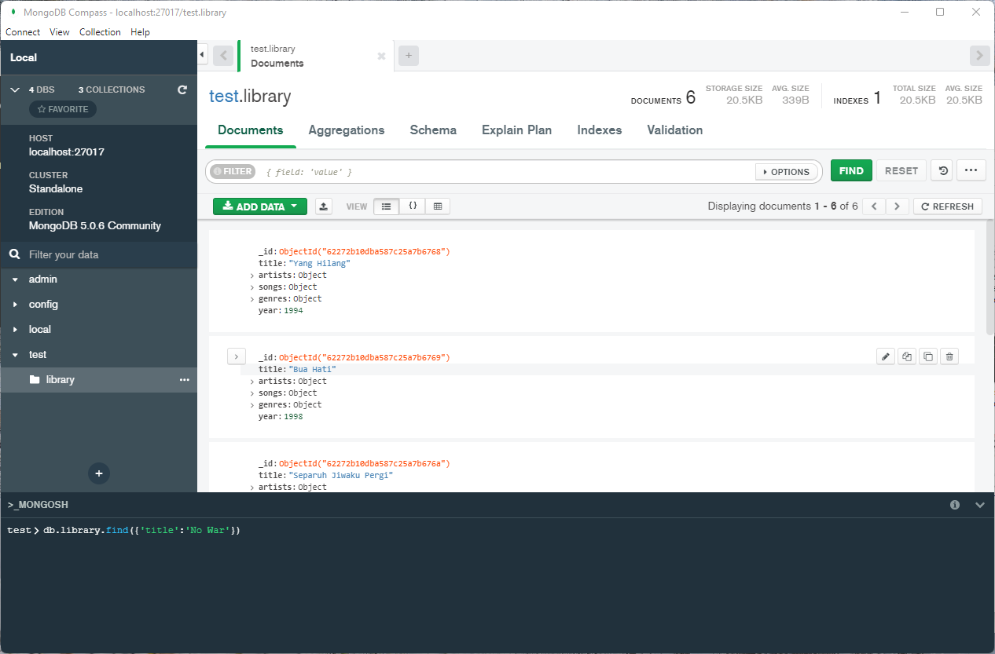
mongoDB
Perform query through MONGOSH
Click “>_MONGOSH” at the bottom.
Try to make a query
(e.g. db.library.find({‘title’:‘No War’}))

Slide 17
mongoDB
Demonstration

Slide 18
See you next week…

