Slide 1
Post-GDPR Threat Hunting on Android Phones: Dissecting OS-level Safeguards of User-unresettable Identifiers (UUIs)
Mark Huasong Meng (National University of Singapore), Qing Zhang (ByteDance), Guangshuai Xia (ByteDance), Yuwei Zheng (ByteDance), , Yanjun Zhang (Deakin University, Australia), Guangdong Bai (University of Queensland, Australia), Zhi Liu (ByteDance), Sin G. Teo (Institute for Infocomm, A*STAR, Singapore), Jin Song Dong (National University of Singapore)
Notes:
Good morning, my name is Mark Meng from National University of Singapore.
The title of the paper is…

Slide 2
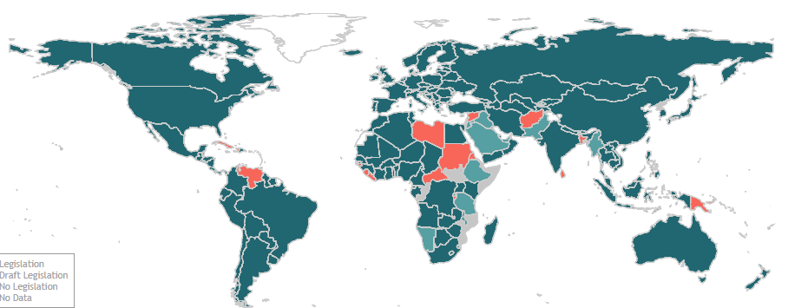

Background
后GDPR时代
Post-GDPR Era
The protection of personal data has gained a great deal of attention around the world.
137 out of 194 countries had put in place legislation to secure the protection of data and privacy.
Our phones are the first line of defence against privacy infringement.
当下个人数据的保护已经成为了一个全球瞩目的话题。
截止2022年，全球共有137个国家已经通过或者实行了个人数据和隐私保护的相关法律。
我们日常使用的智能手机渐渐成为保护个人隐私的最前线。
Data Protection and Privacy Legislation Worldwide (as of 2022)
Notes:
The protection of personal data has gained a great deal of attention around the world.
As of 2022, there are 137 out of 194 countries had put in place legislation to secure personal data and privacy protection.
The European Union’s GDPR is one of the most representative laws which is known to stipulate a large penalty if a company is found not properly handling users’ personal data.
And our smart phones, as our daily used devices, are becoming the first line of defense against privacy infringement.

Slide 3
Background
Android生态
Android Ecosystem
Google has taken steps to enforce new privacy features to restrict apps’ use of user data.
Representative privacy changes in Android 10:
New privileged permissions
READ_PRIVILEGED_PHONE_STATE
Only granted to privileged system apps.
App-unique and user-resettable identifiers
Android advertising ID
Compulsory disclosure of apps’ access, collection, use, and sharing of user data.
Google在过去几年逐步采取了一系列的措施来强化用户数据的保护
在Android 10的系统更新中，Google推行了全新的（仅限系统应用的）高级权限，应用差分且用户可重置的ID，以及强制性的隐私纰漏。
Notes:
On the other hand, from the Android platform’s perspective, Google has taken steps to enforce new privacy features to restrict apps’ use of personal data, especially on user unresettable identifiers.
Let’s take Android 10.0 as an example. There are 3 major changes, as shown on the slide.
The first change is the introduction of a new privileged permission, READ PRIVILEGED PHONE STATE, which is only granted to privileged system apps.
Second, a new app-unique and user-resettable identifier called Advertising ID is introduced to replace the existing Android ID.
Third, app developers are requested to properly disclose their access, collection, use, and sharing of user data to comply with the newly introduced GDPR.

Slide 4
Motivation
系统层面的UUI保护
OS-level UUI Safeguard
Personally identifiable data exfiltration in Android at app-level or library-level has been extensively studied by the research community (Enck et al., 2014, Qiu et al., 2015, Ren et al., 2018, Wang et al., 2020).
Privacy protection at OS-level is still an open question.
Many types of personally identifiable data served at OS-level are user-unresettable.
Serial number, IMEI, MAC Address, etc.
Not easily replaceable as a password once leaked.
We refer to them as user unresettable identifiers (UUIs).
Whether the operating systems (OSes) themselves comprehensively safeguard UUIs?
Android生态下应用/SDK层面的个人信息保护/泄露已经得到了充分的研究，并且有很多“里程碑式”的论文刊登在过去十年的顶级期刊和会议中。
Android生态下系统层面的个人信息保护/泄露，特别是在后GDPR的时代背景下，还没有得到充分研究。
本工作将专注与手机序列号、IMEI、MAC地址等一些列用户不可重置的唯一识别码（user unresettable identifiers ），我们简称为UUIs。
我们手机上的操作系统本身真的可以有效地保护UUI吗？
Notes:
Now moving research perspective. During the past decade, we have witnessed that the personally identifiable data exfiltration in Android at app-level or library-level has been extensively studied.
Leaving privacy protection at OS-level an open question.
In the meantime, we learn that many types of personally identifiable data served at OS-level are user-unresettable, for example the serial number, IMEI and MAC address.
They are not easily replaceable as a password once leaked, and therefore we refer to them as user unresettable identifiers, shortly written as UUIs.
So, we are curious about one question: whether the operating systems themselves comprehensively safeguard UUIs.
And we are going to investigate this question in this paper.

Slide 5
Understanding Android UUIs List of 6 recognized Android UUIs
理解Android UUIs
# | UUI | Category | API(s) | Permission/API changes*
1 | Serial number | Chip & Cellular | android.os.Build: getSerial() | V8-9: READ_PHONE_STATE required. ≥10: READ_PRIVILEDGED_PHONE_STATE required.
2 | Device ID (IMEI or MEID) |  | android.telephony.TelephonyManager: getImei(), getDeviceId(), getMeid() | <10: READ_PHONE_STATE required. ≥10: READ_PRIVILEDGED_PHONE_STATE required.
 |  |  | android.telephony.TelephonyManager: getSimSerialNumber() android.telephony.SubscriptionInfo: getIccid()
3 | ICCID
 |  |  | android.telephony.TelephonyManager: getSubscribeId()
4 | IMSI
5 | Bluetooth MAC Address | Wireless Module | android.bluetooth.BluetoothAdapter: getAddress() | All versions: BLUETOOTH required. ≥10: Randomization or a fixed return value required. V6-10: ACCESS_COARSE_LOCATION or ACCESS_FINE_LOCATION required. ≥10: ACCESS_FINE_LOCATION becomes mandatory.
6 | WiFi MAC Address |  | android.net.wifi.WifiInfo: getMacAddress() | All versions: ACCESS_WIFI_STATE required. V6-9: Randomization suggested. ≥10: Randomization becomes mandatory.
* The color scheme indicate the permission protection levels: normal, dangerous, and signature.
Notes:
This slide shows the 6 pre-identified UUIs, as you may say that they are very common, exactly you’re right.
[CLICK]
These 6 UUIs are officially documented by Google, and they all have official APIs for apps to access.
For each UUI, there is at least 1 official API for apps to access.
But in this paper, we are not only investigating whether these 6 UUIs are well protected or not.
We take these 6 UUIs as seeds, to explore how a UUI could be accessed by apps, and furthermore, how many UUIs that we have never seen before, are in risk of privacy leakage.

Slide 6
Understanding Android UUIs List of 6 recognized Android UUIs
理解Android UUIs
# | UUI | Category | API(s) | Permission/API changes*
1 | Serial number | Chip & Cellular | android.os.Build: getSerial() | V8-9: READ_PHONE_STATE required. ≥10: READ_PRIVILEDGED_PHONE_STATE required.
2 | Device ID (IMEI or MEID) |  | android.telephony.TelephonyManager: getImei(), getDeviceId(), getMeid() | <10: READ_PHONE_STATE required. ≥10: READ_PRIVILEDGED_PHONE_STATE required.
 |  |  | android.telephony.TelephonyManager: getSimSerialNumber() android.telephony.SubscriptionInfo: getIccid()
3 | ICCID
 |  |  | android.telephony.TelephonyManager: getSubscribeId()
4 | IMSI
5 | Bluetooth MAC Address | Wireless Module | android.bluetooth.BluetoothAdapter: getAddress() | All versions: BLUETOOTH required. ≥10: Randomization or a fixed return value required. V6-10: ACCESS_COARSE_LOCATION or ACCESS_FINE_LOCATION required. ≥10: ACCESS_FINE_LOCATION becomes mandatory.
6 | WiFi MAC Address |  | android.net.wifi.WifiInfo: getMacAddress() | All versions: ACCESS_WIFI_STATE required. V6-9: Randomization suggested. ≥10: Randomization becomes mandatory.
For each UUI, there is/used to be at least 1 official API for apps to access.
每一个UUI都拥有（或曾经拥有）至少一个官方API供第三方App访问。
* The color scheme indicate the permission protection levels: normal, dangerous, and signature.
Notes:
…
These 6 UUIs are officially documented by Google, and they all have official APIs for apps to access.
For each UUI, there is at least 1 official API for apps to access.
[CLICK]
But in this paper, we are not only investigating whether these 6 UUIs are well protected or not.
We take these 6 UUIs as seeds, to explore how a UUI could be accessed by apps, and furthermore, how many UUIs that we have never seen before, are in risk of privacy leakage.

Slide 7
Understanding Android UUIs List of 6 recognized Android UUIs
These 6 pre-identified UUIs are useful for us to form our understanding of more types of undiscovered UUIs on Android devices.
这六个预先识别的UUI有助于我们形成对于Android设备UUI的理解，帮助我们去发现更多的、尚未被发现的UUI。
# | UUI | Category | API(s) | Permission/API changes*
1 | Serial number | Chip & Cellular | android.os.Build: getSerial() | V8-9: READ_PHONE_STATE required. ≥10: READ_PRIVILEDGED_PHONE_STATE required.
2 | Device ID (IMEI or MEID) |  | android.telephony.TelephonyManager: getImei(), getDeviceId(), getMeid() | <10: READ_PHONE_STATE required. ≥10: READ_PRIVILEDGED_PHONE_STATE required.
 |  |  | android.telephony.TelephonyManager: getSimSerialNumber() android.telephony.SubscriptionInfo: getIccid()
3 | ICCID
 |  |  | android.telephony.TelephonyManager: getSubscribeId()
4 | IMSI
5 | Bluetooth MAC Address | Wireless Module | android.bluetooth.BluetoothAdapter: getAddress() | All versions: BLUETOOTH required. ≥10: Randomization or a fixed return value required. V6-10: ACCESS_COARSE_LOCATION or ACCESS_FINE_LOCATION required. ≥10: ACCESS_FINE_LOCATION becomes mandatory.
6 | WiFi MAC Address |  | android.net.wifi.WifiInfo: getMacAddress() | All versions: ACCESS_WIFI_STATE required. V6-9: Randomization suggested. ≥10: Randomization becomes mandatory.
For each UUI, there is/used to be at least 1 official API for apps to access.
每一个UUI都拥有（或曾经拥有）至少一个官方API供第三方App访问。
* The color scheme indicate the permission protection levels: normal, dangerous, and signature.
Notes:
…
But in this paper, we are not only investigating whether these 6 UUIs are well protected or not.
These 6 pre-identified UUIs are used for us to form our understanding of more types of undiscovered UUIs on Android devices.

Slide 8
Objective
研究目标
We design and implement U2-I2 (short for UUI Investigator)
Systematically investigates the OS-level UUI protection at large scale.
Designed to assess the protection of not only the six known UUIs, but also other previously unreported ones.
Challenges of our study:
Identify undocumented access channels
Automate assessment process
Pinpoint customized (undiscovered) UUIs
设计并实现了名为U2I2的工具，用以大规模地、系统性地调查OS层面UUI的保护。它不止拘泥于预先识别的六个UUI，更可以帮助我们发现那些先前未被发现的未知UUI。
此工作旨在攻克以下三个难题：（1）寻找并发现官方文档以外的UUI访问渠道（access channels）,（2）将测试过程自动化；（3）锁定先前未识别的UUI（通常为厂商自定义）。
Notes:
Based on the 6 pre-identified UUIs, we are going to design and implement U2I2, to systematically investigate the OS-level UUI protection at large scale.
It is designed to assess the protection of not only the 6 pre-identified UUIs, but also other previously unreported ones.
To achieve our goal, we summarize the main challenges of our study into three points.
First of all, we aim to identify undocumented access channels other than the Android official APIs.
On this basis, we would like to make this process automated as much as possible.
Last but not least, after identifying undocumented access channels, we would like pinpoint customized UUIs.

Slide 9
Assessing
Documented Channels
测试官方文档所记录的访问渠道
U2-I2 aims to test two types of errors:
Legacy permissions
e.g., additional permissions requested, or higher permissions introduced
Missing de-identification
e.g., MAC address randomization
U2I2旨在测试以下两种错误：（1）历史权限，比如新版系统推行了全新的权限，或者更高级别的权限要求。（2）匿名化缺失，例如随机生成MAC地址的机制。
Notes:
Because we have already recognized 6 pre-identified UUIs, our approach starts with documented channel assessment.
At this step, U2I2 tests the UUI access on behalf of a third-party application.
We aim to test 2 types of errors, namely legacy permissions and missing de-identification, for example the MAC address randomization in Android.

Slide 10
Assessing
Undocumented Channels
测试非官方文档所记录的访问渠道
Step 1 - Access Channel Exploration
U2-I2 takes six pre-identified UUIs as seeds, considering that other unknown UUIs may share the same set of access channels.
Two strategies to explore undocumented channels:
Static control flow analysis
Extract method-level call relations until service managers
Map local interfaces to the corresponding remote interfaces
Pinpoint the components that serve the request
Filesystem forensics
Search the values of six pre-identified UUIs
U2I2使用六个预先识别的UUI作为线索，基于“其他未识别的UUI极有可能也会采用类似的访问渠道来通过系统获取而来”的思路，采取了两个策略来寻找非官方渠道：（1）静态控制流分析；（2）搜索文件系统。
Notes:
Next, I’ll share our assessment of undocumented channels. It begins with an exploration of undocumented access channels.
We take the 6 pre-identified UUIs as seeds and expect the unknown UUIs may share the same set of access channels.
To this end, we adopt 2 strategies.
The first one is static control flow analysis. We apply a 3 step approach to perform the static analysis.
We first of all extract method-level call relations until service managers.
After that, we map local interfaces to the corresponding remote interfaces, which are usually owned by Android system services.
In the end, we perform another round of static analysis to pinpoint the components that serve the UUI request.
Besides the static analysis, we also resort to filesystem forensics, to see if we can find any more access channels from there.

Slide 11
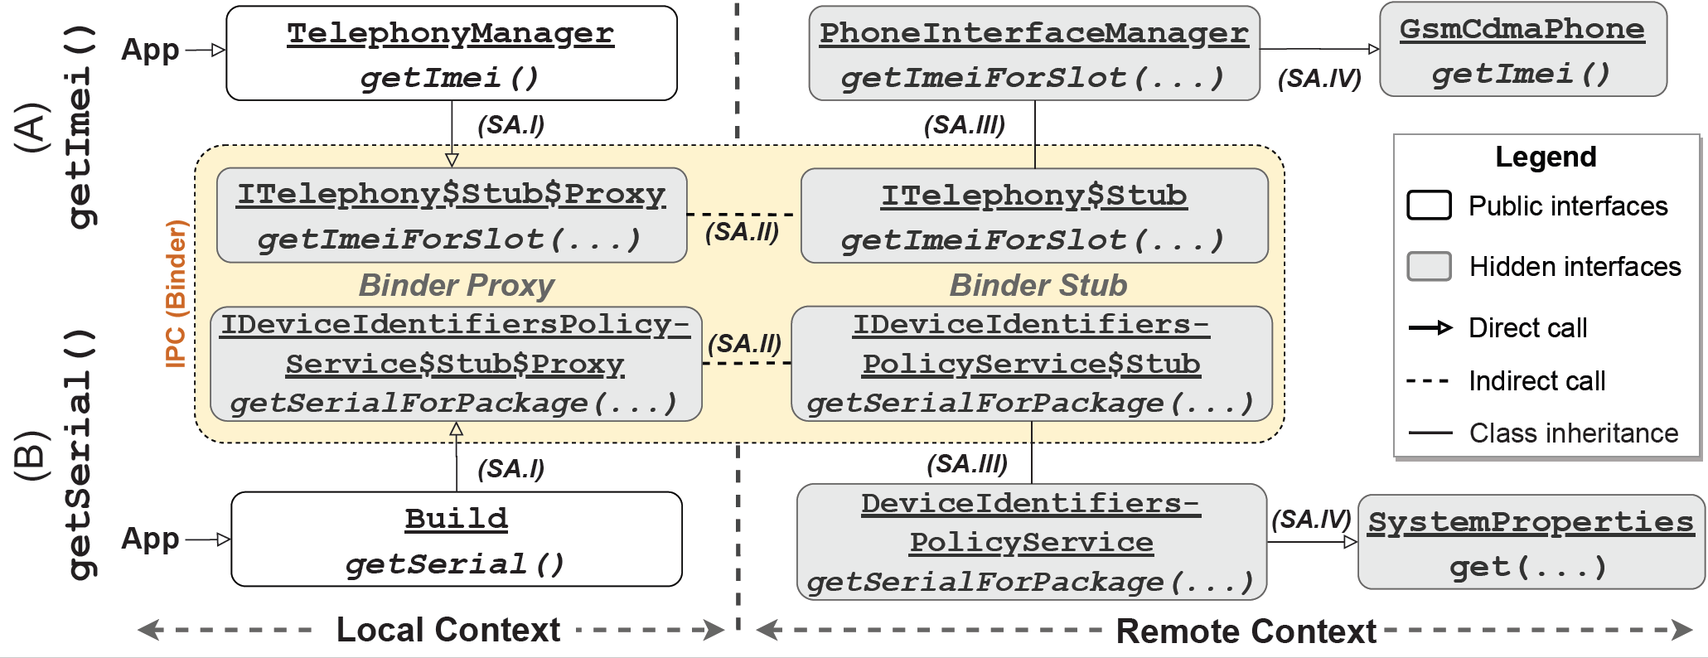
Assessing Undocumented Channels
两种典型的
API调用控制流
Two Typical Static Control Flows of the API Invocation
Notes:
This slide demonstrates two typical static control flow of the API invocation.
The first API is getImei() and the second one is getSerial().
Through the control flow we can see the invocation of API to access pre-identified UUIs shares a similar pattern.
They are usually handled by a system service, as shown in the yellow box on the screen.
The dashed line connecting the local context and remote context represents an inter-process communication, which is realized by the Android binding mechanism. So, after the corresponding system service received the request, the control flow continues until the endpoint that the UUI is to be served by the OS.
[CLICK]
Okay, what we learned from this control flow? First of all, we find that the invocation of API to access a UUI is usually handled by system services.
This inspires us to explore an access channel to directly invoke the public interfaces defined in system services.
We also find another access channel, called system properties, that appears in the green color box, as we find they are the actual provider of the serial number at the end of the control flow.

Slide 12
Assessing Undocumented Channels
The invocation of API to access a UUI is usually handled by a system service of Android.
我们发现绝大多数的API调用其实是由系统服务（system services）来负责的。
Two Typical Static Control Flows of the API Invocation
Visualization of two typical control flows starting from documented APIs. (System properties and system services)
Notes:
…
The invocation of API to access a UUI is usually handled by a system service of Android
This inspires us to explore an access channel to directly invoke the public interfaces defined in system services.
[CLICK]

Slide 13
Assessing Undocumented Channels
The invocation of API to access a UUI is usually handled by a system service of Android.
我们发现绝大多数的API调用其实是由系统服务（system services）来负责的。
Two Typical Static Control Flows of the API Invocation
System properties are the actual component to serve the serial number.
此处，手机的序列号是通过读取系统属性（system properties）获得的。
Visualization of two typical control flows starting from documented APIs. (System properties and system services)
Notes:
…
We also find another access channel, called system properties, appears in the green color box, as we find they are the actual provider of the serial number at the end of control flow.

Slide 14
Assessing
Undocumented Channels
测试非官方文档所记录的访问渠道
Step 1 - Access Channel Exploration
Through the exploration, U2-I2 recognizes three undocumented access channels:
System settings
Stored in persistent storage
Three key-value databases (.xml format)
System properties
Stored inside system directory
Indexed by keys
Initialized at boot time
System services
Enabled by inter-process communication
Serve API requests through its public interfaces
共发现三个非官方访问渠道：
系统设置
永久性保存在手机存储中
共三个数据库性质的表格（以XML格式存在）
系统属性
保存在系统目录中
可通过key查询
在每次系统启动时写入
系统服务
由跨进程通讯实现
用于回应API的request
Notes:
So in the end, we manage to recognize 3 undocumented access channels, namely system settings, system properties and system services.

Slide 15
Assessing
Undocumented Channels
测试非官方文档所记录的访问渠道
Step 2 – Retrieving Entry Points and Testing
U2-I2 first retrieves entry points through the three undocumented channels, then tests through an app installed on the devices.
U2-I2 makes use of public interfaces to query system properties and system settings
U2-I2 resorts to a “hacking way” through Java reflection to bypass the permission check to invoke system services.
U2I2首先检索上述三个非官方渠道的访问点（例如keys或系统服务的class name），然后在手机上逐个测试。
对于系统属性和系统设置而言，测试相对简单直接，我们可以直接使用API访问。
对于系统服务，我们借助Java Reflection（反射机制）来避开调用系统服务的权限限制。
Notes:
After the access channel exploration, we move to the next step, retrieving entry points and testing.
To do this, U2I2 first retrieves entry points through the three undocumented channels, then tests through an app installed on the devices.
For the system properties and system settings, their testing is pretty easy because Google does provide public interfaces for apps to make the query.
But for the system services, conventional binding mechanism is not applicable for us because our tester app won’t have permission to bind all those system services. Therefore we resort to a hacking way through Java reflection to bypass the permission check to directly invoke the public interfaces defined in system services.

Slide 16


Assessing
Undocumented Channels
测试非官方文档所记录的访问渠道
Step 3 – UUI Identification
U2-I2 adopts a two-step approach to pinpoint unknown or OEM-defined UUIs
Filtering
Excludes values of insufficient size (e.g., 4 hex-digit)
Differential Analysis
Excludes values that are same across devices
Excludes values that are changed after factory reset
接下来，我们采取了两步措施来锁定未知的UUI：
筛选
排除掉长度过短的信息
差分分析
排除掉（同型号）不同设备上，数值相同的数据
怕除掉同样设备上，出厂重置后发生变化的数据
***********
********
*
******
***********
***
******
*****
**
*********
***
*****
***
********
A
=
*
A
≠
UUIs
After factory reset
B
Same model devices
Filtering
Differential Analysis
Notes:
After the testing, we will receive huge amount of data. So our next step is to identify UUIs from the data received.
Our U2I2 adopts a two-step approach to pinpoint unknown or OEM-defined UUIs. We first perform a filtering, to exclude values of insufficient size. Next we perform a differential analysis to exclude values that are same across devices, and value that are changed after factory reset.
By doing this, we can easily find UUIs from the data left to us.

Slide 17
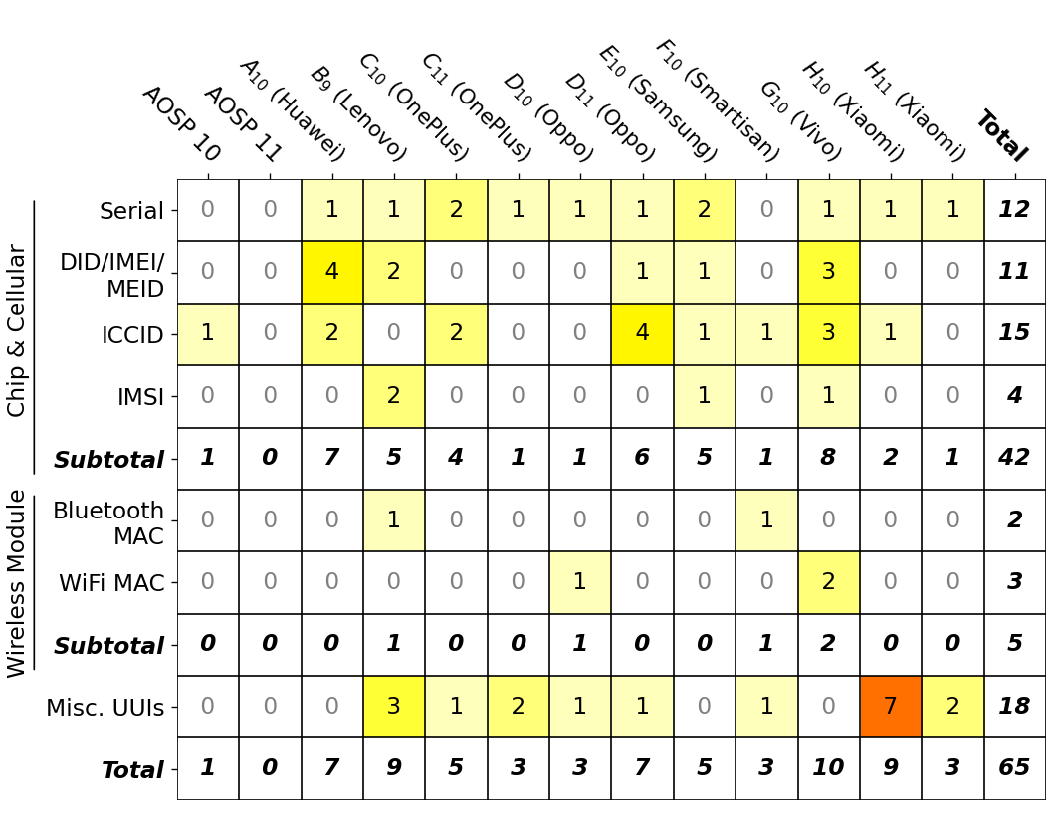
主要发现1
Key Finding 1
Landscape of OS-level UUI Safeguards
Test devices cover 13 latest models from 9 manufacturers, which represent almost 85% of the global market share of Android devices*.
The UUI mishandling issues are pervasive in the latest Android phones.
51 unique vulnerabilities, leading to 65 occurrences of UUI leakages.
12 out of 13 tested device models contain at least 1 UUI leakage,
1 vulnerability found in AOSP# and is inherited in all tested OEM devices.
18 leakages are associated with unknown UUIs (classified as misc. UUIs)
Statistics of the occurrence of UUI leakages detected in our assessment, counted by UUI types and devices
* Data source https://gs.statcounter.com/vendor-market-share/mobile/worldwide
# Google Pixel model(s). AOSP 11 stands for a Google Pixel phone installed with Android OS 11.
Notes:
Now we would like to share a few key findings of this work.
Our first key finding is the landscape of OS-level UUI safeguards.
We conduct a large scale device testing that covers 13 latest models from 9 manufacturers, which represent almost 85% of the global market share of Android devices.
And we find the UUI mishandling issues are pervasive in the latest Android phones.
[READ THE SLIDE]

Slide 18
主要发现1
Key Finding 1
Landscape of OS-level UUI Safeguards – Misc. UUIs
14 unique miscellaneous UUIs recognized from 18 occurrences.
Recognized miscellaneous UUIs covers identifiers of NFC module, display panel, PCB, camera, and fingerprint sensors.
Channel | Name | Format & Purpose (keywords display in Bold format)
System Settings 系统设置 | Global.cplc (C₁₀) | 45-byte hex string, for NFC module
 | Global.ro.boot.oled_wp (H₁₁) | 8-byte hex string, for OLED display panel
 | System.ReaperAssignedDeviceId (B₉) | 30-digit decimal string, unknown type⁺
System Properties 系统属性 | gsm.serial (C_{10,11}, D_{10,11}) | 19-digit decimal string, the device PCB serial number
 | ro.ril.oem.sno (H_{10,11}) | 8-byte hex string, unknown type⁺
 | vendor.camera.sensor.frontMain.fuseID (H₁₀) | 64-byte alphanumeric string, ID of the front main camera
 | vendor.camera.sensor.rearMain.fuseID (H₁₀) | 64-byte alphanumeric string, ID of the rear main camera
 | vendor.camera.sensor.rearUltra.fuseID (H₁₀) | 64-byte alphanumeric string, ID of the rear ultra-wide camera
 | vendor.camera.sensor.rearTele.fuseID (H₁₀) | 64-byte alphanumeric string, ID of the rear telephoto camera
 | persist.vendor.sys.fp.info (H₁₀) | 8-digit hex string, fingerprint sensor related
 | persist.vendor.sys.fp.uid (H₁₀) | 14-digit hex string, fingerprint sensor related
 | ro.qchip.serialno (F₁₀) | 8-digit hex string, a serial number of an embedded chip module
 | ro.recovery_id (B₉) | 32-digit hex string, ID of the boot image
 | ro.expect.recovery_id (B₉) | 32-digit hex string, a same value as above
未知UUI（即官方文档所涵盖的设备组件/硬件以外的UUI）共发现18处，其中涉及14个唯一UUI。
这14个UUI涉及到了NFC模组，显示面板，相机模组和指纹传感器等硬件。
+ The UUIs labelled as “unknown type” contain insufficient information in their names and values.
Notes:
For the miscellenous UUIs, we find 14 unique UUIs from 18 occurrences.
The recognized miscellenous UUIs covers identifiers of NFC module, display panel, PCE, camera and fingerprint sensors.
[JUST READ]

Slide 19
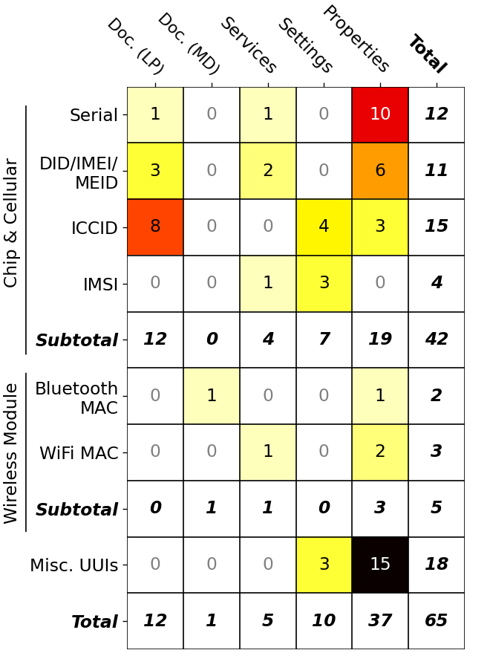
主要发现2
Key Finding 2
Exfiltration points via undocumented access channels
The undocumented access channels are the major exfiltration points.
Contributes 45 out of all 51 vulnerabilities
5 are caught from the system services, 10 in system settings, and the remaining 30 from system properties.
绝大多数的隐私泄露是通过三个非官方访问渠道。
Statistics of the occurrence of UUI leakages detected in our assessment, counted by UUI types and access channels

Slide 20
主要发现3
Key Finding 3
Exploits in the wild
Have our identified undocumented channels already been (ab)used in the wild?
We test the top 150 apps from the Google Play Store and another 150 apps from an alternative app store (Xiaomi App Store).
12 out of 300 analyzed apps have relevant behaviors.
All their accesses are through undocumented access channels.
The broad UUI collection by apps in the wild is not observed in our study.
List of apps found potential UUI collection
# | App package name | Downloads (by Dec 2021) | Involved UUIs | Access channels
1 | com.kwai.m2u | 81mil+ | Device ID, Misc. UUI⁺ | Properties
2 | com.kwai.videoeditor | 86mil+ | Device ID, Misc. UUI⁺ | Properties
3 | com.lbe.parallel.intl | 100mil+ | IMSI | Services
4 | com.liulishuo.engzo | 116mil+ | Device ID | Properties
5 | com.oppo.store | 3mil+ | Misc. UUI⁺ | Properties
6 | com.renrendai.haohuan | 25mil+ | Device ID | Properties
7 | com.tencent.qqimsecure | 682mil+ | IMSI | Settings
8 | com.tencent.wifimanager | 192mil+ | IMSI | Settings
9 | com.wuba.zhuanzhuan | 234mil+ | Device ID | Properties
10 | com.xunmeng.merchant | 50mil+ | Serial | Properties
11 | com.xunmeng.pinduoduo | 5bil+ | Serial | Properties
12 | ru.yandex.searchplugin | 100mil+ | Device ID | Properties
+ The caught UUI access is through requesting the system property “gsm.serial”.
Notes:
Our last key finding, aim to answer the question that, have our identified access channels of UUI access already been abused by apps in the wild.
[JUST READ]

Slide 21
Responsible Disclosure
主要发现3
We have reported all our findings to the relevant parties/stakeholders.
We also have kept them confidential for at least 90 days for them to be mended before we reported them in this paper.
We have received 8 CVE entries registered by Google and four other manufacturers.
CVE-listed vulnerabilities found by U2-I2
# | CVE ID | Affected devices | Involved UUIs
1 | CVE-2020-12488 | Vivo | Serial
2 | CVE-2020-14103 | Xiaomi | Serial
3 | CVE-2020-14105 | Xiaomi | Misc. UUI (ro.ril.oem.sno)
4 | CVE-2021-0428 | Pixel | ICCID
5 | CVE-2021-25344 | Samsung | Serial
6 | CVE-2021-25358 | Samsung | IMSI
7 | CVE-2021-26278 | Vivo | WiFi MAC address
8 | CVE-2021-37055 | Huawei | ICCID
Notes:
We would also remark our responsible disclose.

Slide 22
Conclusion
总结
A comprehensive study to understand OS-level UUI protection.
A systematic assessment approach to explore undocumented channels .
Revealing the status quo of UUI protection on latest versions of Android.
Notes:
Okay, its time to wrap up.
This paper has three main contributions.
First, we conduct the 1st comprehensive study to understand OS-level UUI protection in Post-GDPR era.
We also designed a systematic assessment approach, that is capable to explore as many undocumented channels as possible.
Finally, we successfully reveal the landscape of UUI protection on latest versions of Android OS.

Slide 23





Contacts
Should you have any questions, please feel free to contact us:
Guangdong Bai, UQ (g.bai@uq.edu.au)
Jin Song Dong, NUS (dcsdjs@nus.edu.sg)
Sin Gee Teo, A*STAR I2R (teo_sin_gee@i2r.a-star.edu.sg)
Qing Zhang, ByteDance (security@bytedance.com)
We are recruiting!!!

Slide 24
References
W. Enck, P. Gilbert, S. Han, V. Tendulkar, B.-G. Chun, L. P. Cox, J. Jung, P. McDaniel, and A. N. Sheth, “Taintdroid: an information- flow tracking system for realtime privacy monitoring on smartphones,” ACM Transactions on Computer Systems (TOCS), vol. 32, no. 2, pp. 1–29, 2014.
L. Qiu, Z. Zhang, Z. Shen, and G. Sun, “Apptrace: Dynamic trace on android devices,” in 2015 IEEE International Conference on Commu- nications (ICC), 2015, pp. 7145–7150.
J. Ren, M. Lindorfer, D. J. Dubois, A. Rao, D. Choffnes, and N. Vallina- Rodriguez, “A longitudinal study of pii leaks across android app versions,” in The Network and Distributed System Security Symposium (NDSS), 2018.
Z. Wang, Z. Li, M. Xue, and G. Tyson, “Exploring the eastern frontier: A first look at mobile app tracking in china,” in International Conference on Passive and Active Network Measurement. Springer, 2020, pp. 314–328.

