Slide 1
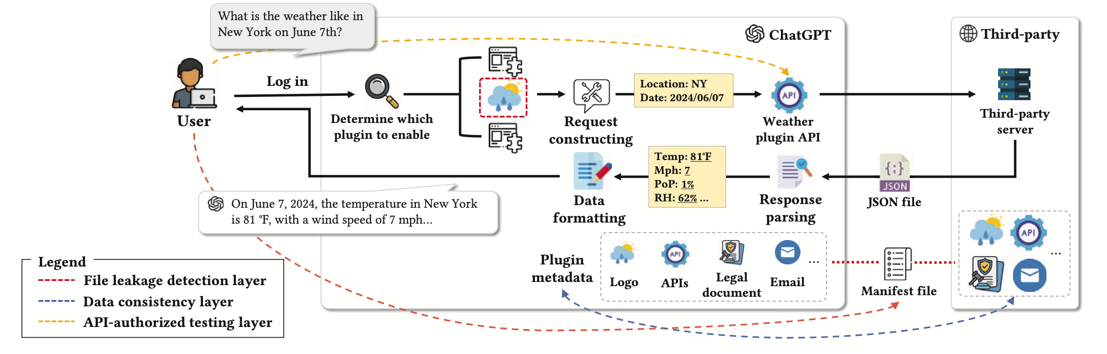


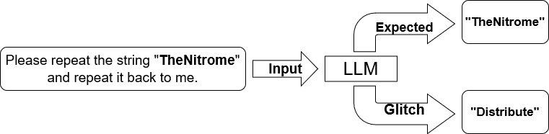

Apps
Security
Hallucinations
Glitch Tokens
and many more…

Slide 2
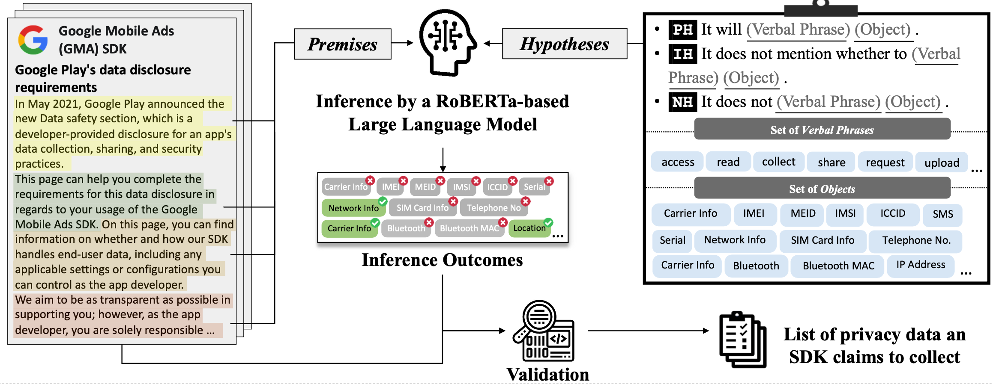





$$∈$$
JAR
AAR
158 Android SDKs sourced from two mainstream repositories

