Slide 1


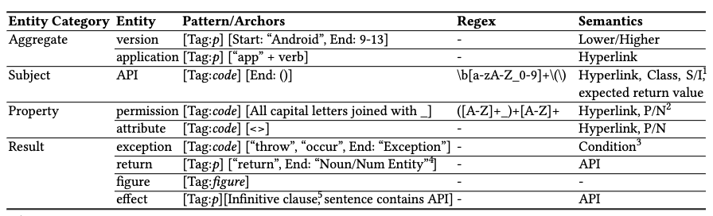
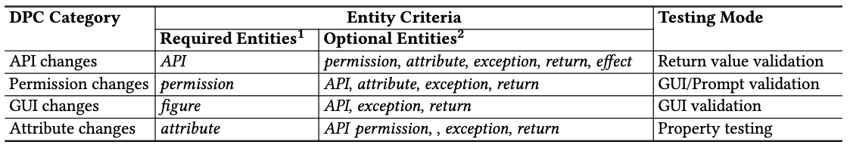
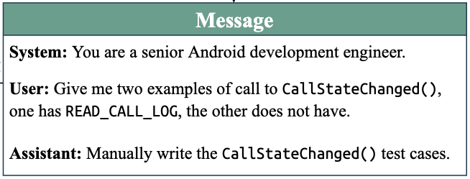
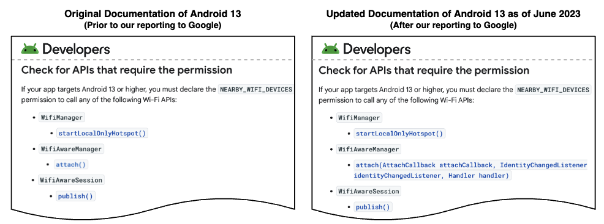
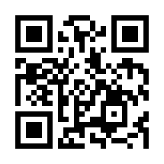
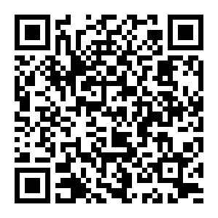
Investigating Documented Privacy Changes in Android OS
Chuan Yan, Mark Huasong Meng, Fuman Xie, Guangdong Bai
The University of Queensland, Australia
Introduction
In recent years, Android has taken proactive measures to adapt its access control policies for such data, in response to the increasingly strict privacy protection regulations around the world. When each new Android version is released, its privacy changes induced by the version evolution are transparently disclosed, and we refer to them as documented privacy changes (DPCs). However, whether the actual access control enforcement in the OS implementations aligns with the disclosed DPCs becomes a critical concern. In this work, we conduct the first systematic study on the consistency between the operational behaviors of the OS at runtime and the officially disclosed DPCs. We propose DopCheck, an automatic DPC-driven testing framework equipped with a large language model (LLM) pipeline. It features a
Fig 1. An example of the DPC issue. Android 10’s documentation states that the API getServiceState() requires a particular permission (left), whereas an app that does not request the permission can still invoke it without throwing any exception (right)
large language model (LLM) pipeline. It features a serial of analysis to extract the ontology from the privacy change documents written in natural language, and then harnesses the few-shot capability of LLMs to construct test cases for the detection of DPC-compliance issues in OS implementations.
DPC Ontology Construction
Test Case Generation
Table 1. Nine types of DPC entities
Table 2. Four categories of DPCs to facilitate assertion construction
Fig 2. An example of the API-return subsumptive relationship
Fig 3. An example of in-context learning
Considering that DopCheck’s test cases mostly center around APIs, we formulate the name of an API as the subject entity, and define another 8 DPC entities to construct the context of an API invocation.
DopCheck harnesses the concept of in-context learning, which allows us to guide the model in producing results that align with specific requirements in a few-shot.
During the execution of the test cases, DopCheck checks whether the invocation of the APIs leads to expected behaviors or not. for example, to check whether the return value matches the descriptions in the document, or to check whether an expected security exception is thrown. To define assertions for this purpose, we take a category-wise strategy.
After DopCheck has recognized entities, its next objective is to discover subsumptive relationships that establish connections among entities, and thereby facilitate the test case generation process. we have defined five subsumptive relationships that are based on the connection between entities.
Conclusion
DopCheck managed to identify a total of 19 bugs, with 13 of them discovered in Android 13 and 6 in Android 10 for the first time. Our work reveals the inconsistency between what does documentation claim and how Android OS actually behave. Our findings emphasize the importance of further research and action to address discrepancies in DPCs, aiming to better align documented capabilities with their actual behavior.
Fig 4. Distribution of DPC categories for each Android version
Fig 5. Change in Android documentation before and after our reporting
Acknowledgments. This work was produced by UQ TrustLab in collaboration with the National University of Singapore (NUS) and led by Assoc. Prof. Guangdong Bai. This work is supported by Australian Research Council Discovery Projects (DP230101196, DP240103068).
UQ TrustLab
Read our paper

