Slide 1
Enhancing Federated Learning Robustness using Data-agnostic Model Pruning
The contents of the slides has been accepted by and presented at The Pacific-Asia Conference on Knowledge Discovery and Data Mining (PAKDD) 2023 in Osaka, Japan.
Mark Meng
Scientist, Cybersecurity Department
Institute for Infocomm Research (I²R)
28 May 2024

Slide 2
Agenda
Background
3
Our Approach
8
Evaluation
12
Discussion & Conclusion
22
FL + FM Research Direction
25

Slide 3
Background
Federated Learning (FL)
Attacking Federated Learning
Byzantine-robust Federated Learning
When Pruning meets Federated Learning…

Slide 4



Background
Federated Learning (FL)
Collaborative machine learning has been demonstrated effective on lightweight devices like smartphones.
Federated learning (FL) is a collaborative learning paradigm designed to preserve participating clients’ data.
It also enables mobile and edge devices to participate in solving complex real-world problems, including financial services, cybersecurity, healthcare, and knowledge discovery.
Google’s Gboard is a representative application of federated learning on Android devices.
Gboard (Google’s input method on Android devices) has adopted federated learning technique in predicting users’ keyboard input.

Slide 5
Background
Attacking Federated Learning
FL is prone to be manipulated by malicious clients.
Malicious clients can deploy the poisoning attack.
Untargeted attacks
Aims to reduce the overall learning accuracy.
(Comparably) easier to defend.
Targeted attack
Aims to precisely misclassify.
By label-flipping or backdoor.

Slide 6
Background
Byzantine-robust Federated Learning (as of mid-2023)
Byzantine-resilient aggregations (instead of FedAvg)
Statistical: Median, Trimmed-mean (Yin et al., 2018)
Distance-based: Krum, Multi-Krum, Bulyan (Blanchard et al., 2017, El Mhamdi et al., 2018)
Auxiliary (but effective) defenses
Pre-aggregation or Post-aggregation
ERR, LFR, and ERR+LFR (Fang et al., 2020)
Trust bootstrapping (Cao et al., 2021)
Post-training pruning & fine-tuning (Wu et al., 2022)
And many more…

Slide 7

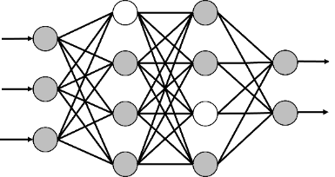
Background
When Pruning meets Federated Learning…
Pruning has shown effective in robust-FL (Wu et al., 2022).
It can remove redundant and “backdoor” neurons that trigger misbehaviours.
It relies on a voting process which requests participating clients’ cooperation.
Pruning can be data-hungry and data-agnostic.
Data-agnostic pruning is a stream of pruning techniques that does not request dataset access and re-training.
Date-free parameter pruning (Srinivas & Babu, 2015)
Paoding-dl (Meng et al., 2023)
Data-agnostic pruning is suitable for the FL paradigm because each party only has limited access to the training dataset.

Slide 8
Our Approach
Motivation
Approach Overview
Data-free Model Pruning

Slide 9
Our Solution
Motivations
Byzantine-resilient aggregations
Tend to over-rely on the estimation of the population of malicious clients.
Auxiliary defences
Request participating clients’ cooperation, or even disclosure of their training set.
Do not work well with each other.
Our Goal
We study the adoption of pruning that ⁽¹⁾ does not rely on the training data and therefore, can be solely performed by the server ⁽²⁾ to boost the robustness-preservation ⁽³⁾ without (explicitly) asking for clients’ cooperation.

Slide 10
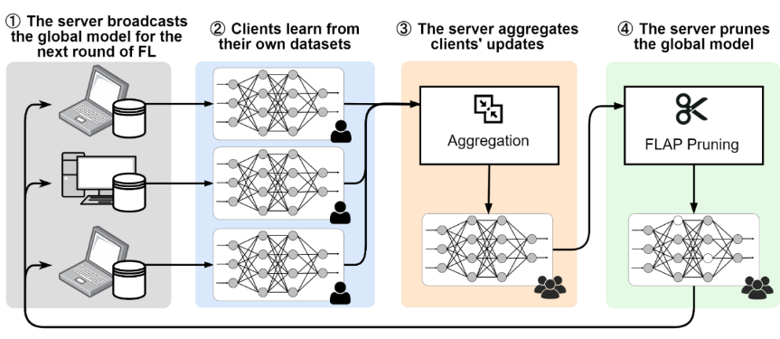
Our Solution - FLAP
FLAP is motivated by an insight that model pruning could disable the insignificant and dormant parameters.
Approach Overview
The biggest challenge of the design of FLAP is how to achieve fidelity and robustness-preserving model pruning without the client’s training data.
The workflow of federated learning with FLAP

Slide 11
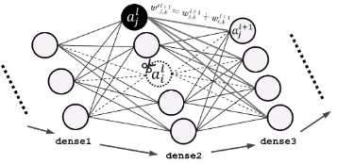
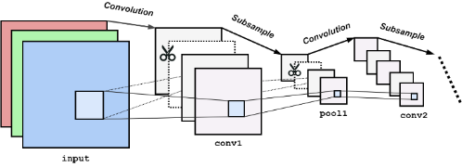
Our Solution - FLAP
Data-free Pruning
The design of FLAP adopts the existing data-free pruning techniques (Srinivas & Babu, 2015, Meng et al., 2023) to prune hidden units in dense layers.
Pair-wise pruning (i.e., cut one and keep the other).
Cross-layer saliency-based sampling.
Zero out the pruned parameter.
FLAP also performs a scale-based sampling strategy for convolutional layers.
Prioritize the least salient channels for pruning.
Measure the scale of a channel via L1-norm.

Slide 12
Evaluation
Experiment Setups & Objective
Effectiveness of FLAP in benign settings
FLAP in adversarial settings
With and w/o SoTA Byzantine-resilient aggregations
Vs. advanced adversarial and defensive models

Slide 13
Evaluation Experiment Setup
Federated Learning
We implement the FL based on TensorFlow.
The benchmarked defensive & adversarial models are based on a public repository (pps-lab/fl-analysis).
One server and 80 participating clients.
20% (16) clients are malicious and performing targeted poisoning attack starting 21st round.
Pruning
Prunes 1% hidden units (at least 1 per layer) at every dense and Conv2D layer.
Models & Datasets
LeNet-5, MLP, and ResNet-18 models, trained with FEMNIST dataset.
Benchmarking
FLAP does not aim to replace existing defence but to co-exist and boost them.
We carry out benchmarking by observing robustness-preservation with and without FLAP.

Slide 14
Objective
Our evaluation aims to address two research questions:
RQ1: What is the effectiveness of the proposed FLAP? Does it preserve the model fidelity in benign settings? Does it impair the learning process?
RQ2: What is the performance of FLAP in adversarial settings? Does FLAP outperform existing defenses? Can FLAP boost existing defensive techniques towards Byzantine-robust FL?

Slide 15
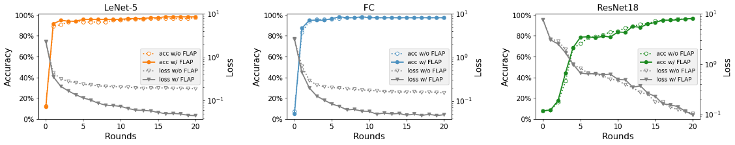
Evaluation RQ1: Effectiveness of FLAP in benign settings
Observations
The growth of test accuracy of models with FLAP is almost identical with the models without it.
The adoption of FLAP can accelerate the loss descent.
Summary
FLAP shows promising fidelity preservation in a non-adversarial circumstance.
FLAP does not impair the learning process.
Test accuracy and loss of FL up to round 20, with and without FLAP

Slide 16
Evaluation RQ2: FLAP in adversarial settings
RQ2 aims to study if FLAP can boost the existing defensive techniques towards Byzantine-robust FL.
Experiment Setup
We use three modes (conservative, perfect, and radical) to simulate when the server under-estimates, exactly estimates, and over-estimates the presence of adversarial clients.
We calculate the average error rate (for robustness evaluation) and test accuracy for 10 rounds.
We reflect the change (annotated with growth ▲, unchanged ◆ and decay ▼) in the table (in the next two slides).

Slide 17
Evaluation RQ2.1: FLAP in adversarial settings (vs. Byzantine-resilient aggregations)
Observations
Existing Byzantine-resilient aggregations help reduce the error rate and improve the test accuracy only when the server sufficiently estimates the presence of malicious clients (i.e., perfect and radical modes).
The adoption of FLAP is independent of the server’s knowledge about the attackers’ population.
Findings
FLAP can improve the FL in all three modes of the two aggregation algorithms.
FLAP reduces error rate by up to 12.5%.
FLAP helps FL to better converge with an improvement in average test accuracy of 21.5%.
Average error rates and test accuracy of FL (ResNet-18) equipped with different robust-aggregation rules, with (bold) and w/o FLAP
Aggregation Rules (in diff. configurations) |  | Error Rate (Lower is Better) | Test Accuracy (Higher is Better)
FedAvg |  | 30.8%, 20.0% (-10.8%▼) | 10.3%, 10.9% (0.6%▲)
Trimmed Mean | Conserv. | 87.0%, 74.0% (-12.3%▼) | 11.5%, 14.6% (3.1%▲)
 | Perfect | 30.0%, 17.5% (-12.5%▼) | 92.1%, 97.8% (5.7%▲)
 | Radical | 11.4%, 9.8% (-1.6%▼) | 94.6%, 95.1% (0.5%▲)
Multi- Krum | Conserv. | 84.3%, 83.7% (-0.6%▼) | 34.5%, 56.0% (21.5%▲)
 | Perfect | 35.6%, 43.5% (-2.7%▼) | 35.6%, 43.5% (7.9%▲)
 | Radical | 28.8%, 27.3% (-1.5%▼) | 35.3%, 44.2% (8.9%▲)

Slide 18
Evaluation RQ2.1: FLAP in adversarial settings (vs. Byzantine-resilient aggregations)
Observations
Existing Byzantine-resilient aggregations help reduce the error rate and improve the test accuracy only when the server sufficiently estimates the presence of malicious clients (i.e., perfect and radical modes).
The adoption of FLAP is independent of the server’s knowledge about the attackers’ population.
Findings
FLAP can improve the FL in all three modes of the two aggregation algorithms.
FLAP reduces error rate by up to 12.5%.
FLAP helps FL to better converge with an improvement in average test accuracy of 21.5%.
Average error rates and test accuracy of FL (ResNet-18) equipped with different robust-aggregation rules, with (bold) and w/o FLAP
Aggregation Rules (in diff. configurations) |  | Error Rate (Lower is Better) | Test Accuracy (Higher is Better)
FedAvg |  | 30.8%, 20.0% (-10.8%▼) | 10.3%, 10.9% (0.6%▲)
Trimmed Mean | Conserv. | 87.0%, 74.0% (-12.3%▼) | 11.5%, 14.6% (3.1%▲)
 | Perfect | 30.0%, 17.5% (-12.5%▼) | 92.1%, 97.8% (5.7%▲)
 | Radical | 11.4%, 9.8% (-1.6%▼) | 94.6%, 95.1% (0.5%▲)
Multi- Krum | Conserv. | 84.3%, 83.7% (-0.6%▼) | 34.5%, 56.0% (21.5%▲)
 | Perfect | 35.6%, 43.5% (-2.7%▼) | 35.6%, 43.5% (7.9%▲)
 | Radical | 28.8%, 27.3% (-1.5%▼) | 35.3%, 44.2% (8.9%▲)

Slide 19
Evaluation RQ2.1: FLAP in adversarial settings (vs. Byzantine-resilient aggregations)
Observations
Existing Byzantine-resilient aggregations help reduce the error rate and improve the test accuracy only when the server sufficiently estimates the presence of malicious clients (i.e., perfect and radical modes).
The adoption of FLAP is independent of the server’s knowledge about the attackers’ population.
Summary
FLAP can improve the FL in all three modes of the two aggregation algorithms.
FLAP reduces error rate by up to 12.5%.
FLAP helps FL to better converge with an improvement in average test accuracy of 21.5%.
Average error rates and test accuracy of FL (ResNet-18) equipped with different robust-aggregation rules, with (bold) and w/o FLAP
Aggregation Rules (in diff. configurations) |  | Error Rate (Lower is Better) | Test Accuracy (Higher is Better)
FedAvg |  | 30.8%, 20.0% (-10.8%▼) | 10.3%, 10.9% (0.6%▲)
Trimmed Mean | Conserv. | 87.0%, 74.0% (-12.3%▼) | 11.5%, 14.6% (3.1%▲)
 | Perfect | 30.0%, 17.5% (-12.5%▼) | 92.1%, 97.8% (5.7%▲)
 | Radical | 11.4%, 9.8% (-1.6%▼) | 94.6%, 95.1% (0.5%▲)
Multi- Krum | Conserv. | 84.3%, 83.7% (-0.6%▼) | 34.5%, 56.0% (21.5%▲)
 | Perfect | 35.6%, 43.5% (-2.7%▼) | 35.6%, 43.5% (7.9%▲)
 | Radical | 28.8%, 27.3% (-1.5%▼) | 35.3%, 44.2% (8.9%▲)

Slide 20
Evaluation RQ2.2: FLAP in adversarial settings (vs. advanced adversarial/defensive models)
Benchmarking
FLAP does not aim to replace existing defense but to co-exist and boost them.
We carry out benchmarking by observing robustness-preservation with and without FLAP.
Defensive effectiveness:
FLAP only
Fang’s defence (a.k.a. ERR+LFR) only
FLAP together with Fang’s defence
Adversarial models
Partial knowledge attack (Fang et al., 2020)
Full knowledge attack (Fang et al., 2020)

Slide 21
Evaluation RQ2.2: FLAP in adversarial settings (vs. advanced adversarial/defensive models)
Changes in average error rates and test accuracy of FL (ResNet-18) in various adversarial and defensive settings, after the adoption of FLAP
Aggregation Rules | Auxiliary Defense | Adversarial Models | Adversarial Models
 |  | Targeted Label Flipping | Targeted Label Flipping | Partial Knowledge | Full Knowledge
Error Rates (▼ Lower is Better)
FedAvg | –– |  | -10.8%▼ | -42.8%▼ | -20.0%▼
Trimmed Mean (Cons.) | –– |  | -12.3%▼ | -9.6%▼ | -31.8%▼
 | ERR+LFR |  | -39.2%▼ | -8.7%▼ | -16.3%▼
Trimmed Mean (Perfect) | –– |  | -12.5%▼ | -5.4%▼ | -5.1%▼
 | ERR+LFR |  | -1.2%▼ | -1.3%▼ | -6.4%▼
Trimmed Mean (Radical) | –– |  | -1.6%▼ | -1.7%▼ | -2.1%▼
 | ERR+LFR |  | 0.0%◆ | -1.6%▼ | -0.3%▼
Multi-Krum (Conserv.) | –– |  | -0.6%▼ | -18.5%▼ | -9.6%▼
 | ERR+LFR |  | -0.8%▼ | -10.9%▼ | -8.1%▼
Multi-Krum (Perfect) | –– |  | -2.7%▼ | -7.1%▼ | -6.4%▼
 | ERR+LFR |  | -2.7%▼ | -6.4%▼ | -6.4%▼
Multi-Krum (Radical) | –– |  | -1.5%▼ | -9.4%▼ | -2.3%▼
 | ERR+LFR |  | -6.4%▼ | -6.9%▼ | -10.2%▼
Test Accuracy (▲ Higher is Better)
FedAvg | –– |  | 0.6%▲ | 0.0%◆ | 0.2%▲
Trimmed Mean (Cons.) | –– |  | 3.1%▲ | 3.8%▲ | 2.6%▲
 | ERR+LFR |  | -0.2%▼ | 5.2%▲ | 1.3%▲
Trimmed Mean (Perfect) | –– |  | 5.7%▲ | 0.9%▲ | 2.6%▲
 | ERR+LFR |  | -0.4%▼ | 0.5%▲ | -0.2%▼
Trimmed Mean (Radical) | –– |  | 0.5%▲ | 0.9%▲ | -0.4%▼
 | ERR+LFR |  | 0.2%▲ | 0.3%▲ | 0.0%◆
Multi-Krum (Cons.) | –– |  | 21.5%▲ | 20.8%▲ | 14.6%▲
 | ERR+LFR |  | 21.6%▲ | 21.7%▲ | 22.1%▲
Multi-Krum (Perfect) | –– |  | 7.9%▲ | 8.7%▲ | 8.7%▲
 | ERR+LFR |  | 7.9%▲ | 8.7%▲ | 10.4%▲
Multi-Krum (Radical) | –– |  | 8.9%▲ | 9.9%▲ | 11.3%▲
 | ERR+LFR |  | 8.9%▲ | 12.4%▲ | 11.5%▲
Observations
FLAP brings a higher accuracy and lower error rate in the vast majority of adversarial settings.
Findings
FLAP is shown effective towards Byzantine-robust FL in both benign and adversarial environments.
It can boost existing defenses for a higher degree of Byzantine-robustness.

Slide 22
Discussion & Conclusion

Slide 23
Future Directions
Improvement of current data-agnostic pruning
Expand the coverage of model pruning (e.g., support of residual blocks)
Use test set to guide model pruning
An adaptive defence paradigm toward Byzantine-robust FL
Adaptive in the black-box adversarial settings
Expect new defence that can co-exist with existing approaches

Slide 24
Contributions
FLAP: a novel FL pruning technique for enhancing robustness
Without relying on an estimation of malicious clients’ population
Makes no request for the cooperation of participating clients
FLAP is a defensive technique that can coexist with off-the-shelf approaches and boost their robustness preservation.

Slide 25
FL + FM Research Direction

Slide 26
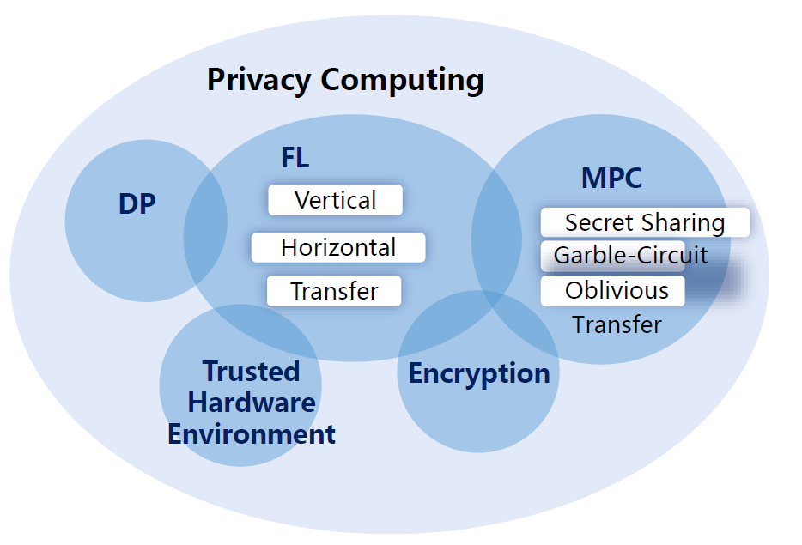
FL + FM Research Direction
Gartner Hype Cycle
Data Privacy Laws in Europe, US,
and Singapore, etc.
Data Exchanges
Responsible AI Development

Slide 27
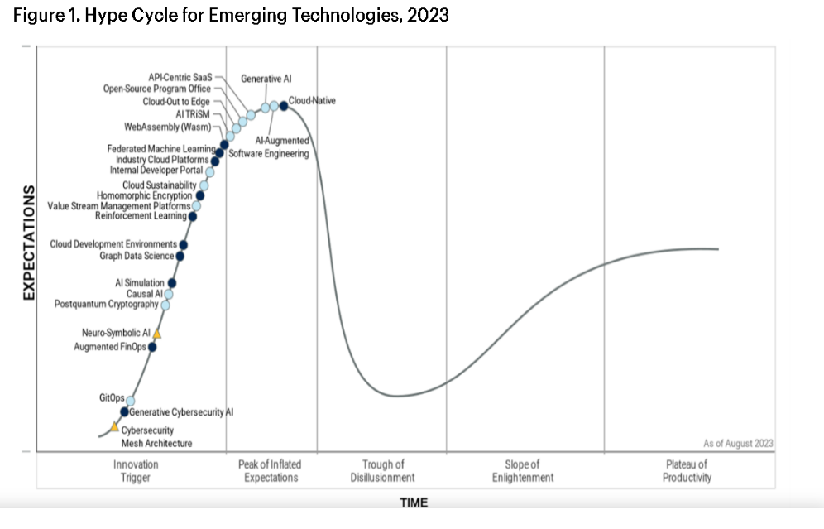
Impact of FL Increasing Fast

Slide 28
Motivation for FL-LLM
Privacy in Fine-tuning, Prompting
High-quality public-domain data depleted.
*Will we run out of data? An analysis of the limits of scaling datasets in Machine Learning.

Slide 29
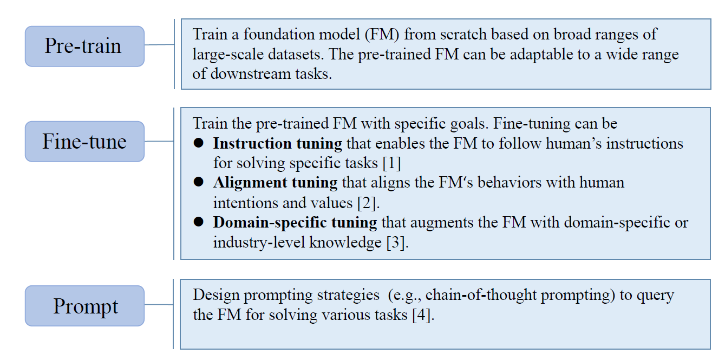
Three Stages of LLM

Slide 30
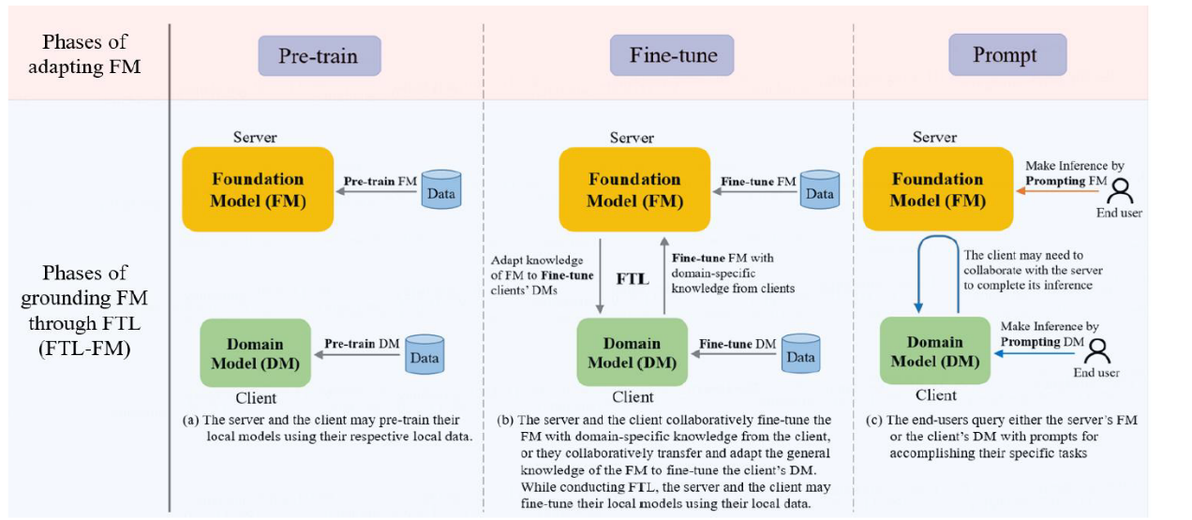
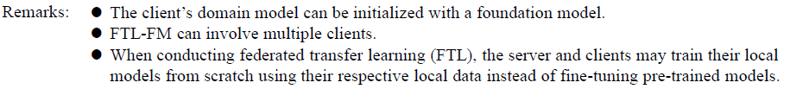
FTL-LLM

Slide 31
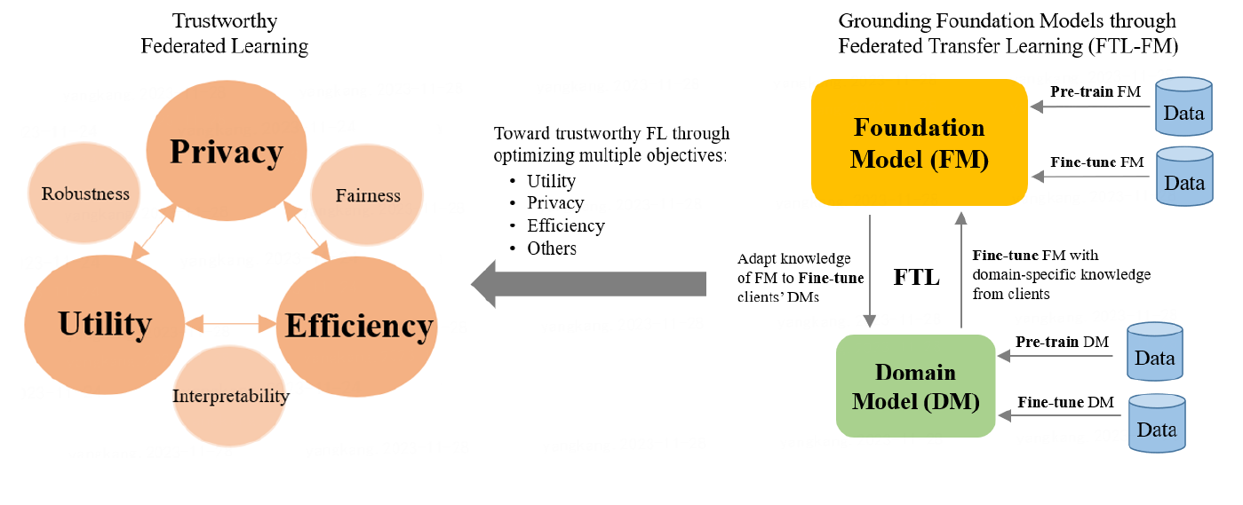
Trustworthy FL + LLM

Slide 32
Q&A

Slide 33
References
Blanchard, P., Mhamdi, E.M.E., Guerraoui, R., Stainer, J.: Machine learning with adversaries: Byzantine tolerant gradient descent. In: Advances in neural information processing systems (NeurIPS). pp. 119–129 (2017)
Cao, X., Fang, M., Liu, J., Gong, N.Z.: Fltrust: Byzantine-robust federated learning via trust bootstrapping. In: Network and Distributed System Security Symposium (NDSS). The Internet Society (2021)
Chen, X., Liu, C., Li, B., Lu, K., Song, D.: Targeted backdoor attacks on deep learning systems using data poisoning. arXiv preprint arXiv:1712.05526 (2017)
El Mhamdi, E. M., Guerraoui, R., and Rouault, S.： The hidden vulnerability of distributed learning in Byzantium. In: 35th International Conference on Machine Learning (ICML) (2018)
Fang, M., Cao, X., Jia, J., Gong, N.: Local model poisoning attacks to byzantine-robust federated learning. In: 29th USENIX Security Symposium (2020)
Meng, M.H., Bai, G., Teo, S.G., Dong, J.S.: Supervised robustness-preserving data-free neural network pruning. In: International Conference on Engineering of Complex Computer Systems (ICECCS) (2023)
Meng, M.H., Bai, G., Teo, S.G., Hou, Z., Xiao, Y., Lin, Y., Dong, J.S.: Adversarial robustness of deep neural networks: A survey from a formal verification perspective. IEEE Transactions on Dependable and Secure Computing (IEEE TDSC) (2022)
Srinivas, S., Babu, R.V.: Data-free parameter pruning for deep neural networks. In: Proceedings of the British Machine Vision Conference (BMVC) (2015)
Yin, D., Chen, Y., Ramchandran, K., Bartlett, P.L.: Byzantine-robust distributed learning: Towards optimal statistical rates. In: International Conference on Machine Learning (ICML) (2018)
Wu, C., Yang, X., Zhu, S., Mitra, P.: Toward Cleansing Backdoored Neural Networks in Federated Learning. In: IEEE 42nd International Conference on Distributed Computing Systems (ICDCS) (2022)

