Slide 1
ScopeFoundry Key Concepts

Slide 2
App Structure

Slide 3
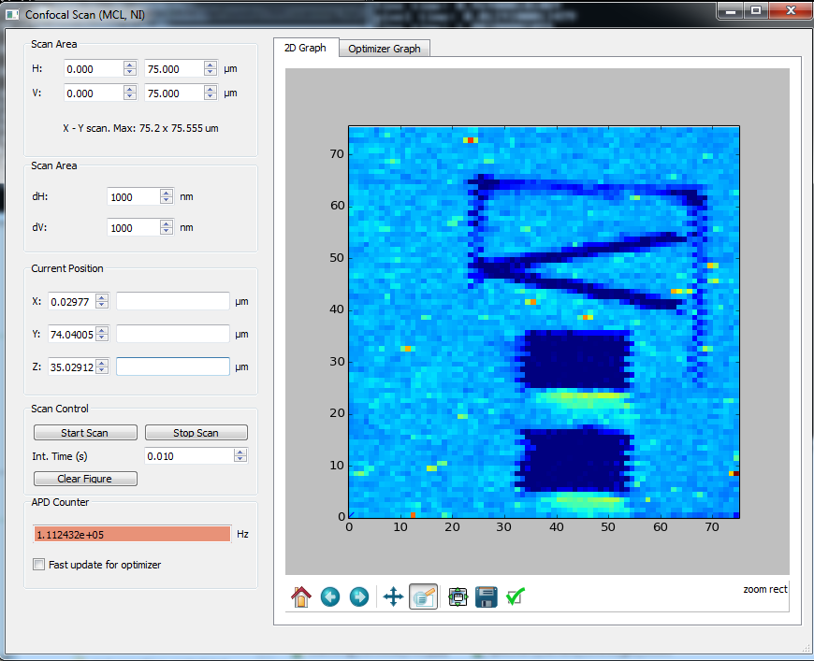
App:
Qt GUI + PyQtGraph
Measurement
Hardware Plug-in
ctypes wrapper
Direct I/O
to Hardware
Hardware Vendor DLL

Slide 4
Hardware Plug-in
LQ1
LQ1
Python Wrapper
ctypes wrapper
Direct I/O
to Hardware
Hardware Vendor DLL

Slide 5
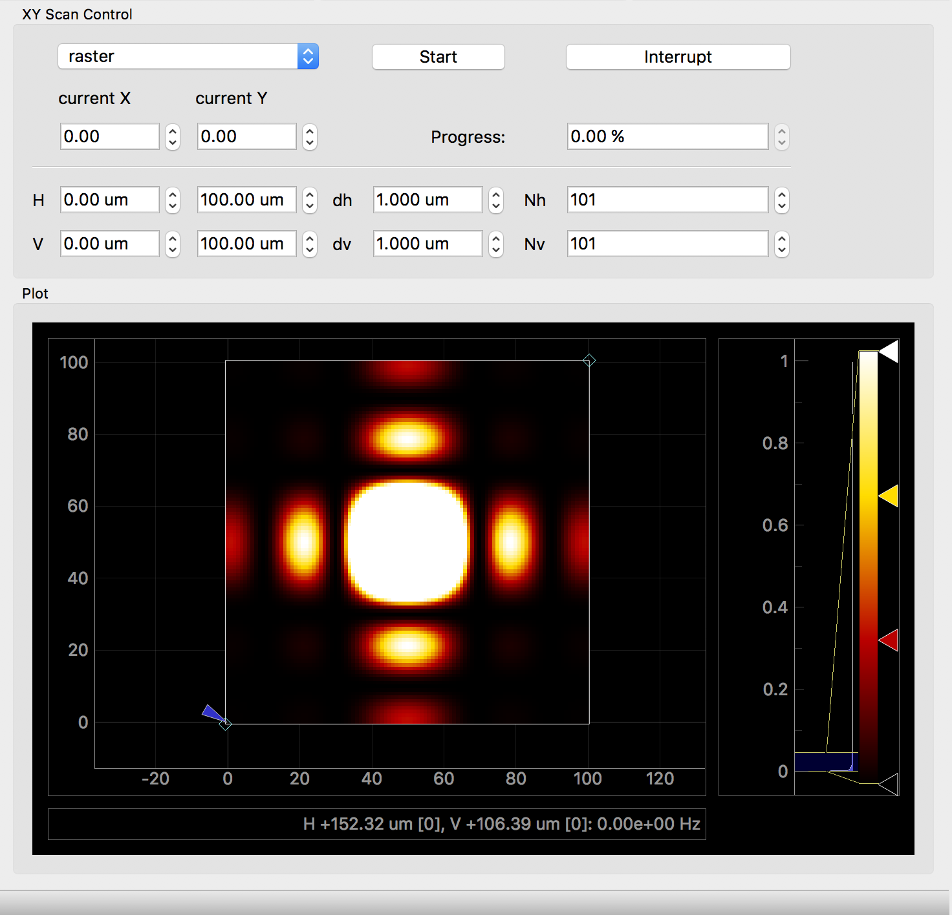
App
Hardware 1
Hardware 2
Hardware 3
Measurement UI
Measurement 1
Measurement 2

Slide 6
Anatomy of an H5 file

Slide 7
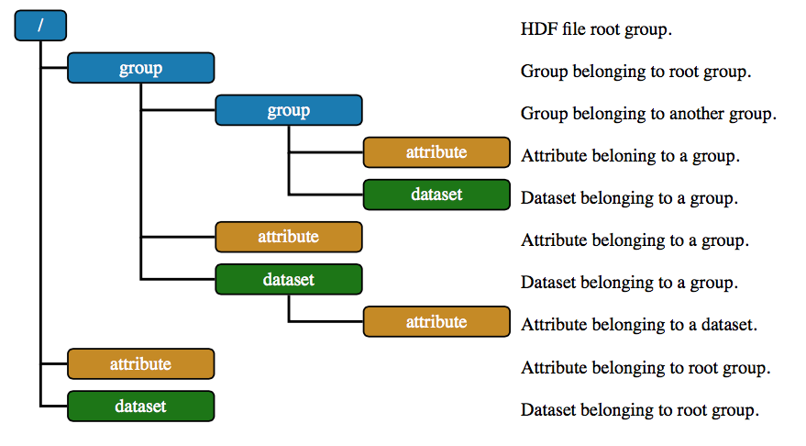
http://emdatasets.lbl.gov/spec/

