Slide 1
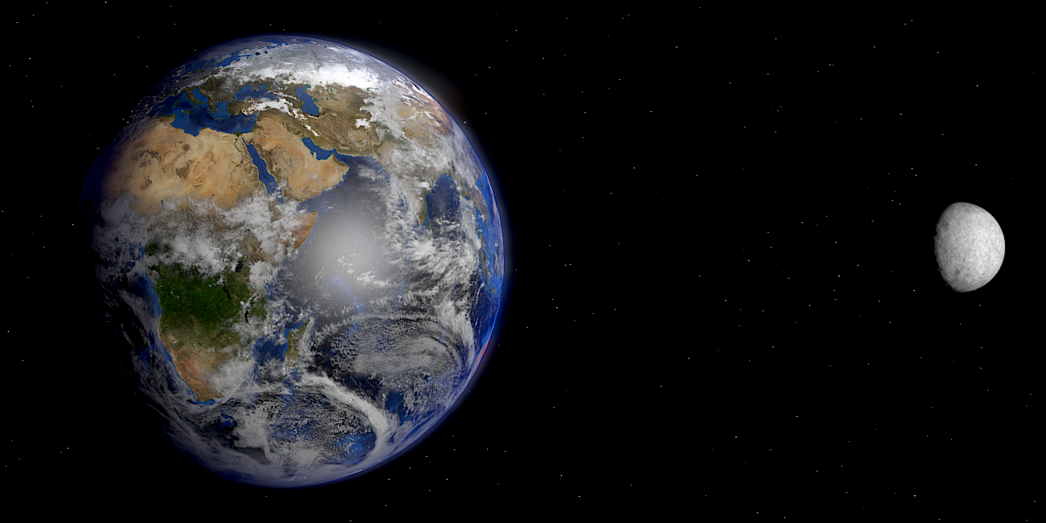

The Stack of Dollar Bills for the National Debt
Debt stack of dollar bills is 4 times the distance of the moon

Slide 2
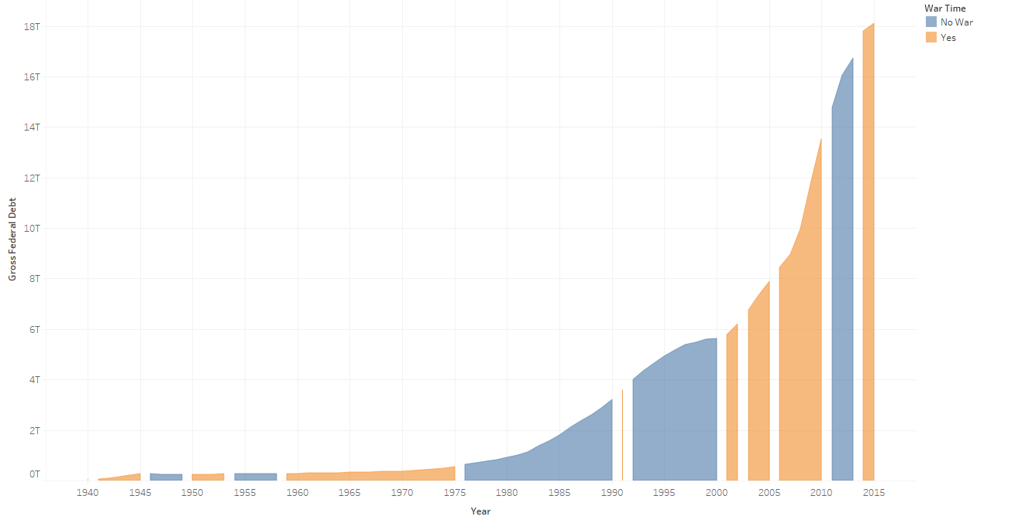
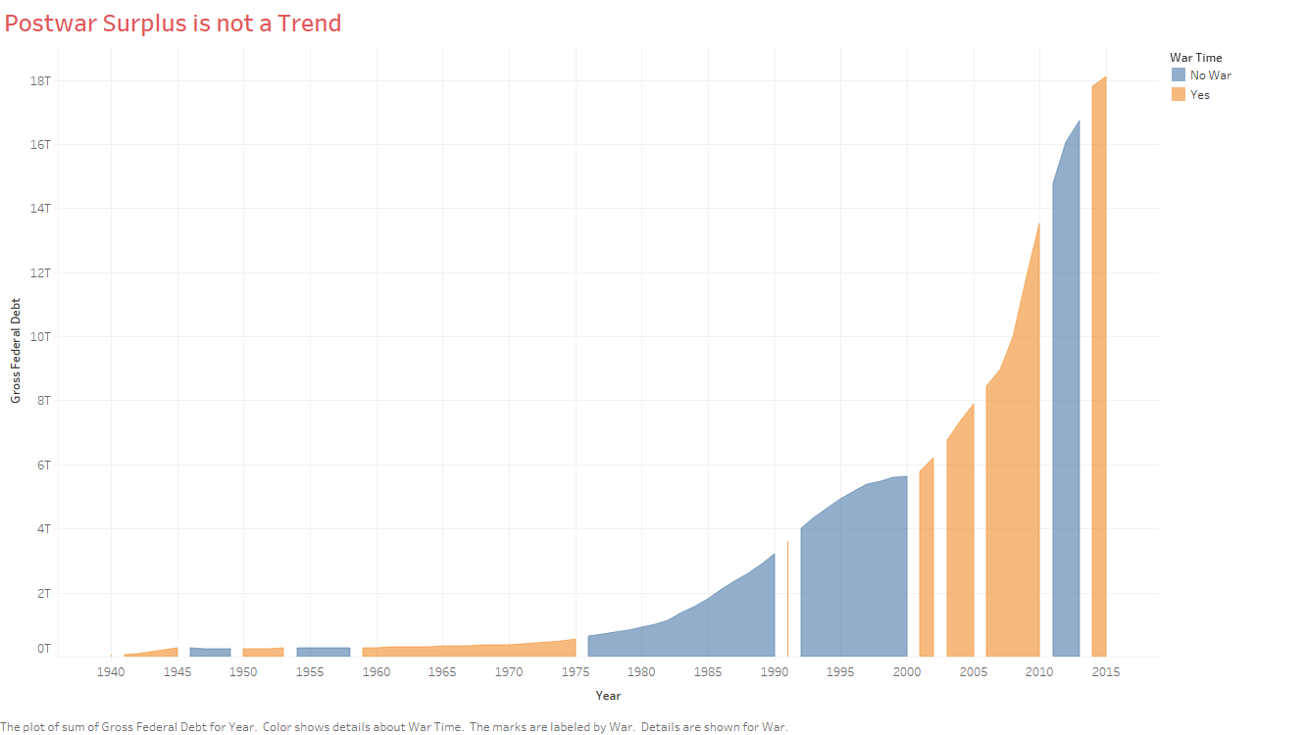
Postwar Surplus is not a Trend

Slide 3
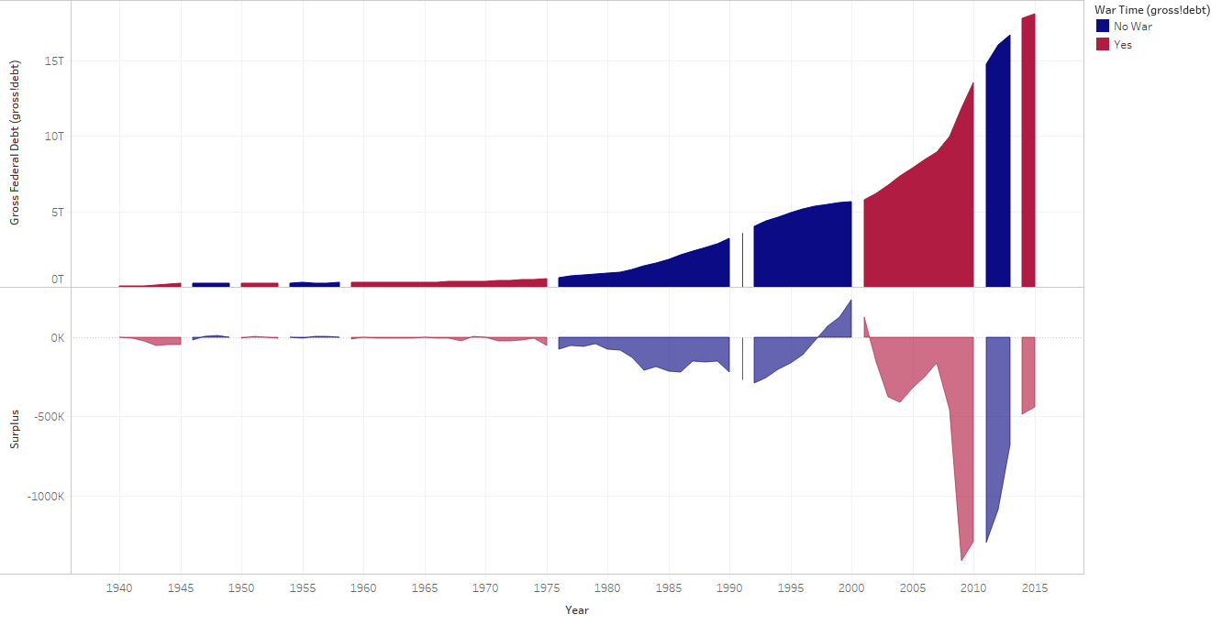
Postwar Surplus is not a Trend
Debt Reduced after World War 2
Debt increased During War and Harmony
Only Significant Surplus During Clinton Time

Slide 4
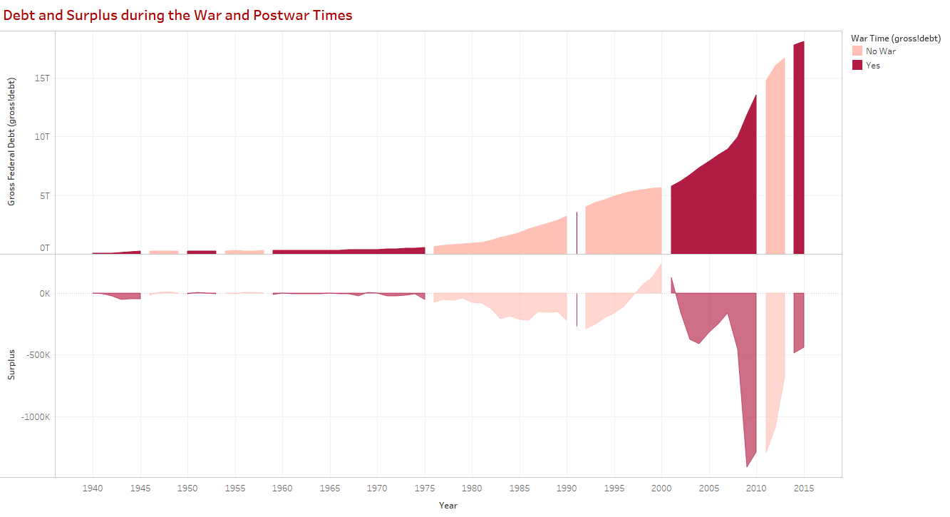
Postwar Surplus is not a Trend
Debt Reduced after World War 2
Debt increased During War and Harmony
Only Significant Surplus During Clinton Time

Slide 5
US & Other Nations Debts to GDP

Slide 6
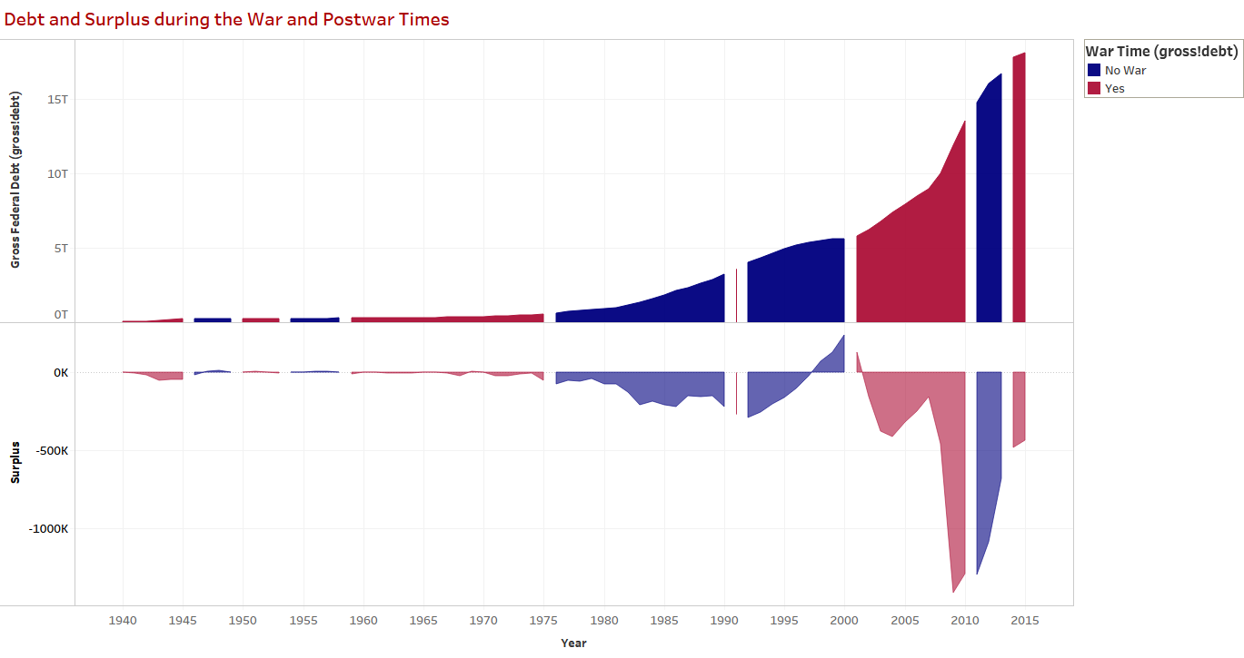
Postwar Surplus is not a Trend
Debt Reduced after World War 2
Debt increased During War and Harmony
Only Significant Surplus During Clinton Time

Slide 7
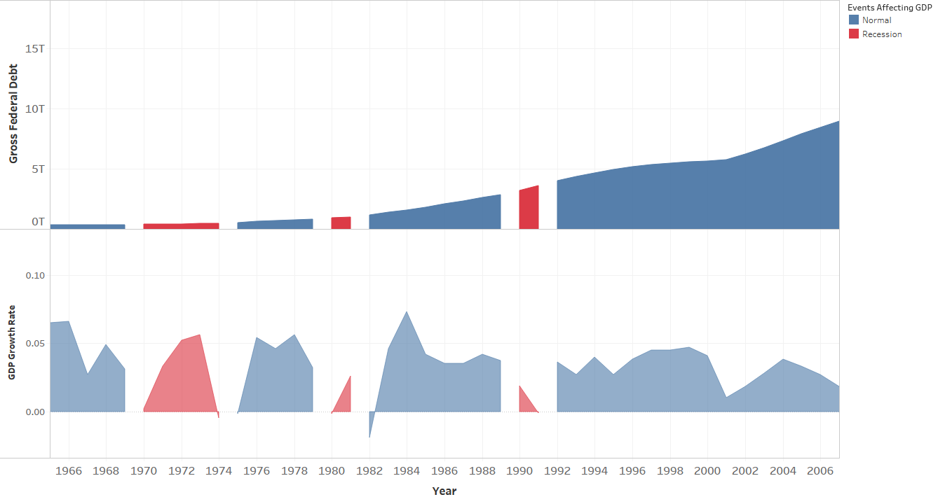
Debt vs Recession/Growth Time Periods
GDP Growth reduced during recession
No significant debt growth during recession

Slide 8
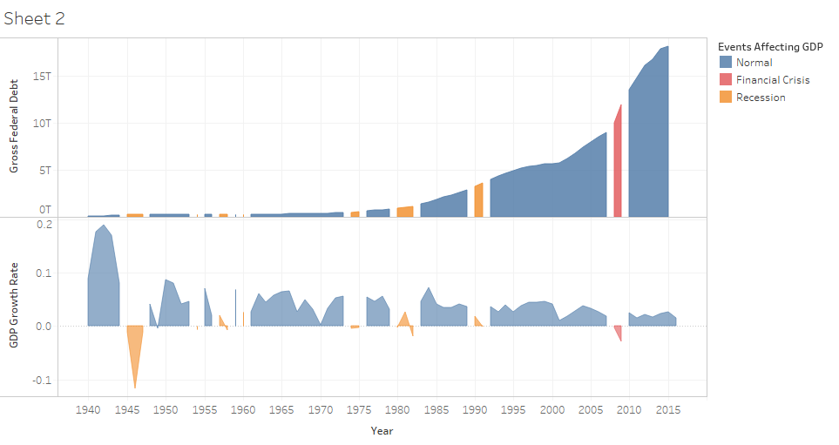
Debt vs Recession/Growth Time Periods
GDP Growth reduced during recession
No significant debt growth during recession
GDP Growth reduced during recession
No significant debt growth during recession

Slide 9
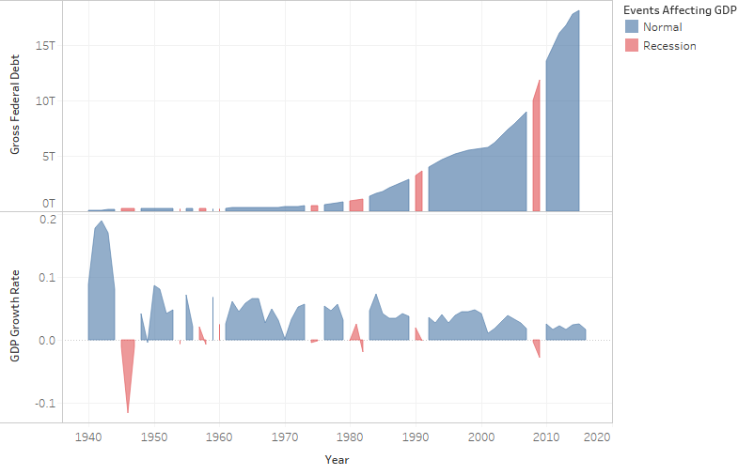
Debt vs Recession/Growth Time Periods
GDP Growth reduced during recession
No significant debt growth during recession

