Slide 1
High Level Page Organization/Content
index.html
Main page, basic introduction of company, images of facility and classes
about.html
Background of owner and company
Nondiscriminatory policy
classes.html
List of classes and information
instructors.html
Bio for each instructor
location.html
Location address, embedded google maps.
Additional pictures of the facility
contact.html
Web form for emailing for help/information
Address and phone information, social media
Create pages layout on desktop and mobile screens

Slide 2
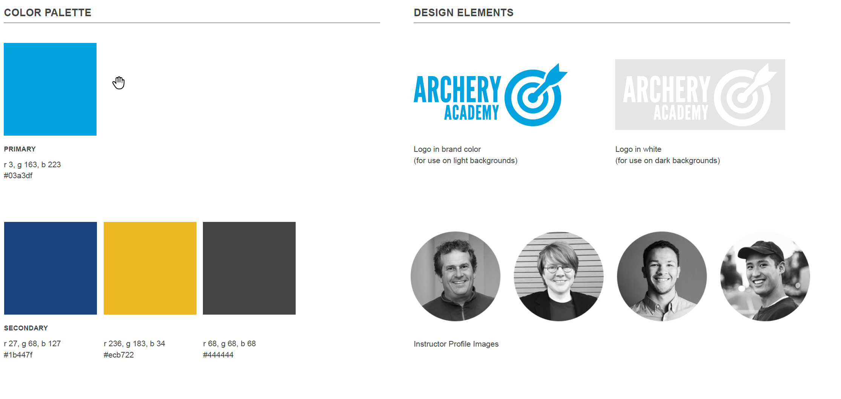

Slide 3


Slide 4


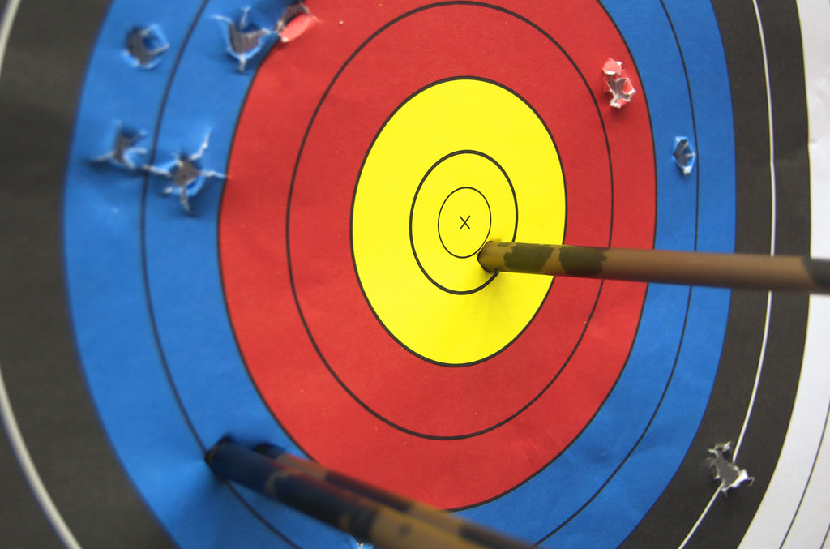

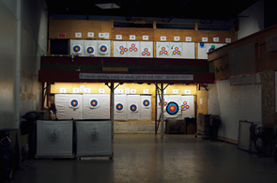
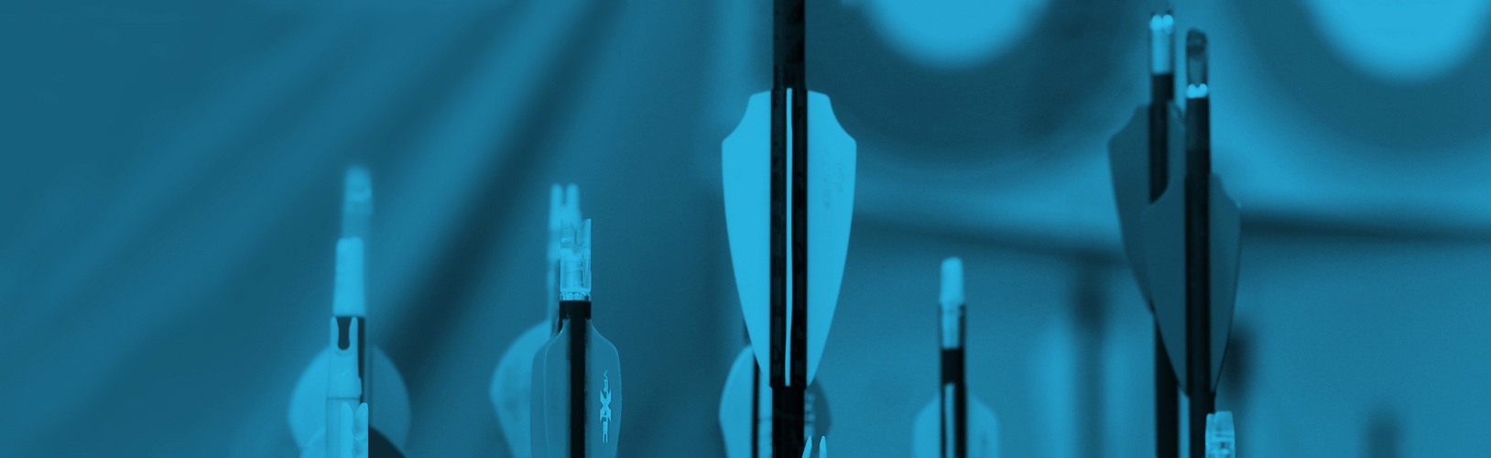

Index.html
Classes / Instructors / About
Notes:
Make header sticky
Wrap text around images.
Icon returns user to index.html
Menu icon on mobile replaces the links in desktop header.
Straight to the Point Archery is a non profit archery education center founded in 2005 by Giap Nguyen. Our state of the art educational and training facility incorporates detailed technical video analysis combined with generations of archery experience from certified coaches and instructors.
Straight to the Point Archery is a non profit archery education center founded in 2005 by Giap Nguyen. Our state of the art educational and training facility incorporates detailed technical video analysis combined with generations of archery experience from certified coaches and instructors.
Straight to the Point Archery is an indoor training facility with 28 shooting (14 - 10 yard lanes and 14 – 20 yard lanes) and 2 private coaching rooms. We also have access to 26 additional 20 yard lanes and an outdoor shooting field. We offer several types of lessons to accommodate everyone from the first time archer to the professional archer. Once set up with proper fitting equipment, each archer will be given the basic safety instruction to start and will be introduced to various shooting techniques.
Straight to the Point Archery is an indoor training facility with 28 shooting (14 - 10 yard lanes and 14 – 20 yard lanes) and 2 private coaching rooms. We also have access to 26 additional 20 yard lanes and
528 Nock Point Ln
Tacoma, WA 98412
Location / Contact Us / About
2018 Archery Acadmey | Tacoma. WA
2018 Archery Acadmey | Tacoma. WA

Slide 5
about.html
Classes / Instructors / About
Notes:
About
Giap Nguyen started Straight to the Point Archery in 2005. He's an avid and accomplished archer himself, having competed with the United States Archery Team in the 2000 Summer Olympics. He has three children, and started Straight to the Point in part because he was not satisfied with the archery eduction options for them in Tacoma. After The Hunger Games books and movies came out, he noticed a surge in popularity of archery among young people, especially young women, and the business has been booming ever since.
Nondiscriminatory Policy
Next Step Archery admits students of any race, gender presentation, sexuality, religion, national origin or ethnic origin to all rights, privileges, programs and activities available to students at the school. We do not discriminate in administration of our educational policies, admission policies and other school administered programs. All students are welcome and valuable members of our community.
About
Giap Nguyen started Straight to the Point Archery in 2005. He's an avid and accomplished archer himself, having competed with the United States Archery Team in the 2000 Summer Olympics. He has three children, and started Straight to the Point in part because he was not satisfied with the archery eduction options for them in Tacoma. After The Hunger Games books and movies came out, he noticed a surge in popularity of archery among young people, especially young women, and the business has been booming ever since.
Nondiscriminatory Policy
528 Nock Point Ln
Tacoma, WA 98412
Location / Contact Us / About
2018 Archery Acadmey | Tacoma. WA
2018 Archery Acadmey | Tacoma. WA

Slide 6
classes.html
Classes / Instructors / About
Notes:
Classes are setup like cards.
Enable the page to scale and tile the cards.
Additional classes can be easily added later as company grows.
Classes
A101 Basic Archery
Basic archery course that focuses on beginning archery safety, skills, and drills. Participants learn about archery form, range rules and etiquette. Form training and fun games are introduced in this class.
Equipment will be provided with exception of safety kit.
$120/month
Mondays and Wednesdays, 4-5pm
Prerequisite: Interest in learning about the sport of archery. Minimum age 8 years old or 7 w/ pre-evaluation.
A102 Intermediate Archery
Intermediate archery course that focuses on intermediate archery safety, form, and introduces new equipment styles of shooting Recurve and Compound bows. Fun games and form reinforcement techniques are emphasized in this class.
Equipment will be provided with exception of safety kit.
$120/month
Tuesdays and Thursdays, 4-5pm
Prerequisite:A101 or recommendation from private lesson instructor. Minimum age 7 years old.
A101 Basic Archery
Basic archery course that focuses on beginning archery safety, skills, and drills. Participants learn about archery form, range rules and etiquette. Form training and fun games are introduced in this class.
Equipment will be provided with exception of safety kit.
$120/month
Mondays and Wednesdays, 4-5pm
Prerequisite: Interest in learning about the sport of archery. Minimum age 8 years old or 7 w/ pre-evaluation.
Enroll
Enroll
Enroll
A103 Advanced Archery
After taking the A101, A102 classes, students are eligible to participate in the A103 class. This class focuses on a continued education towards tournament styles of shooting used by many archery tournament associations from around the world. Along with the tournament lesson, participants receive continued knowledge around their shooting form and advice on personal equipment selections.
Equipment will be provided with exception of safety kit.
Cost: $120/month
Schedule: Tuesdays and Thursdays, 5-6pm
Prerequisite: A101/A102 or equivalent. Minimum age 7 years old.
Private Lessons
Single Lesson
Description: 1 hour of expert guidance by a USA Archery-certified coach
$50
A102 Intermediate Archery
Intermediate archery course that focuses on intermediate archery safety, form, and introduces new equipment styles of shooting Recurve and Compound bows.
Enroll
528 Nock Point Ln
Tacoma, WA 98412
Location / Contact Us / About
2018 Archery Acadmey | Tacoma. WA
Enroll
2018 Archery Acadmey | Tacoma. WA

Slide 7
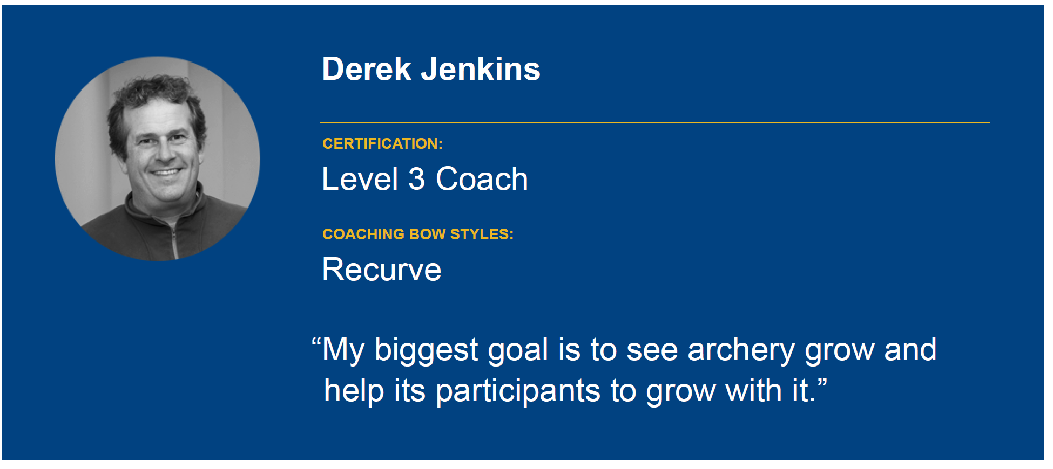
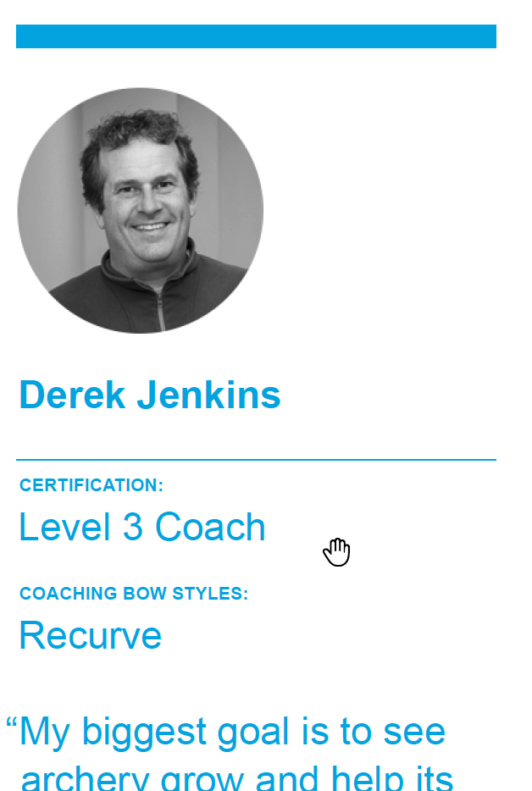
instructors.html
Classes / Instructors / About
Notes:
Meet our Instructors
Meet our Instructors
528 Nock Point Ln
Tacoma, WA 98412
Location / Contact Us / About
2018 Archery Acadmey | Tacoma. WA
2018 Archery Acadmey | Tacoma. WA

Slide 8
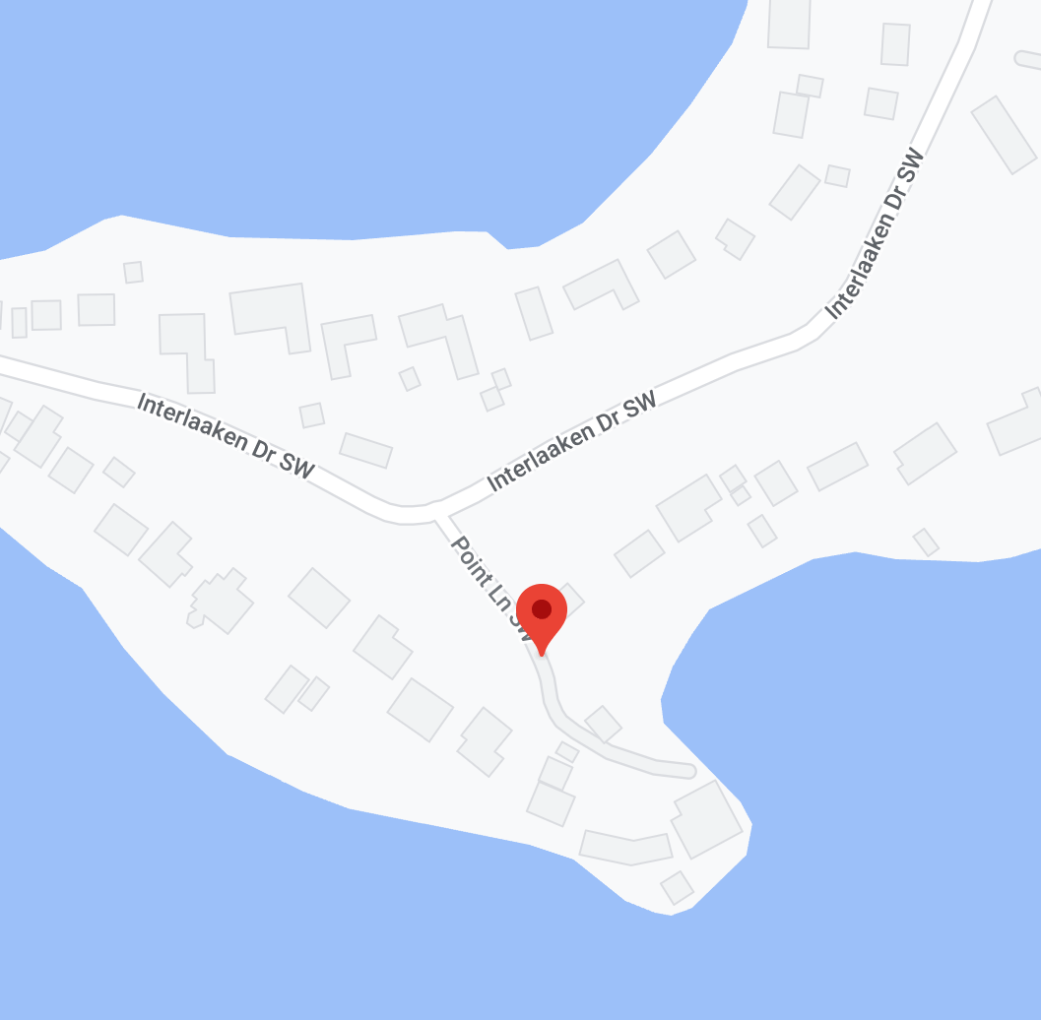
location.html
Classes / Instructors / About
Notes:
Embedded google maps view
Location
Straight to the Point Archery
528 Nock Point Ln
Tacoma, WA 98412
(253)555-1010
Location
Straight to the Point Archery
528 Nock Point Ln
Tacoma, WA 98412
(253)555-1010
Our Facility
We have an indoor training facility with 28 shooting (14 - 10 yard lanes and 14 – 20 yard lanes) and 2 private coaching rooms. We also have access to 26 additional 20 yard lanes and an outdoor shooting field.
528 Nock Point Ln
Tacoma, WA 98412
Location / Contact Us / About
2018 Archery Acadmey | Tacoma. WA
2018 Archery Acadmey | Tacoma. WA

Slide 9
contact.html
Classes / Instructors / About
Notes:
Contact Us
Full Name
Contact Us
Full Name
Email
Email
Message
Message
Submit
Submit
528 Nock Point Ln
Tacoma, WA 98412
Location / Contact Us / About
2018 Archery Acadmey | Tacoma. WA
2018 Archery Acadmey | Tacoma. WA

