Slide 1
Rigorous analysis of
Combined software processes via Model Checking
Mark McDermott

Slide 2
01
03
problem
RESULTS
02
04
solution
CONCLUSIONS

Slide 3
We want an automatic way to combine several processes potentially written by different people and to check for common properties.
Problem statement
01

Slide 4
Combining and analyzing multiple concurrent processes, perhaps written by different people, is increasingly important in today’s mobile, distributed, ad-hoc computational environments. For example: Medical processes that guide medical procedures in hospitals are written by different people, yet they are performed concurrently on the same patient by different agents. Failure to adhere to critical safety/liveness properties may result in the loss of life or serious disability.
Motivation

Slide 5
solution
02
Covid-19
Little-JIL XML
COVID-19 Patient
Hospital Ordering Ventilator
Semantic Translation
Kripke / CTL
$
banking
Antlr
JUNG / Java Swing
Deposits
Transfers

Slide 6
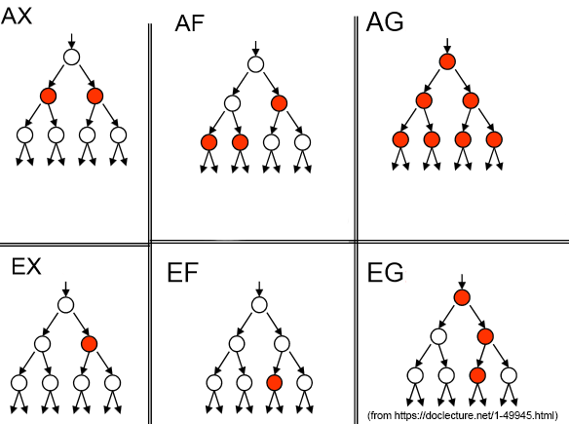
ctl

Slide 7
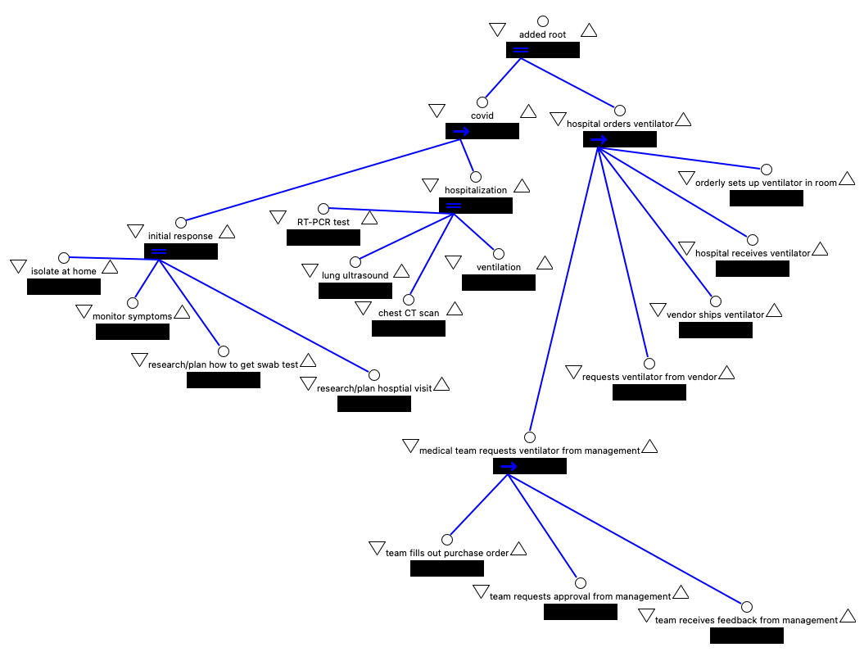
Little-jil

Slide 8
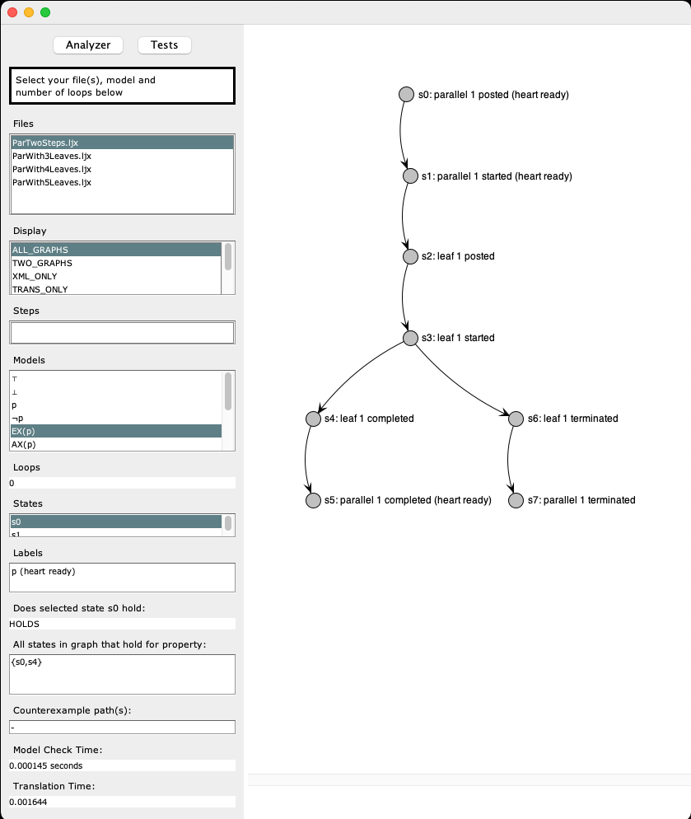
Program GUI

Slide 9
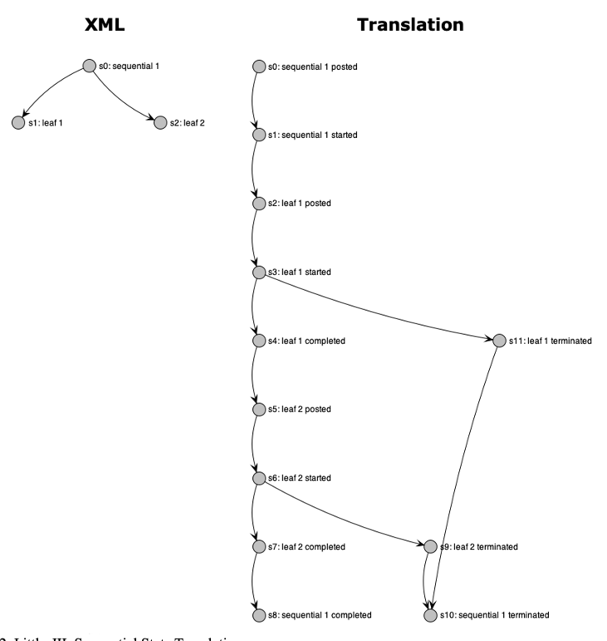
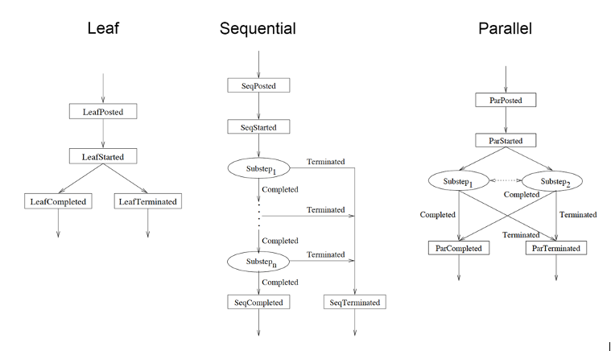
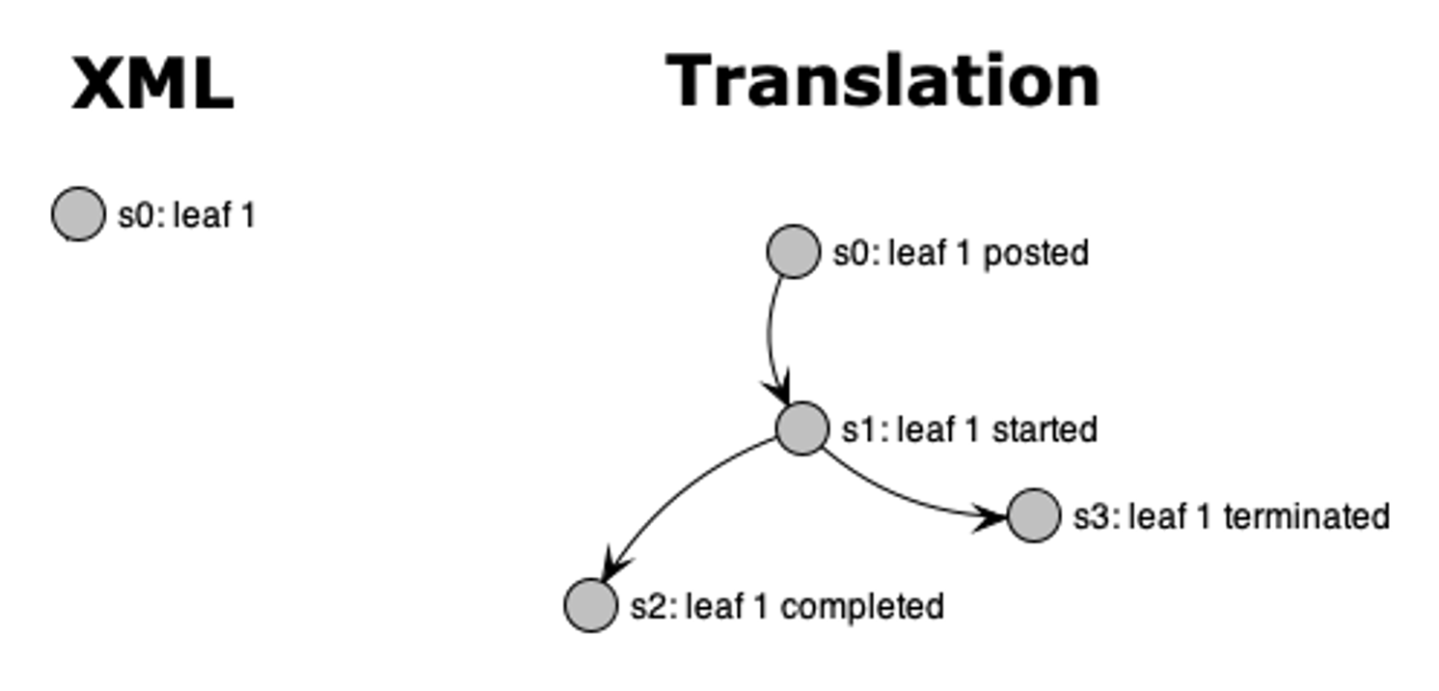
Translation
Sequential
Leaf
Transfers

Slide 10
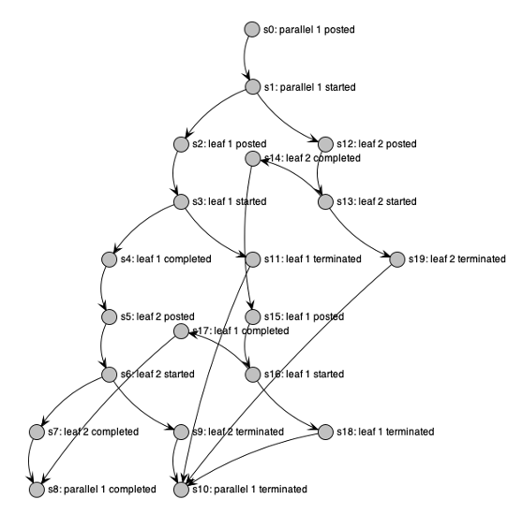
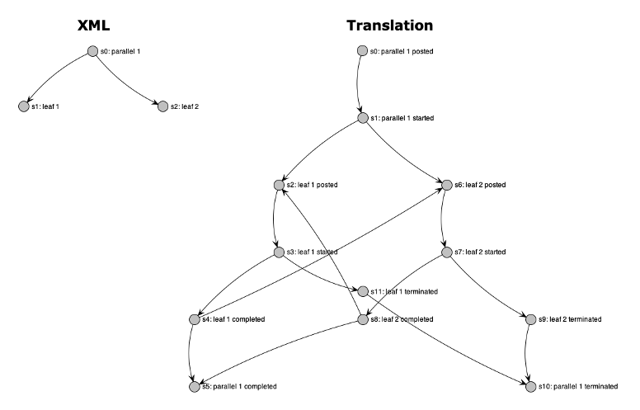
Translation (semantically equivalent)
Parallel (explicit interleavings)
Parallel (no explicit interleavings)

Slide 11
models
Proposition |  | CTL
someone who is a high Covid-19 risk to others Will never be at home |  | AG¬(p∧q)
If a ventilator is requested, it will eventually be available |  | AG(p→AF(q))
Transfer buffer is always null until the checks’ array size is zero & the check buffer is closed |  | A[¬p U q∧¬r]

Slide 12
{ }
Core Translation algorithms
O(n),
sometimes O(n!)
swapInTemplate(template) {
// add template nodes to nodeList
for (node in template.nodeList) { nodeList.add(node) }
// remove the node being replaced
nodeList.remove(template.nodeToReplace)
// remove children replaced by interleavings
nodeList.remove(template.childrenReplacedByInterleavings)
}
// from https://www.geeksforgeeks.org/write-a-c-program-to-print-all-permutations-of-a-given-string/
getInterleavings(list, l, r) {
// base case
if (l == r) {
// unique permutation found and stored in interleavings global variable
interleavings.add(list)
// recursive case
} else {
for (int i=l; i<=r; i++) {
// swaps l & i elements
swap(list[l], list[i]);
// l increases by one with each recursion until base case is met
getInterleavings(list, l+1, r);
// swaps l & i elements back
swap(list[l], list[i]); }
}
}
translate(nodeList, showInterleavings) {
// swap in template for root node
root = nodeList.getRoot
switch (root.getNodeType) {
case leaf: root = leafTemplate(root)
case sequential: root = sequentialTemplate(root)
case parallel: root = parallelTemplate(root, showInterleavings)
}
// run translateChildrenRecursively on root
translateChildrenRecursively(root)
}
translateChildrenRecursively(node, showInterleavings) {
// translate all the children
for (child in node.getChildren) {
if (child.isOriginal) {
switch (root.getNodeType) {
case leaf: swapInTemplate(leafTemplate(node))
case sequential: swapInTemplate(sequentialTemplate(node))
case parallel: swapInTemplate(parallelTemplate(node, showInterleavings))
}
}
}
// loop through all current children and run
for (child in node.getChildren) {
translateChildrenRecursively(child, showInterleavings)
}
}
O(1)
O(n!)
O(n),
sometimes O(n!)

Slide 13
{ }
Leaf & sequential templates
leafTemplate(node) {
// create template nodes
leafPosted = new node()
leafStarted = new node()
leafCompleted = new node()
leafTerminated = new node()
// hook template nodes to each other
leafPosted.addChild(leafStarted)
leafStarted.addChild(leafCompleted)
leafStarted.addChild(leafTerminated)
// hook up parents
parents = node.getParents
for (parent in parents) {
parent.addChild(leafPosted)
}
// hook up children
children = node.getChildren
for (child in children) {
if (child.getStatus == terminated) {
leafTerminated.addChild(child)
} else if (child.getStatus == completed) {
leafCompleted.addChild(child)
}
}
return new nodeList(leafPosted,leafStarted,leafCompleted,leafTerminated)
}
sequentialTemplate(node) {
…
// hook up substeps
for (i=0; i<substeps.length; i++) {
substep = substeps[i]
lastIndex = substeps.length - 1
// if not last substep, hook up to next substep
if (i != lastIndex) {
substep[i].addChild(substep[i+1])
// if last substep, hook up to seqCompleted
} else {
substep.addChild(seqCompleted)
}
// all substeps get hooked up to seqTerminated
substep.addChild(seqTerminated)
}
// hook up children
children = node.getChildren
for (child in children) {
// hook up seqTerminated to any children of status terminated
if (child.getStatus == terminated) {
seqTerminated.addChild(child)
// hook up all other children to seqCompleted
} else if {
leafCompleted.addChild(child)
}
}
return new nodeList(seqPosted,seqStarted,seqCompleted,seqTerminated)
}
O(n),
sometimes O(n!)
O(n),
sometimes O(n!)

Slide 14
{ }
Parallel template
parallelTemplate(node, showInterleavings) {
…
// if not showing interleavings
if (!showInterleavings) {
// hook up substeps
substeps = node.getSubsteps
for (i=0; i<substeps.length; i++) {
substep = substeps[i]
for (j=0; j<substeps.length; j++) {
if (i != j) {
substep.addChild(substep[j])
}
}
substep.addChild(parCompleted)
substep.addChild(parTerminated)
}
// hook up children
for (child in children) {
// hook up parTerminated to any children of status terminated
if (child.getStatus == terminated) {
parTerminated.addChild(child)
// hook up all other children to leafCompleted
} else if {
parCompleted.addChild(child)
}
}
…
// else if showing interleavings
} else {
// get interleavings & store in global interleavings variable
l=0 // index of first element to permute
r=child.length - 1 // index of last element to permute
getInterleavings(children, l, r) // stores permutations in interleavings global variable
// clean up the interleavings
for (interleaving in interleavings) {
for (i=0; i < interleaving.length; i++) {
thisNode = interleaving[i]
thisNode.removeChildren() // remove original children from each node
if (i == 0) {
parStarted.addChild(thisNode) // hook up first node in each interleaving to parStarted
}
if (i < interleavings.length - 1) {
nextNode = interleaving[i + 1]
thisNode.addChild(nextNode) // link interleaving nodes in the order of each permutation
}
}
}
…
}
}
O(n!)
O(n²)

Slide 15

Experimental results
03
Proposition | Holds? | Nodes | Time (s)
someone who is a high Covid-19 risk to others Will never be at home
If a ventilator is requested, it will eventually be available
Transfer buffer is always null until the checks’ array size is zero & the check buffer is closed
1600
0.02 s
1600
0.09 s
375
0.003 s
* nodes & times rounded

Slide 16
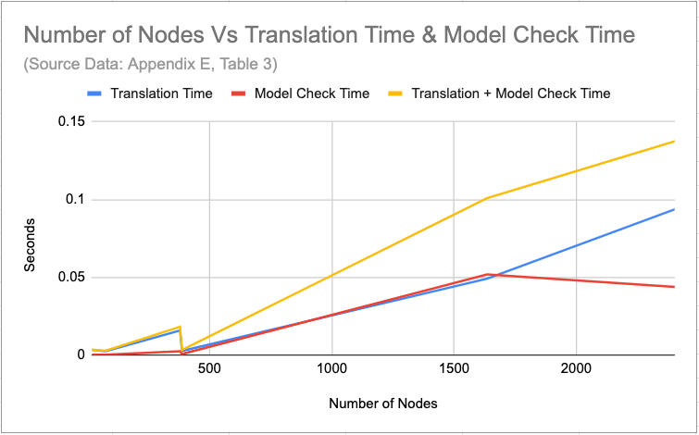

Slide 17
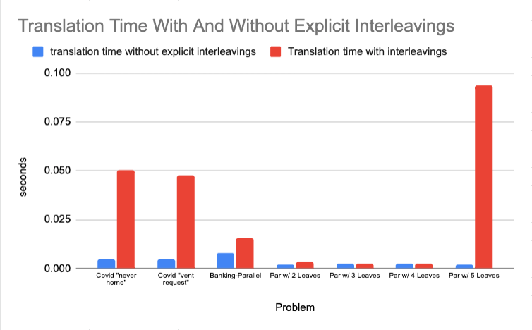
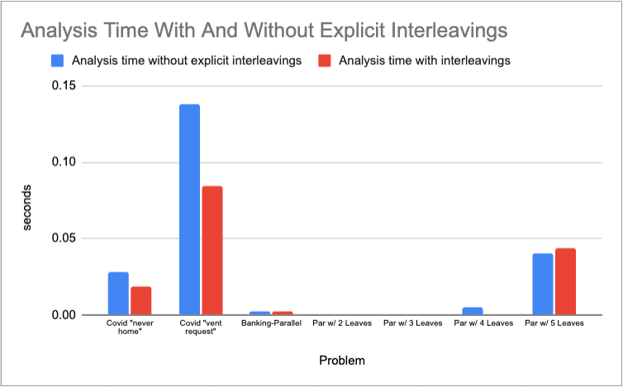

Slide 18
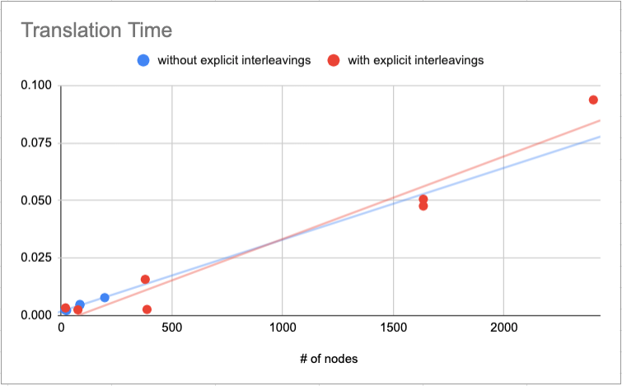
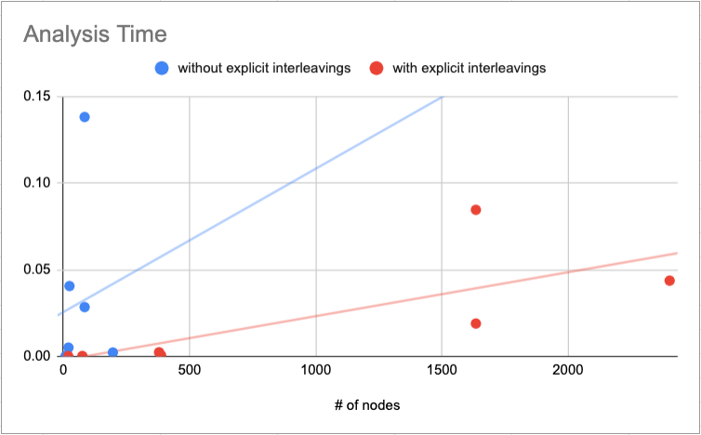

Slide 19
conclusion
04
● Both translation time and analysis time roughly increase linearly with an increase in the number of nodes in the graph
● Translation time increases dramatically with interleavings
● Analysis time in the general case decreases with interleavings, but when the graph is extremely large, it increases
● Modern personal computing processor power is easily sufficient for moderately sized graphs (5-20 nodes before translation, 1,500 – 2,500 after translation)

