Slide 1
Task and Definitions
Task: Stick Game – While blinded, S guesses a stick’s length multiple times Ss finger progresses from left to right over discrete equidistant points (signified by raised asterisk marks on the stick; the distance between each asterisk is one inch). S will provide a guess whenever prompted by the experimenter. Game is over once Ss finger reaches the end of the stick or experimenter signals end of the game. Experimenter has a predetermined set of points on the stick for which the cue to S will be given (at minimum this will be one point).
Stick looks like this: |---*---*---*---*---*---*---~---|
S starts his/her finger on the left end-point, then moves to each asterisk in order and responds regarding the stick’s length on the asterisks for which S is cued. (Note: S can pause when cued to consider the response for no longer than 5 seconds.)
Definitions
L_{total} is length of stick (in inches).
L_{finger} is length from left end-point to Ss current position (in inches).
Empirical distribution is the real-world distribution of sticks (in inches and within 100 miles of a subject’s home).

Slide 2
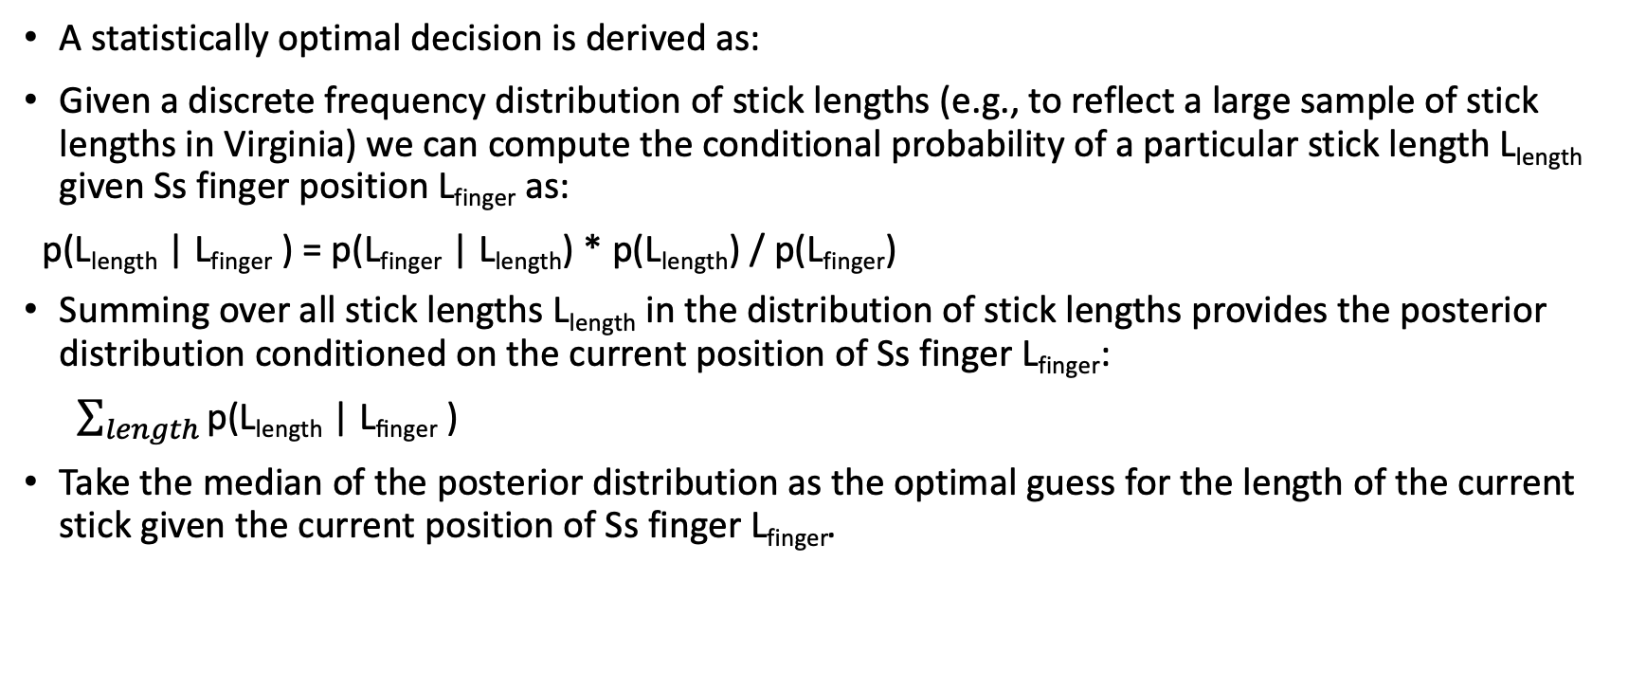
Bayesian Formulation
A statistically optimal decision is derived as:
Given a discrete frequency distribution of stick lengths (e.g., to reflect a large sample of stick lengths in Virginia) we can compute the conditional probability of a particular stick length L_{length} given Ss finger position L_{finger} as:
p(L_{length} | L_{finger} ) = p(L_{finger} | L_{length}) * p(L_{length}) / p(L_{finger})
Summing over all stick lengths L_{length} in the distribution of stick lengths provides the posterior distribution conditioned on the current position of Ss finger L_{finger}:
$\sum_{length}{\text{p}\text{(}\text{Lleng}\text{th}\text{ | }\text{Lfinger}\text{ )}}$
Take the median of the posterior distribution as the optimal guess for the length of the current stick given the current position of Ss finger L_{finger}.

Slide 3
One-shot game
Experimenter only provides one cue and then ends the game.
For empirical distributions that are Gaussian-like, the main empirical findings show a correspondence between the optimal guess of the Bayesian formulation and the human guesses:
For values of L_{finger} not near and to the left of the median of the empirical distribution, the median of the empirical distribution is the optimal guess and this is how people respond.
For values of L_{finger} approaching the median of the empirical distribution (approaching from the left of the median), as L_{finger} approaches the median of the empirical distribution, the optimal guess increases monotonically and this is how people respond.

Slide 4
Multiple-shot game
Experimenter provides multiple cues and then ends the game.
The experimental findings do not yet exist for this condition.
However, it presents an interesting case:
Assume that S is cued multiple times in one game and that several of these cues are not near and to the left of the median of the empirical distribution. Call this set of cues “early cues.”
Assume that some of Ss cues are near and approaching the median of the empirical distribution (approaching from the left of the median). Call this set of cues “late cues.”
The S, as a plausible hypothesis, has a response conflict. Responses to early cues will, by the Bayesian formulation, be values near the median of the empirical distribution. Responses to the late cues will, by the same Bayesian formulation, be of larger values compared to early cued responses. Given that this conflict occurs within-stick, it presents a response conflict.

Slide 5
Research Question
Is there evidence for a response conflict, within-stick, as described on the prior slide?
One simple way to measure this is to compute the median of the prior distribution that matches the Ss response and the value of L_{length}. This is a handy way to test if there is response conflict.
Response conflict would manifest if the median of the prior distribution decreases as L_{finger} approaches the value of the median of the empirical distribution.
Note, the empirical distribution and the prior distribution can be identical but only under the condition that the Ss response is optimal.

