Slide 1
song_id
evaluation
Instance-Based Memory as a
Basis for Aesthetic Judgment
Modeling aesthetic preference as declarative memory activation, using pyactup
Mark Orr

Slide 2
Three Ideas, One Model
song_id
X
Instance-Based
Learning
Rational Memory
(Anderson)
Inverted-U
Complexity
Past experiences (instances),
not rules, drive decisions.
(Gonzalez et al., 2003)
Memory activation tracks
statistical regularities
in the environment.
Moderate stimulus complexity
is preferred over very simple
or very complex stimuli.
Aesthetic judgment as a function of memory activation

Slide 3
FOUNDATION
song_id
The Core Mechanism: Algorithm A
X
1. Predict
Retrieve the memory chunk pyactup would predict next → predicted_activation
2. Observe
Look up the actual song's own chunk → actual_activation
3. Compare
aesthetic_basis =
| predicted − actual |
Each song is a pyactup chunk {song_id, complexity}. Activation reflects how strongly
memory "expects" that chunk right now — the gap between prediction and reality is the
aesthetic signal.

Slide 4
DESIGN 1
song_id
Random, Ergodic Environment
X
100 songs, each with a fixed complexity
10,000 exposures drawn uniformly at random (i.i.d.)
aesthetic_basis measured as a time series
Summarized with a 20-exposure rolling average
song_id
complexity
Each exposure is
encoded as a chunk
like this.

Slide 5
DESIGN 1
song_id
Design 1 — The Math
X
song(t) ~ Uniform{ song_1 ... song_100 }
aesthetic_basis(t) = | A_pred(t) − A_actual(t) |
rolling_mean(t) = mean( aesthetic_basis[t-19 : t] )
Activation is read via pyactup's activation_history — there is no
direct "get activation" lookup in the library.

Slide 6
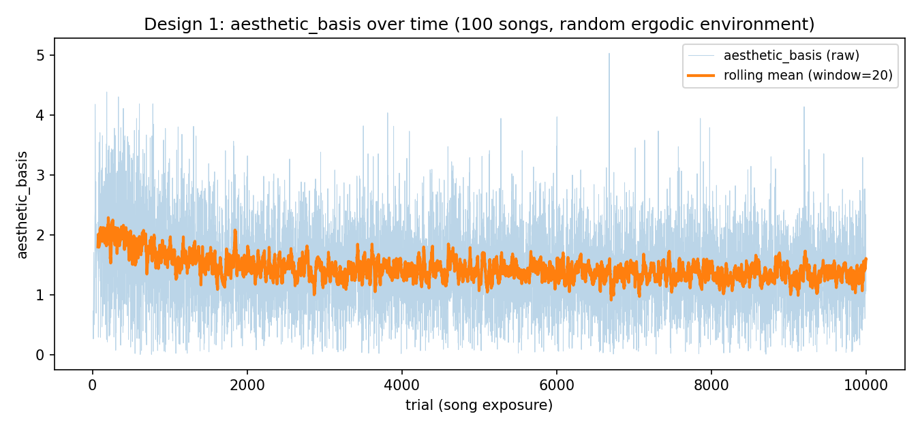
DESIGN 1
song_id
Design 1 — Result
X
aesthetic_basis settles into a steady fluctuation (~1.3–1.4) after an initial transient.

Slide 7
DESIGN 1
song_id
Design 1 — What does this tell us?
X
Once memory saturates, the “surprise” signal stabilizes — consistent with an ergodic environment reaching a steady state
This is the baseline case: no structure in the environment to track
Sets up the comparison for Design 2's structured environment

Slide 8
DESIGN 2
song_id
A Cyclic “Spotlight” Environment
X
Same 100 songs, now placed at equally-spaced points on a circle
A von Mises distribution's center sweeps around the circle over time
Models a systematically drifting popularity trend — a moving spotlight
Same aesthetic_basis measurement as Design 1
song_id
complexity
Each exposure is
encoded as a chunk
like this.

Slide 9
DESIGN 2
song_id
Design 2 — The Math
X
μ(t) = 2π · num_cycles · t / num_exposures
weight(song_i) ∝ exp( κ · cos(angle_i − μ(t)) )
song(t) ~ Categorical(weight)
κ (kappa) controls how tightly the spotlight focuses: low κ → nearly
uniform, high κ → a narrow beam.

Slide 10
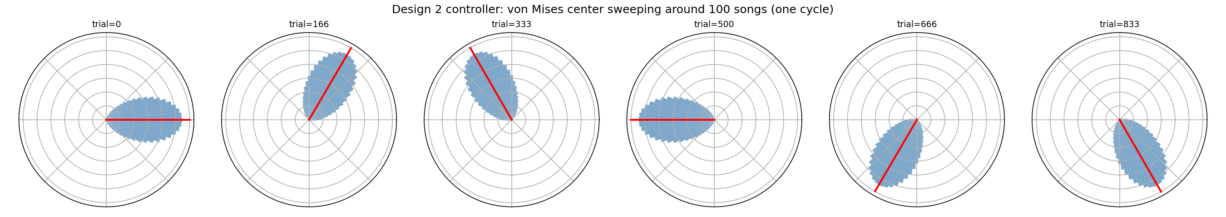
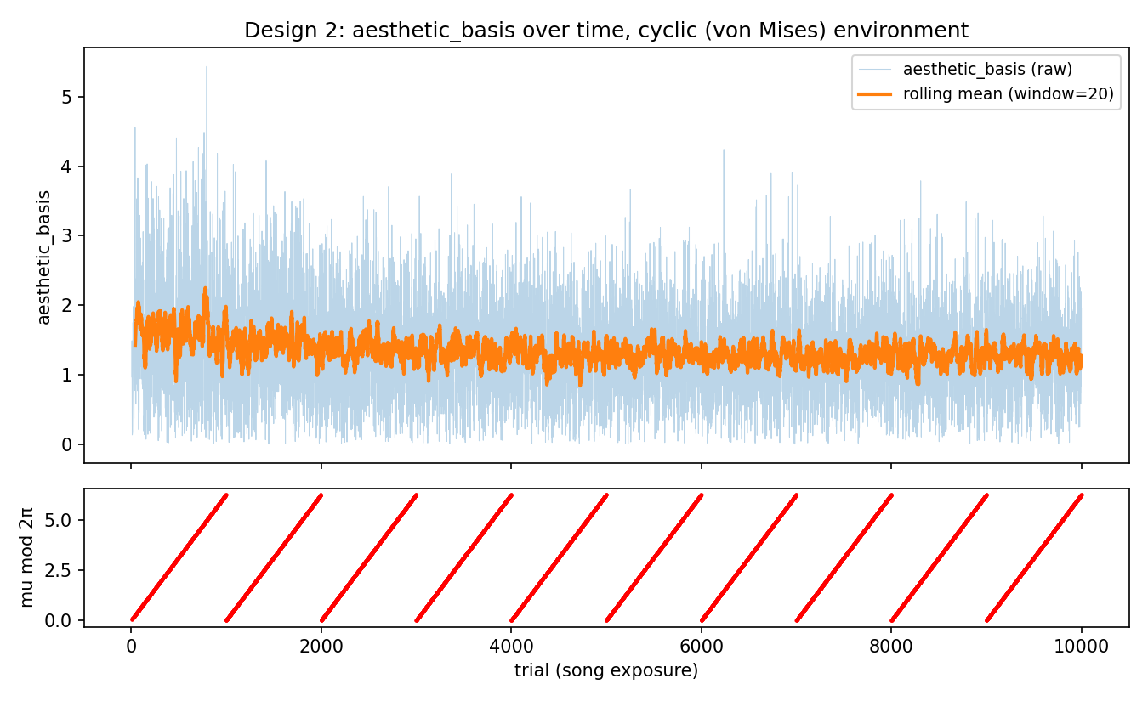
DESIGN 2
song_id
Design 2 — Result
X
Six snapshots across one cycle: the sampling distribution (blue) sweeps around all 100 songs, centered on the red line.

Slide 11
DESIGN 2
song_id
Design 2 — What does this tell us?
X
aesthetic_basis shows a similar transient-then-steady-state pattern to Design 1
No obvious visual periodicity tied to the sweep cycle yet — an open question
Suggests the memory-activation signal may be robust to this kind of structured drift

Slide 12
DESIGN 3
song_id
A Richer “Evaluation” Signal
X
Same cyclic environment as Design 2
Each memory chunk now stores an evaluation, not a fixed complexity
Introduces Algorithm A2: evaluation depends on predictability AND recent change
Every new evaluation creates a new chunk — each experience is its own instance
song_id
evaluation
Each exposure is
encoded as a chunk
like this.

Slide 13
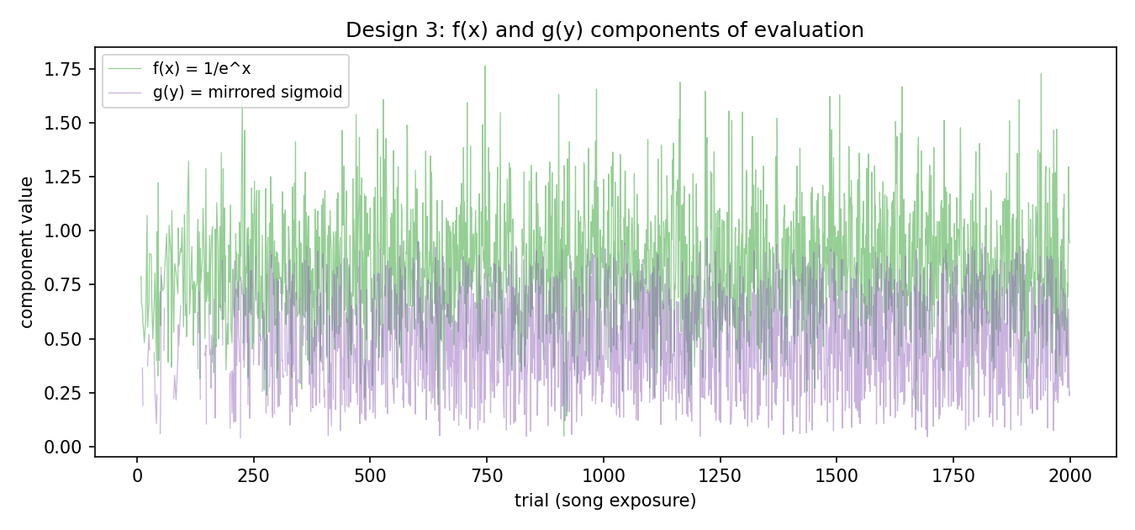
DESIGN 3
song_id
Design 3 — Algorithm A2
X
x = predicted_activation f(x) = 1 / e^x
y = actual_activation(t) − actual_activation(t−2)
g(y) = mirrored sigmoid = 1 / (1 + e^y)
evaluation = g(y) · f(x)
y compares a song's own last two activation readings — not
predicted vs. actual, but “how has my memory of this song changed?”

Slide 14
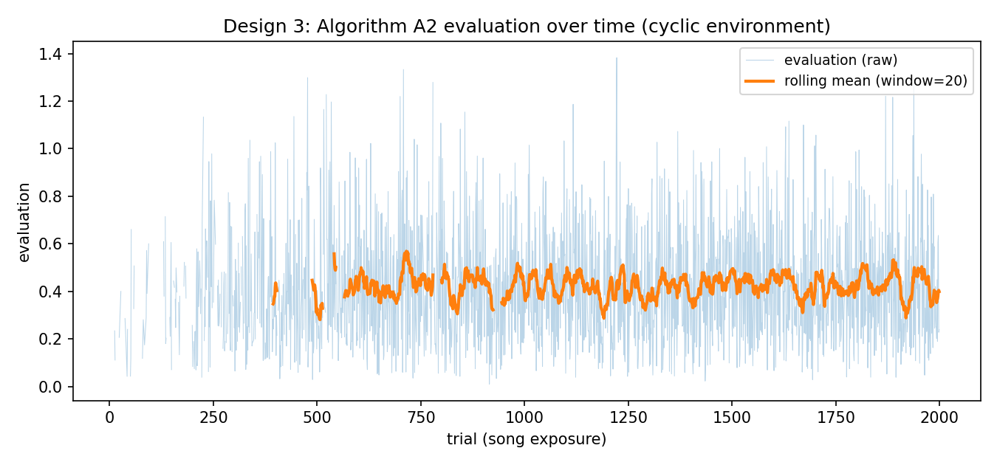
DESIGN 3
song_id
Design 3 — Result
X
evaluation settles to a steady fluctuation around ~0.4, a similar qualitative shape to Designs 1–2.

Slide 15
DESIGN 3
song_id
Design 3 — What does this tell us?
X
evaluation multiplicatively combines “how surprising is the predicted alternative” (f) with “how much has this song's pull on memory changed” (g)
Because every evaluation is its own chunk, memory becomes a growing library of felt experiences, not just facts
Real cost: chunk count grows with exposures, so retrieval scales roughly quadratically

Slide 16
?
?
Open Questions
Algorithm B: a similarity-based alternative to activation-difference (not yet defined)
Connecting aesthetic_basis / evaluation directly to the inverted-U complexity hypothesis
Future directions (not yet implemented): evolutionary-game-theoretic competition between songs; an agent that chooses not to encode a song at all
Thank you — Questions?

