Slide 1
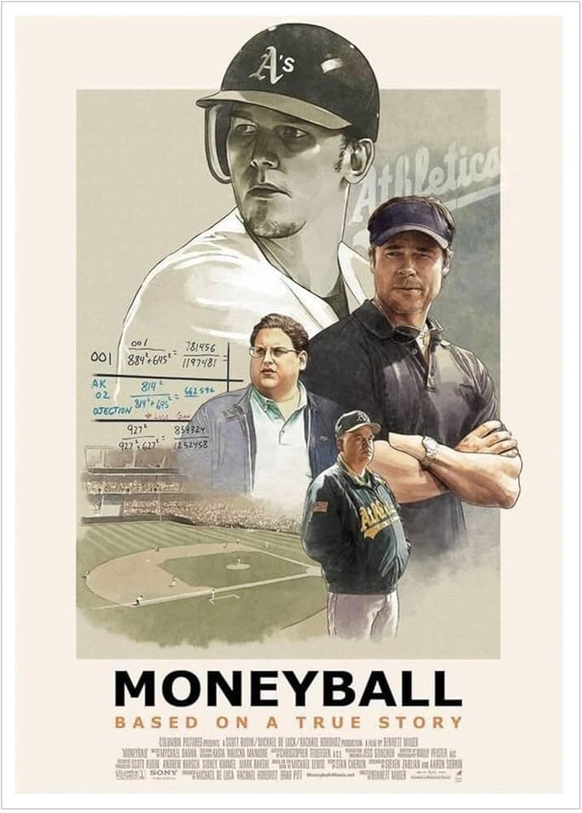
Moneyball
& Personal projects
A footy obsession… and a lot of vibe coding.
Notes:
So you've watched Moneyball. Billy Beane walked into a room full of scouts who trusted their gut, and he said: 'No. We're using the data.' That's kind of what I've been doing in my living room on weekends — except instead of the Oakland A's, it's my SuperCoach fantasy footy team. And instead of on-base percentage, it's a LightGBM model predicting AFL player scores. Let me show you what I built.

Slide 2
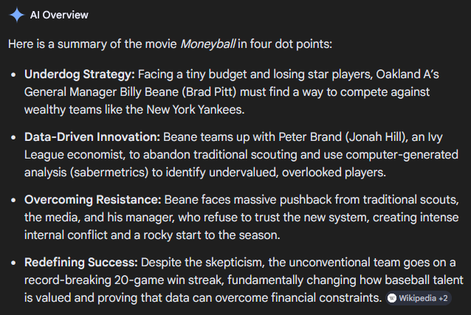
Show of hands
🙋 Who here plays or has played fantasy sport? (SuperCoach, AFL Fantasy, NRL, anything)
🙋 Who's done a personal coding or data project outside of work?
🙋 Who thought Moneyball was a great film?
Why?
Notes:
Before I dive in — let's get a feel for the room. Hands up if you play any kind of fantasy sport. Keep it up if you've ever built something in your own time — a script, a dashboard, a little side project. And of course — who genuinely enjoyed Moneyball? Good. You'll get the references today.

Slide 3

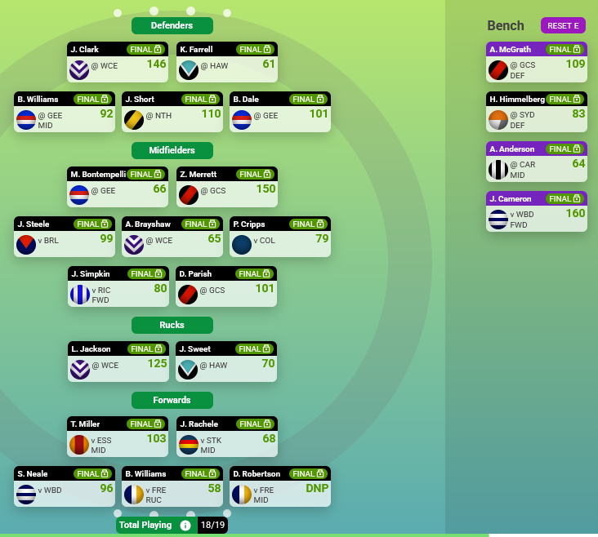
SuperCoach Draft is fantasy footy. Here's how it works.
800+ AFL players available. One job: pick the best team.
Each real AFL player earns points based on their stats each week (kicks, marks, tackles)
You pick a squad - on-field starters + bench
Trade players in and out each week to maximise your score
Compete against others in a league — highest score wins
Notes:
For the uninitiated — SuperCoach is a fantasy footy game. You draft or pick a squad of AFL players, and each week they earn points based on what they actually do on the field. Kicks, marks, tackles, handballs — all converted into a score. The goal is to have the highest-scoring team in your league each week. There are about 800 players to choose from. The question is: who do you pick?

Slide 4
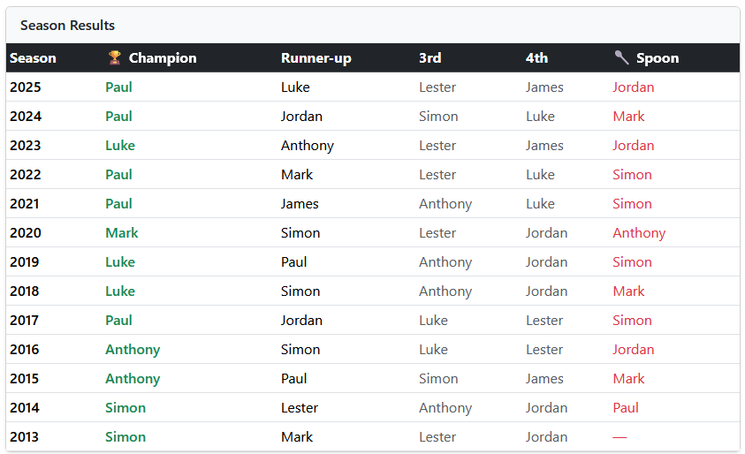
I was losing… and I was guessing.
There had to be a better way.
Every week: who's underpriced? Who's about to score big?
800 players… it’s impossible to track manually
Everyone else was using gut feel and Twitter hot takes
I wanted an actual edge
Notes:
Here's the honest truth — I was making decisions based on vibes. I'd scroll Twitter, read a footy forum, and pick whoever sounded hot. Sound familiar? That's exactly what the scouts in Moneyball were doing. And just like Billy Beane, I got sick of it. I figured: I work in data. I know how to build stuff. Why am I not using that here?

Slide 5
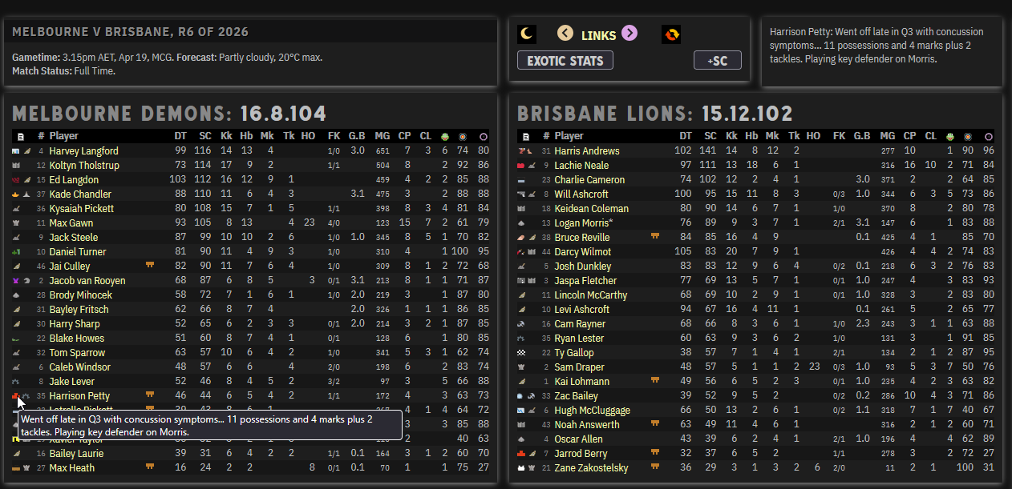

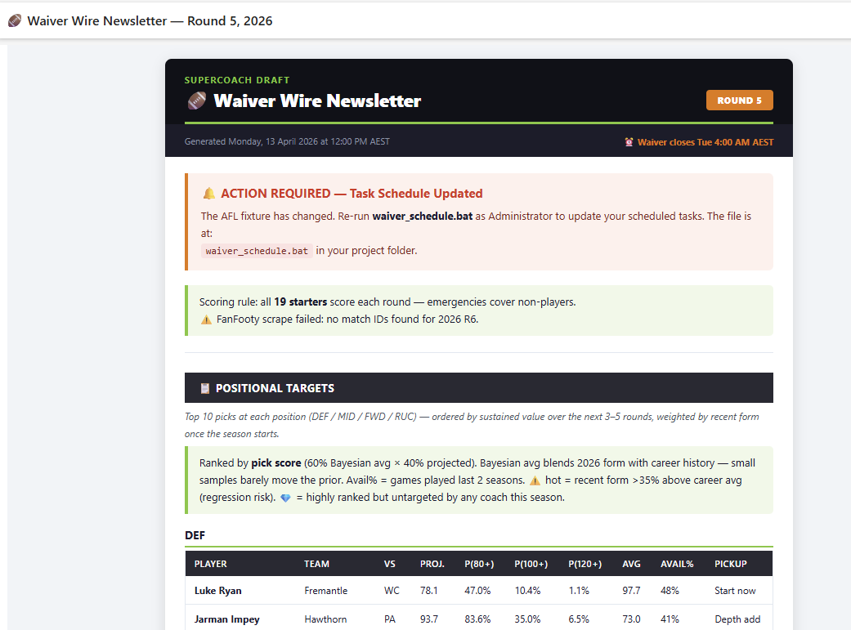
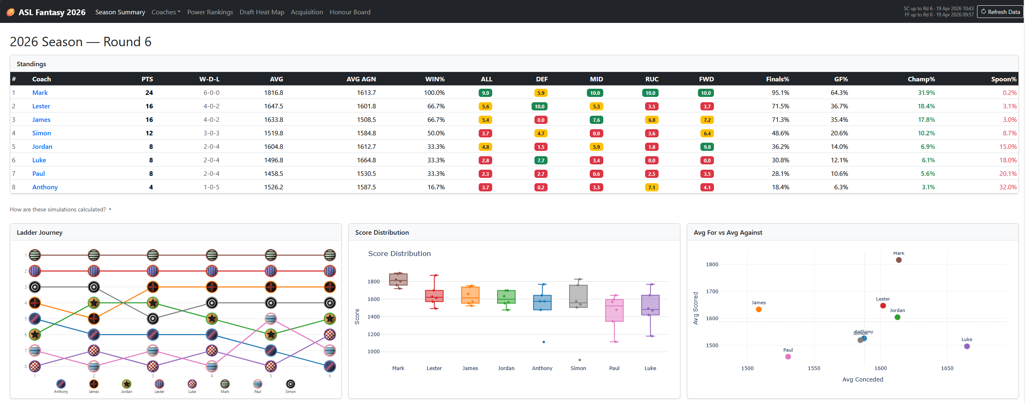
I built a full analytics pipeline. From scratch.
Scrape → process → predict → publish.
🔍 Scrape: FanFooty match data + SuperCoach API (every week, automated)
⚙️ Process — clean, merge, engineer 76 features per player per round
🧠 Predict — LightGBM ML model → player score forecasts
📬 Publish — weekly newsletter + live web dashboard
💬 Pop Quiz:
Q: In Moneyball what stat did they use instead of batting average?
A: → On-base %.
Q: What is the SuperCoach Draft equivalent?
A: How often a player scores 100+.
Notes:
So here's what I actually built. It starts with a web scraper that pulls match data every week. That feeds into a data pipeline that cleans and processes everything. The clean data goes into a machine learning model that predicts player scores. And the output? A weekly newsletter and a live web dashboard I built myself. All in Python, all running on my own machine, all in my own time.

Slide 6
Does it actually work?
Let me show you.
Notes:
DEMO CUE — switch to browser now.
Show in order:
1. Web dashboard — live league standings, player scores, team view.
Say: 'This is running on Flask, a Python web framework. Auto-refreshes from the API. I built this myself.'
2. Weekly newsletter — open latest output.
Say: 'Every week this generates automatically. It recommends which free agents to pick up, flags players to drop, and highlights the ceiling chasers — the players most likely to go huge.'
Return to slides after ~2 minutes.

Slide 7
The parallels are pretty clear.
Data beats gut feel
Moneyball: scouts used gut feel → SC: coaches use Twitter hot takes
Moneyball: on-base % (OBP) → SC: Ceiling Index (CI%)
Moneyball: undervalued players → SC: underpriced free agents
Moneyball: systematic selection → SC: weekly newsletter picks
💬 Q: Where at Reece are we still relying on gut feel?
Notes:
Here's the Moneyball moment. In the film, Billy Beane didn't just use better stats — he built a system that found value where others couldn't see it. That's exactly what this does. Instead of on-base percentage, I use Ceiling Index. Instead of undervalued players, I'm looking for underpriced free agents. The principle is identical: replace intuition with a repeatable, data-driven process.
QUESTION (pause): Pete Brand in Moneyball used first principles thinking to see what the scouts couldn't. Where in your day job are you still relying on gut feel when you could be using data?

Slide 8
Skills here can map to our work.
Personal projects aren’t really just personal projects.
Web scraping → API integrations, data extraction tasks
Data pipelines → Power Automate flows, ETL, Power BI refreshes
Machine learning → forecasting, classification, anomaly detection
Flask dashboard → internal reporting tools, lightweight web apps
Automated reports → a scheduled email or report
Notes:
None of this is exotic. Web scraping is just API calls and HTML parsing — you do that every time you pull data into Power BI. The data pipeline is the same logic as any Power Automate flow. The ML model is the same class of tool we use for forecasting at work. The newsletter is a scheduled report. The skills are identical — I just learned them by doing something I actually cared about.

Slide 9
How to start.
Start small. Stay curious.
Pick a problem you actually care about — sport, finance, music, travel, anything
Build the scraper or the CSV first. One step at a time.
Use Claude or ChatGPT to help you write the code — you don't need to know everything
Share it. Even half-finished. That's how you learn.
🙋 Who here has a project idea they've been sitting on?
Thanks team! 🙂
Notes:
I'm not standing up here to show off. I'm standing up here because I want you to do this too. The biggest thing I learned? Just start. The scraper was 30 lines of Python. The first version of the model was terrible. But I built on it week by week because I cared about the outcome. Pick something you'd actually use, and go. And use AI to help you — that's the whole point of the tools we have now.
SHOW OF HANDS: Who here has a project idea they've been sitting on? Keep your hand up if the only thing stopping you is not knowing where to start.

