Slide 1
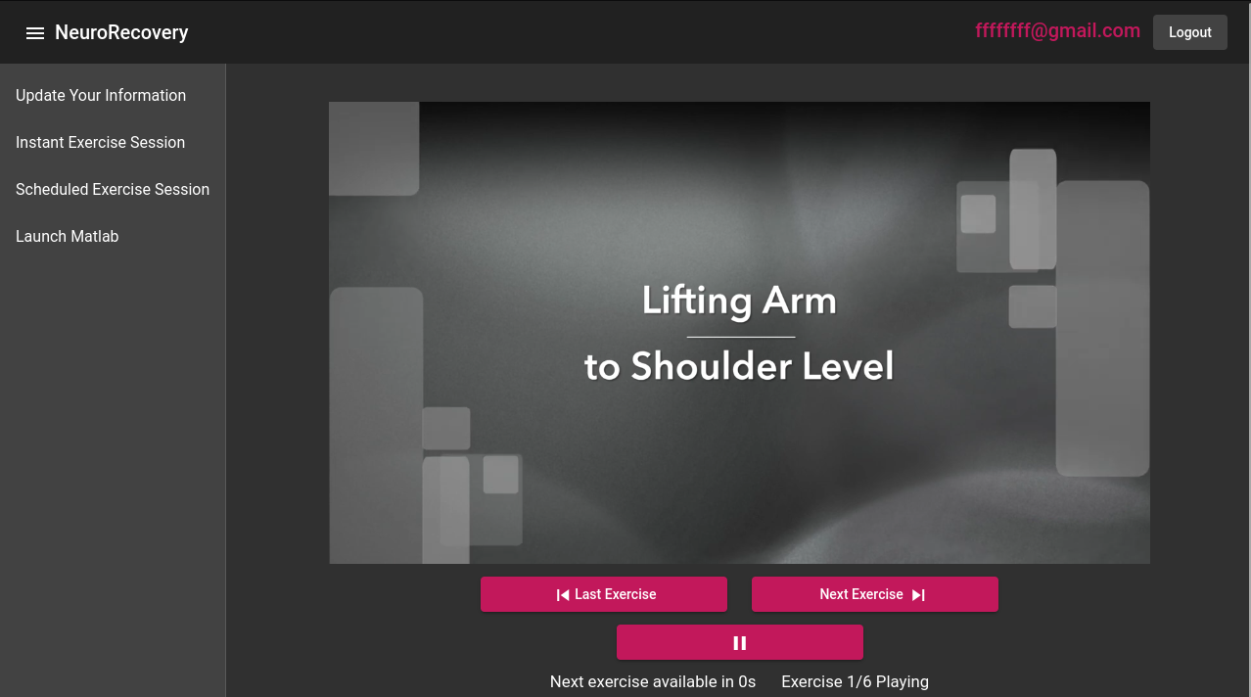
NeuroRecovery App
The NeuroRecovery App assists post-stroke patients with their recovery through a web application

Slide 2
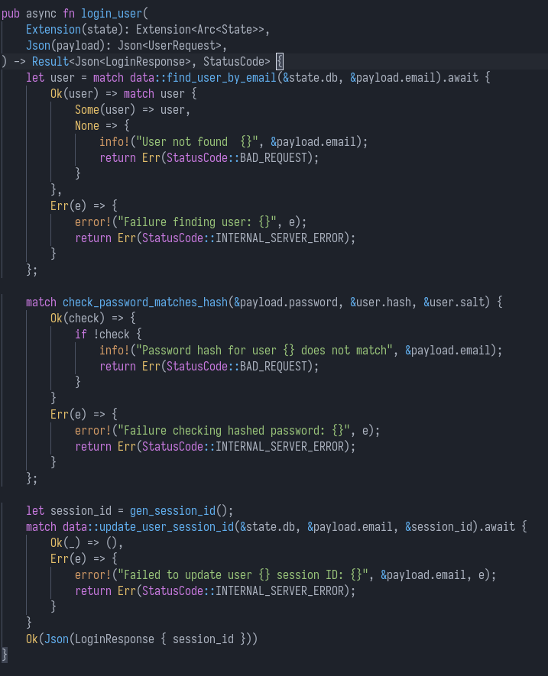
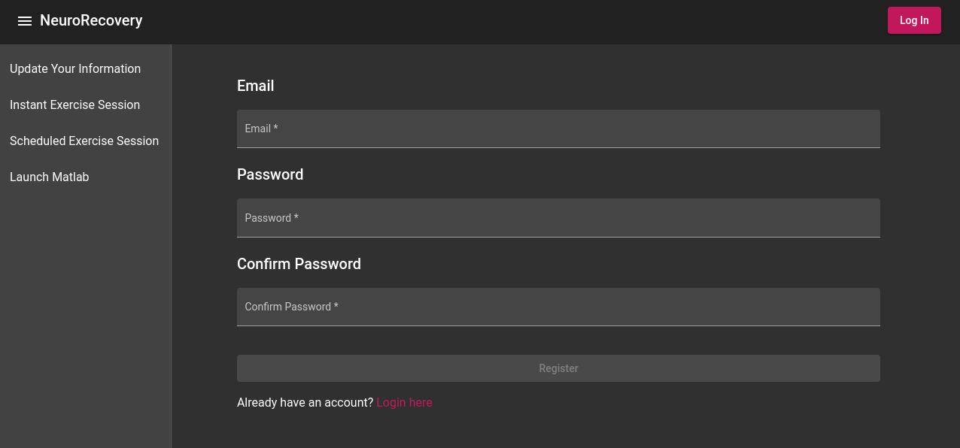
Login/Register System
Email/Password based authentication
Passwords are stored as Argon2id hashes for security
Secure Session ID is stored in browsers localStorage

Slide 3
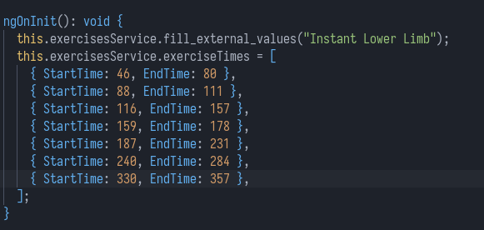
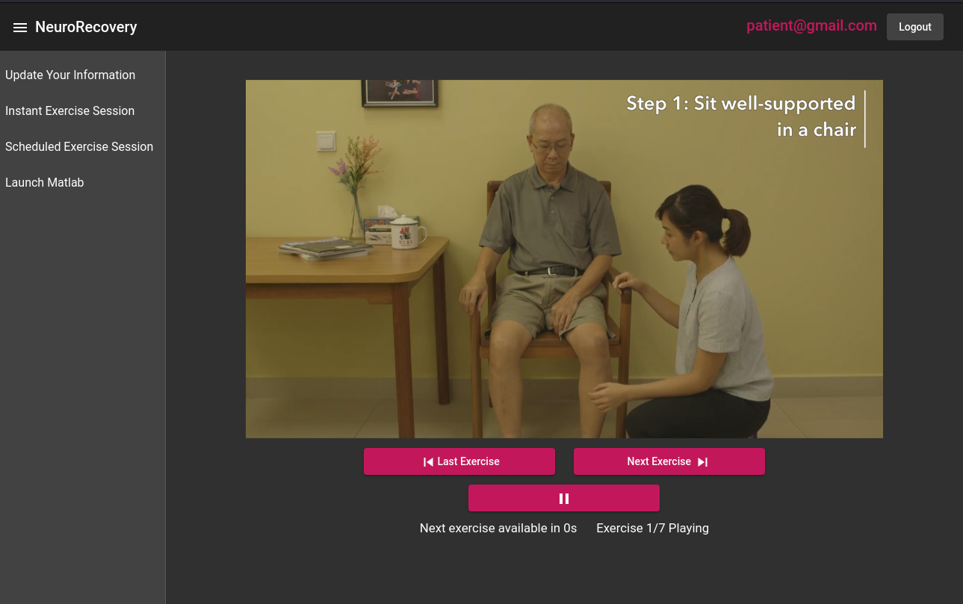
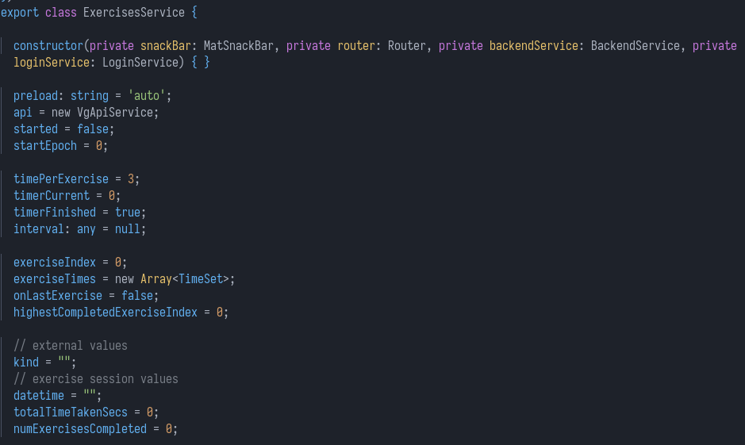
Instant Exercise Sessions
Looped video clips of the exercise being demonstrated
Countdown timer on each exercise before “Next Exercise” can be clicked
Easy to add new videos with an mp4 file and an array of TimeSets

Slide 4
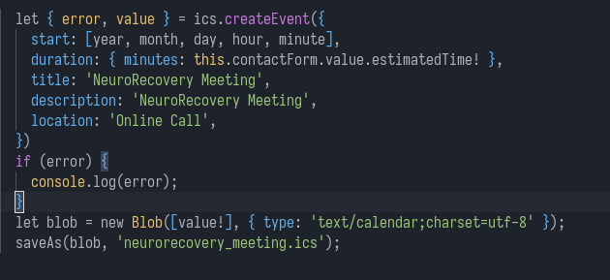
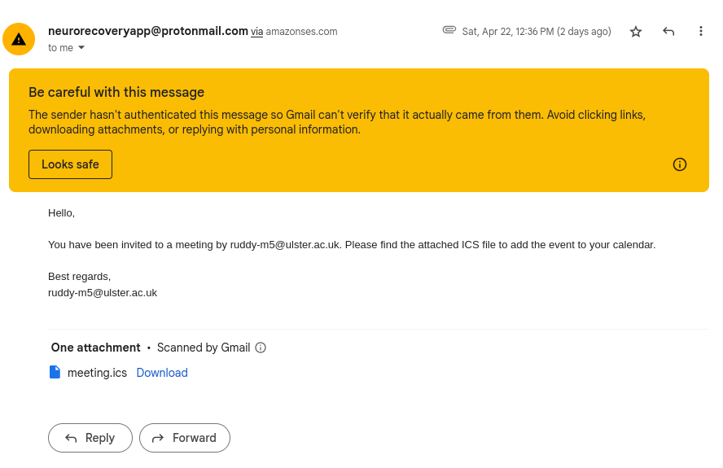
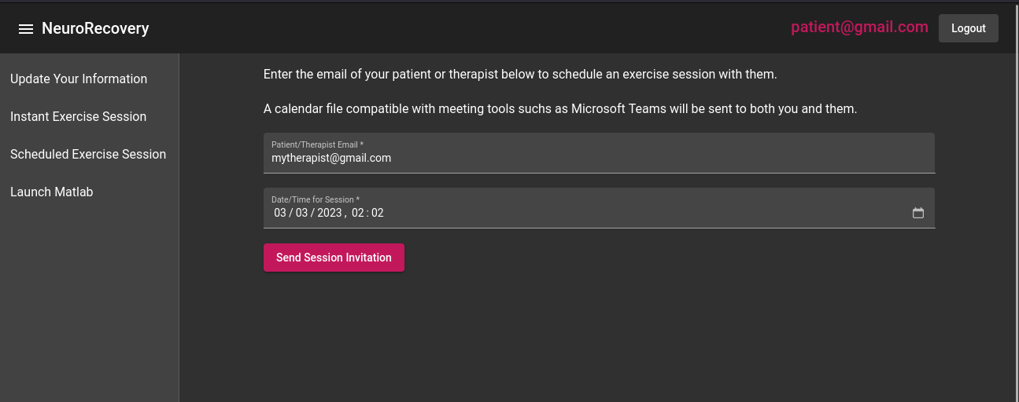
Scheduled Exercise Sessions
Form to enter email of meeting attendee and datetime
Generates ICS calendar file and emails it to both parties

Slide 5
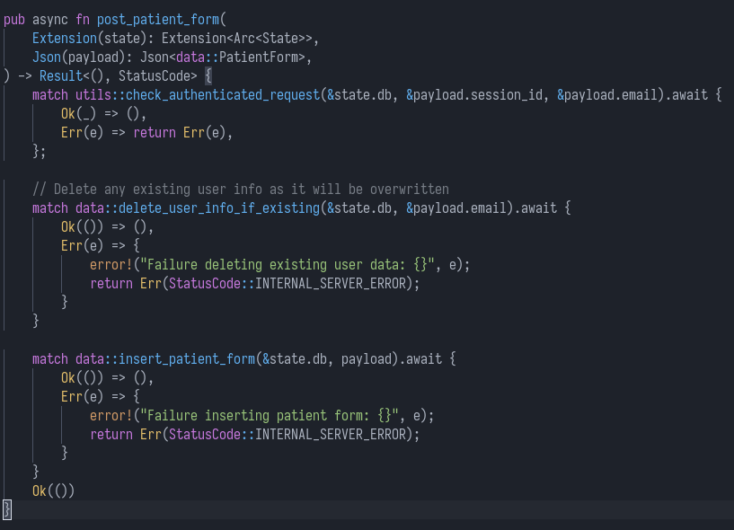
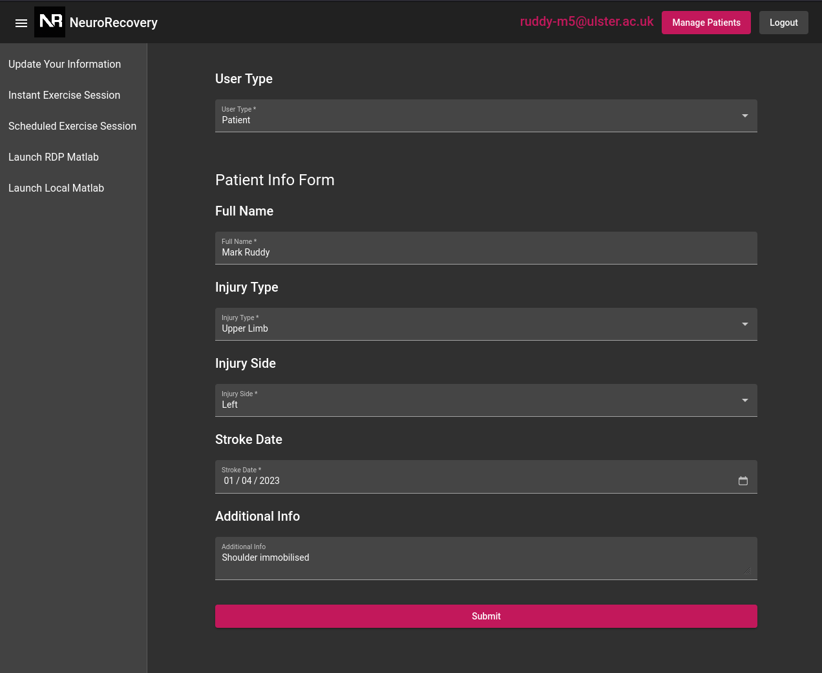
Patient and Therapist User Data Form
Form to submit data on Patient/Therapist information

Slide 6
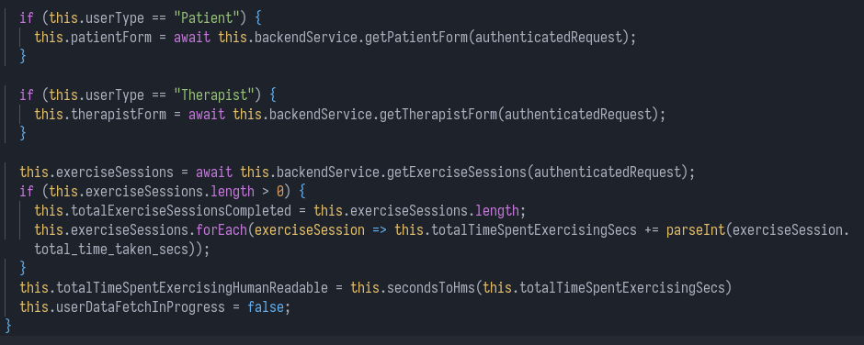
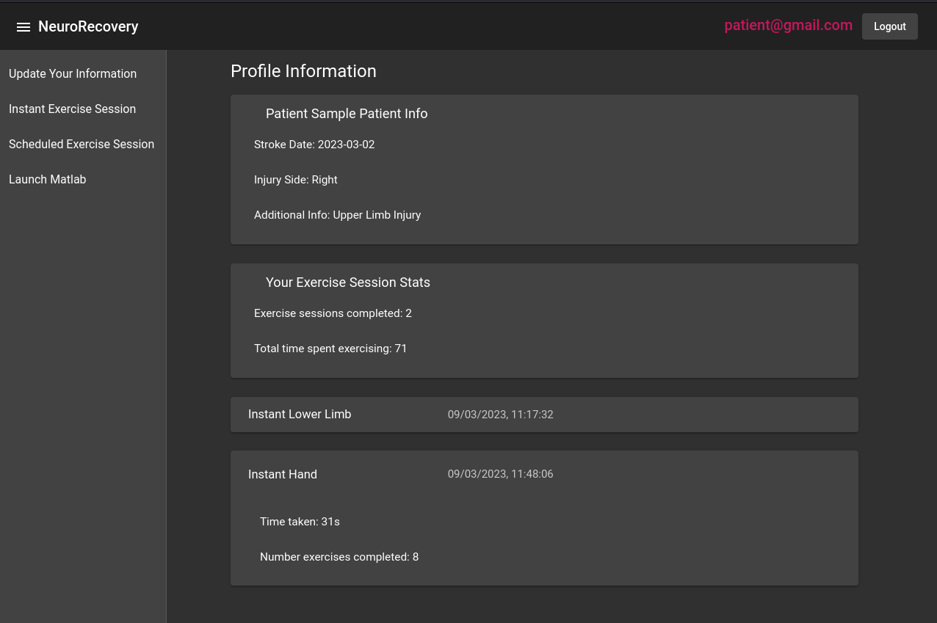
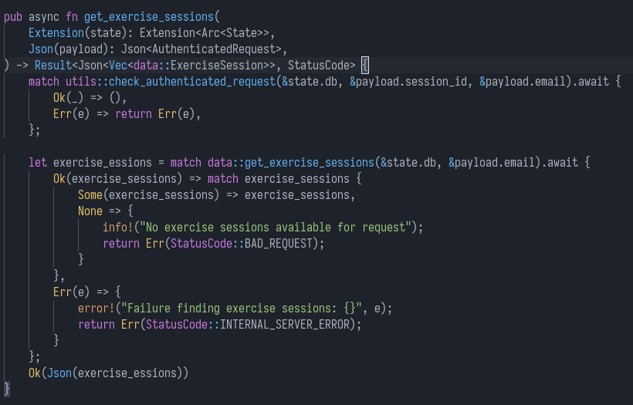
User Statistics
Submitted form information is displayed on user stats page
Exercise session statistics, including total time spent exercising and sessions completed

Slide 7
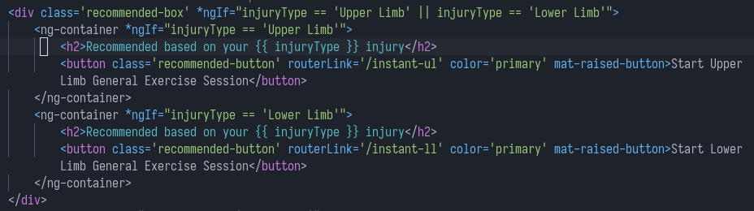
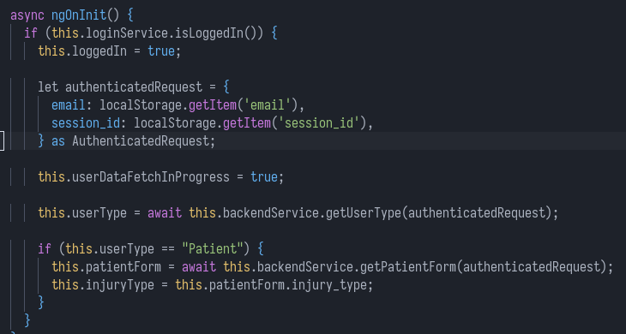
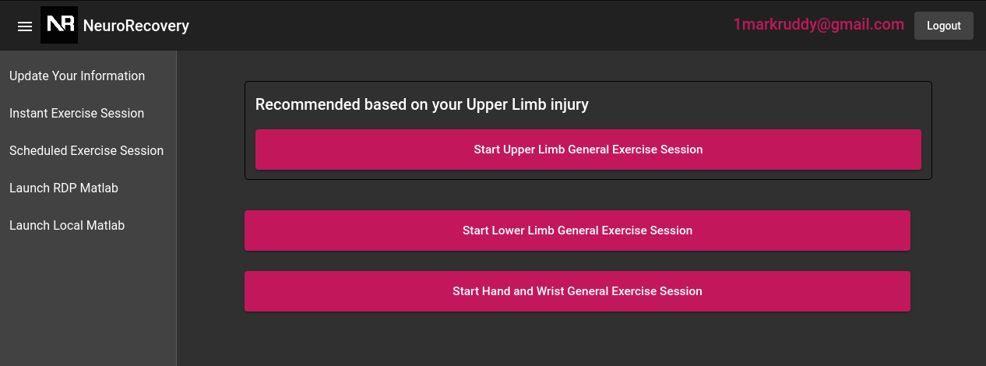
Recommendations
Patient’s form information is used to provide exercise recommendations

Slide 8
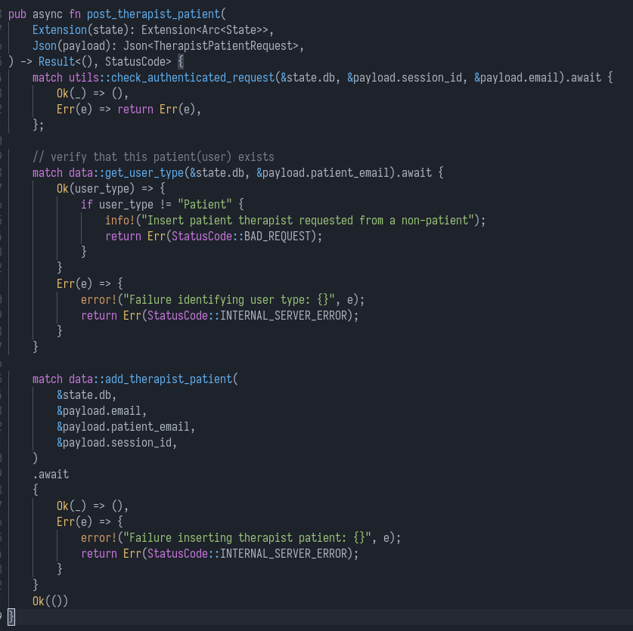
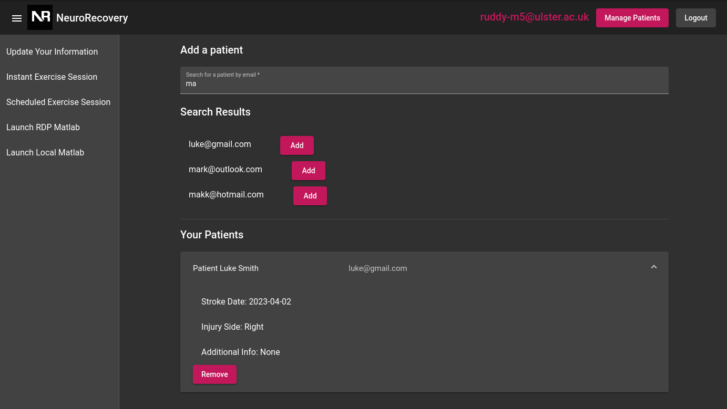
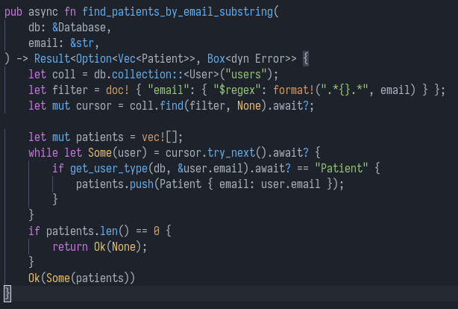
Therapist-Patient Link
Therapist can search patients by email
Therapist can add patients and view their statistics

Slide 9
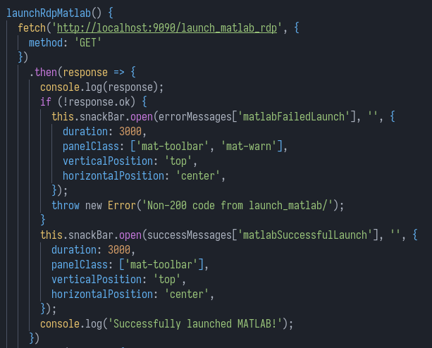
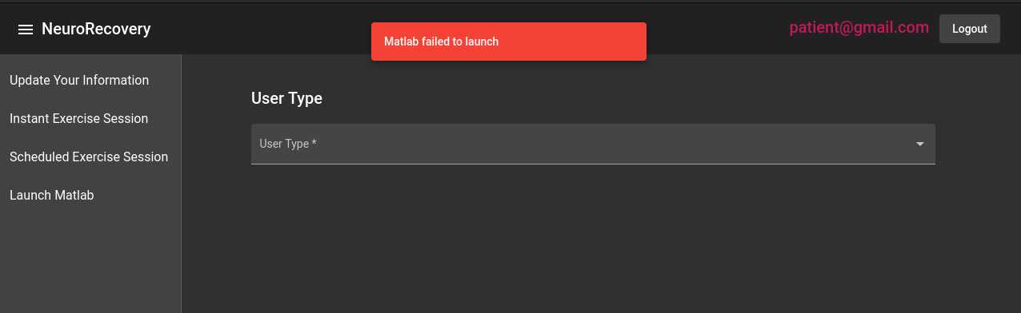
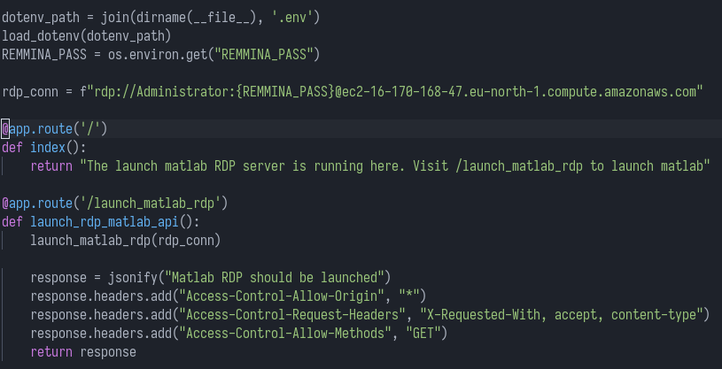
MatLab Psychtoolbox Simulation Integration
Aim is to integrate the NeuroRecovery app with a MatLab Psychtoolbox Simulation
Local Python server on client triggers RDP or Local Matlab program for Psychtoolbox Simulation

Slide 10
Technical Implementation
Frontend is a Typescript Angular SPA
Backend is a Rust Axum server
MongoDB NoSQL database
Hosted in a Kubernetes Cluster(K3s) running in an Azure RHEL Virtual Machine

Slide 11
Frontend is a Typescript Angular SPA
Backend is a Rust Axum server
MongoDB NoSQL database
Hosted in a Kubernetes Cluster(K3s) running in an Azure RHEL Virtual Machine

