Slide 1
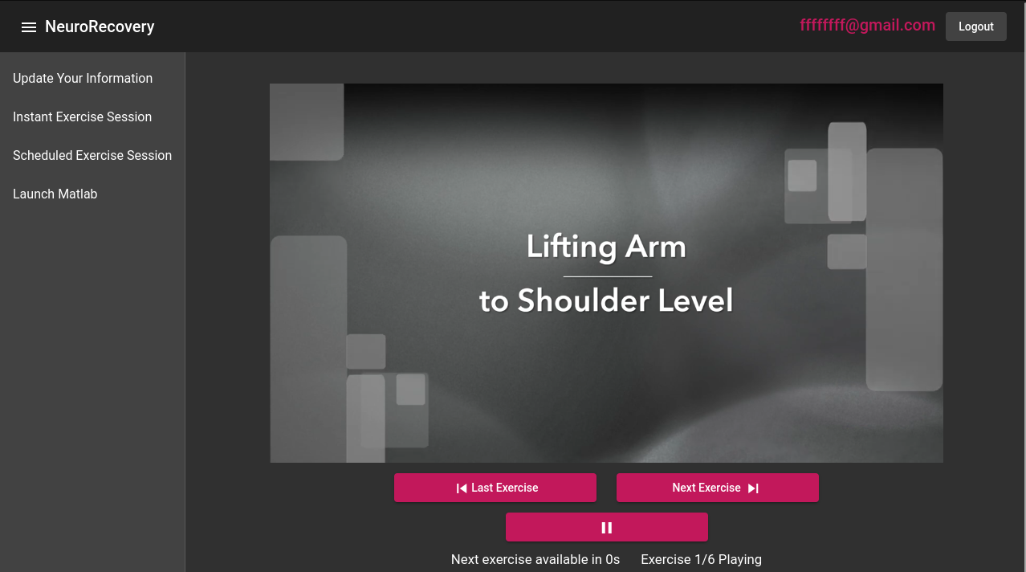
NeuroRecovery App
The NeuroRecovery App assists post-stroke patients with their recovery through a web application

Slide 2
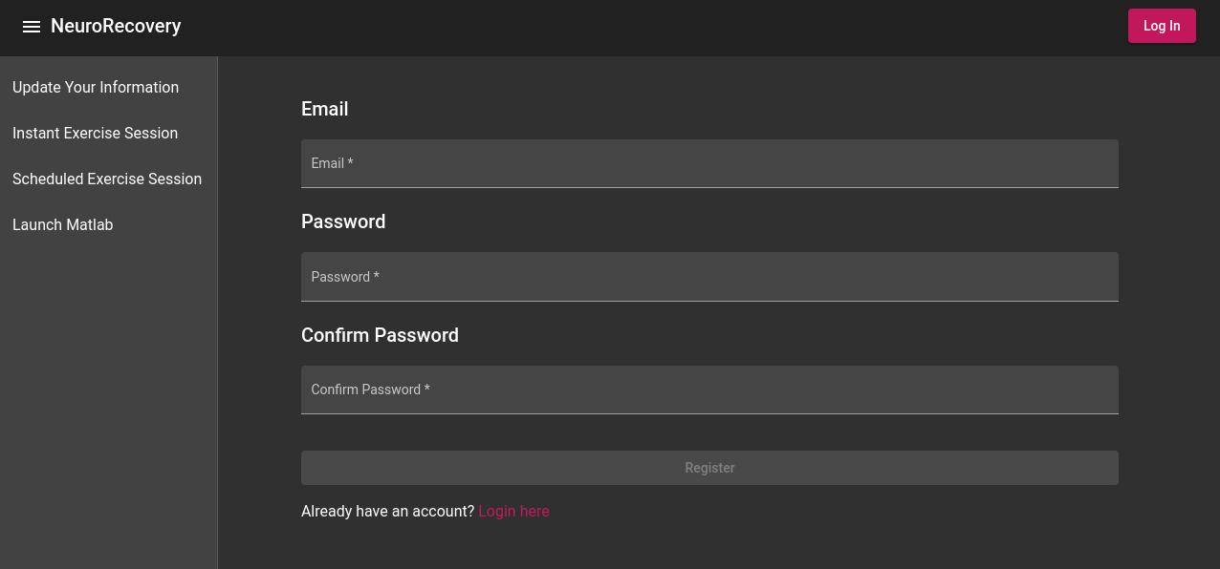
Login/Register System
Email based authentication
Passwords are stored as Argon2id hashes for security
User log in state is stored in browsers localStorage

Slide 3
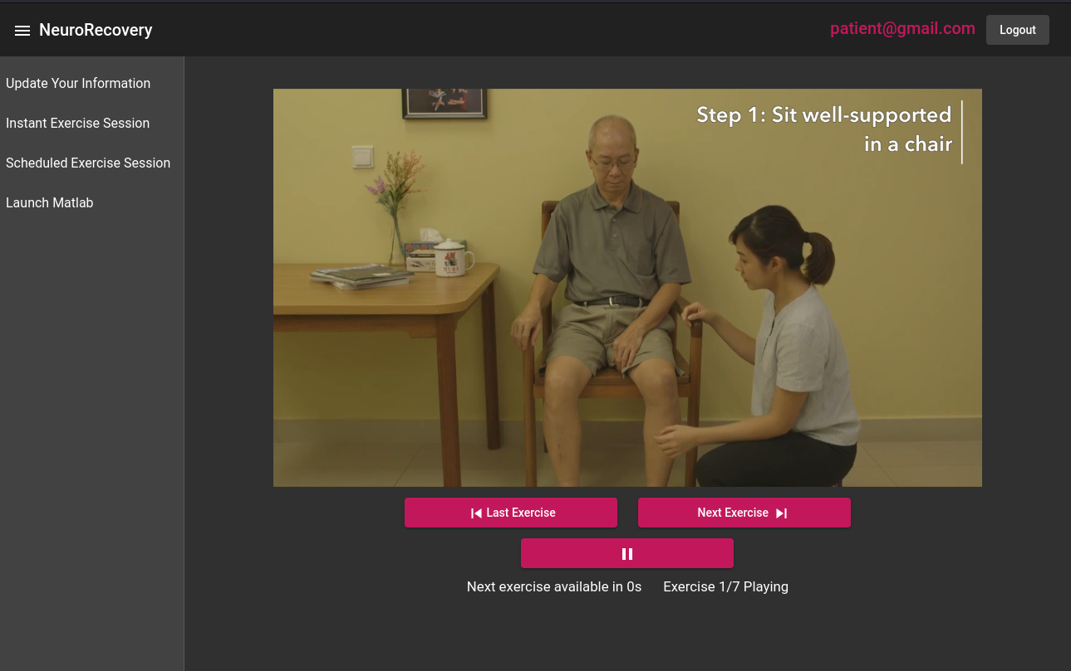
Instant Exercise Sessions
Looped video clips of the exercise being demonstrated
Countdown timer on each exercise before “Next Exercise” can be clicked
Easy to add new videos with an mp4 file and an array of TimeSets

Slide 4
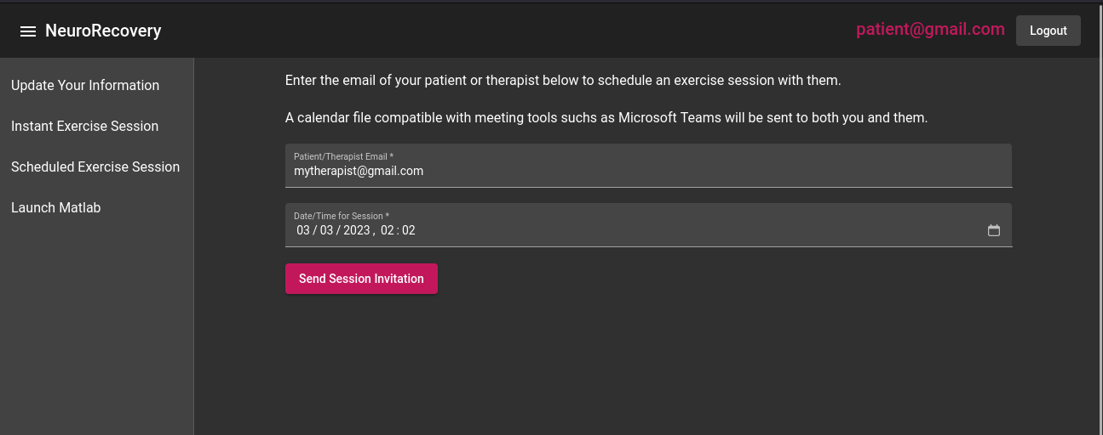
Scheduled Exercise Sessions
Form to enter email of meeting attendee and time
NIY: Backend code uses MailGun API to send email to registered user and the entered form email

Slide 5
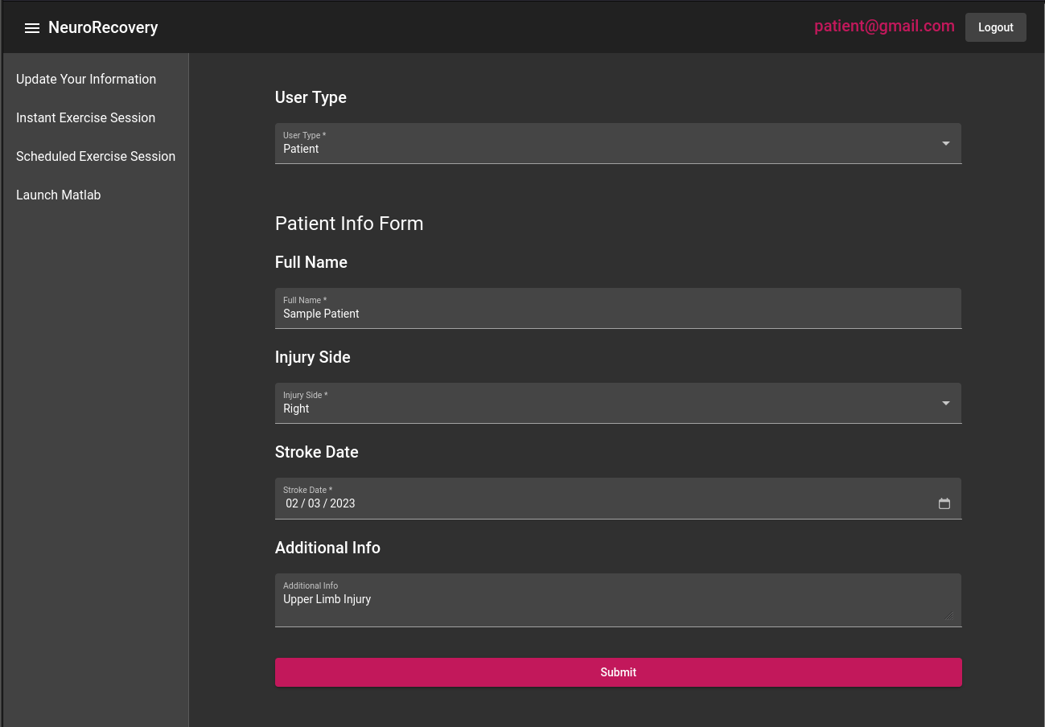
Patient and Therapist User Data Form
Form to submit data on Patient/Therapist information
NIY: Information can be sent to patient’s contact by email

Slide 6
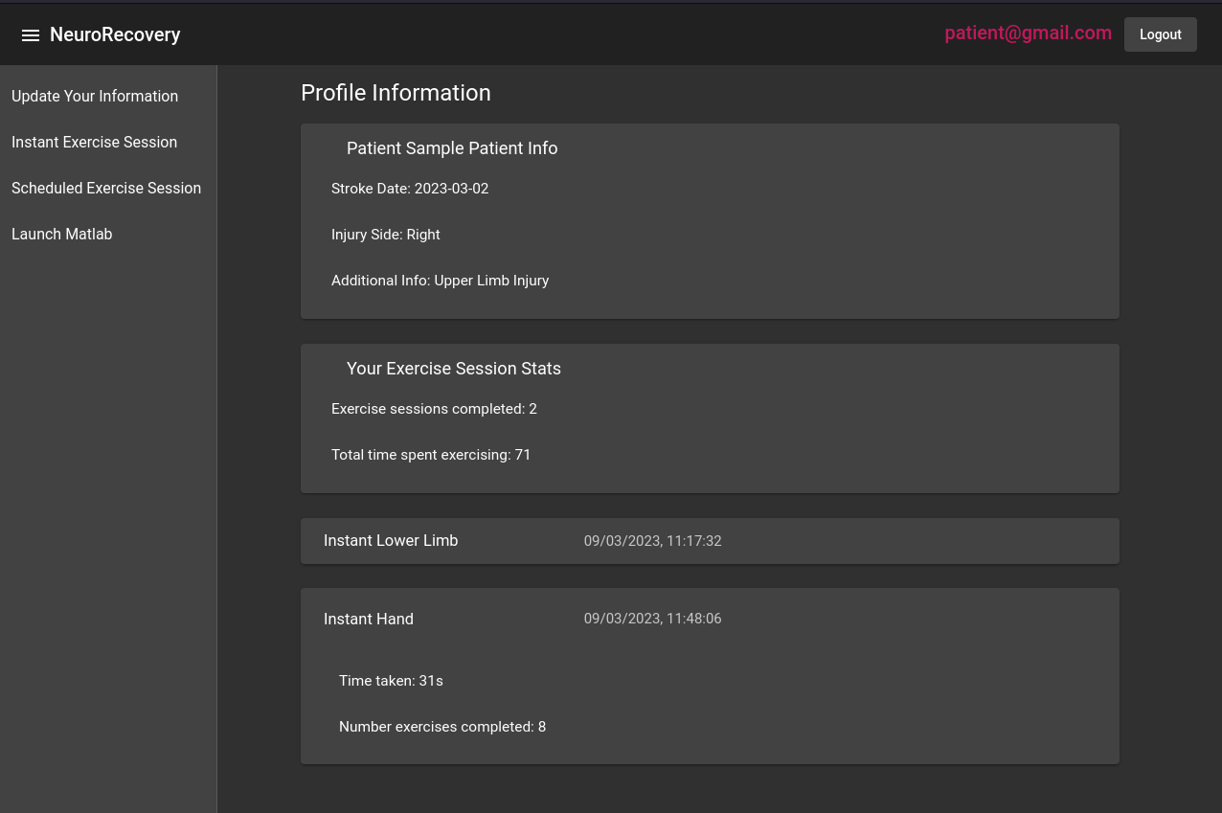
User Stats
Submitted form information is displayed on user stats page
Exercise session statistics, including total time spent exercising and sessions completed
Each exercise session is logged here with the date and time it was completed, how long it took, and number of exercises completed

Slide 7
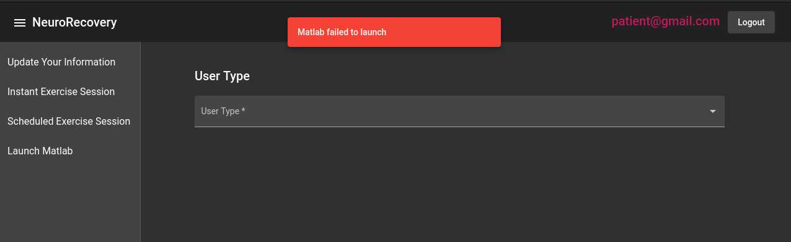
MatLab Psychtoolbox Simulation Integration
Aim is to integrate the NeuroRecovery app with a MatLab Psychtoolbox Simulation
Current proof of concept involves a local Python server running on the computer that has the MatLab simulation installed. This server is then called by the “Launch Matlab” button in the NeuroRecovery App
NIY: Better user experience of jumping straight to simulation. Integration with Matlab drive to make solution portable

Slide 8
Technical Implementation
Frontend is a Typescript Angular SPA
Backend is a Rust Axum server
MongoDB NoSQL database
App is entirely ran in Kubernetes. Currently investigating most cost effective cloud provider to host Kubernetes application on.

Slide 9
Next Features
Matlab integration with a good user experience
Fully supported scheduled exercise sessions
Exercise session statistics with greater granularity
Tailoring of application behaviour to users submitted data, such as recommending different exercise sessions based on injury side for a patient

