Slide 1
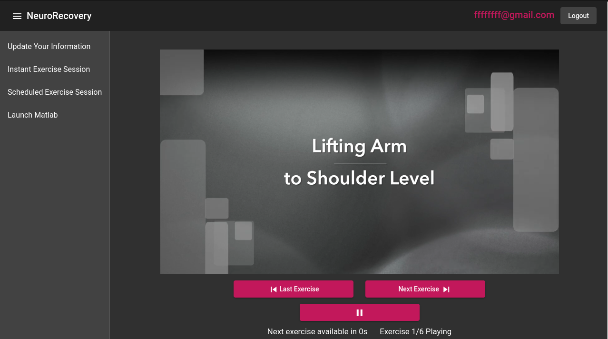
NeuroRecovery App
The NeuroRecovery App assists post-stroke patients with their recovery through a web application

Slide 2
Core Features
Login/Register system with password hashing
Instant exercise sessions
Scheduled exercise sessions
Patient and therapist user data forms
User exercise statistics
Exercise recommendations based on user data
Therapist-Patient link
Matlab Psychtoolbox simulation connection

Slide 3
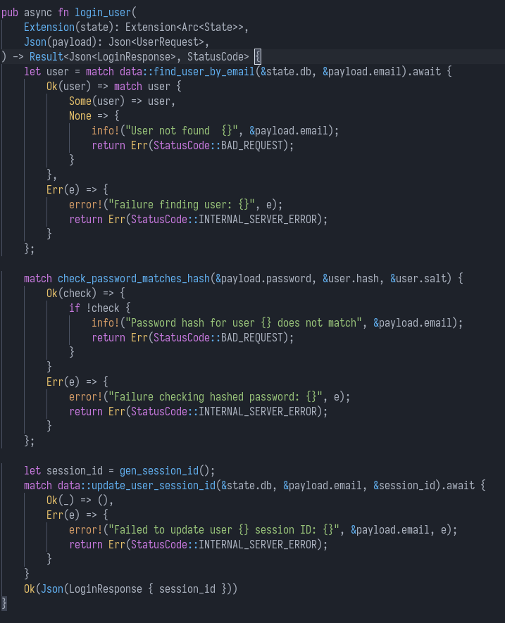
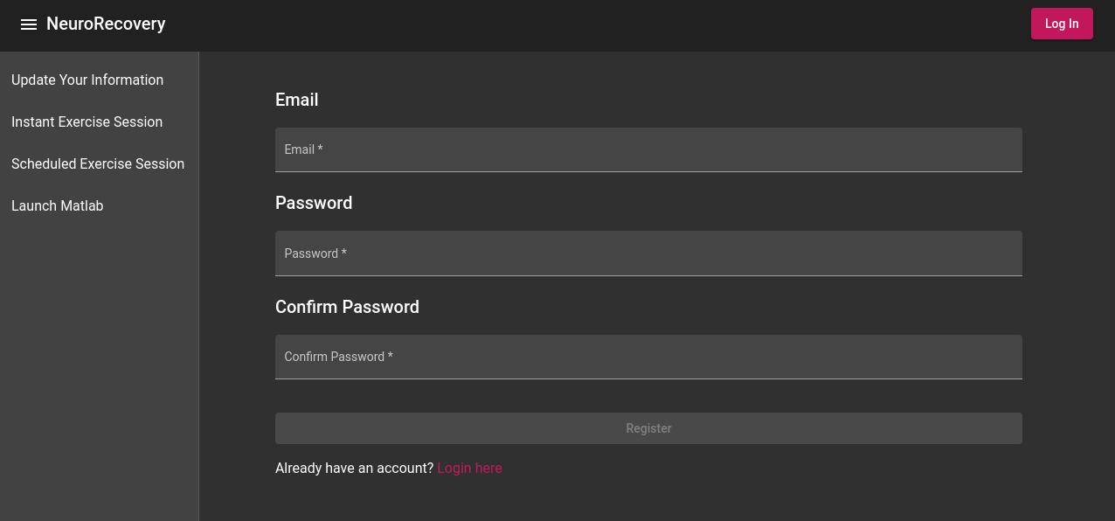
Login/Register System
Email/Password based authentication
Passwords are stored as Argon2id hashes for security
Secure Session ID is stored in browsers localStorage

Slide 4
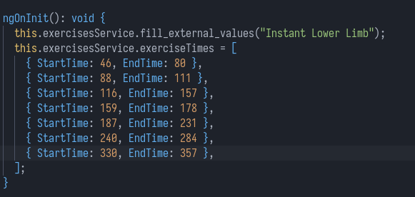
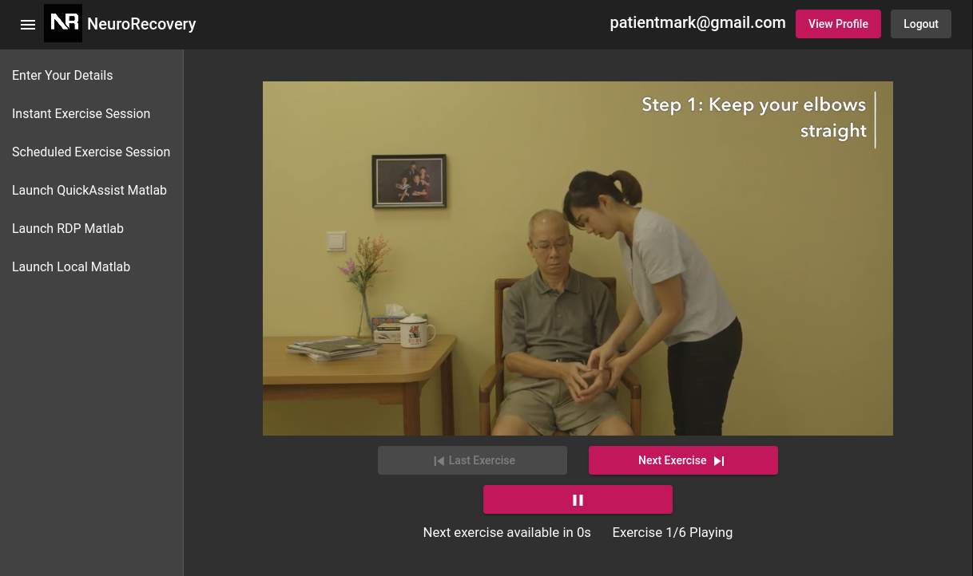
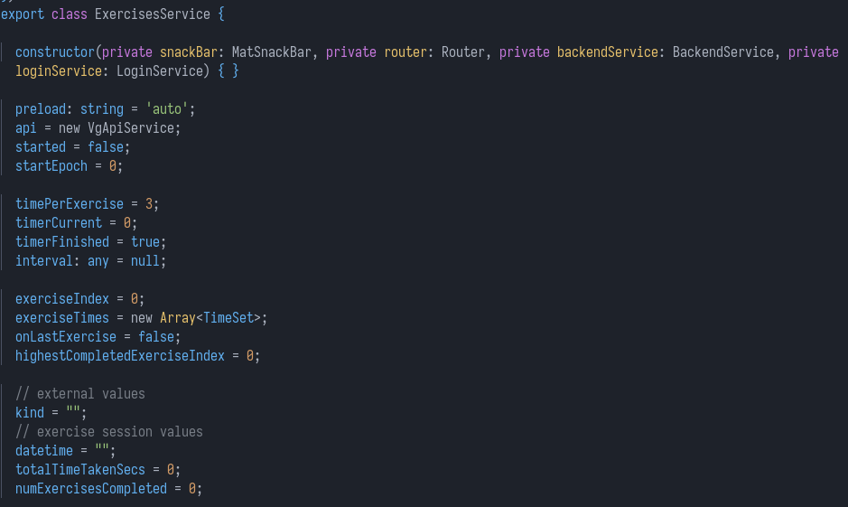
Instant Exercise Sessions
Looped video clips of the exercise being demonstrated
Easy to add new videos with an mp4 file and an array of TimeSets

Slide 5
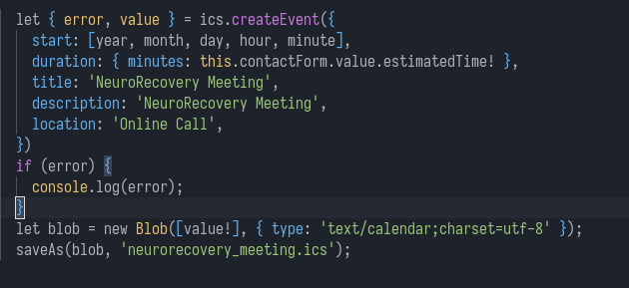
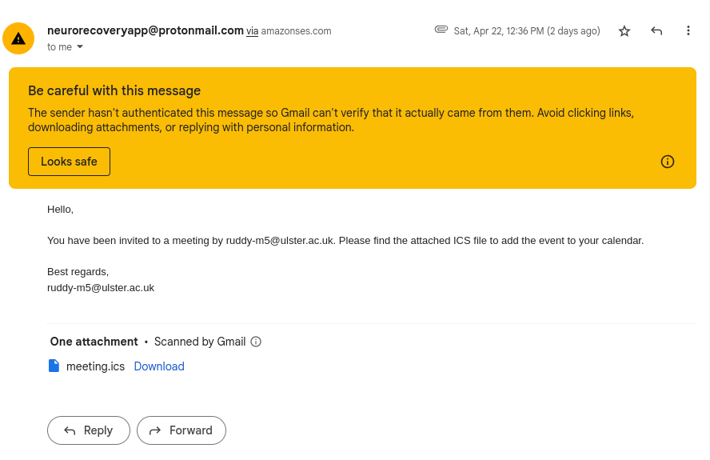
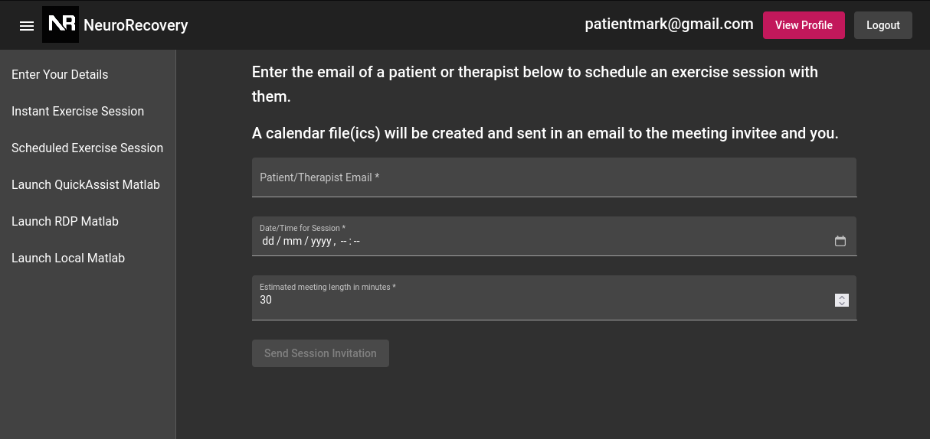
Scheduled Exercise Sessions
Form to enter email of meeting attendee and datetime
Generates ICS calendar file and emails it to both parties

Slide 6
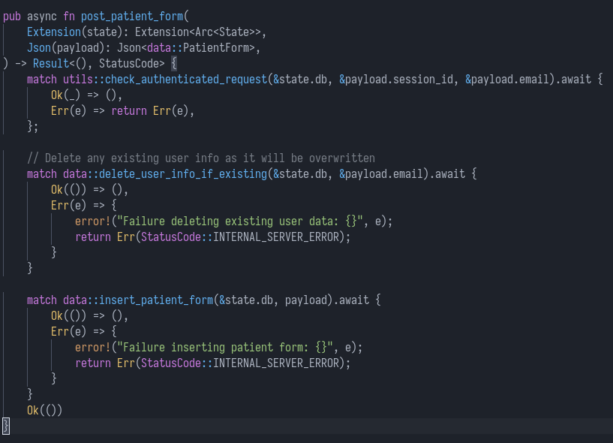
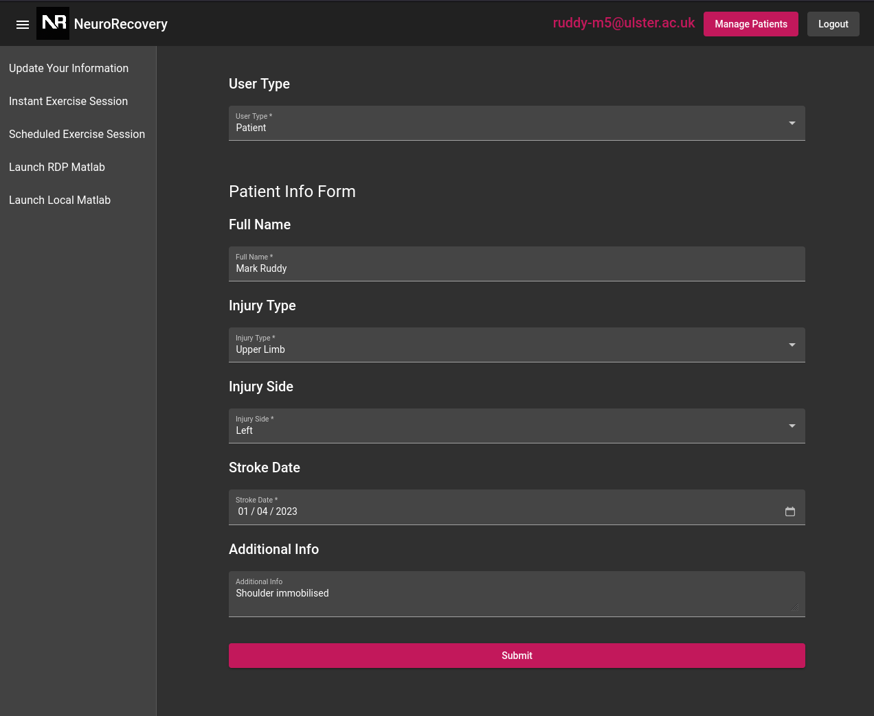
Patient and Therapist User Data Form
Form to submit data on Patient/Therapist information

Slide 7
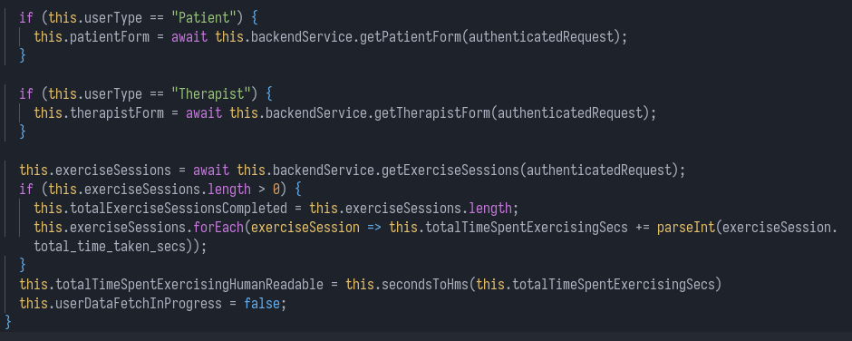
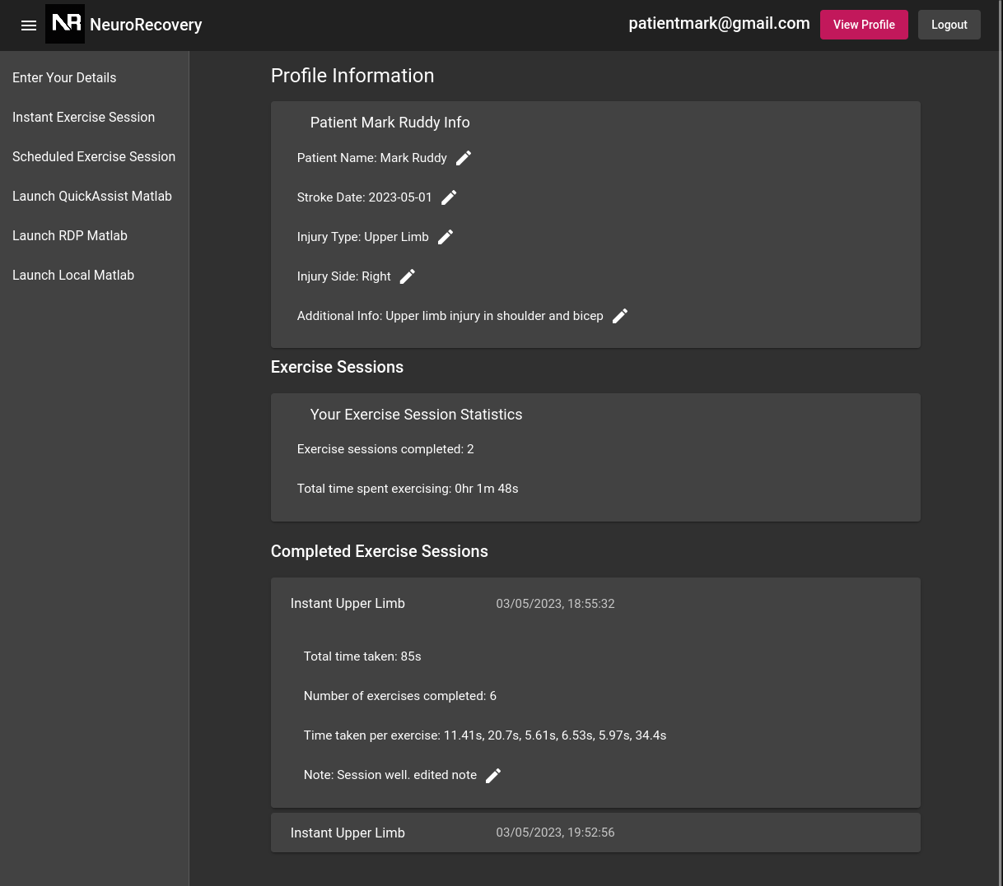
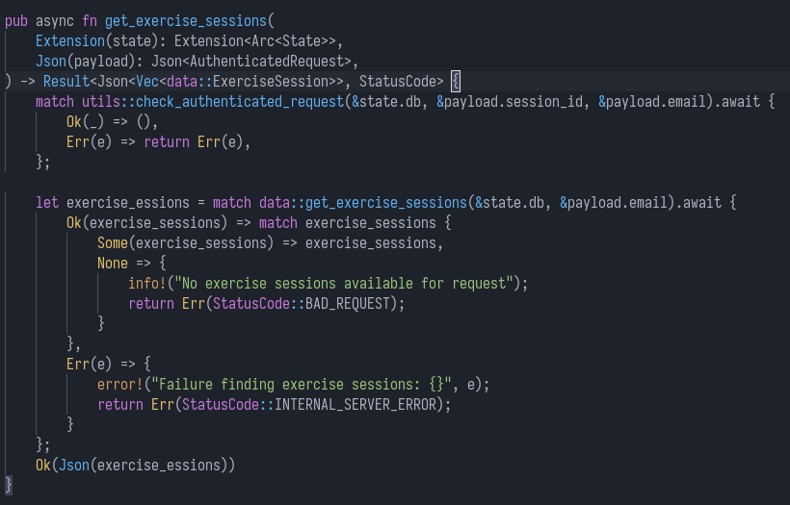
User Statistics
Submitted form information is displayed on user stats page
Exercise session statistics, including total time spent exercising and sessions completed

Slide 8
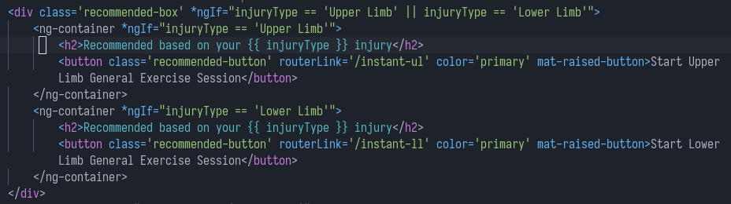
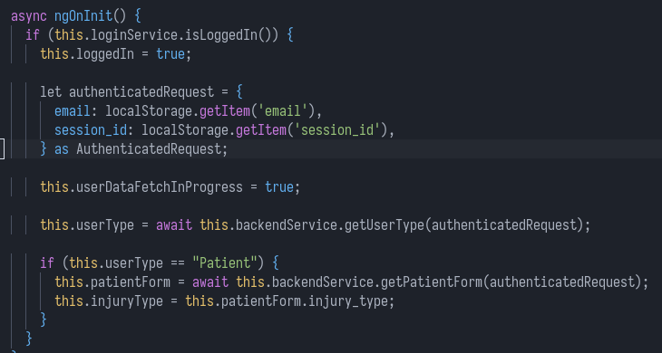
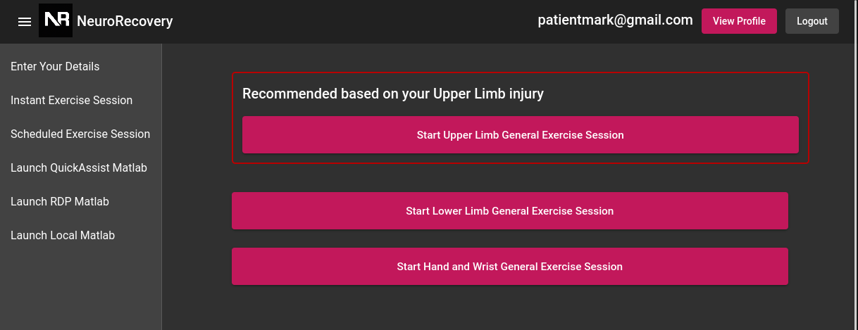
Exercise Recommendations
Patient’s form information is used to provide exercise recommendations

Slide 9
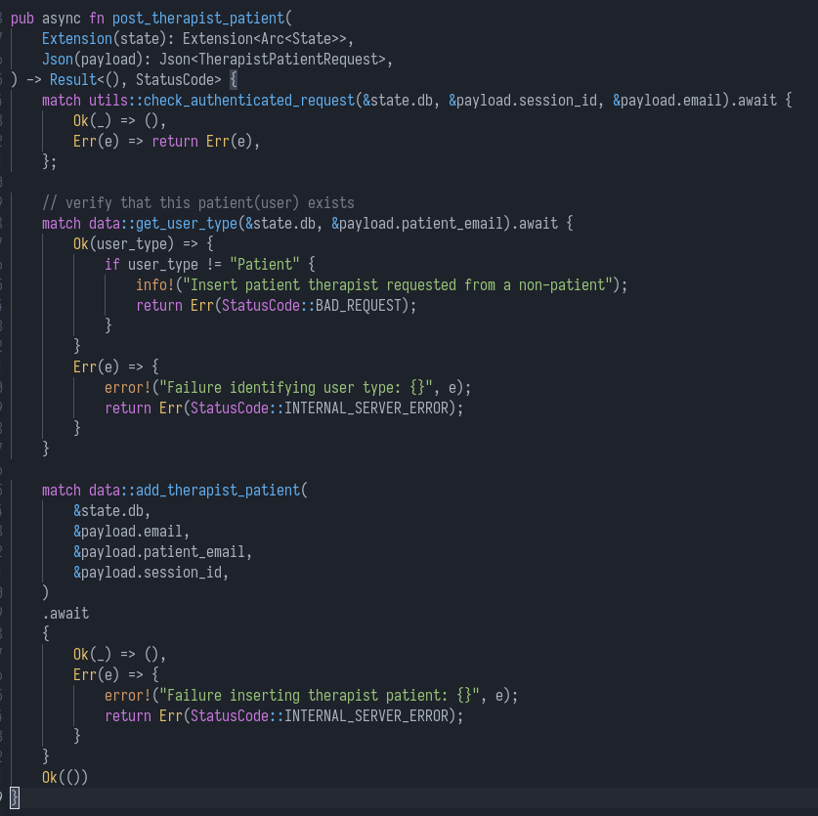
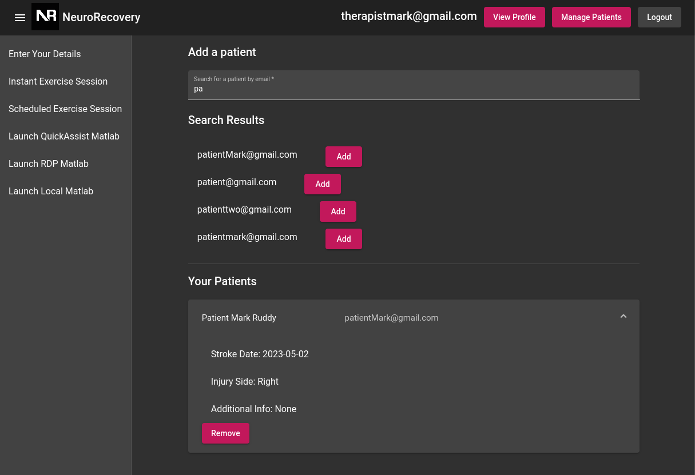
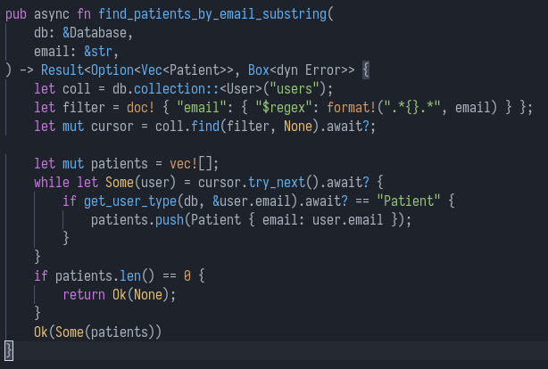
Therapist-Patient Link
Therapist can search patients by email
Therapist can add patients and view their statistics

Slide 10
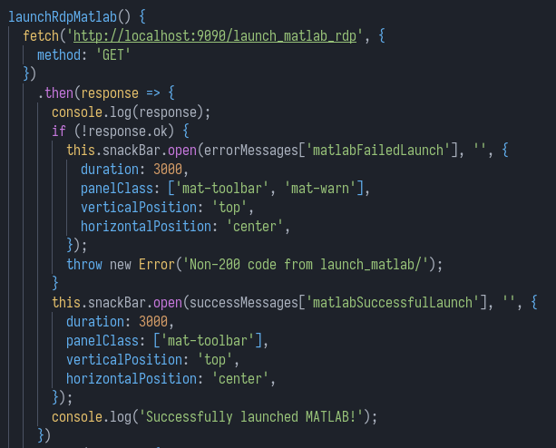
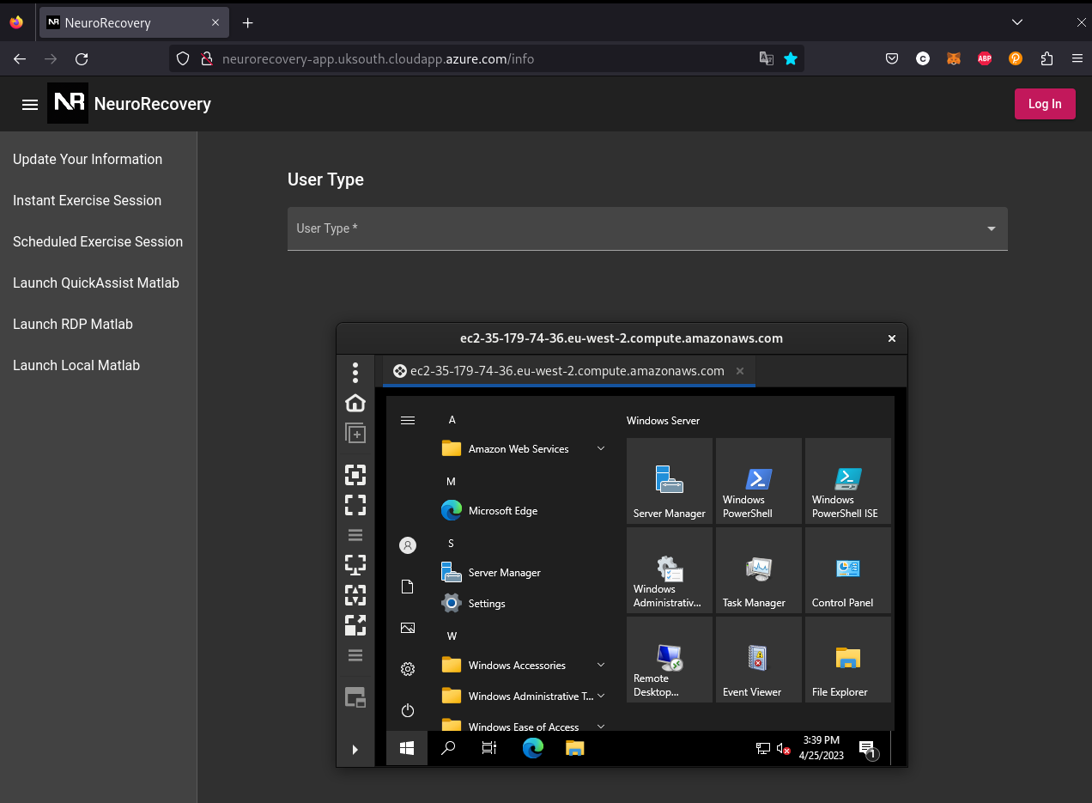
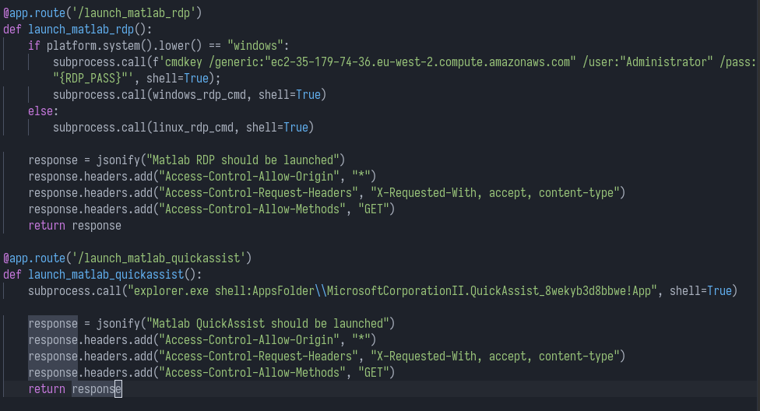
MatLab Psychtoolbox Simulation Integration
NeuroRecovery app provides a frontend button to reach MatLab Psychtoolbox Simulation
Local Python server on client triggers QuickAssist, RDP or Local Matlab program for Psychtoolbox Simulation

Slide 11
Technical Implementation
TypeScript Angular SPA Frontend
Rust Axum Backend
MongoDB NoSQL database
Hosted in a Kubernetes Cluster(K3s) running in an Azure RHEL Virtual Machine
Tilt CI/CD is ran in the VM to provision the full app

Slide 12
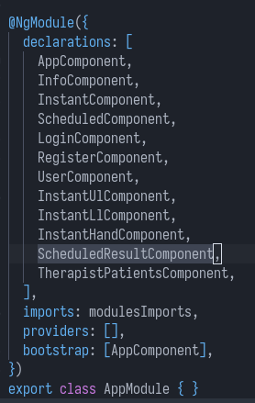
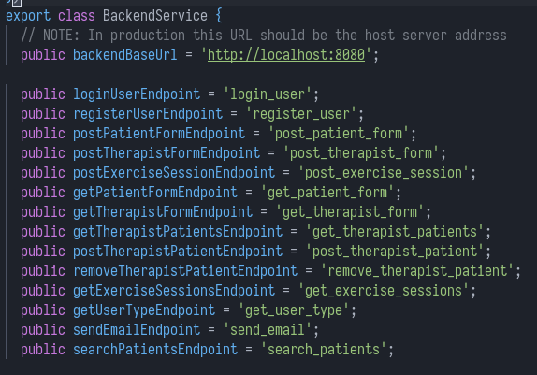
TypeScript Angular SPA Frontend
Single Page Application(SPA) returns a HTML, CSS and JavaScript bundle to user’s browser
Instantaneous page switches when no backend interaction is required
Backend interaction requires requests to be made from the user’s browser using the JavaScript fetch API
Component-based frontend development, each page in the app is a separate component

Slide 13
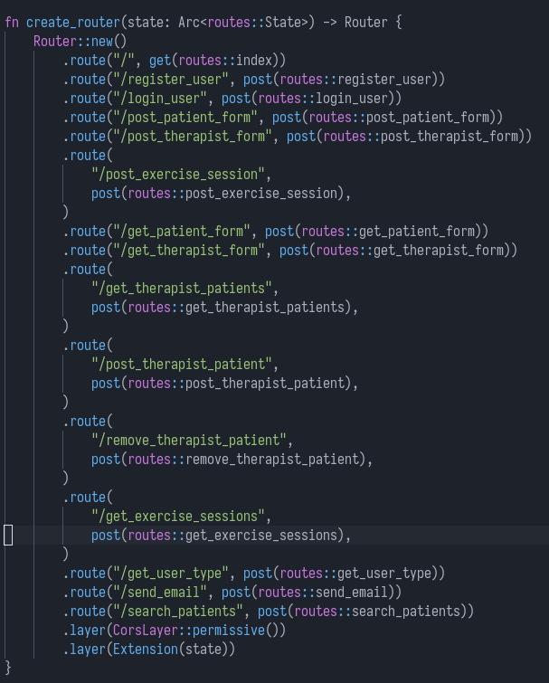
Rust Axum Backend
Rust HTTP API developed with Axum framework
Structs dictate request and response data, which is serialised and deserialised as JSON
Uses mongodb Rust crate for database interaction
Frontend sends requests to the backend defined HTTP endpoints

Slide 14
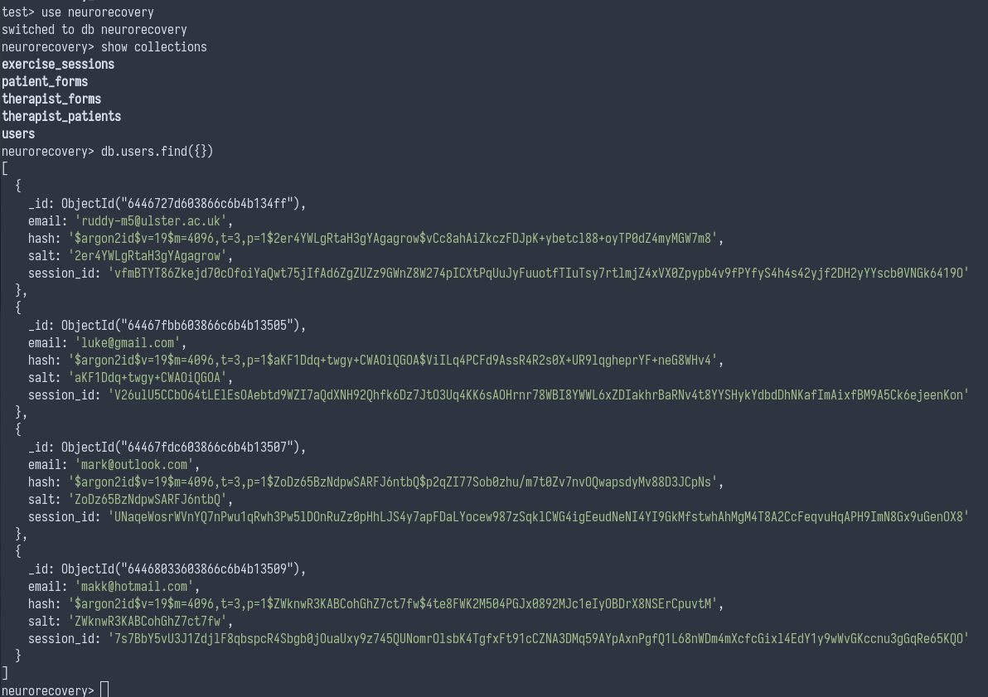
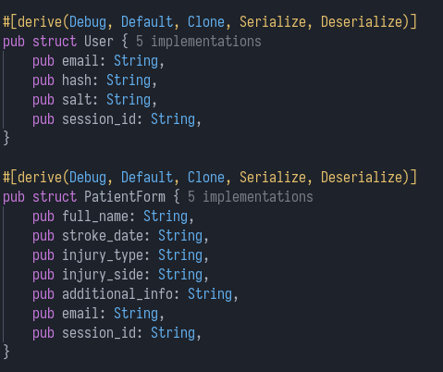
MongoDB NoSQL Database
No explicit database schema is required as MongoDB is a NoSQL database
Rust structs define the data structures that are stored in the database
Only the backend server interacts with the MongoDB database. It is not exposed to the internet and is only accessible from within the Kubernetes cluster

Slide 15
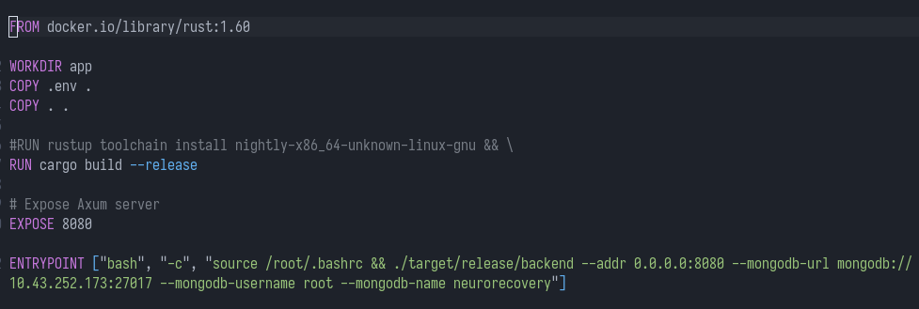
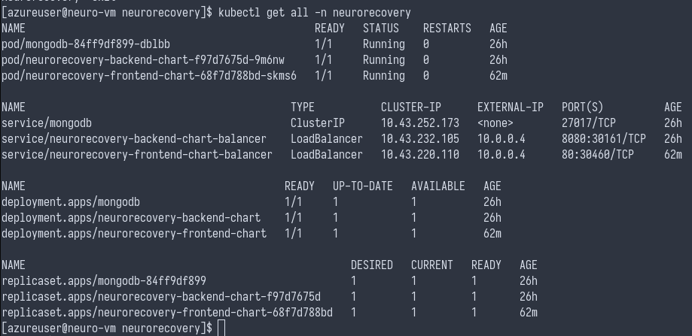
Kubernetes Cluster in Azure VM
Runs in K3s, a lightweight Kubernetes cluster distribution. Hosted in an Azure RHEL VM.
Angular Frontend, Axum Backend, MongoDB all run in separate Docker containers
Docker containers allow for consistent and reproducible deployments of software that won’t be affected by changes on the host machine
Kubernetes is a Container Orchestrator, which provides solutions such as automatic container restarts on failure to create resilient deployments

Slide 16
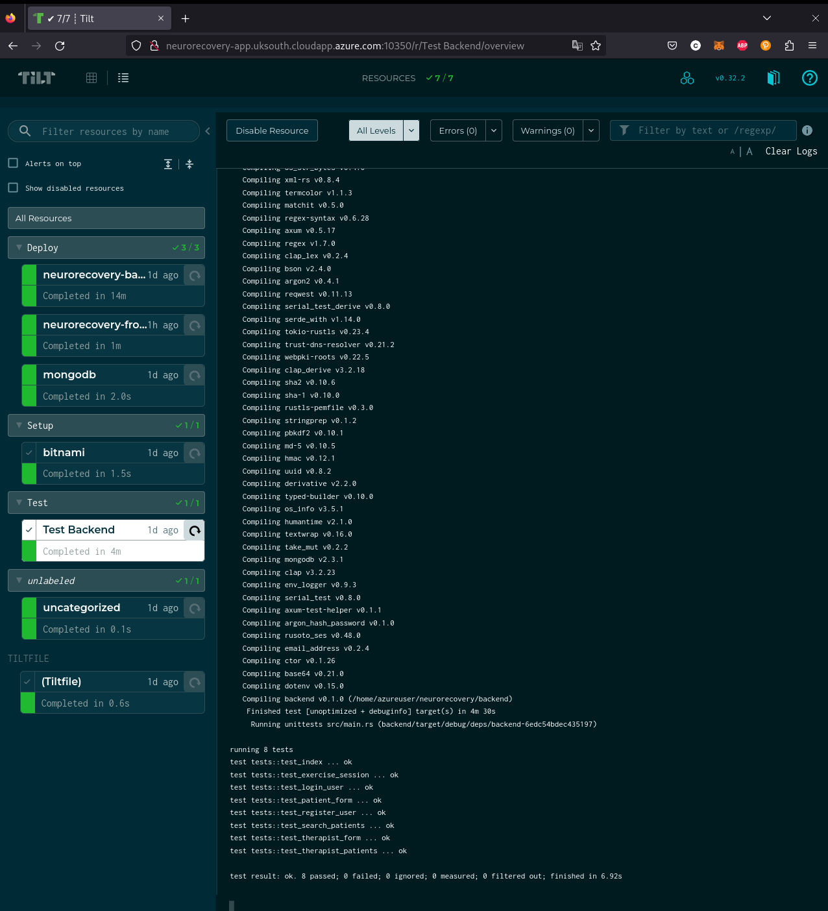
Tilt CI/CD
While Kubernetes and containers provide a solution for running a resilient app deployment, they do not provide a way to boot all of it up automatically
Tilt CI/CD can deploy the entire NeuroRecovery webapp with a single command: “tilt up”
Once running, an admin accessing the Tilt CI/CD dashboard can rebuild each microservice with a click. This allows for fast developer feedback after making code changes.
Automatically runs the Rust Axum backend tests, providing confidence that the code works

