Slide 1

Welcome!
Our session will begin in a few moments. Please review the steps on the screen before we get started.
Click here if you have a question.
Please mute your mic.
Prepare to participate in the session.
Click here to Chat and share comments.
Provide reactions of thumbs up or applause.
Please turn your camera on.

Slide 2

Notes:
https://www.youtube.com/watch?v=7yC6evAfjL4

Slide 3

Diversity, Equity, and Inclusion (DEI) Overview
© 2025 Nordic®. All rights reserved. Confidential. Edition: 01/09/2025

Slide 4

Go to www.menti.com

Slide 5

DEI = Stronger Teams
3.5 times more likely to experience stress and burnout
60% are more likely to leave their jobs within the next year
21% higher profitability
17% higher productivity
5
Source

Slide 6


Diversity
The acceptance and celebration of visible differences such as race, age, and religion and invisible differences such as diversity of thought and education status.
6

Slide 7


Inclusion
Building a work environment where all individuals feel respected, accepted, supported, and valued, and diverse individuals are able to participate fully in decision-making processes and development opportunities.
7

Slide 8



Equity
Ensuring fair access to opportunity, information, and resources, all while striving to identify and eliminate unfair biases, stereotypes, or barriers that may inadvertently exclude underrepresented employees.
8

Slide 9

Equity
Ensuring fair access to opportunity, information, and resources, all while striving to identify and eliminate unfair biases, stereotypes, or barriers that may inadvertently exclude underrepresented employees.
9

Slide 10

MAXIMS

Slide 11
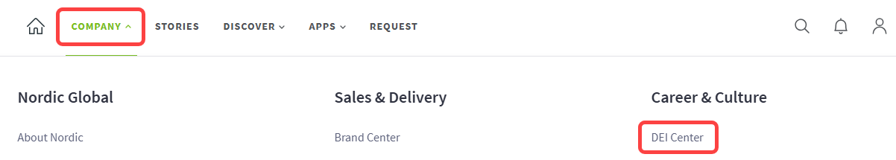

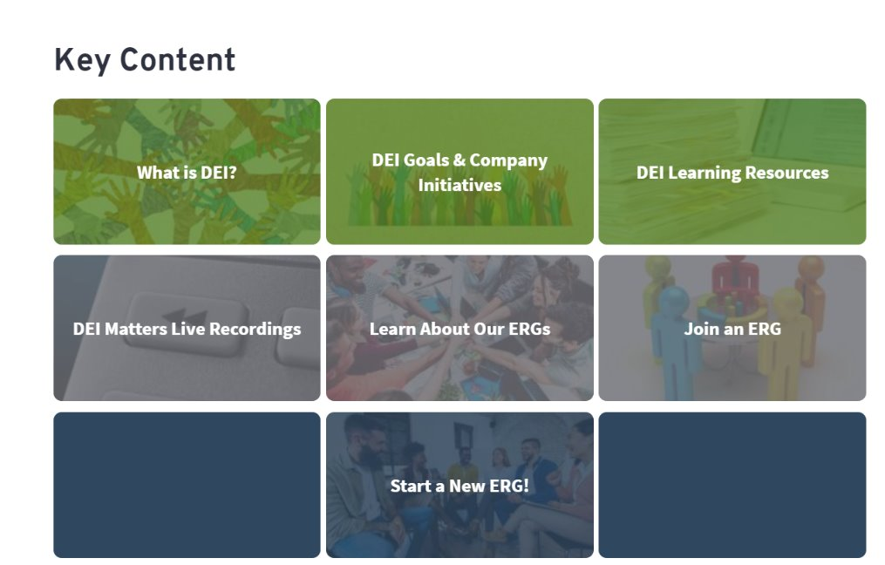
DEI Center

Slide 12
Go to www.menti.com

Slide 13




ERGs at Nordic

Slide 14

What Our ERGs Do
Membership meetings
Cigna EAP (Employee Assistance Program) sessions
Cultural Heritage Month programs
ERG Leadership Summit
14

Slide 15

DEI in Action
Share Your Pronouns
Use Inclusive Language
Avoid Assumptions about Others
Understand Colleagues’ Communication Styles
Speak Up Against Exclusion
Share Opportunities with Diverse Communities
Learn about DEI

Slide 16

Thank you
Click to complete the course evaluation

