Slide 1


Python Fundamentals
Environment setup, data types, console I/O, modern f-string formatting, and practical Mad Libs generators using str.format().

Slide 2

Setup & Prerequisites
Option 1: Online IDE (Zero Install)
Option 2: Local VS Code + Python
Run code instantly in your web browser without local configuration:
Standard professional workflow for persistent project files:
# 1. Open in any browser:
https://www.onlinegdb.com/
# 2. Select Language dropdown: "Python 3"
# 3. Write code directly into editor window
# 4. Click "Run" or press F9 to execute
print
"Hello from OnlineGDB!"
# Step 1: Install Python runtime from python.org
# Ensure "Add Python to PATH" is checked during setup
# Step 2: Install VS Code & official "Python" extension
# Step 3: Verify installation in VS Code Terminal:
# Output: Python 3.11.x (or newer)
Best for quick classroom demos and machines without admin privileges.
Required for local file management, modules, and full debug tooling.

Slide 3




Course Progression
2. Core Types
4. Mad Libs Project
Master str, int, float, bool with runtime casting.
Assemble interactive story generators using parsed inputs.
1. Prerequisites
3. String Formatting
Configure OnlineGDB or local Python with VS Code editor.
Compare inline f"" expressions with .format() templates.

Slide 4
Primitive Data Types
Type | Keyword | Assignment Example | Runtime Result | Practical Use Case
String | str | lang = "Python 3" | 'Python 3' | Textual data, usernames, sentences.
Integer | int | count = 42 | 42 | Whole quantities, iterations, counters.
Float | float | score = 98.75 | 98.75 | Measurements, prices, rates, scientific data.
Boolean | bool | is_valid = True | True | Conditional flags, state checks, logic branches.

Slide 5

Type Checking & Casting
Type Inspection Examples
Explicit Conversion Examples
Determine variable types dynamically using type() or isinstance():
Convert incompatible data types using explicit constructor functions:
# Inspect variable type
100
print
type
#
# Safe inheritance validation
print
isinstance
int
# True
print
isinstance
float
# False
# String to Numeric
int
"24"
# Result: 24 (int)
float
"3.14"
# Result: 3.14 (float)
# Numeric to String
"Score: "
str
99
# Result: "Score: 99"
bool
1
# Result: True

Slide 6


Reading Input: input()
▸
input("Prompt: ") always captures terminal input as a str.
▸
Arithmetic performed directly on raw input triggers a TypeError.
▸
Wrap immediately in int() or float() for numeric computations.
# Capturing string input
input
"Enter name: "
# User enters: Alex -> player = "Alex"
# Capturing and casting integer input
int
input
"Item count: "
# User enters: 5 -> items = 5
10
print
"Total coins:"
# Output: Total coins: 50

Slide 7
Console Output: print()
Parameter / Feature | Python Code Example | Console Output | Operational Behavior
Default Arguments | print("Item:", 42, True) | Item: 42 True | Separates multiple arguments with a single space.
Custom Separator (sep) | print("2026", "09", "12", sep="-") | 2026-09-12 | Replaces default space delimiter with specified string.
Custom End (end) | print("Loading", end="..."); print("Done!") | Loading...Done! | Replaces trailing newline (\n) with custom ending.
Escape Characters | print("Line 1\nLine 2\tTabbed") | Line 1 Line 2 Tabbed | Interprets special characters like newlines and tabs.

Slide 8


f-String Syntax Examples
Basic Variable Insertion: Prepend literal with f and place variables inside braces.
name = "Sam"; print(f"Hello, {name}!") ➔ Hello, Sam!
Inline Expressions & Methods: Compute math or execute string operations directly inside {}.
a, b = 10, 5; print(f"Sum: {a + b}, Upper: {name.upper()}") ➔ Sum: 15, Upper: SAM
Float Precision Specifier: Constrain floating point decimal outputs via :.Nf.
price = 19.458; print(f"Price: ${price:.2f}") ➔ Price: $19.46
Text Alignment & Padding: Align strings with width parameters like :>10 or :<10.
qty = 7; print(f"Count: [{qty:>5}]") ➔ Count: [ 7]

Slide 9
The str.format() Method
Positional & Index Arguments
Keyword Placeholders
Values populate empty braces {} sequentially or by explicit zero-based index {0}:
Assign identifiers inside placeholders for self-documenting template patterns:
# Sequential replacement
"{} scored {} points"
format
"Elena"
92
# Output: 'Elena scored 92 points'
# Positional index reordering
"{1} comes before {0}"
format
"B"
"A"
# Output: 'A comes before B'
# Explicit keyword mapping
"Player {hero} has {hp} HP."
format
"Arthur"
100
# Output: 'Player Arthur has 100 HP.'
# Precision formatting with format()
print
"Val: {:.2f}"
format
5.6789
# Val: 5.68

Slide 10
f-Strings vs str.format()
Comparison Criterion | f-Strings (f"...") | str.format() Method
Syntax Form | f"User: {name}, Age: {age}" | "User: {}, Age: {}".format(name, age)
Evaluation Timing | Evaluated immediately at line execution. | Evaluated whenever .format() is invoked.
Variable Scope | Must access variables existing in current scope. | Templates can be stored in files/constants first.
Execution Speed | Fastest (compiled into bytecode directly). | Slightly slower (function call overhead).
Best Applied To | Immediate console output and inline scripts. | Stored localization files and reusable templates.

Slide 11
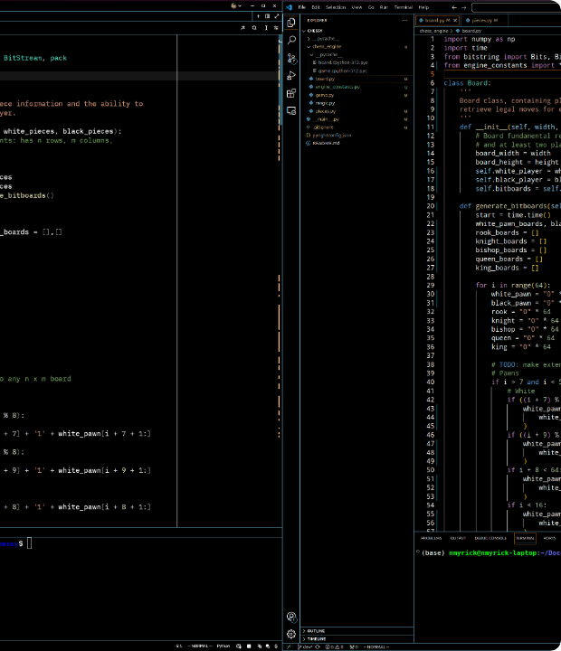
Mad Libs Architecture
Sequential Execution Flow
Step 1: Prompt user inputs for words (nouns, adjectives, verbs, numbers).
Step 2: Cast inputs requiring calculations to int or float.
Step 3: Inject variables into a pre-written story template via f"" or .format().
Step 4: Print the formatted narrative directly to the terminal.

Slide 12
Mad Libs: f-Strings Script
Complete Python Script
Sample Terminal Interaction
# 1. Gather word inputs
input
"Enter an adjective: "
input
"Enter a creature: "
input
"Enter a verb (action): "
int
input
"Enter hours (number): "
# 2. Render story via f-string
f"Today, a {adj} {noun} decided to "
f"{verb} across campus for {hours} hours!"
print
"\n--- YOUR STORY ---"
print
Enter an adjective: energetic Enter a creature: robot Enter a verb (action): sprint Enter hours (number): 3 --- YOUR STORY --- Today, a energetic robot decided to sprint across campus for 3 hours!
# Calculation inside f-string:
print
f"Minutes spent: {hours * 60}"
# Output: Minutes spent: 180

Slide 13
Mad Libs: format() Script
Complete Python Script
Sample Terminal Interaction
# 1. Define decoupled template string
"Captain {pilot} flew the {ship} into a "
"{hazard} sector, saving {crew} officers!"
# 2. Collect user values
input
"Captain name: "
input
"Spaceship name: "
input
"Danger (hazard): "
int
input
"Crew count: "
# 3. Supply keyword arguments
format
print
Captain name: Sarah Spaceship name: Nebula Voyager Danger (hazard): solar flare Crew count: 12 Captain Sarah flew the Nebula Voyager into a solar flare sector, saving 12 officers!
# Advantage: Template remains reusable
# template.format(...) can be called again
# with alternative inputs without redefining.

Slide 14
Common Errors & Solutions
TypeError on Raw input(): age = input(); age + 5 fails because age is a string.
Fix: age = int(input("Age: ")); print(age + 5)
ValueError on Non-numeric Input: int("apple") crashes immediately with a ValueError.
Fix: Validate text with str.isdigit() before casting to numeric types.
Quote Collision in f-Strings: f"{info['name']}" works; f"{info["name"]}" creates a syntax error in older Python.
Fix: Alternate between single and double quotes inside expressions.
Escaping Literal Braces: Printing literal {} inside f-strings or format strings.
Fix: Double the brackets: f"Set: {{1, 2, 3}}" outputs Set: {1, 2, 3}.

Slide 15
Practice Challenges
1. Receipt Printer: Ask for item name, price (float), and qty (int); print a receipt using f-strings with :.2f alignment.
2. Mad Libs Replay: Build a 5-variable Mad Libs script and implement both f"" and str.format() versions.

Slide 16


Image Sources
https://i.sstatic.net/9q98Y.png
Source: stackoverflow.com
https://preview.redd.it/vscode-dark-high-contrast-theme-v0-jknlvljg35fd1.png?width=3771&format=png&auto=webp&s=0498e42dfbefda0dc9eb0c6149513c5df07b90a1
Source: www.reddit.com

