Slide 1

Python

Slide 2
Control Flow
Conditional statements (if, elif, else)
Loops (for, while)
Notes:
Ngayon naman aaralin natin kung paano nagdedesisyon ang isang program at paano ito paulit-ulit gumagawa ng isang task gamit ang loops.

Slide 3
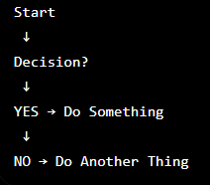
What is Control Flow?
Control Flow determines the order in which Python executes instructions.
Notes:
Isipin natin parang traffic light. Depende sa kondisyon, iba ang magiging daan ng program.

Slide 4
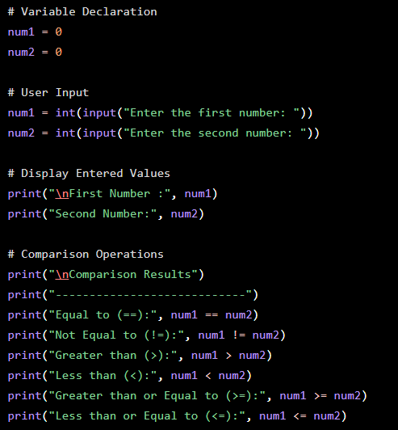
Notes:
# Comparison Operators with Variable Declaration and User Input
# Variable Declaration
num1 = 0
num2 = 0
# User Input
num1 = int(input("Enter the first number: "))
num2 = int(input("Enter the second number: "))
# Display Entered Values
print("\nFirst Number :", num1)
print("Second Number:", num2)
# Comparison Operations
print("\nComparison Results")
print("----------------------------")
print("Equal to (==):", num1 == num2)
print("Not Equal to (!=):", num1 != num2)
print("Greater than (>):", num1 > num2)
print("Less than (<):", num1 < num2)
print("Greater than or Equal to (>=):", num1 >= num2)
print("Less than or Equal to (<=):", num1 <= num2)

Slide 5
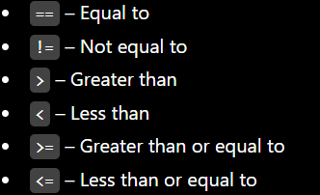
Comparison Operators
Symbol used to compare two values. It returns True if the comparison is correct and False if it is not.
Notes:
Comparison operators compare two values and return either True or False based on the result.

Slide 6
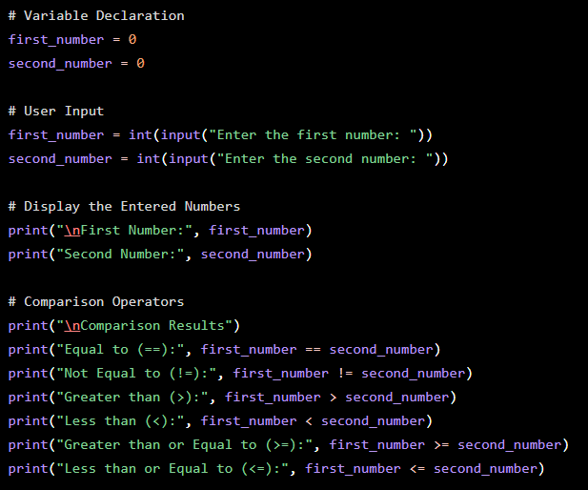
Notes:
# Program: Comparison Operators with Variable Declaration and User Input
# Variable Declaration
first_number = 0
second_number = 0
# User Input
first_number = int(input("Enter the first number: "))
second_number = int(input("Enter the second number: "))
# Display the Entered Numbers
print("\nFirst Number:", first_number)
print("Second Number:", second_number)
# Comparison Operators
print("\nComparison Results")
print("Equal to (==):", first_number == second_number)
print("Not Equal to (!=):", first_number != second_number)
print("Greater than (>):", first_number > second_number)
print("Less than (<):", first_number < second_number)
print("Greater than or Equal to (>=):", first_number >= second_number)
print("Less than or Equal to (<=):", first_number <= second_number)

Slide 7
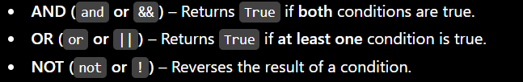
Logical Operators
To combine or modify multiple conditions. It returns True or False based on the logical relationship between the conditions.
Notes:
Isipin natin parang traffic light. Depende sa kondisyon, iba ang magiging daan ng program.

Slide 8
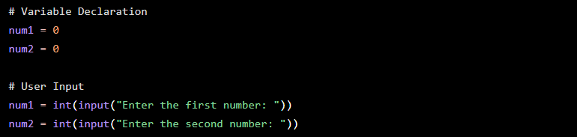
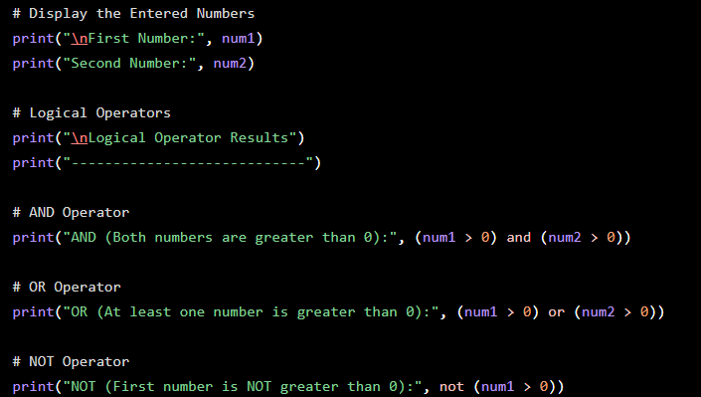
Notes:
# Program: Logical Operators with Variable Declaration and User Input
# Variable Declaration
num1 = 0
num2 = 0
# User Input
num1 = int(input("Enter the first number: "))
num2 = int(input("Enter the second number: "))
# Display the Entered Numbers
print("\nFirst Number:", num1)
print("Second Number:", num2)
# Logical Operators
print("\nLogical Operator Results")
print("----------------------------")
# AND Operator
print("AND (Both numbers are greater than 0):", (num1 > 0) and (num2 > 0))
# OR Operator
print("OR (At least one number is greater than 0):", (num1 > 0) or (num2 > 0))
# NOT Operator
print("NOT (First number is NOT greater than 0):", not (num1 > 0))

Slide 9
Conditional Statements
Used to make decisions in a program. They execute different blocks of code depending on whether a condition is True or False.
if – Executes a block of code if the condition is true.
elif – Checks another condition if the previous condition is false.
else – Executes a block of code if none of the conditions are true.
Notes:
used to make decisions in a program. They execute different blocks of code depending on whether a condition is True or False.
if – Executes a block of code if the condition is true.
elif – Checks another condition if the previous condition is false.
else – Executes a block of code if none of the conditions are true.

Slide 10
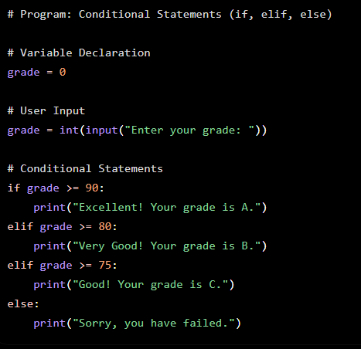
Notes:
# Program: Conditional Statements (if, elif, else)
# Variable Declaration
grade = 0
# User Input
grade = int(input("Enter your grade: "))
# Conditional Statements
if grade >= 90:
print("Excellent! Your grade is A.")
elif grade >= 80:
print("Very Good! Your grade is B.")
elif grade >= 75:
print("Good! Your grade is C.")
else:
print("Sorry, you have failed.")

Slide 11
Loops (for, while)
Loops are used to execute a block of code repeatedly until a specified condition is met.
for loop – Repeats a block of code a specific number of times or iterates through a sequence. while loop – Repeats a block of code as long as a condition is True.
Notes:
forUsed when the number of repetitions is known.
whileUsed when the number of repetitions depends on a condition.
Summary
✅ for loop – Repeats a block of code a fixed number of times.
✅ while loop – Repeats a block of code while a condition remains True.

Slide 12
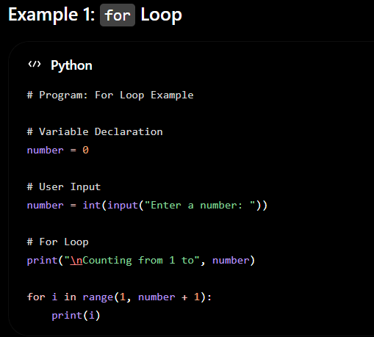
Notes:
# Program: For Loop Example
# Variable Declaration
number = 0
# User Input
number = int(input("Enter a number: "))
# For Loop
print("\nCounting from 1 to", number)
for i in range(1, number + 1):
print(i)

Slide 13
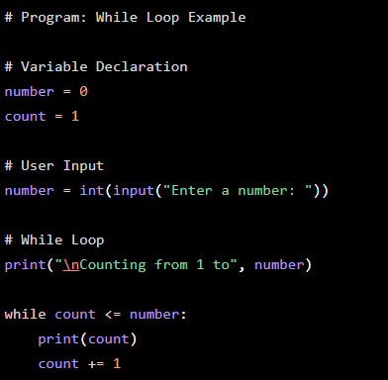
Notes:
# Program: While Loop Example
# Variable Declaration
number = 0
count = 1
# User Input
number = int(input("Enter a number: "))
# While Loop
print("\nCounting from 1 to", number)
while count <= number:
print(count)
count += 1

Slide 14
Lists & Tuples (Collection of Variables)
A List and a Tuple are Python data structures used to store multiple values in a single variable. Instead of creating many separate variables, you can group related data together.
Notes:
forUsed when the number of repetitions is known.
whileUsed when the number of repetitions depends on a condition.
Summary
✅ for loop – Repeats a block of code a fixed number of times.
✅ while loop – Repeats a block of code while a condition remains True.

Slide 15
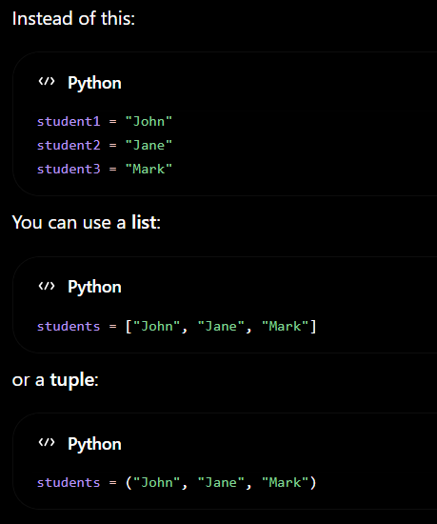

Slide 16
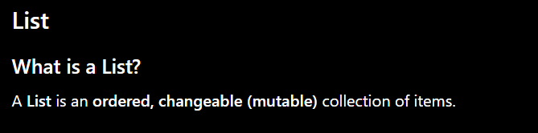

Notes:
Characteristics of Lists
Ordered
Mutable (can be modified)
Allows duplicate values
Can store different data types

Slide 17



Slide 18
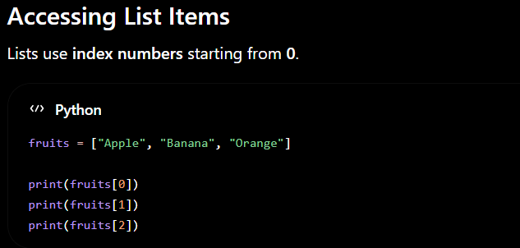
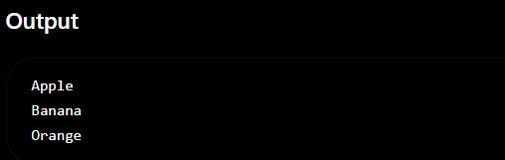
Notes:
Accessing List Items
Lists use index numbers to access individual items. In Python, indexing starts at 0, which means the first item is at index 0, the second item is at index 1, and so on.
In the example below:
fruits = ["Apple", "Banana", "Orange"]
print(fruits[0])
print(fruits[1])
print(fruits[2])
fruits[0] accesses the first item, "Apple".
fruits[1] accesses the second item, "Banana".
fruits[2] accesses the third item, "Orange".
Output
Apple
Banana
Orange
Note: If you try to access an index that does not exist (e.g., fruits[3]), Python will raise an IndexError because there is no fourth item in the list.

Slide 19
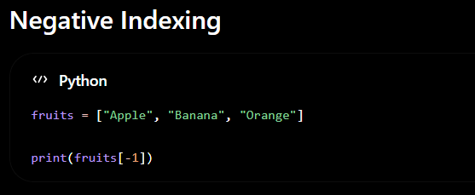
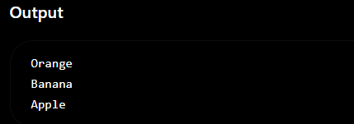
Notes:
Negative Indexing
Negative indexing allows you to access list items starting from the end of the list instead of the beginning. In Python:
-1 refers to the last item.
-2 refers to the second-to-last item.
-3 refers to the third-to-last item, and so on.
This is useful when you want to access the last elements of a list without knowing its exact length.
Explanation:
fruits[-1] returns "Orange" because it is the last item in the list.

Slide 20
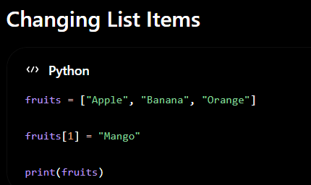
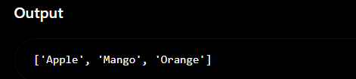
Notes:
Explanation
fruits[1] = "Mango" replaces the item at index 1 ("Banana") with "Mango".
The other items in the list remain unchanged.
Before:
Index: 0 1 2
Apple Banana Orange
After:
Index: 0 1 2
Apple Mango Orange
Note: Lists are mutable, meaning their contents can be modified at any time. This makes lists ideal for storing data that may change during program execution.

Slide 21
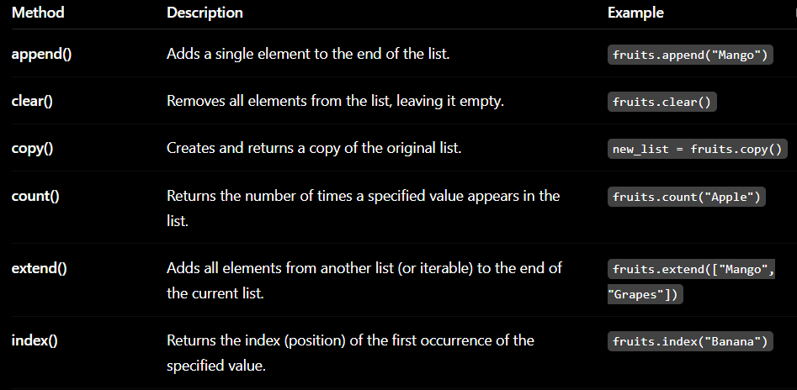
Notes:
# List Methods Example
fruits = ["Apple", "Banana", "Orange"]
# append()
fruits.append("Mango")
print("append():", fruits)
# insert()
fruits.insert(1, "Grapes")
print("insert():", fruits)
# remove()
fruits.remove("Banana")
print("remove():", fruits)
# pop()
fruits.pop()
print("pop():", fruits)
# sort()
fruits.sort()
print("sort():", fruits)
# reverse()
fruits.reverse()
print("reverse():", fruits)
# count()
print("count('Apple'):", fruits.count("Apple"))
# index()
print("index('Orange'):", fruits.index("Orange"))
# copy()
new_fruits = fruits.copy()
print("copy():", new_fruits)
# clear()
fruits.clear()
print("clear():", fruits)

Slide 22
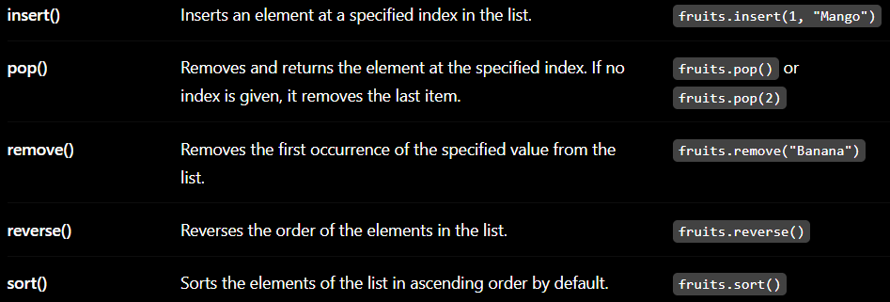
Notes:
# List Methods Example
fruits = ["Apple", "Banana", "Orange"]
# append()
fruits.append("Mango")
print("append():", fruits)
# insert()
fruits.insert(1, "Grapes")
print("insert():", fruits)
# remove()
fruits.remove("Banana")
print("remove():", fruits)
# pop()
fruits.pop()
print("pop():", fruits)
# sort()
fruits.sort()
print("sort():", fruits)
# reverse()
fruits.reverse()
print("reverse():", fruits)
# count()
print("count('Apple'):", fruits.count("Apple"))
# index()
print("index('Orange'):", fruits.index("Orange"))
# copy()
new_fruits = fruits.copy()
print("copy():", new_fruits)
# clear()
fruits.clear()
print("clear():", fruits)

Slide 23
Functions in Python
What is a Function?
A function is a reusable block of code that performs a specific task. Instead of writing the same code multiple times, you can define it once and call it whenever needed.
Notes:
Functions in Python
What is a Function?
A function is a reusable block of code that performs a specific task. Instead of writing the same code multiple times, you can define it once and call it whenever needed.
Benefits of Functions
✔ Makes code reusable
✔ Improves readability
✔ Reduces code duplication
✔ Makes debugging and maintenance easier
✔ Organizes programs into smaller, manageable parts

Slide 24
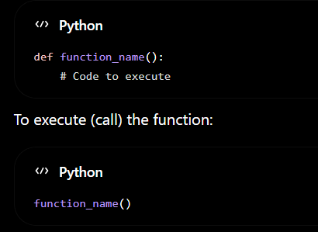
Defining and Calling Function
Notes:
Explanation
def is the keyword used to define a function.
greet is the function name.
The code inside the function executes only when the function is called.

Slide 25
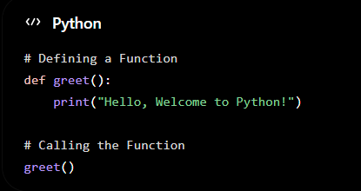
Defining and Calling Function
Notes:
# Defining a Function
def greet():
print("Hello, Welcome to Python!")
# Calling the Function
greet()Explanation
def is the keyword used to define a function.
greet is the function name.
The code inside the function executes only when the function is called.

Slide 26
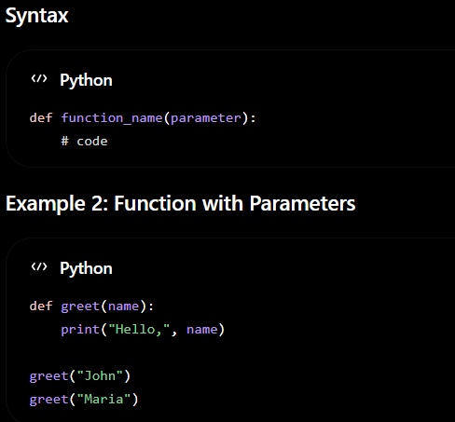
Parameters
Parameters allow you to pass information into a function.
Notes:
a variable name listed inside the parentheses of a function definition. It acts as a temporary placeholder that specifies what kind of data the function expects to receive when it is called

Slide 27
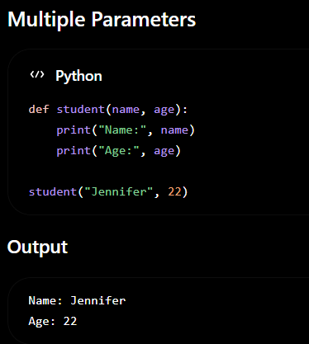
Parameters
Multiple parameters
Notes:
Multiple parameters means defining a function to accept more than one piece of input data. [1, 2]
Parameters act as named placeholders inside the function parentheses. They allow a single function to process different sets of information dynamically. [1, 2]
Basic Syntax

Slide 28
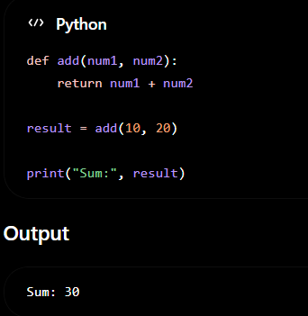
Return values
Instead of printing the result, a function can return a value using the return keyword.
Notes:
Explanation
return sends the result back to the caller.
The returned value can be stored in a variable.

Slide 29
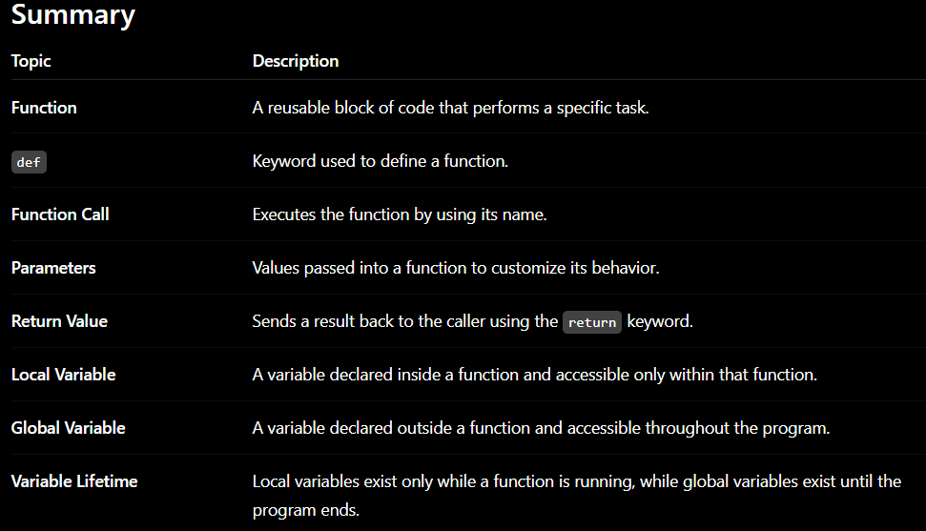
Notes:
Key Takeaway: Functions make programs more organized, reusable, and easier to maintain. By using parameters, return values, and understanding variable scope, you can write cleaner and more efficient Python programs.

