Slide 1
INTRODUCTION TO SQL

Slide 2

Clarence Adriane Concepcion
Data Analyst
Network Engineer
IT Associate
BS in Information Technology
ExcelHelpline SQL

Slide 3
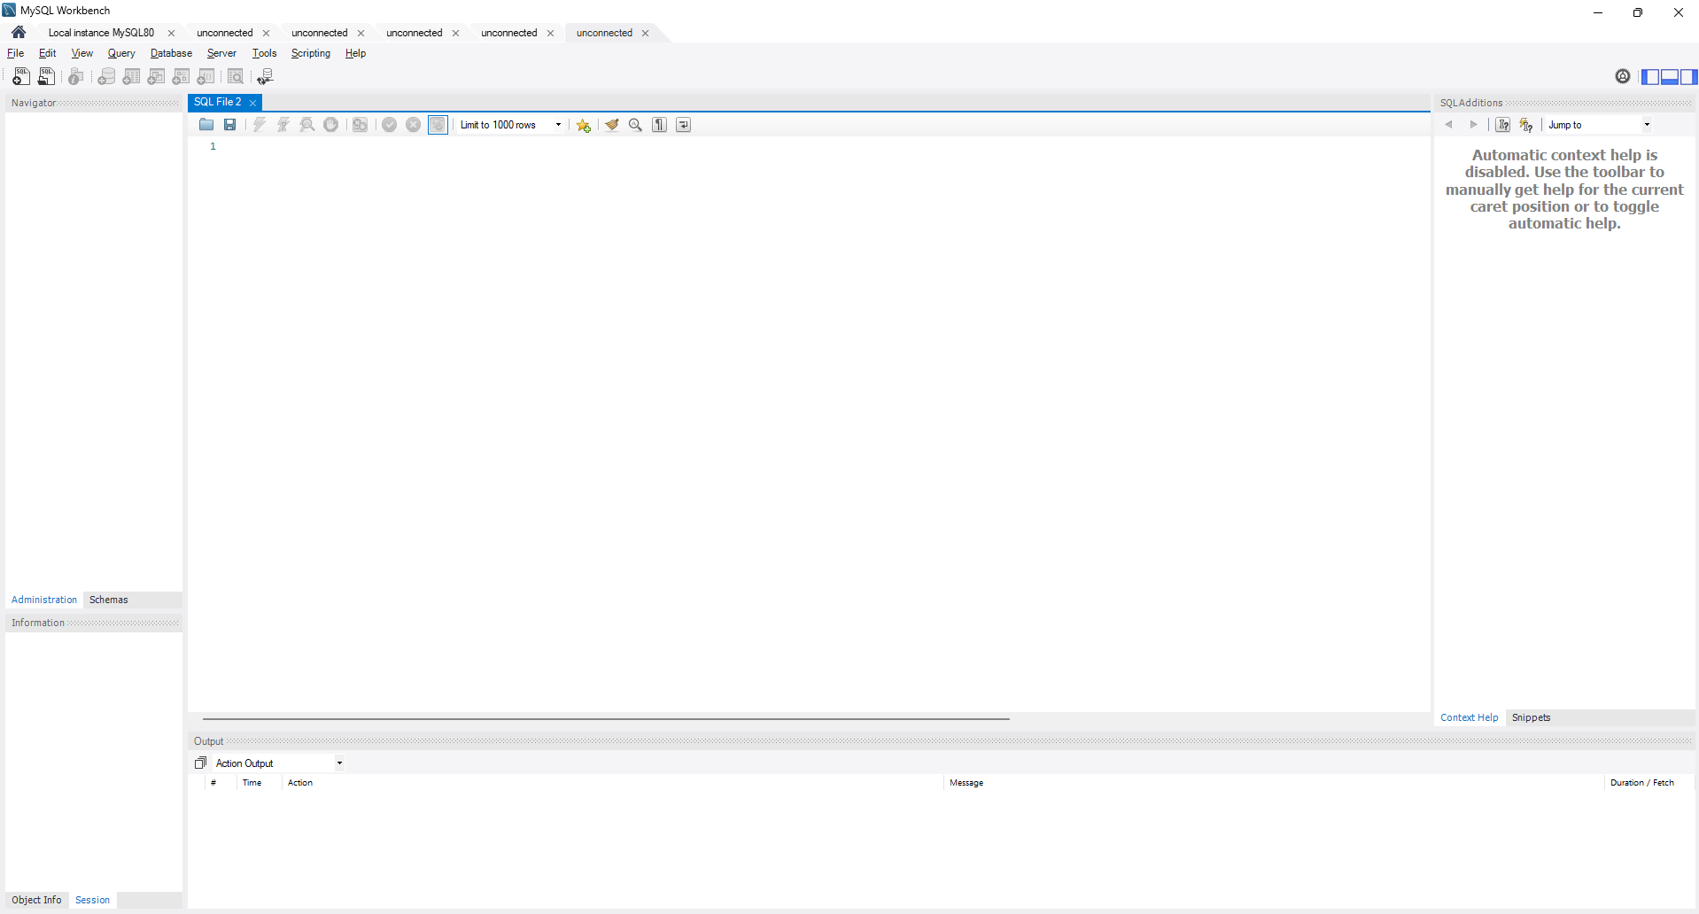
IDE: INTEGRATED DEVELOPMENT ENVIRONMENT.
https://dev.mysql.com/downloads/installer/

Slide 4
WHAT IS SQL?
SQL (Structured Query Language) is a programming language used to store, manage, and retrieve data from relational databases.
What is Database?
It is a structed set of data held in a computer or Server, Which can be accessed by programs or software for use in their system.

Slide 5
What Does SQL do?
Create databases and tables
Store and retrieve data
Update existing data
Delete data
Filter and sort records
Combine data using relationships

Slide 6
WHAT IS A RELATIONAL DATABASE?
A Relational Database is a type of database that stores data in tables (also called relations). These tables are made up of rows and columns, and they are related to each other through keys (primary keys and foreign keys). This structure makes it easy to store, organize, and retrieve data efficiently.

Slide 7
Why is it called "Relational"?
Customer Table
Because the data in tables can be related to each other.
Example:
A Customers table
An Orders table
You relate them using a Customer_ID.
Customer_ID | Name | City
1 | Clarence | Calamba
2 | Adriane | Manila
Order Table
Order_ID | Customer_ID | Item
101 | 1 | Laptop
102 | 2 | Keyboadrd

Slide 8
SOME OF THE MOST IMPORTANT SQL COMMANDS
SELECT - extracts data from a database
UPDATE - updates data in a database
DELETE - deletes data from a database
INSERT INTO - inserts new data into a database
CREATE DATABASE - creates a new database
ALTER DATABASE - modifies a database
CREATE TABLE - creates a new table
ALTER TABLE - modifies a table
DROP TABLE - deletes a table
CREATE INDEX - creates an index (search key)
DROP INDEX - deletes an index

Slide 9
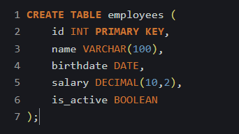
COMMON DATA TYPES:
Data types are categories that define what kind of data can be stored in a column or variable.
Data Type | Stores
INT | Whole numbers
DECIMAL | Numbers with decimals
VARCHAR | Text (names, emails)
DATE | Calendar dates
BOOLEAN | True/False

Slide 10
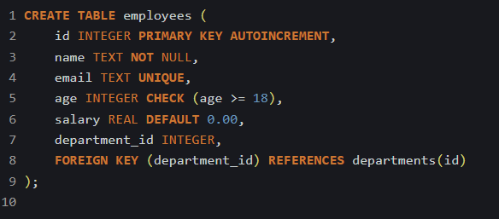
SQL CONSTRAINTS:
Constraint | Purpose
PRIMARY KEY | Unique row identifier
FOREIGN KEY | Links tables
UNIQUE | No duplicate values
NOT NULL | Cannot be empty
CHECK | Must meet a condition
DEFAULT | Automatic value
AUTO_INCREMENT | Auto numbering
SQL constraints are rules you apply to table columns to control what kind of data is allowed. They help keep your database accurate, consistent, and reliable.

Slide 11
DATABASE STRUCTURE
(FULL SCHEMA)
Table
DATA
tbl_student
Database
db_school
Table
DATA
tbl_Employee

Slide 12
IMPORTANT SQL PRACTICES:
Understand your data and table structure
Use clear naming conventions
Use primary keys and indexes
Use aliases for readability
Test queries on sample data first
Comment your SQL queries
Keep queries simple & readable
Backup data regularly
Practice hands-on exercises consistently

Slide 13
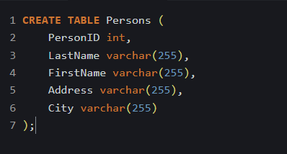
CREATING DATABASE:
Syntax:
CREATE DATABASE database_name;
Creating Tables:
Sample:
Syntax:
CREATE TABLE table_name (
column1 datatype,
column2 datatype,
column3 datatype,
....
);

Slide 14
ACTIVITY: CREATE A TABLE
Create student table and it should have the following columns:
Column that is an integer and is a primary key
Column that is varchar and not null,
Column that is an integer,
Column that is a varchar
With the details below
Student number
Student First name
Student Last name
Age
Contact Number
Address

Slide 15
INSERTING DATA:
Syntax:
INSERT INTO table_name (column1, column2, column3, ...)
VALUES (value1, value2, value3, ...);
Sample:

Slide 16


SELECTING DATA:
Syntax:
Sample:
Selecting specific data
SELECT column1, column2, ...
FROM table_name;
Selecting all data
SELECT * FROM table_name;

Slide 17
ACTIVITY:
Create a Sales table for the company
Create a sales table that includes the columns relating to
products such as its id, name, quantity, price, and date sold.
Insert at least 3 sales records and then run the following queries:
1. Select the whole table.
2. Select only the quantity and the name of the product
3. Select the prices of the products.

Slide 18
Homework
Build a small database with two related tables.
Build a small database for sales company. This table and its contents
should be the following:
Customers: CustomerID (PK), Name, Email, Address
Orders: OrderID, CustomerID (FK), Product, Quantity, Date
Insert sample data and write queries to select all the orders and the
customers.
Make a copy of the given answer sheet and write your queries made
there. Export the tables and submit it through email in .csv file,
together with the .pdf of your query answer sheet.
Send your answers here:
excelhelplineph@gmail.com
Homework deadline:
Wednesday EOD

