Slide 1
SQL FOR DATA ANALYTICS
Module 2: Update, Delete, Querying & Filtering Data

Slide 2
OVERVIEW:
This lesson introduces students to essential SQL skills used in real-world data analytics and database management. Learners will explore how to retrieve, filter, update, and remove data safely and effectively. By the end of the session, students will understand how to write precise queries to analyze datasets and maintain clean, accurate database records.
By the end of this lesson, learners will:
Confidently query and filter datasets for analytics tasks.
Perform update and delete operations while minimizing risk.
Understand the importance of accuracy, safety, and validation when modifying data.

Slide 3
KEY LEARNING AREAS:
1. Querying Data
  Use the SELECT statement to retrieve specific columns or entire datasets.
  Apply aliases to rename columns for readability.
  Understand how to sort and limit results for better data exploration.
2. Filtering Data
  Filter records using WHERE with comparison and logical operators.
  Use pattern matching with LIKE and wildcard characters.
  Apply conditions to extract actionable insights from datasets.
3. Aggregating Data
  Use aggregate functions such as COUNT(), SUM(), AVG(), MIN(), and MAX() to summarize data.
  Group data using GROUP BY to analyze trends and patterns across categories.
  Filter aggregated results using HAVING to refine grouped data.
  Apply aggregation in real analytics scenarios such as total sales, average revenue, customer count, and performance metrics.
4. Updating Data
  Modify existing records using the UPDATE statement.
  Apply safe update practices using targeted WHERE clauses.
  Understand risks of broad updates and how to avoid unintended changes.
5. Deleting Data
  Remove records using the DELETE statement.
  Implement safe delete operations with proper condition filtering.
  Learn best practices for backup and data integrity before deletion.

Slide 4

SELECT Statement:
The SELECT command is the most frequently used SQL statement. Data analysts use it to retrieve data from one or more tables.
Key Points
SELECT * retrieves everything, but is not recommended for production work.
It is better to name only the columns you need.
Aliases (AS) improve readability of reports.
Sorting and limiting help analysts explore large datasets faster.
Syntax :
SELECT column1, column2, ...
FROM table_name;

Slide 5

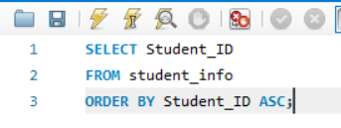

EXAMPLE:
Using Aliases:
Using Aliases:
Syntax:
SELECT column_name AS alias_name
FROM table_name;
Sorting:
Sorting:
Syntax:
ORDER BY Can Be:
ASC: Ascending
DESC: Descending
SELECT column1, column2
FROM table_name
ORDER BY column1 ASC;
Limit:
Limit: Returns the first 5 rows
Syntax:
SELECT *
FROM table_name
LIMIT 5;

Slide 6
WHERE Statement:
Filtering is essential in analytics—it narrows down data to what is relevant. WHERE allows analysts to apply conditions.
Comparison Operators
= equal
<> not equal
> greater than
< less than
>= greater than or equal
<= less than or equal
Logical Operators
AND (all conditions must be true)
OR (at least one condition must be true)
NOT (excludes specific values)
Pattern Matching with LIKE
% = many characters
_ = single character
SYNTAX:
SELECT column1, column2, ...
FROM table_name
WHERE condition;

Slide 7
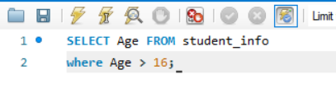
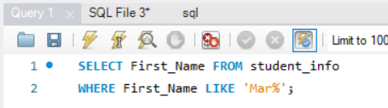
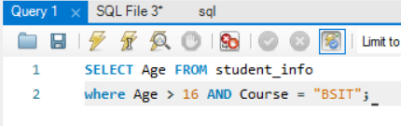
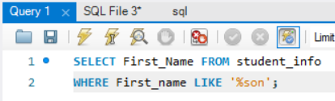
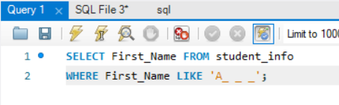
EXAMPLE
Pattern Matching with LIKE
🔹 % — matches ANY number of characters
(including zero characters)
Comparison Operators
Get All Name with Start in “Mar”
Logical Operators
Get All Name with End in “Son”
🔹 _ — matches EXACTLY one character

Slide 8
ACTIVITY #1: Filter Data
From the deliveries_data table query the products by:
Filtering delivery fee prices that is less than 500 pesos
Filtering all the Delivery In NCR
Filtering all the Vehicle except for Truck

Slide 9
AGGREGATION FUNCTIONS
Aggregation functions summarize or combine multiple rows of data into a single value. They are commonly used with SQL GROUP BY or alone to analyze data.
Function | Purpose | Example
COUNT() | Counts number of rows | COUNT(*) → total rows
SUM() | Adds values | SUM(salary) → total salary
AVG() | Computes average | AVG(age) → average age
MIN() | Finds smallest value | MIN(price)
MAX() | Finds largest value | MAX(score)

Slide 10
HOW AGGREGATION TRANSFORMS DATA?
Raw Data
Aggregated Metrix
Business Insights
Transactions
Totals
KPIs

Slide 11
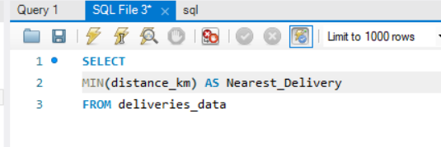
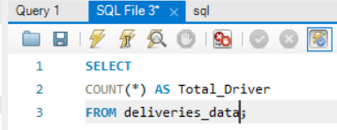
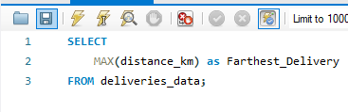
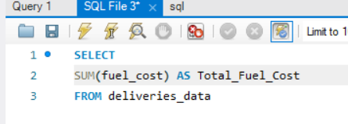
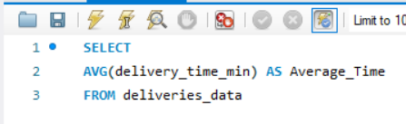
EXAMPLE:
Nearest Destination
Count Total Drivers
Farthest Destination
Total Fuel Cost
Average Delivery Time

Slide 12
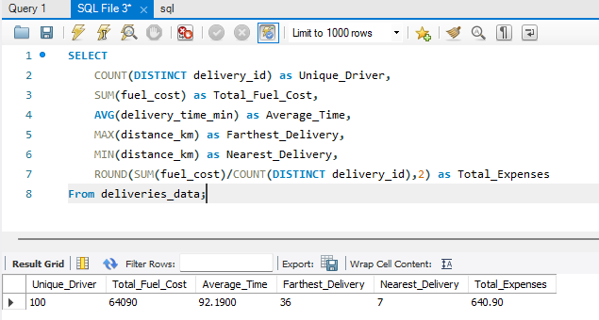
AGGREGATION COMBINATIONS

Slide 13
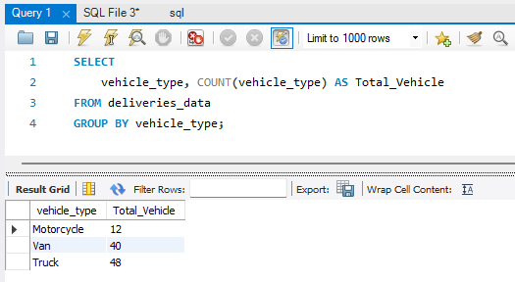
GROUPING ROWS WITH GROUP BY
GROUP BY is an SQL clause used to group rows that have the same values in one or more columns, so you can apply aggregation functions (like COUNT, SUM, AVG) to each group.
Example:

Slide 14
HAVING CLAUSE
HAVING clause is an SQL keyword used to filter groups after using GROUP BY.
Different Between WHERE and HAVING
Feature | WHERE | HAVING
Purpose | Filters rows before grouping | Filters groups after grouping
Used With | Any SELECT query | Usually used with GROUP BY
Can Use Aggregation Functions? (COUNT, SUM, etc.) | ❌ No | ✔️ Yes
When it Happens | Before grouping | After grouping

Slide 15
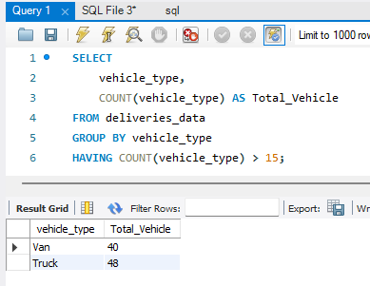
EXAMPLE:
Remember:
WHERE = Row filter
  Filters individual records
  Cannot use aggregates like COUNT()
HAVING = Group filter
  Filters groups after applying GROUP BY
  Can use aggregates like COUNT() or SUM()

Slide 16
ACTIVITY #2: GROUP BY AND HAVING CLAUSE
Use the deliveries_data table to answer the questions below.
Each question requires a SQL query using GROUP BY.
Some questions require HAVING to filter groups.
1. Count how many deliveries each vehicle type made.
Use GROUP BY.
2. Show which vehicle types traveled more than 500 km in total.
Use HAVING with SUM(distance_km).
3. For each vehicle type, show: total fuel cost, total price, and ROI
ROI = (SUM(price) – SUM(fuel_cost)) / SUM(fuel_cost)
Use GROUP BY.

Slide 17
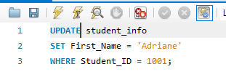
UPDATING DATA USING UPDATE
UPDATE allows modifying existing data. Analysts rarely use it directly—but data engineers frequently do. However, analysts must know how it works for data cleaning.
Syntax:
UPDATE table_name
SET column1 = value1, column2 = value2, ...
WHERE condition;

Slide 18
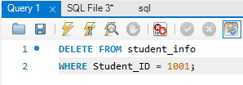
DELETING DATA USING DELETE
Concept Explanation
DELETE removes rows from a table. It is a powerful command and should be used carefully.
Important Warning
Never delete without a WHERE clause.
Syntax:
DELETE FROM table_name WHERE condition;
Best Practices
Always test with SELECT before UPDATE/DELETE.
Be specific with WHERE.
Never modify production data without a backup.

Slide 19

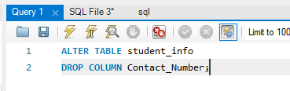
MODIFY COLUMNS USING ALTER TABLE
The ALTER TABLE statement is used to add, delete, or modify columns in an existing table.
The ALTER TABLE statement is also used to add and drop various constraints on an existing table.
Syntax:
ALTER TABLE table_name
ADD column_name datatype;
Add Column
Drop Column

Slide 20
ACTIVITY: UPDATE, DELETE AND ALTER TABLE
Use university Data to do the task Below.
Change all Enginering in Department Column to Engineering
Drop Units Column
Add Column for Year_Section

Slide 21
HOMEWORK:
Hospital Analytics
A hospital chain wants to analyze its patient and treatment records to improve
service efficiency, manage costs, and identify departments that need attention.
You are part of the hospital’s data analytics team tasked with using SQL
aggregation and the HAVING clause to generate insights from summarized data.
Problem 1 – High-Cost Departments
Find the departments where the average total cost (treatment + medicine)
exceeds ₱15,000.
Problem 2 – Long-Stay Departments
Show departments that have an average length of stay greater than 5 days.
Hint: Use AVG(length_of_stay) and group by department.
Problem 3 – Costly Doctors
List doctors whose average treatment cost per patient is greater than ₱10,000,
and show their corresponding departments.
Problem 4 – Elderly Patients Trend
Identify departments where the average age of patients is over 60 years old but
the average treatment cost is below ₱12,000.
Make a copy of the given
answer sheet and write your
queries made there, plus a
snip/screenshot of the results
in the table. Submit your
answer sheet through email
in .pdf file.
Send your answers here:
excelhelpline.submissions@gmail.com
Homework deadline:
Wednesday EOD

