Slide 1
SQL FOR DATA ANALYTICS
Module 3: Joins & Data Analytics Use Cases

Slide 2
Objectives:
Learn how to combine multiple tables and apply SQL for analytics tasks.
Understand table relationships in a relational database.
Apply JOIN operations (INNER, LEFT, RIGHT) in combining data across tables.
Perform aggregations across multiple tables for meaningful insights.
Apply CTEs, CASE WHEN, and window functions for real-world analytics.
Develop practical problem-solving skills through a case study

Slide 3
WHAT ARE JOINS?
In SQL, joins are used to combine rows from two or more tables based on a related column between them. They allow you to retrieve data that is spread across multiple tables in a database. Without joins, you would have to query each table separately and manually combine the results.

Slide 4
IMPORTANT OF JOINS
1. Combine Related Data
  Databases are usually normalized, meaning related data is stored in different tables.
  Joins let you combine these tables to get meaningful information.
Example: Get customer details along with their orders, even though customers and orders are in separate tables.
2. Avoid Data Duplication
  Without joins, you might need to duplicate data in one table to analyze it together.
  Joins allow you to retrieve data from multiple tables without repeating it, keeping the database efficient.
3. Support Complex Queries
Joins allow for complex analytics like:
  Which products are selling the most?
  Which customers haven’t made any orders?
  Total revenue per customer or region.
4. Improve Data Accuracy
  Using joins ensures that relationships between tables are respected.
  This avoids errors that might happen if you manually combine data.
5. Efficient Reporting & Business Insights
  Business reporting often requires data from different tables (e.g., sales, customers, products).
  Joins make it possible to analyze and generate reports efficiently.

Slide 5
WHY TABLE RELATIONSHIPS MATTER?
Primary Key (PK) Is a Unique Identifier for a row
Foreign Key(FK) is a column that references a primary key in another table
Customer tbl
Order tbl
Why are they important?
Keys ensure data consistency A lows.
combining data across tables Mimics.
real-world business structures (customers, orders, products).
CustomerID
CustomerID
PRIMARY KEY
FOREIGN KEY

Slide 6
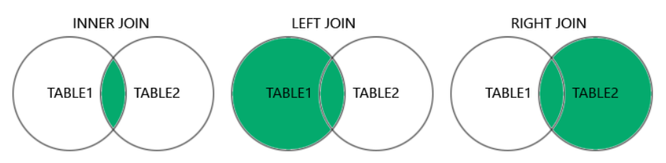
TYPES OF JOINS
INNER JOIN
LEFT JOIN
RIGHT JOIN

Slide 7
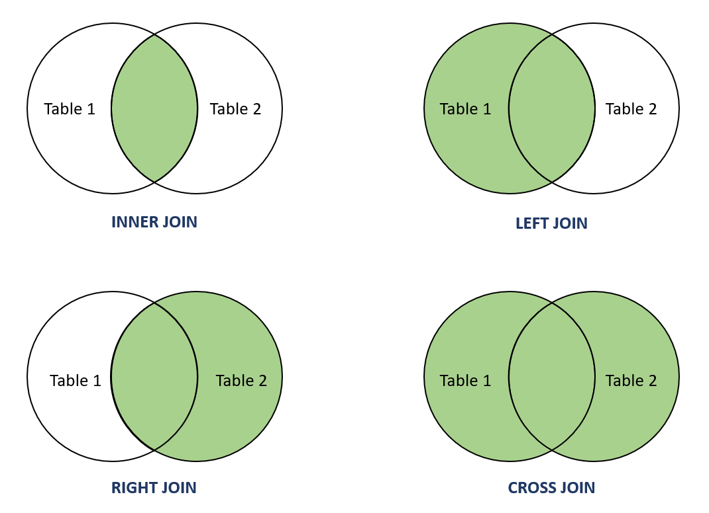
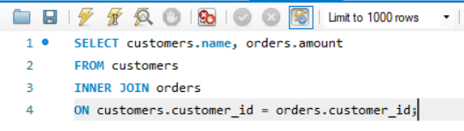
INNER JOIN:
An INNER JOIN in SQL is a type of join that returns only the rows that have matching values in both tables. If there’s no match, the row is not included in the result.
Syntax:
SELECT table1.column1, table2.column2
FROM table1
INNER JOIN table2
ON table1.common_column = table2.common_column;
Task:
Create a sales report indicating the purchase histories per customer.

Slide 8
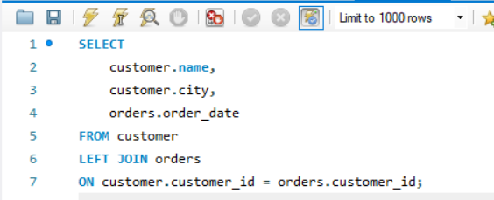
LEFT JOIN
A LEFT JOIN (or LEFT OUTER JOIN) in SQL is a type of join that returns all rows from the left table, and the matching rows from the right table.
If there is no match in the right table, the result will show NULL for the right table’s columns.
Think of it as: “Give me everything from the left table, and if there’s matching data in the right table, include it.”
Syntax:
SELECT table1.column1, table2.column2
FROM table1
LEFT JOIN table2
ON table1.common_column = table2.common_column;
Task:
Identify the registered customers, and how much have they spend, including those who haven’t purchased yet

Slide 9
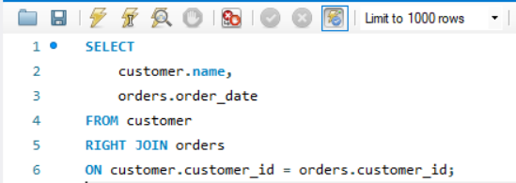
RIGHT JOIN
A RIGHT JOIN (or RIGHT OUTER JOIN) in SQL returns all rows from the RIGHT table,
and the matching rows from the LEFT table.
If there is no match from the left table, the result will show NULL for the left table’s columns.
Syntax:
SELECT table1.column1, table2.column2
FROM table1
RIGHT JOIN table2
ON table1.common_column = table2.common_column;
Task:
Identify the products that exist in our catalog, and how many
Units of each were sold including those with zero sales.

Slide 10
ACTIVITY : JOINING CUSTOMERS & ORDERS TABLE
Write SQL queries to identify:
1. The top 5 customers with the highest total purchases
2. The most popular product categories by revenue

Slide 11
AGGREGATIONS WITH JOINS
Joins become powerful when combined with aggregate functions.
With this, you can gain business insights to which you can identify
high-value customers, purchase frequency and trends.
Aggregation turns raw transaction logs into KPIs (totals, averages, and
trends) that drive decision-making.
Task:
Calculate the total orders, total revenue and its average order value of
each product category.

Slide 12
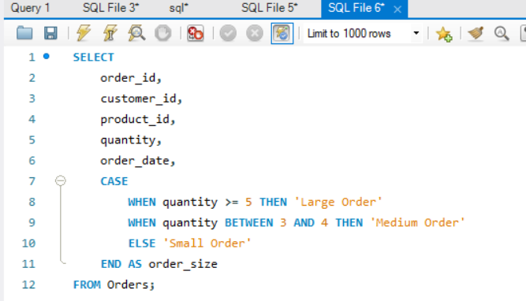
CASE WHEN:
With CASE WHEN, an attribute value can be classified and then assigned a label. This helps analysts classify data into groups for reports or dashboards.
works like an if-else statement in SQL.
Task
Group products as High, Average, or
Low Performers based on earned
revenue.
Syntax:
SELECT
column1,
column2,
CASE
WHEN condition1 THEN result1
WHEN condition2 THEN result2
ELSE result3
END AS new_column_name
FROM table_name;

Slide 13
COMMON TABLE EXPRESSIONS (CTES)
Common Table Expressions (CTEs) are used to break complex problems into logical steps.
This makes it reusable for dashboards, analytics scripts, and reports.
Task
Group products as High, Average, or
Low Performers based on earned
revenue.
Syntax:
WITH cte_name AS (
-- Your query here
SELECT column1, column2
FROM table_name
WHERE condition
)
SELECT *
FROM cte_name
WHERE another_condition;

Slide 14
ACTIVITY: OPERATIONAL INSIGHTS DASHBOARD
Create an SQL dashboard answering these questions:
  Which cities generate the most revenue?
  Which year and month had the highest total sales?
  Who are the top 5 customers per city?

Slide 15
WRAPPING UP
Here are our key takeaways from
this module:
Relationships enable data integration
Joins (INNER, LEFT, RIGHT) give different perspectives.
CASE WHEN, and CTEs

Slide 16
MINI-PROJECT
SQL Case Study
You are part of a data analytics team for an organization (business, institution, or research
unit). Your task is to design a relational database and create SQL reports that answer key
analytical questions relevant to your chosen context. This exercise integrates everything
learned about joins, aggregation, filtering, and window functions, showing how real-world
datasets are combined and transformed into actionable insights.
1. Choose a context
2. Design a Relational Schema
3. Populate your tables

Slide 17
MINI-PROJECT
SQL Case Study
Achieve these Report Objectives
1.Engagement/Retention Analysis
(e.g. “Which departments conducted multiple studies this year?“)
2. Category or Group contribution
(e.g. “Which product types contribute most to total revenue?”)
3. Regional or Hierarchical Ranking
(e.g. “Which cities perform best by total revenue?”)
4. Temporal growth or Trend Analysis
(e.g. “What is the quarterly growth in observations or funding?”)

Slide 18
MINI-PROJECT
Deliverables
1. SQL Script (.sql file)
2. One-Page Summary Report
3. (Optional) Visualization
Send your answers here:
excelhelpline.submissions@gmail.com
Homework deadline:
Wednesday EOD

