Slide 1
AirBNB new user bookings
EDA & Predictive model
7th May 2020

Slide 2
New users on Airbnb can book a place to stay in 34,000+ cities across 190+ countries. By accurately predicting where a new user will book their first travel experience, Airbnb can share more personalized content with their community, decrease the average time to first booking, and better forecast demand.

Slide 3
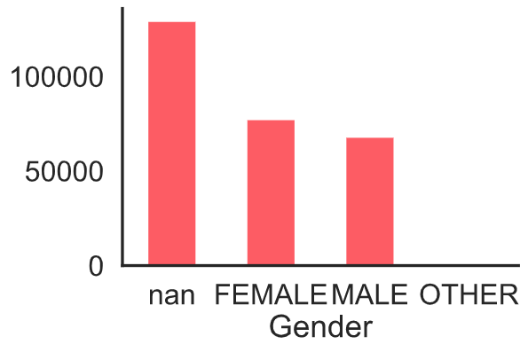
Gender distribution

Slide 4
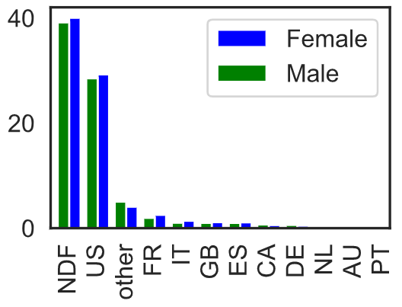
Target destination in terms of gender

Slide 5
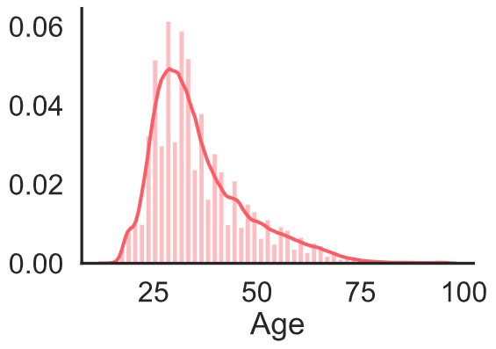
Age distribution

Slide 6
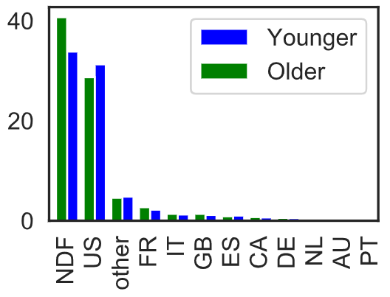
Target destination in terms of age

Slide 7
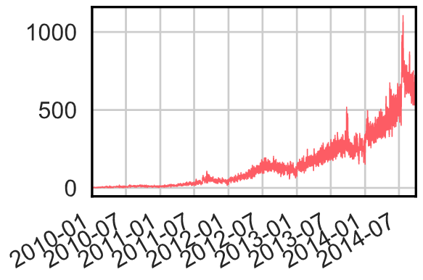
Account creation distribution over time

Slide 8
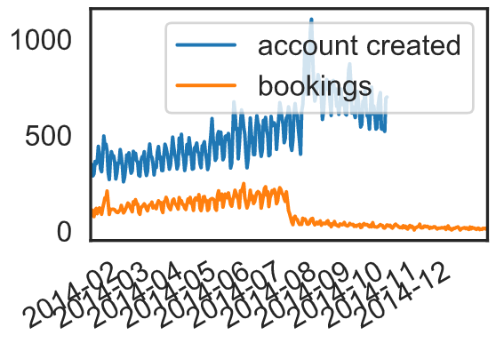
Accounts created vs bookings

Slide 9
Machine learning model
To build a machine learning model to predict user destinations, the following steps were implemented:
Loading the dataset
Data cleaning
Feature engineering
Classification

Slide 10
Machine learning model
We can see that date_first_booking feature is always NaN in test dataset so I will remove it from both training and testing.
the common age to travel is between 14 and 70. So I will smooth Age distribution by remove all values bellow 14 and above 70.
One-hot encoding is performed for categorical variables
Label encoder is used for target variable

Slide 11
XGBClassifier
XGBoost is an algorithm that has recently been dominating applied machine learning and Kaggle competitions for structured or tabular data.
XGBoost is an implementation of gradient boosted decision trees designed for speed and performance.
The two reasons to use XGBoost are also the two goals of the project:
Execution Speed.
Model Performance.

Slide 12
Hyperparameters
The following hyper parameters were applied to the model:
Maximum tree depth of 6 so only 6 features are considered in a single tree
Number of estimators is 25
The usual choice for multi-class classification is the softmax layer, Basically both softmax and softprob are used for multiclass classification. It’s the output which separates them. In Softmax you will get the class with the maximum probability as output, but with Softprob you will get a matrix with probability value of each class you are trying to predict.
We will use Softprob to predict top 5 locations for each customer.

