Slide 1
Superconductivity in NbH3 at 190 GPa

Slide 2
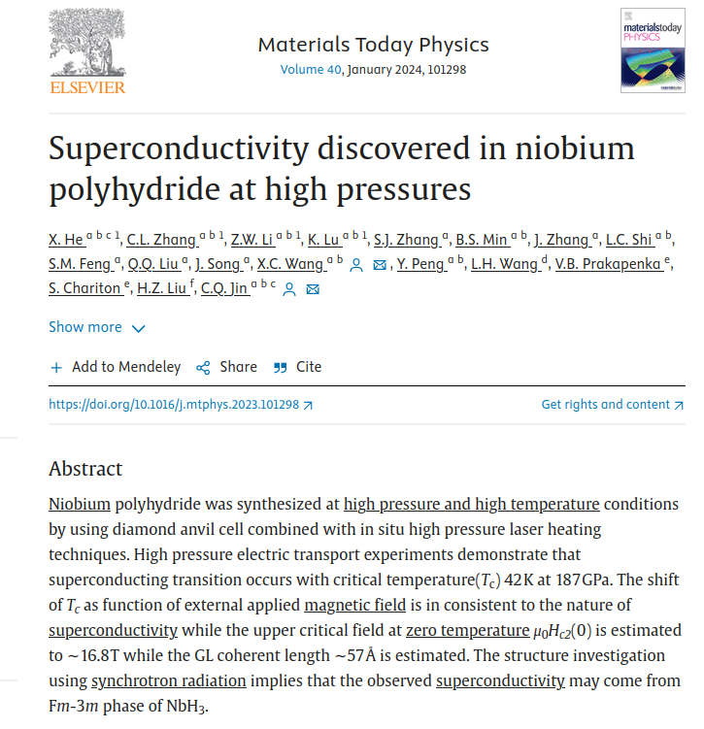
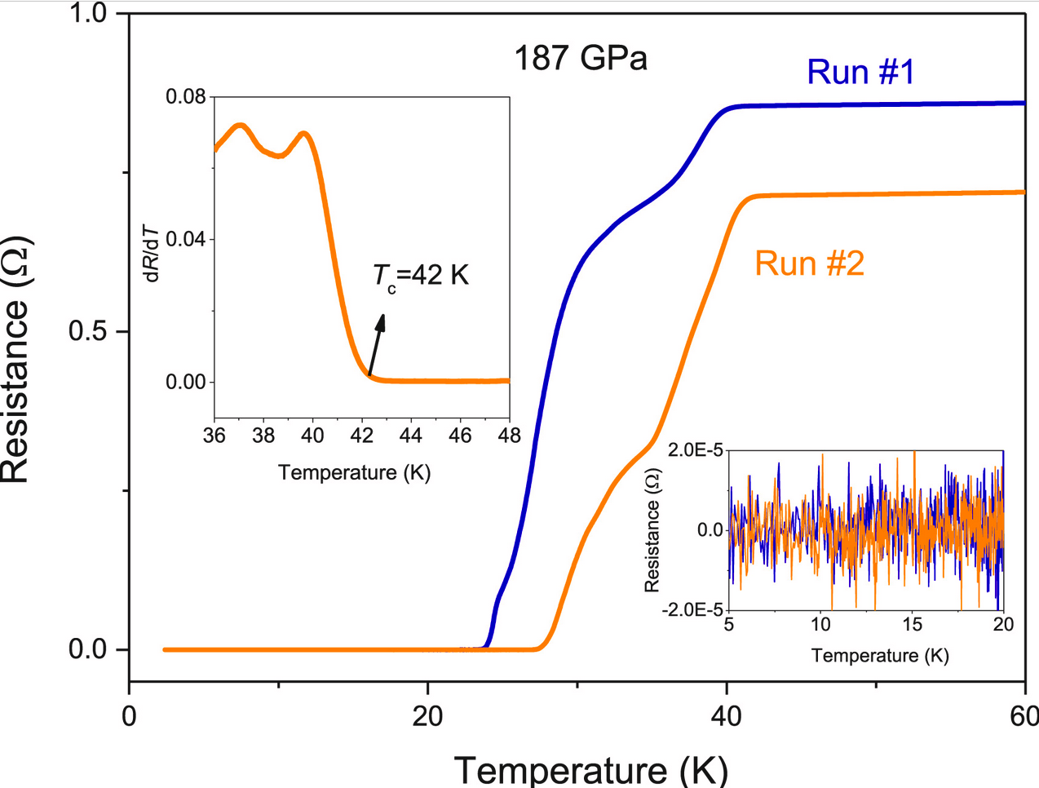
Publication in Mat. Today Physics 2024

Slide 3
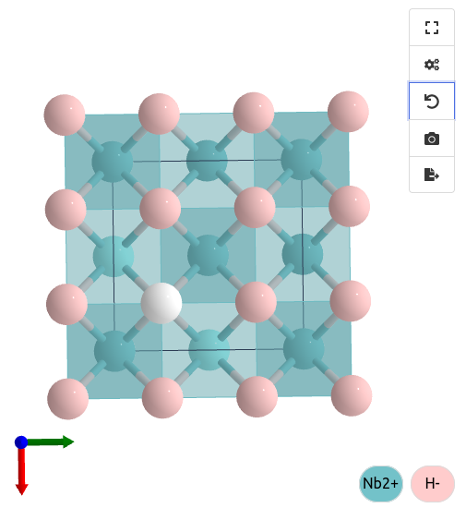
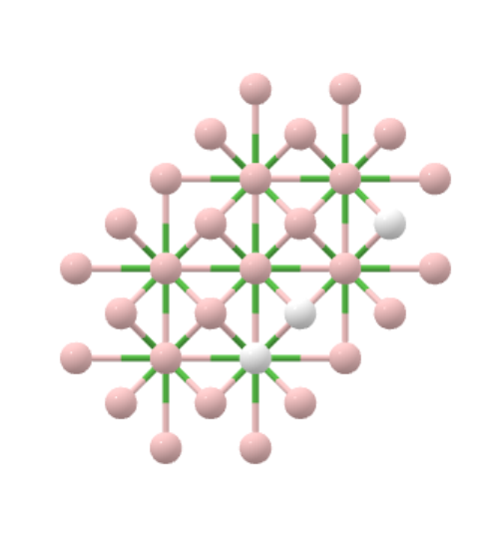
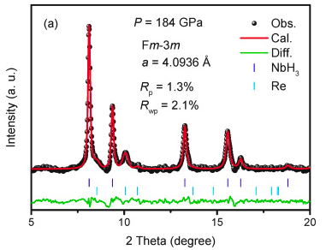
Publication in Mat. Today Physics 2024
NbH2 NbH3
After DFT optimization at 190 GPa:
a = 3.94 A a = 4.009 A

Slide 4
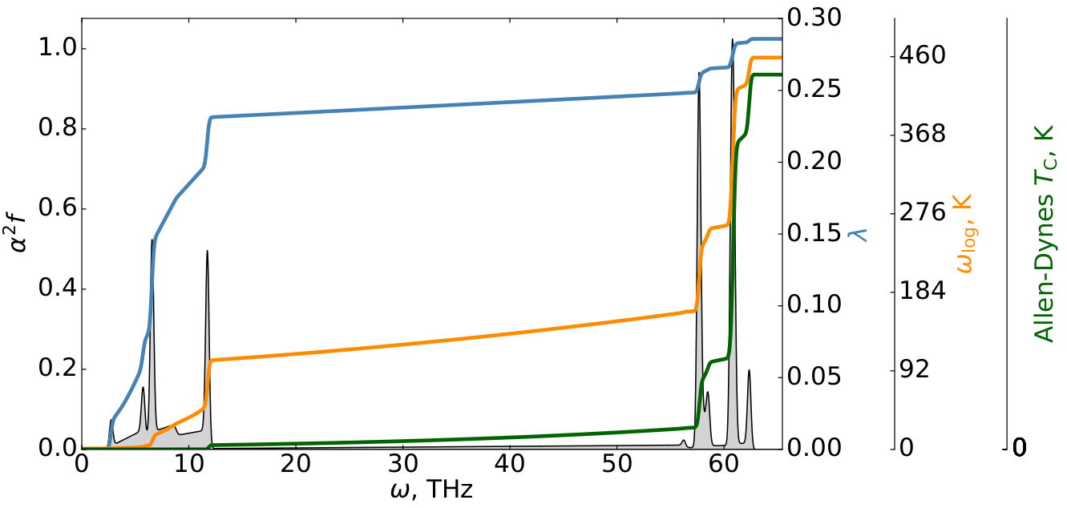
Cubic NbH2 at 190 GPa (q = 222, k = 161616, K = 242424)
No imaginary
frequencies

Slide 5
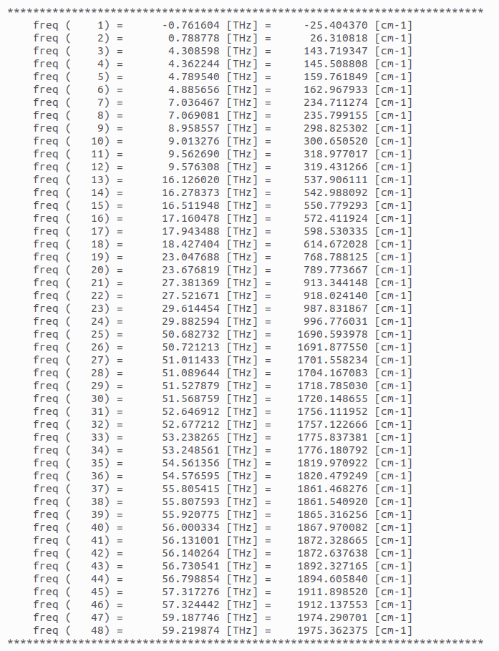
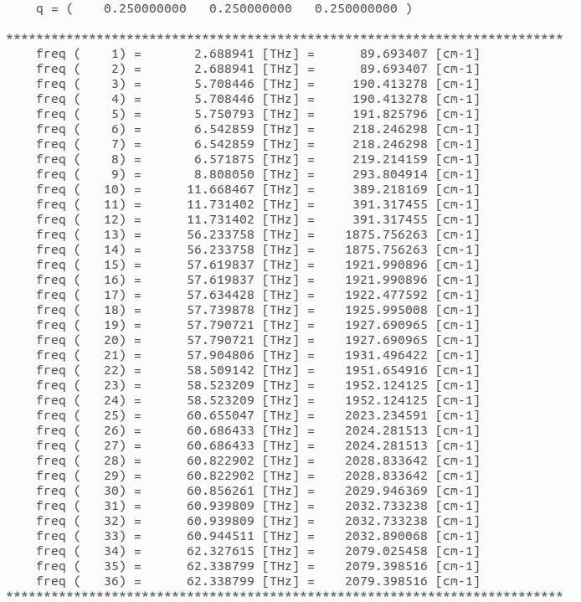
Phonons NbH2 and NbH3
NbH2
NbH3

Slide 6
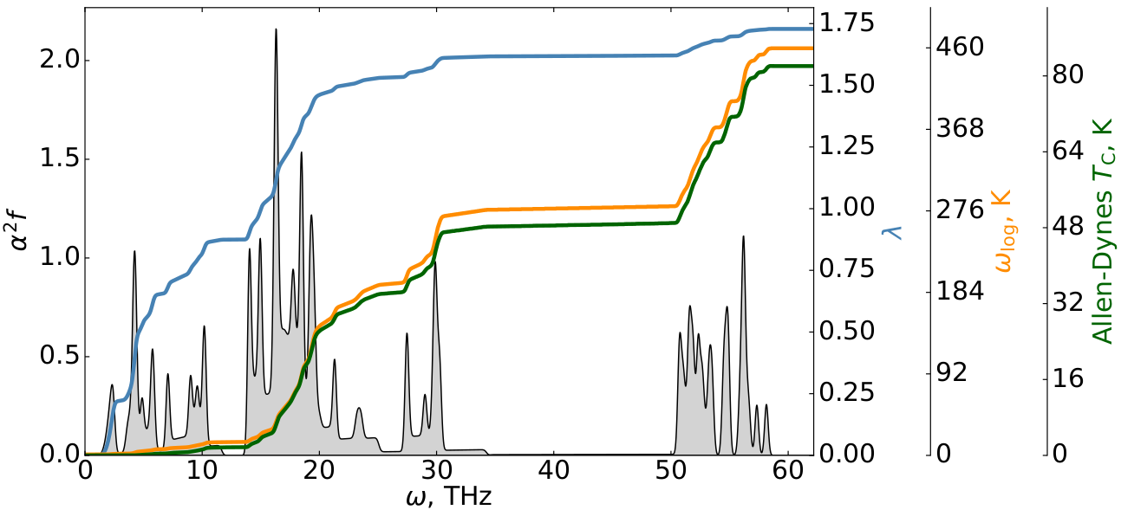
Cubic NbH3 at 190 GPa (q = 333, k = 161616, K = 242424)

Slide 7
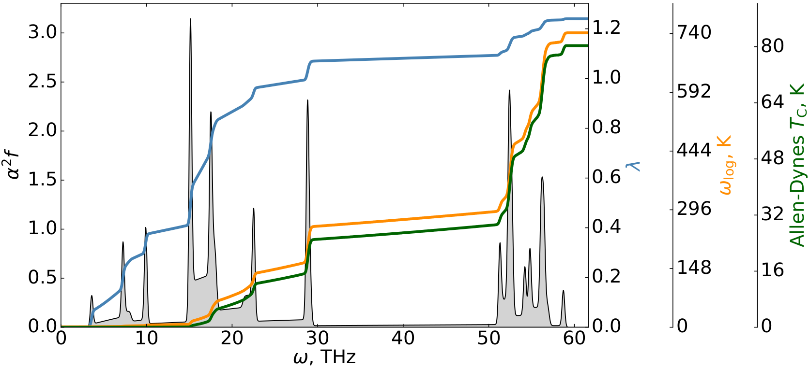
Cubic NbH3 at 190 GPa (q = 222, k = 161616, K = 242424)

Slide 8
Conclusion
Difference between experimental TC in NbH3 and DFT calculated TC is about 2 times (DFT error = 100 %)

