Slide 1

利率及衍生性金融商品介紹
報告單位：銀行金融交易處利率交易部利率衍生性商品組
報 告 人：王信閎
報告日期：2025年3月4日

Slide 2
大綱
Interest Rate Swap (IRS)
–TWD TAIBOR IRS & USD SOFR IRS
Cross Currency Swap (CCS)

Slide 3
IRS定義
IRS為金融交易合約,交易雙方約定在未來的某一段期間內,交換名目本金下之利息收入
承作 IRS 相當於訂約雙方互相承諾 ，在固定期間內雙方交換同一名目本金計算下的一系列利息
利息交換的型態可分為
  固定利息與浮動利息的交換(Fixed v.s. Floating)
  浮動利息與浮動利息的交換(Floating v.s. Floating, Basis Swaps)
由於計息引用同一名目本金，因此在實務上本金並不交換，每一計息日僅在利息差額上做交換 (Netting)
Fixed Rate
A
B
3M TAIBOR

Slide 4
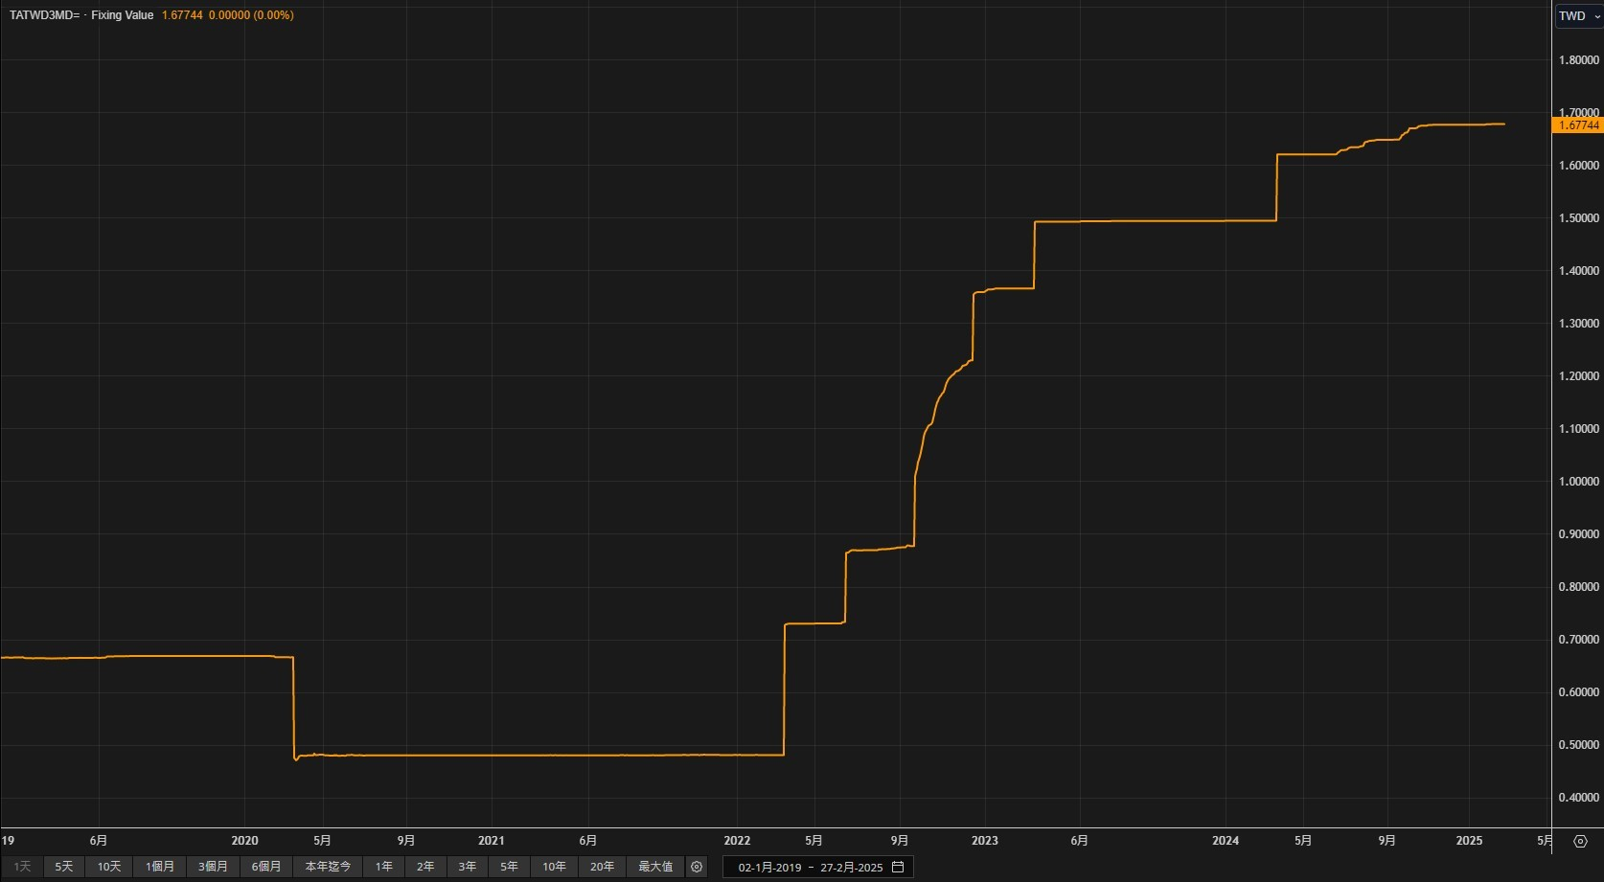
升降息時3M TAIBOR變化

Slide 5
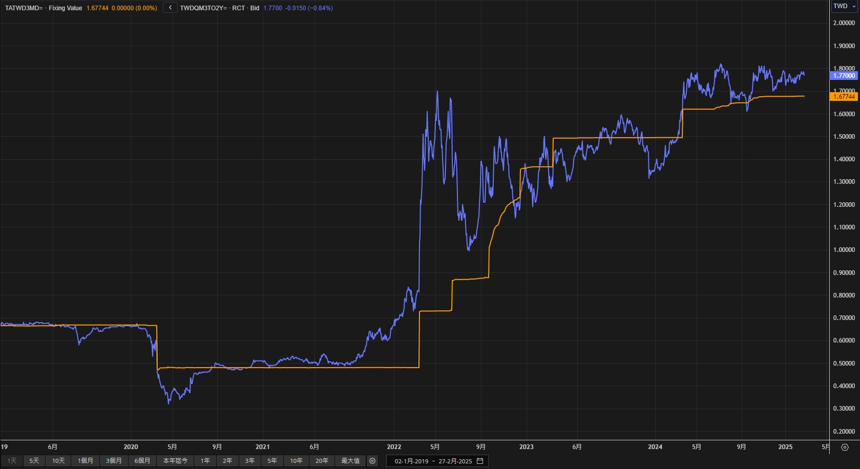
升降息時3M TAIBOR變化

Slide 6
TWD IRS架構
Floating Rate index: 3M Taibor
Both legs : Quarterly paid
The day count basis : Act/365
Maturity Date
R1 Payment
R2 Payment
R3 Payment
Rn Payment
R1 Fixing
Trade date
R2 Fixing
R3 Fixing
R4 Fixing
…
…
計息前 2 日fixing
計息天數 , Act/365
Fixed Rate Payment
Fixed Rate Payment
Fixed Rate Payment
Effective Date

Slide 7
TWD IRS架構
舉例: 2024/7/2承做2Y TWD IRS
*Floating端
期數 | Start Date | End Date | Fixing Date | Fixing Rate | Payment Date
1 | 2024/7/4 | 2024/10/4 | 2024/7/2 | 1.63% | 2024/10/4
2 | 2024/10/4 | 2025/1/6 | 2024/10/2 | Unknown | 2025/1/6
3 | 2025/1/6 | 2025/4/7 | 2025/1/2 | Unknown | 2025/4/7
4 | 2025/4/7 | 2025/7/4 | 2025/4/1 | Unknown | 2025/7/4
5 | 2025/7/4 | 2025/10/7 | 2025/7/2 | Unknown | 2025/10/7
6 | 2025/10/7 | 2026/1/5 | 2025/10/2 | Unknown | 2026/1/5
7 | 2026/1/5 | 2026/4/7 | 2025/12/31 | Unknown | 2026/4/7
8 | 2026/4/7 | 2026/7/6 | 2026/4/1 | Unknown | 2026/7/6

Slide 8
TWD IRS報價方式
IRS以固定端為報價基礎，在Bloomberg與Reuters (page TWDIRS)中都可以取得即時參考報價
價格跳動多數時間以0.5bps為單位，但市場最低容忍限度為0.25 bps為跳動單位
實務上，利率報價可精確至小數點下4位
市場有多家經紀商彙整各家銀行報價後，報出市場最佳買賣價，供參與者（銀行、券商與票券商）進行交易，報價年期以1~5,7 and 10 yr為主
若5Y為 1.90/1.88，即報價者願意收取固定利息於1.90%，或付固定利息於1.88%

Slide 9
TWD IRS交易內容
Tenor：契約年期 1~5yr, 7yr or 10yr
Notional Amount：通常以TWD 300或500 Mio為單位
Effective Date：起息日
Maturity Date：到期日
Payement Date：交割日期
Floating Rate Index：3M Taibor
Fixed Rate Payer：固定端付息者
Floating Rate Payer：浮動端付息者
Fixed Rate：固定利率水準
Day Count Basis：Act/365fix

Slide 10
Applications of IRS
Lock in a FIXED rate when rates are Rising
Changing to a FLOATING rate when the rates are Falling
Changing the TERM of the interest rate period

Slide 11
IRS避險用途
規避資產或負債面的利率風險
  貸款（聯貸案、企業貸款、房貸）
  企業發債（公司債、金融債）
  結構型存款（Structured Deposit）
  etc..

Slide 12
IRS風險
Market Risk ( Interest Rate Risk)
Credit Risk
Liquidity Risk

Slide 13
Market Risk
(Interest Rate Risk)
指利率變動時，造成IRS市場價值動的風險
Interest Rate Risk的衡量：DVO1

Slide 14
Credit & Liquidity Risk
Credit Risk:指交易對手不依合約履行其義務或發生倒帳的風險
Liquidity Risk:指成交量不足或缺乏意願交易的對手，導致未能在理想的時點/價位完成買賣的風險

Slide 15
SOFR
SOFR是無風險利率：由銀行間美債擔保RP利率的加權平均計算而得
Backward looking：NY Fed每日8:00 a.m. ET. 公告前一日的SOFR rate
SOFR Convention：ACT/360
For IR derivatives in the purpose of trading, SOFR is suggested to be the reference index.
8:00 a.m. ET. 公告
前一日(2022/11/14)的SOFR rate
2022/11/14
Value date
2022/11/15
2022/11/16
Trade date
對美洲盤而言，SOFR報價lag 1天
對亞洲盤而言，SOFR報價相當於lag 2天，即在2022/11/16這天只能知道兩天前(2022/11/14)的fixing
Notes:
MUREX compounding 畫面

Slide 16
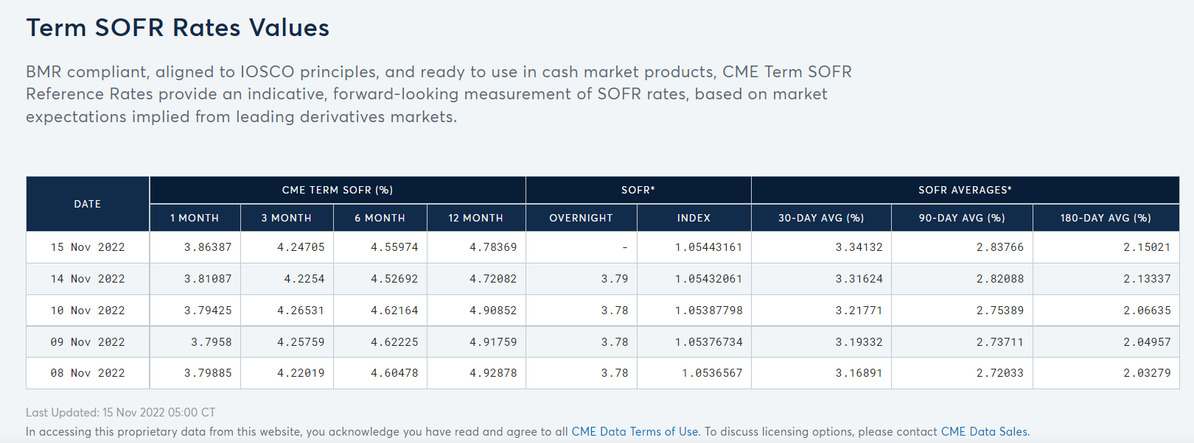
Term SOFR
美國替代參考利率委員會（「ARRC」）於2021年7月29日宣布，已正式建議市場參與者採用芝加哥商品交易所集團（「CME」）的前瞻性擔保隔夜融資期限利率（「SOFR期限利率」）
Term SOFR are suggested to be reference for loans and syndicated products only.
Term SOFR為參考1M、3M CME SOFR futures實際交易報價組合計算而得
目前公告的Term SOFR天期有1M、3M、6M、12M
Forward looking
每日5:00 a.m. CT 公告前一日
Notes:
Term SOFR - CME Group
https://www.google.com.tw/url?sa=t&rct=j&q=&esrc=s&source=web&cd=&cad=rja&uact=8&ved=2ahUKEwi0z8WcwrL7AhXQc3AKHaZdChUQFnoECBMQAw&url=https%3A%2F%2Fwww.cmegroup.com%2Farticles%2Ffaqs%2Fcme-term-sofr-reference-rates.html&usg=AOvVaw22s2nPNdqNa6C8oTlwsJPU
Forward looking Term RFRs are now available albeit not for all products as there may be regulatory restrictions to their use (e.g. Term SONIA) and not for all currencies, particularly those where there is no active and liquid derivatives market (e.g. CHF SARON).
Term RFRs provide an indicative, forward-looking measurement of RFR rates, based on market expectations implied from relevant RFR derivatives markets. They include expectations of future level of interest rates but do not include any interbank credit premium.
Due to these differences, adjustments for credit and term differences may need to be used to transition existing contracts and agreements that reference IBORs to RFRs.

Slide 17
Forward and Backward looking
OIS SOFR compounding structure from ISDA and ARRC: Compound SOFR in Arrears with Payment Delay
SOFR compounding
2022/11/17
1st fixing
2023/2/16
last fixing
Backward Looking
O/N SOFR daily compounding
+2
……….………………………………………...
0
1
T
T+2
2022/11/15
Trade date
2022/11/17
Start date
2022/11/18
2023/2/17
End date
2023/2/22
Payment date
(2023/2/21 Market closed on President Day)
OIS settle
at T+2
3M
Term SOFR
Forward Looking
3M Term SOFR
Fixing
2022/11/15
Trade date
2022/11/17
Spot date
2023/2/17
Payment date
Notes:
in arrears (for FRNs, and syndicated and bilateral business loans)
in advance (for intercompany loans and consumer products).

Slide 18
SOFR OIS與USD LIBOR 差異
Convention 差異比較
SOFR IRS 交易tenor, TradeWeb default為1y-1y 主流交易方式(但也可選擇其他tenor) , 與LIBOR主流是1y-3m,6m不同
Rate type | Fixing rate | Fixing type | Fixing Date | back office Fixing | Payment day
Term SOFR IRS | Term SOFR | in advance | trade day | trade day +1d | payment day=End day
SOFR OIS CMP Rate | SOFR daily compounding | in arrear | interest period end day (SOFR published lag 1d) | interest period end day +1d (SOFR published lag 1d) | payment day=End day +2 (Payment lag 2d)

Slide 19
CROSS CURRENCY SWAP (CCS)
與 IRS 不同，CCS 為兩種不同幣別貨幣間，本金和利息的互相交換
利息交換的型態可分為 (1)固定利息與浮動利息的交換 (2)浮動利息與浮動利息的交換，或 (3)固定利息與固定利息的交換
本金交換的部份，可以視客戶之需要選擇交換或不交換，但牽涉台幣的 CCS 交易須符合中央銀行之部份規定，且非銀行間之交易必須呈送相當證明文件

Slide 20
Cross Currency Swap ( TWD/USD )
公司向銀行承做S/B (Sell/Buy) USDTWD SOFR CCS
S/B：期初先借出美金&借入台幣，到期再拿回美金&還台幣
Swap
Bank
NTD
Company
Floating
USD Debt
USD
期初交換本金
USD
NTD
Fixed Interest
Swap
Bank
Company
Floating
USD Debt
期間交換利息
USD
Floating Interest
USD
Floating Interest
Swap
Bank
NTD
Company
Floating
USD Debt
USD
期末換回本金
USD

Slide 21
USD/TWD CCS架構
Floating Rate index: USD SOFR
Both legs : Semi paid
The day count basis : USD, Act/360 ; TWD, Act/365
Maturity Date
Notional Exchange
FX0
USD
Payment
USD
Payment
USD
Payment
USD
Payment
Trade Date
Fixing
Fixing
Fixing
Fixing
…
…
計息日fixing到end date
計息天數
USD, Act/360; TWD Act/365
Reverse
Notional Exchange
FX0
Fixed Rate
TWD Payment
Fixed Rate
TWD Payment
Fixed Rate
TWD Payment
Effective Date

Slide 22
USD/TWD CCS架構
2024/7/2承做2Y S/B USDTWD SOFR CCS, 假設spot在32.0
*USD端
期數 | Start Date | End Date | Start Fixing Date | Last Fixing Date | Fixing Rate | Payment Date | Flow
1 | 2024/7/5 | 2025/1/6 | 2024/7/5 | 2025/1/3 | Unknown | 2025/1/8
2 | 2025/1/6 | 2025/7/7 | 2025/1/6 | 2025/7/3 | Unknown | 2025/7/9
3 | 2025/7/7 | 2026/1/5 | 2025/7/7 | 2026/1/2 | Unknown | 2026/1/7
4 | 2026/1/5 | 2026/7/6 | 2026/1/5 | 2026/7/2 | Unknown | 2026/7/8
期初 |  |  |  |  |  | 2024/07/05 | USD -1mio
期初 |  |  |  |  |  | 2024/07/05 | TWD +32mio
期末 |  |  |  |  |  | 2026/07/06 | USD +1mio
期末 |  |  |  |  |  | 2026/07/06 | TWD -32mio

Slide 23
CCS避險用途
同時規避匯率與部分利率風險
  投資資金匯出（國壽、新壽）

Slide 24
Example (Insurance Company & CCS)
壽險向銀行承做B/S (Buy/Sell) USDTWD SOFR CCS
所得之台幣
1.可用以提供長
天期固定利率放款
2.其他台幣相關投資
TSIB
(Bank)
NTD
XX Insurance
Foreign
Investment
NTD
2.0% NTD
6M SOFR
USD
USD
USD
2.0% NTD
NTD
所需之美元
1.可由Interbank拆借
2. Back-to-Back CCS Deal
Principal
TWD Liability
Interest

Slide 25

Q & A

Slide 26
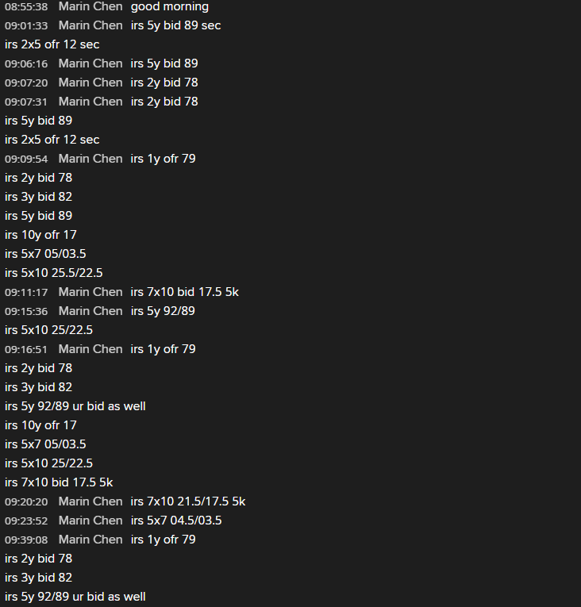
附錄：實際TWD IRS交易畫面

Slide 27
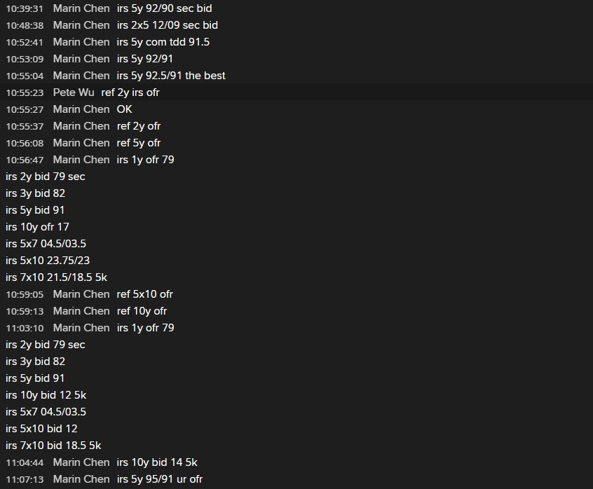
附錄：實際TWD IRS交易畫面(續)

