Slide 1

Price Action Trading
Trend Line Breakout Strategy
(by Albert Kuo)
僅供內部教育訓練之用，請勿外流

Slide 2
Introduction
This is a rule-based and objective method with clear and not ambiguous entry and exit rules.
This strategy is as easy as pie and the tool we use is only trend lines.
We don’t use any technical indicators(neither EMA, RSI, KD nor MACD) so we don’t need to optimize parameters of the indicators and have no problem of overfitting a model.
We can use Fibonacci Retracement to decide S/L and T/P levels.
We can use trailing stop strategy to capture massive moves.
It’s a trend reversal strategy with pretty high odds.
This strategy can work well in daily chart but it can also do on other time frame.

Slide 3
How to Draw Valid Trend Lines
Step 1: Identify obvious peaks and troughs
Step 2A: In a downtrend(it forms lower highs, but lower lows are not
necessary), connect a minimum of 3 peaks (or highs) with a
line from left to right and we have a downward trend line
Step 2B: In an uptrend(it forms higher lows, but high highs are not
necessary), connect a minimum of 3 troughs (or lows) with
a line from left to right and we have a upward trend line
Step 3: We can draw 2 parallel lines to mark trend line(as a trend zone)
*3 Common Mistakes in Drawing Trend Lines:
1. Drawing trend line through an obstruction
2. Drawing through the body of a candlestick
3. Not drawing a new trend line and keeping a breached trend line
*It’s acceptable that sometimes a trend line doesn’t touch the wick but
is very close to the end of a wick.
*It’s acceptable that sometimes a trend line is through the body of a
candlestick but only a tiny part of the body.

Slide 4
How to Draw Valid Trend Lines
Uptrend Line
Downtrend Line

Slide 5
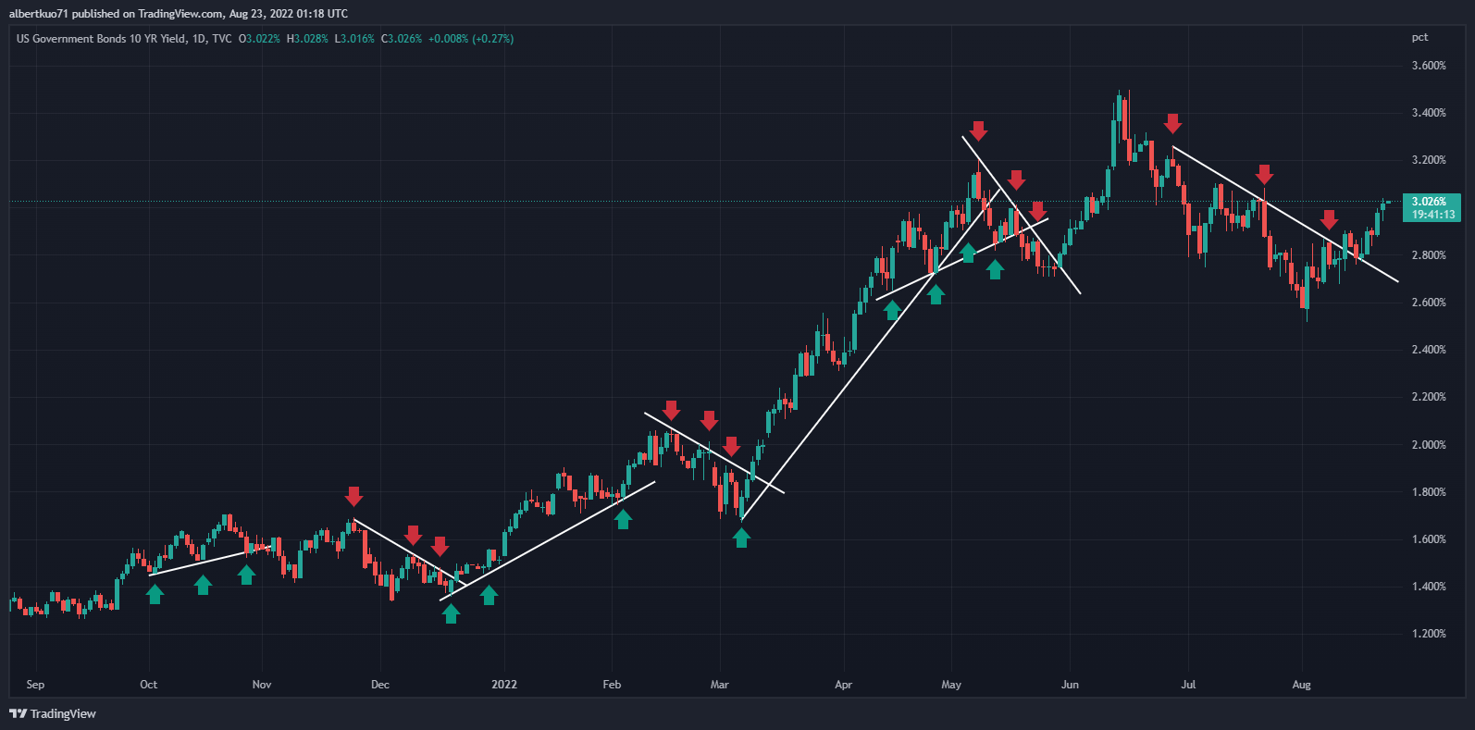
How to Draw Valid Trend Lines

Slide 6
Entry Rules
Long Entry
Aggressive Entry: If the price closes above the last point
touching the downtrend line, make a long entry.
Conservative Entry: If the price crosses above the last
point touching the downtrend line and retests it, make
a long entry.
Conservative Entry
Aggressive Entry
Downtrend Line

Slide 7
Entry Rules
Short Entry
Aggressive Entry: If the price closes below the last point
touching the uptrend line, make a short entry.
Conservative Entry: If the price crosses below the last
point touching the uptrend line and retests it, make
a short entry.
Uptrend Line
Aggressive Entry
Conservative Entry

Slide 8
Special Cases
Uptrend Line
Not Here
Enter Here

Slide 9
Special Cases
Not Higher Highs
Uptrend Line
Enter Here

Slide 10
Entry Rules
Retracement(Pull Back)
Uptrend Line
Enter
(Higher Odds)
Downtrend

Slide 11
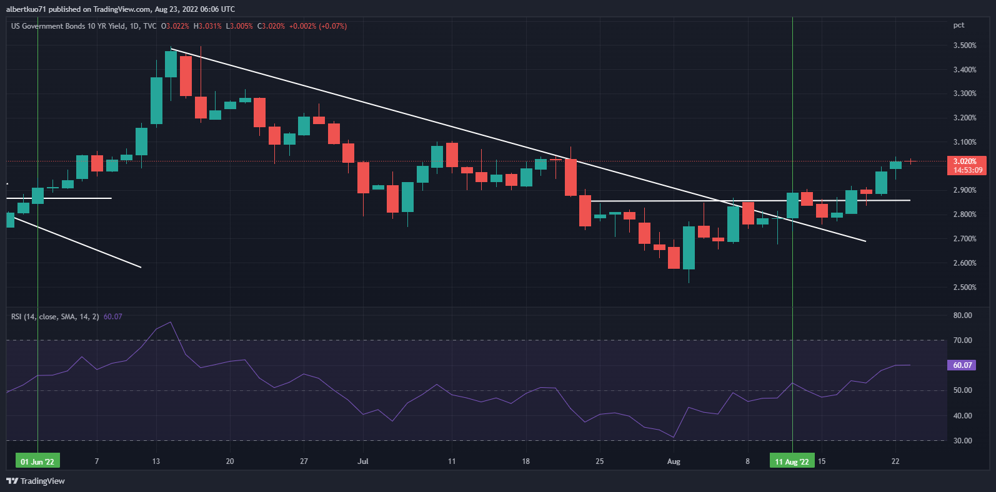
Example
Enter Here

Slide 12
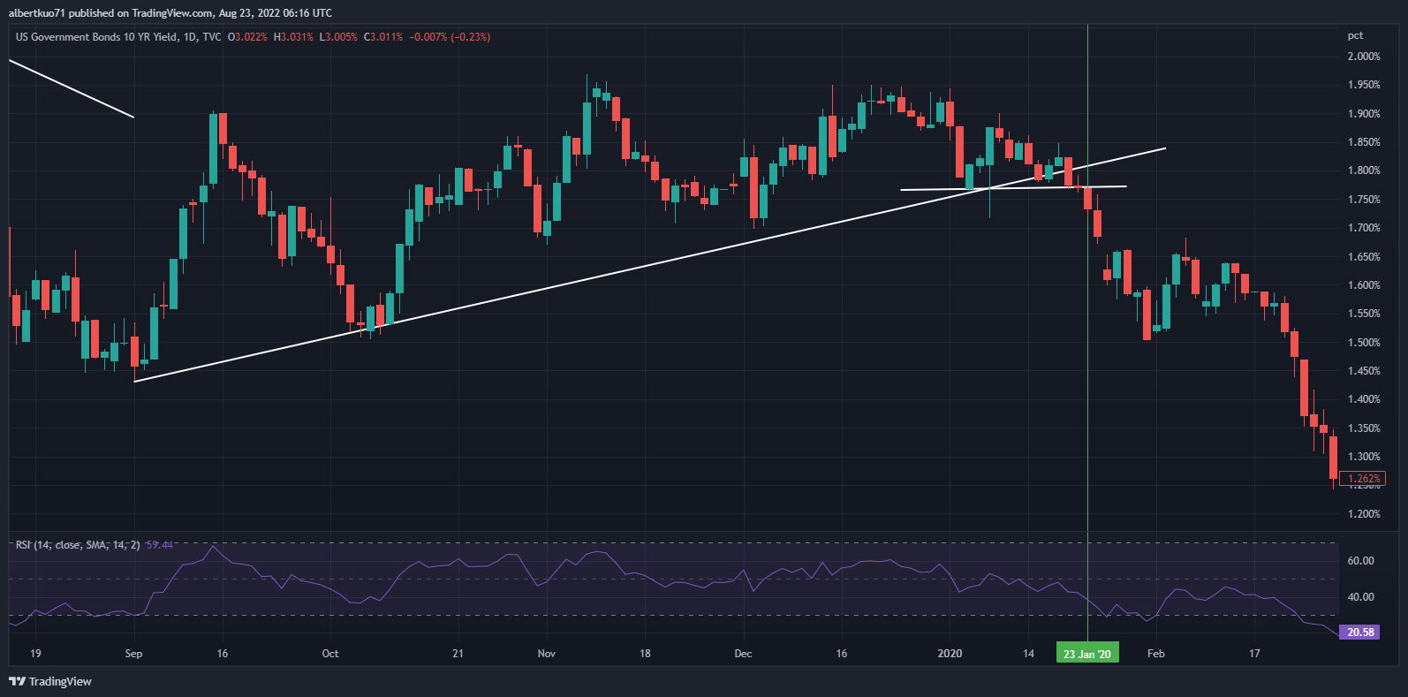
Example
Enter Here

Slide 13
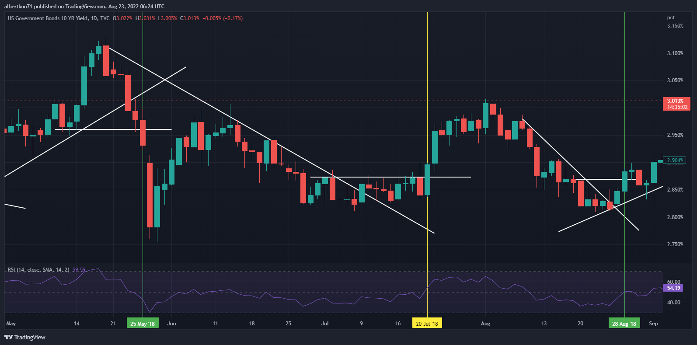
Example
Enter Here
Enter Here

Slide 14
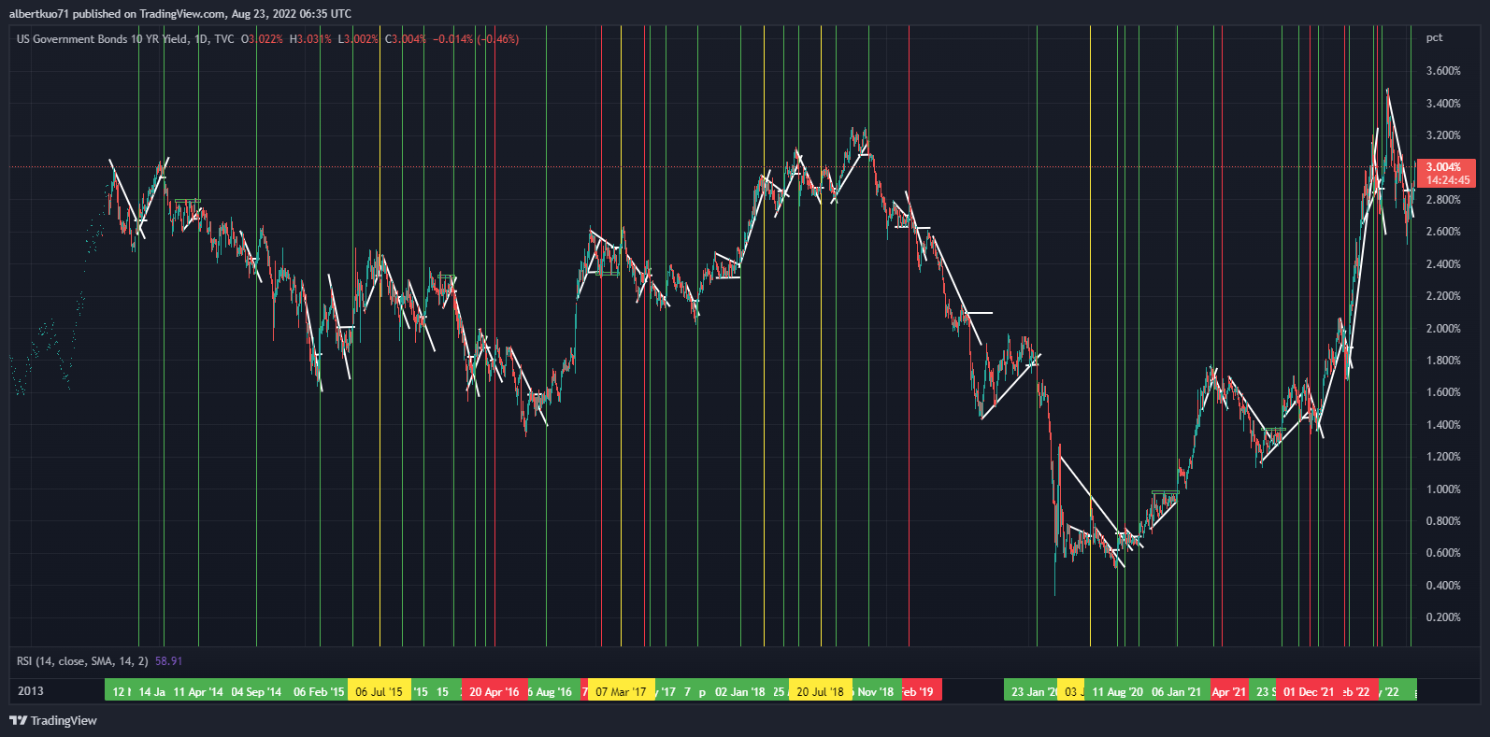
Back Test
US 10Y Daily Chart: 2013 Sep ~ 2022 Aug, Total Entry Times 46, Winner 33
Breakeven 5, Loser 8, Winning% 71.74%

Slide 15
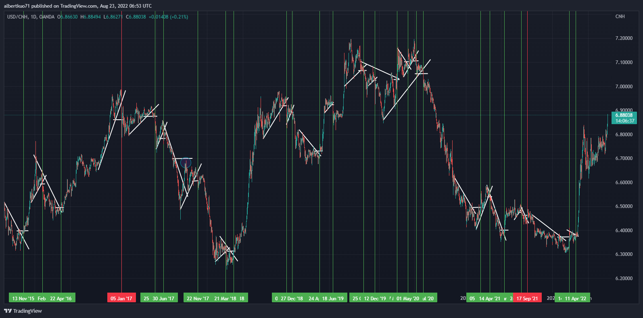
Back Test
USDCNH Daily Chart: 2011 Nov ~ 2022 Aug, Total Entry Times 26, Winner 24
Loser 2, Winning% 92.86%

Slide 16
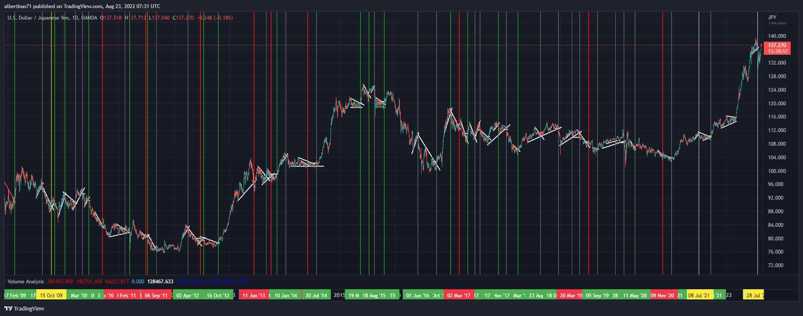
Back Test
USDJPY Daily Chart: 2009 Jan ~ 2022 Aug, Total Entry Times 52, Winner 35
Breakeven 3, Loser 14, Winning% 67.31%

