Slide 1
美債期貨
簡嘉宏

Slide 2
U.S. Treasury Futures
Deep Liquidity
Nearly 24-hour electronic access
Margin offset savings
Capital efficiency of Futures
Safety and security

Slide 3
 | 2-Year T-Note Futures |  | 3-Year T-Note Futures | 5-Year T-Note Futures | 10-Year T-Note Futures | Classic T-Bond Futures |  | Ultra T-Bond Futures
Contract Size | $200,000 face-value |  |  | $100,000 face-value
Delivery Grade | Notes with original maturity no greater than 5-1/4 years and remaining maturity no greater than 2 years but not less than 1 year, 9 months |  | Notes with original maturity no greater than 5-1/4 years and remaining maturity no greater than 3 years but not less than 2 years, 9 months | Notes with original maturity no greater than 5-1/4 years and remaining maturity of at least 4 years, 2 months | Notes with original maturity no greater than 10 yrs and remaining maturity of at least 6-1/2 years | Bonds with remaining maturity of at least 15 years, but no more than 25 yrs |  | Bonds with remaining maturity of at least 25 yrs but no more than 30 yrs
Invoice Price | Invoice price = settlement price x conversion factor (CF) + accrued interest Where CF = hypothetical price to yield 6%
Price Quote | 1/4th of 1/32nd ($15.625) |  |  | 1/4th of 1/32nd ($7.8125) | ½ of 1/32nd ($15.625) | 1/32nd ($31.25)
Ticker Symbols GLOBEX Bloomberg | ZT TU | Z3 3Y |  | ZF FV | ZN TY | ZB US | UL WN

Slide 4
T Futures-contract spec.
EX:US 10YR T-Note Futures
Contract size：100,000 USD
Trading Hours：06：00~05：00
Underlying：US 10yr 6%
Price：130-08
Contract value：$ 130,250
(100,000 * 130.25/100=130,250 )
Tick Size：0-00+ (64ths)
Tick Value：$15.625
(100,000 /100 * 0.5/32=15.625)

Slide 5
Contract Months：Quarterly: March, June, September and December
Symbol：/ＴＹＨ4、/ＴＹＭ4、/ＴＹＵ4、/ＴＹＺ4
Last Trade date：on the seventh business day preceding the last business day of the delivery month
Last Delivery date：Last business day of the delivery month
Delivery Procedure：Federal Reserve book-entry wire-transfer system
Deliverable Bond：U.S. Treasury notes with a remaining term to maturity of at least six and a half years, but not more than seven and three quarters years, from the first day of the delivery month.

Slide 6
Physical Delivery
Which one will be delivery ？Given that a significant number of securities, ranging widely in terms of coupon and maturity, may be eligible for delivery.
Conversion Factor : The conversion factor is the price of the delivered note ($1 par value) to yield 6 percent.

Slide 7
Conversion Factor Invoicing System
A “conversion factor” invoicing system to reflect the value of the security that is tendered by reference to the 6% futures contract standard.
The “Principal Invoice Amount” paid from long to short upon delivery:
Principal Invoice Amount
= Futures Settlement Price x Conversion Factor (CF) x $1,000
Total Invoice Amount
= Principal Invoice Amount+ Accrued Interest

Slide 8
CTD
The Cheapest to Delivery Bonds
CTD is the cheapest bond that can be delivered to the long position to satisfy the contract specifications which specify that any treasury bond can be delivered so long as it is within a certain maturity range and has a certain coupon rate.

Slide 9
The cash flow of short at delivery time
= Total Invoice Amount - the cost of the delivery
bond
=Futures Settlement x Conversion Factor (CF) x $1,000
+AI – (the price of the the delivery bond + AI)
=FP×CF-Bond
Short-side choose the ith eligible bond to delivery:
The cash flow = FP×CFi－Pi
Find the CTD bond by Max FP×CFi－Pi
Or Min Pi- FP×CFi

Slide 10
Basis
Basis = Cash Price-Adjusted Futures Price
Adjusted Futures Price = Futures Price x Conversion Factor
 | 3-3/8%-19 | 1-3/4%-22
Cash Price | 114-00¾ | 99-18¾
Futures Price | 131-23+ | 131-23+
x CF | 0.8604 | 0.7077
Adjusted Futures | ~113-11 | ~93-072
Basis | 21.734/32nds | 203.441/32nds
the security with the lowest basis , i.e., the largest gain or smallest loss on delivery, may be considered CTD

Slide 11
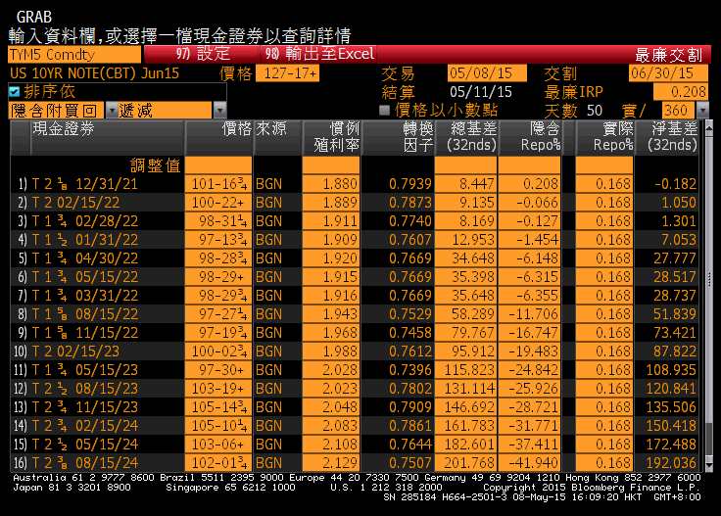
Futures-CTD分析

Slide 12
Basis Trade
“Long the Basis” = Buy cash securities & sell futures
“Short the Basis” = Sell cash securities & buy futures
E.g., if one were to buy the basis by buying $10 million face value of the 2-3/8%-8/24 note, one might sell 81 December 2017 futures by reference to the conversion factor of 0.8072.
E.g., if one were to sell the basis by selling $10 million face value of the 1-7/8%-8/24 note, one might buy 78 December futures by reference to the conversion factor of 0.7807.

Slide 13
IRR(隱含附買回利率)
Implied Repo rate為持有現貨與空期貨至交割日的報酬率
IRR最大者的債券，就是CTD

Slide 14
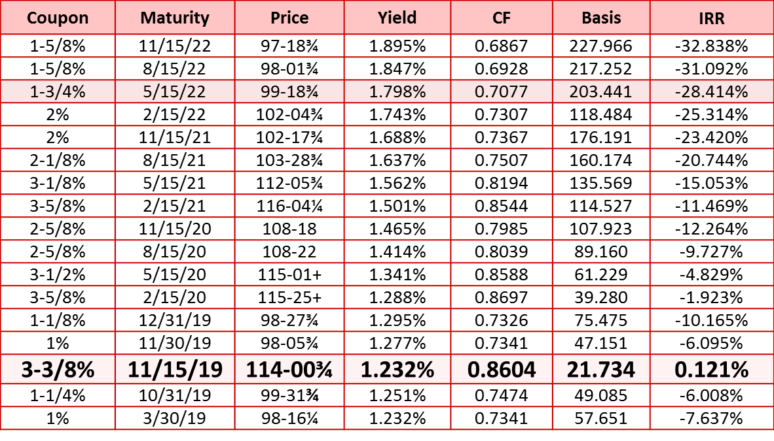
期貨價格在131-23+
3-3/8% 11/15/19 is CTD
3-3/8% | 11/15/19 | 114-00¾ | 1.232% | 0.8604 | 21.734 | 0.121%

Slide 15
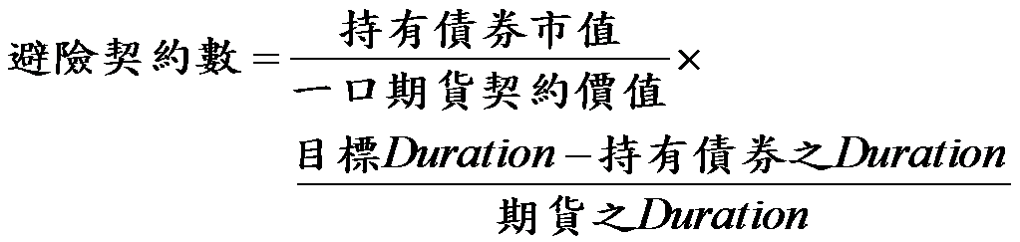

運用公債期貨調整持有部位之Duration，達到規避持有債券之跌價風險：
P.S. 期貨之duration = CTD債券之duration

Slide 16
王先生預期利率即將走揚，擔心持有投資組合市值約2400萬的公債現貨蒙受損失，倘若其現貨之duration為6，欲將目標duration為0，而債券期貨價格為120-00，期貨之duration為8，則王先生需要避險的口數為何?
一口期貨價值=100,000*120/100=120,000
避險口數=24,000,000/120,000*(0-6)/8=-150口

Slide 17
固定利率資產負債風險管理
規避持有債券之跌價風險
V：持有債券總市值(2億)
D：持有債券之Duration(7.6)
Dt： Duration之目標值0(0)
Df： 期貨之Duration＝CTD之Duration(9.0)
FP：期貨價格(83.895)
N避險所需之契約數
N= V / (FP＊5萬) ＊ (Dt－D)/ Df
N=2億/(83.95/100＊500萬) ＊ (0－7.6)/9=－4,023(空4,023口)
PS. Dt可是任何數字，若確定利率會上揚， Dt可定成負數，如此利率上揚整體部位仍可獲利，若預期利率下跌，則可將Dt放大(大於D) ，如鬆緊帶，可快速伸縮

Slide 18
A/L Duration Gap之管理
A=利率敏感性資產價值 (400億)
Ｌ=利率敏感性負債價值 (350億)
Da=資產之Duration (2.8)
DL=負債之Duration (1.9)
若A＊Da>L＊DL➔利率上漲將使淨值下跌
若A＊Da<L＊DL➔利率下跌將使淨值下跌
FP=債券期貨價格(83.895) ， Df=債券期貨之Duration(9) ， N=債券期貨之契約數
A*Da+N*FP*Df＝L*DL
N=(L*DL-A*Da)/(FP*5萬*Df)
=(350億*1.9-400億*2.8)/(83.895/100*5萬*9)=－120,521
故賣出120,521個契約可填補A/L之Duration Gap

