Slide 1

Price Action Trading
Examples(2022/05/10)
僅供內部教育訓練之用，請勿外流

Slide 2
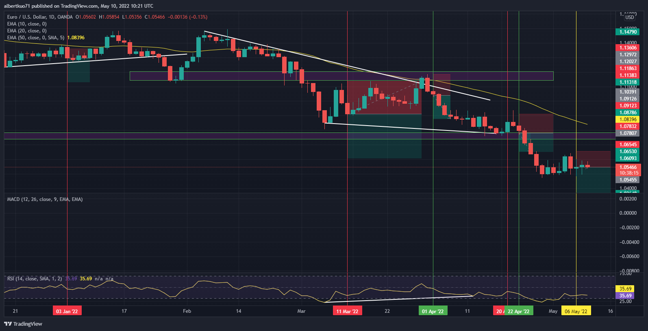
Example
Ex1. EURUSD Daily Chart:

Slide 3
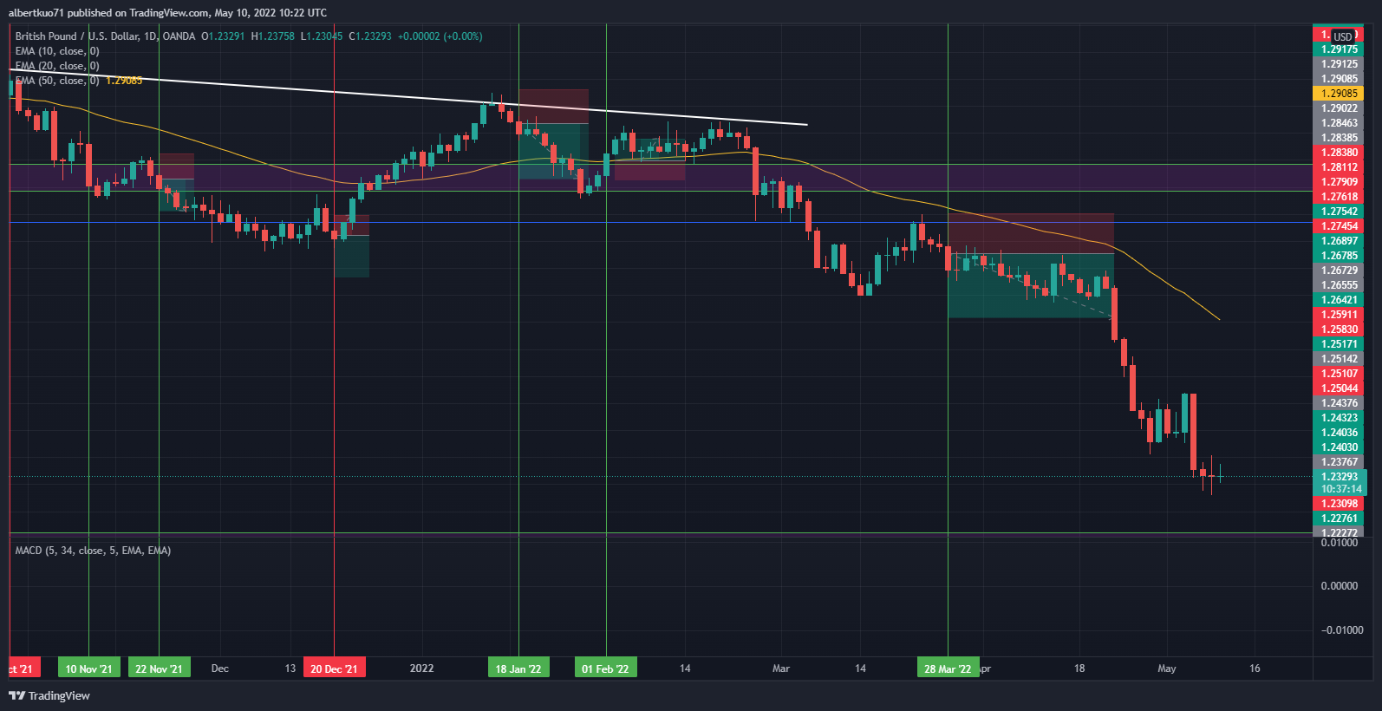
Example
Ex2. GBPUSD Daily Chart:

Slide 4
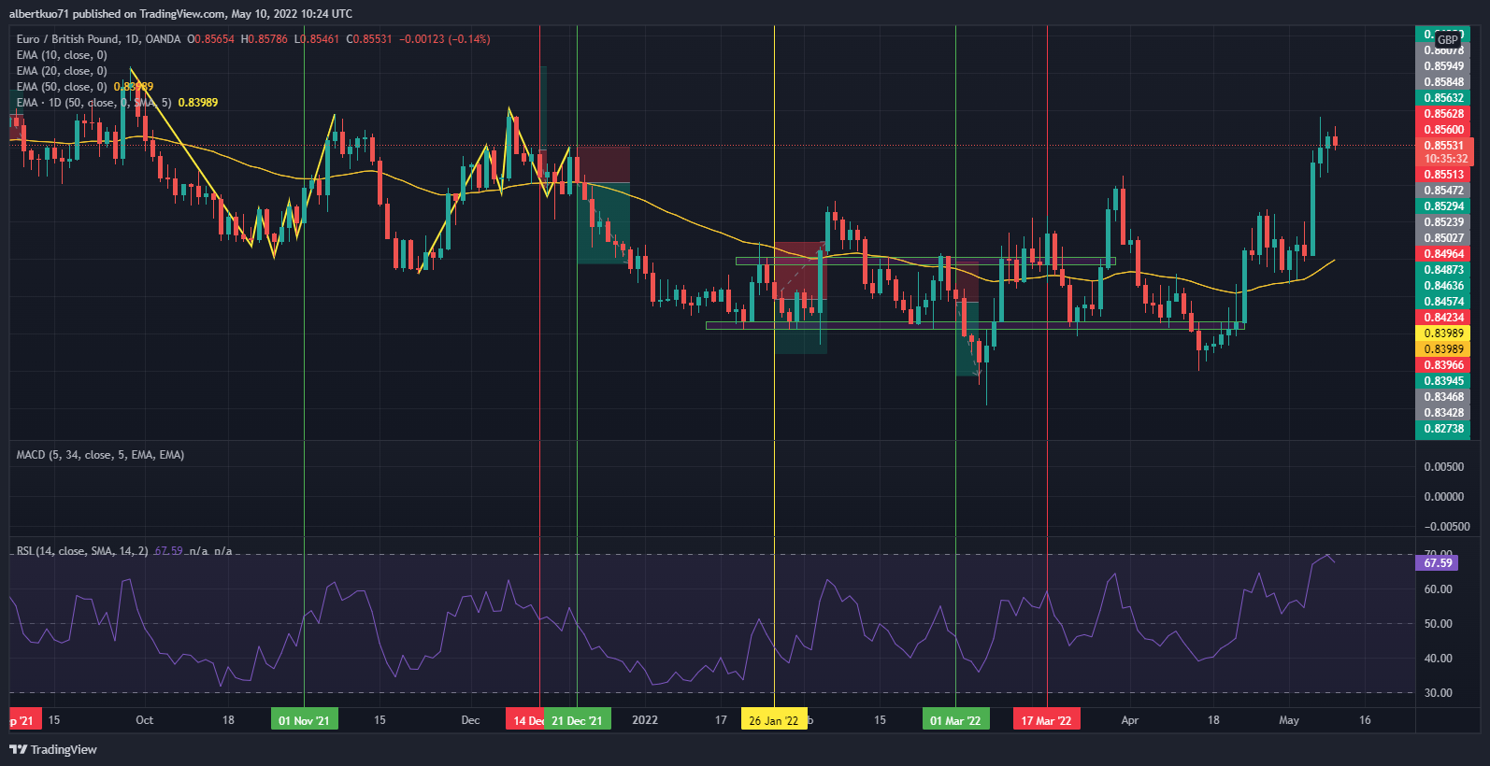
Example
Ex3. EURGBP Daily Chart:

Slide 5
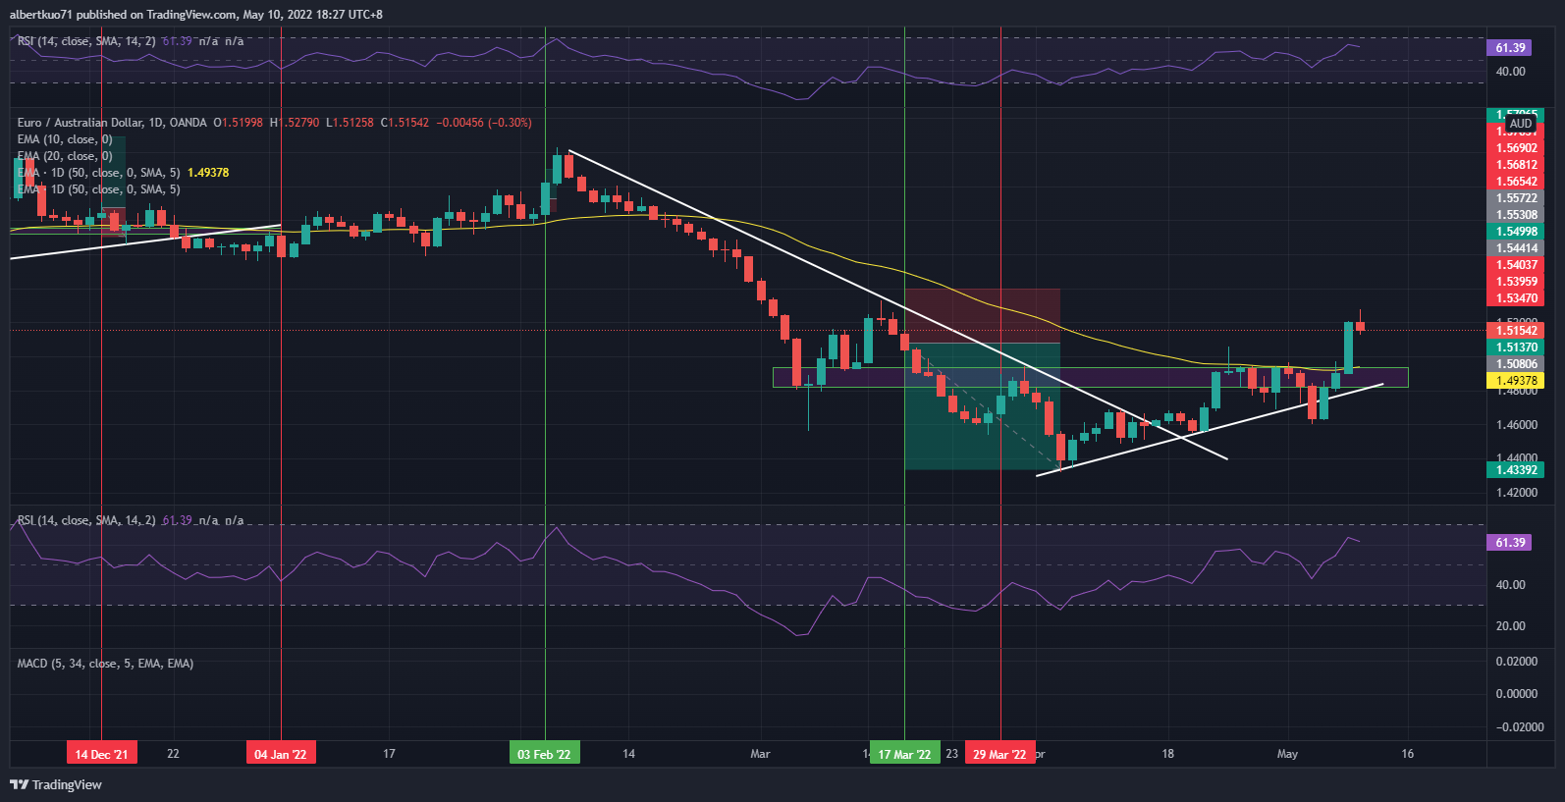
Example
Ex4. EURAUD Daily Chart:

Slide 6
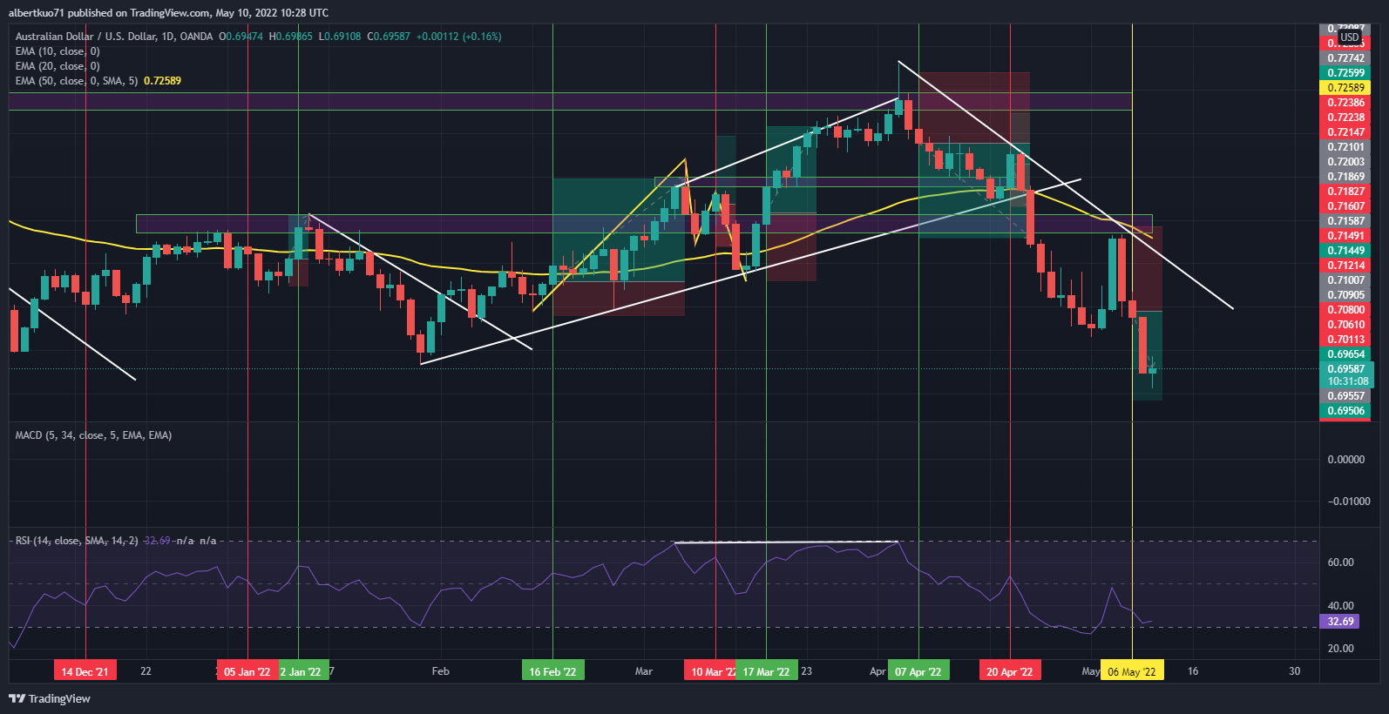
Example
Ex5. AUDUSD Daily Chart:

Slide 7
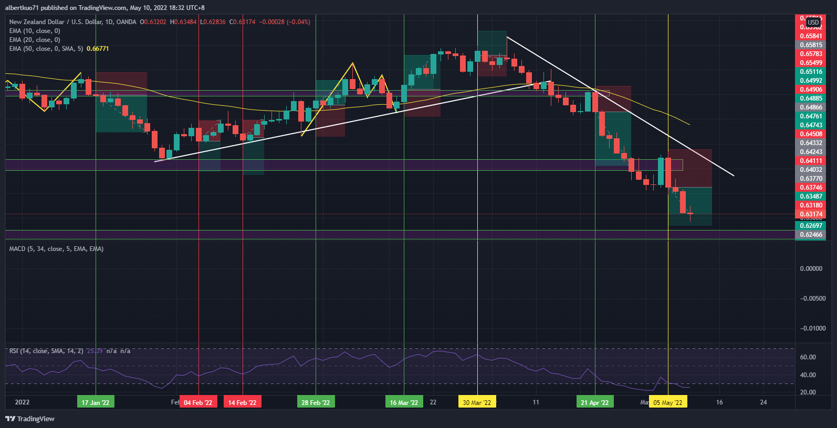
Example
Ex6. NZDUSD Daily Chart:

Slide 8
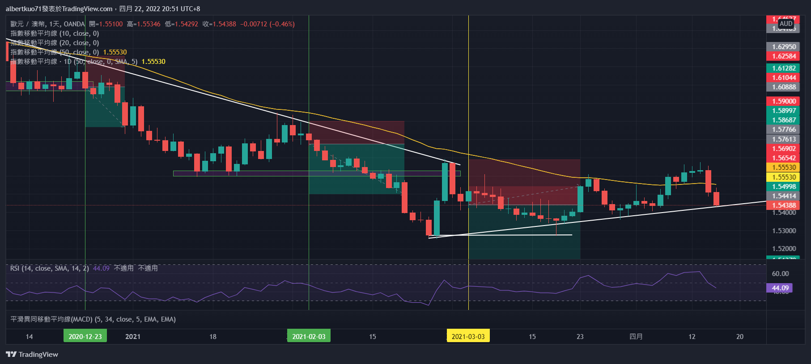
Example
Ex7. EURAUD Daily Chart: The price on 15 Apr 2021 pulled back touching the uptrend line, and higher high and higher low have formed already, so move to 4-Hour chart to see if there’s short entry opportunity.

Slide 9
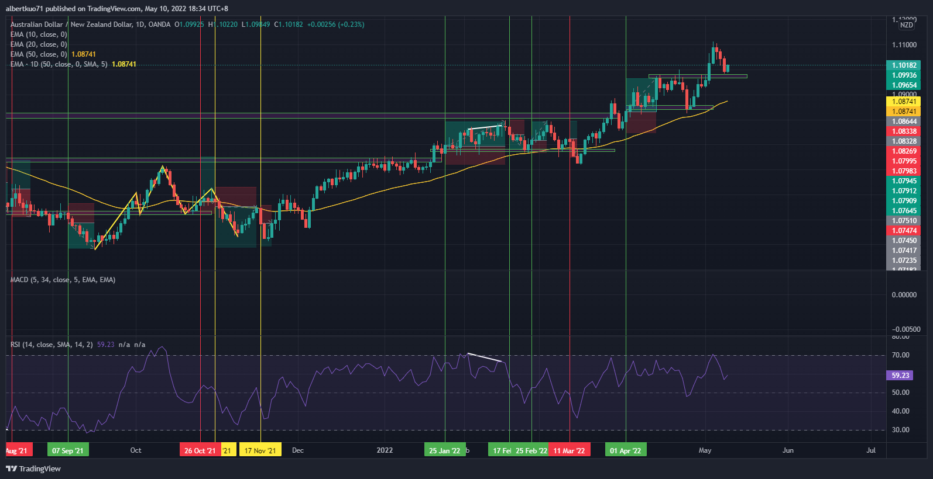
Example
Ex8. AUDNZD Daily Chart:

Slide 10
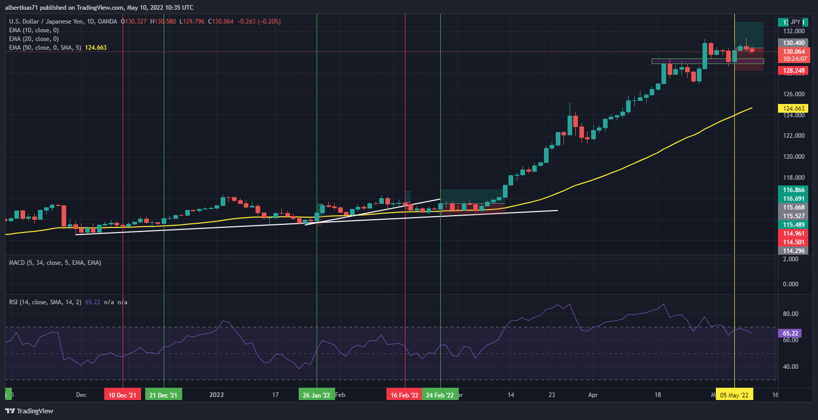
Example
Ex9. USDJPY Daily Chart:

Slide 11
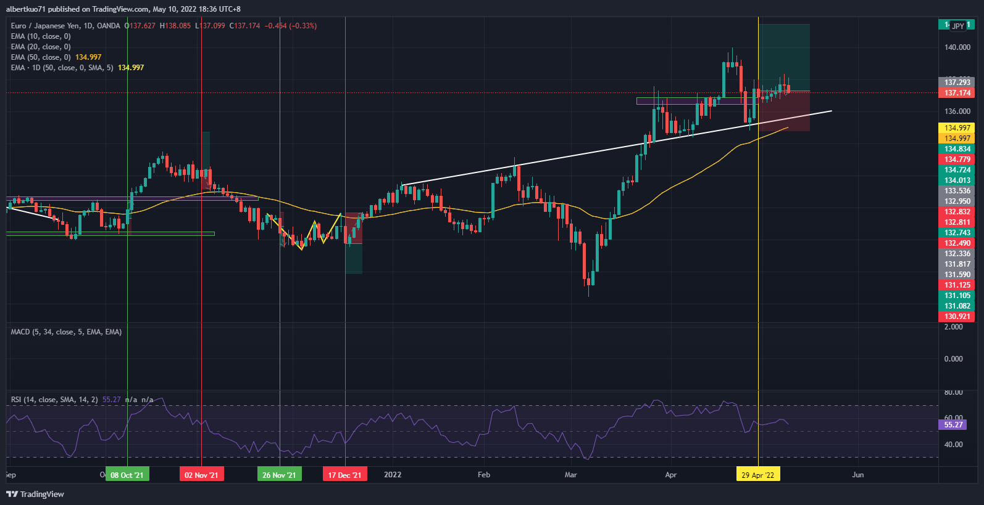
Example
Ex10. EURJPY Daily Chart:

Slide 12
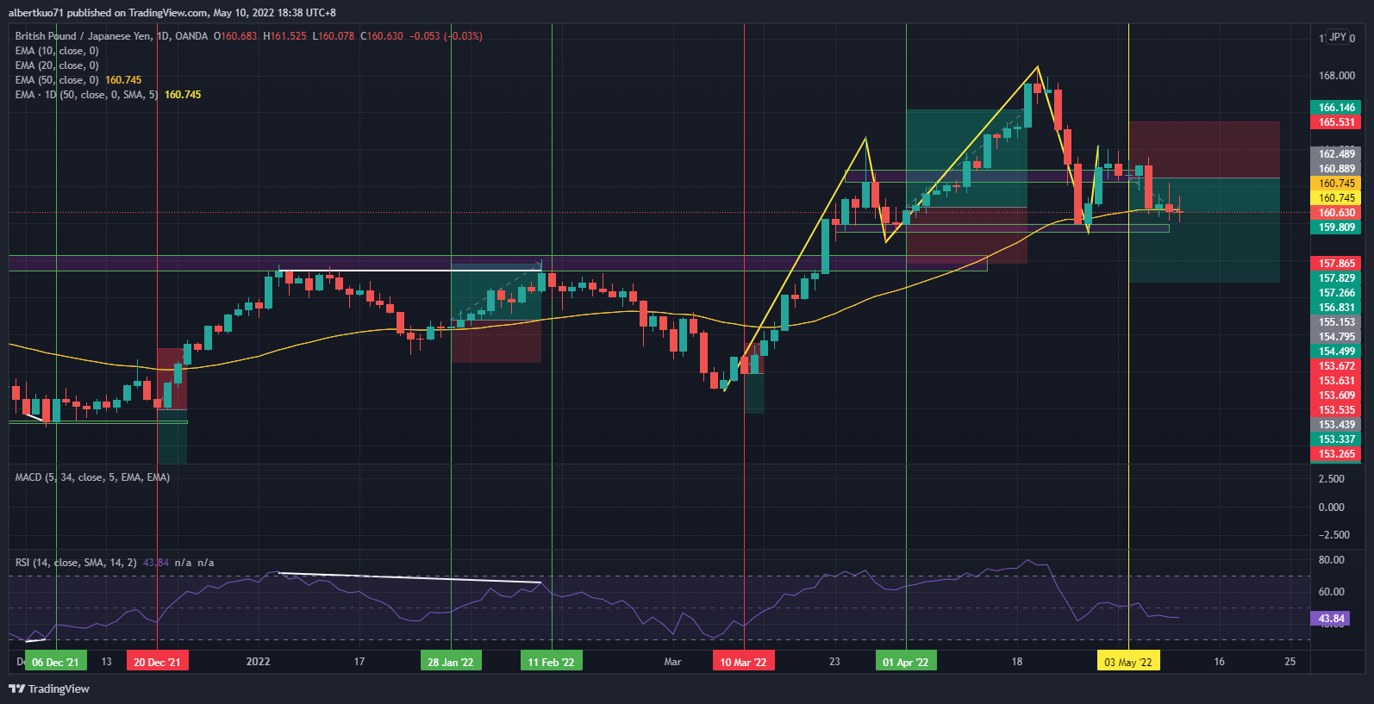
Example
Ex11. GBPJPY Daily Chart:

Slide 13
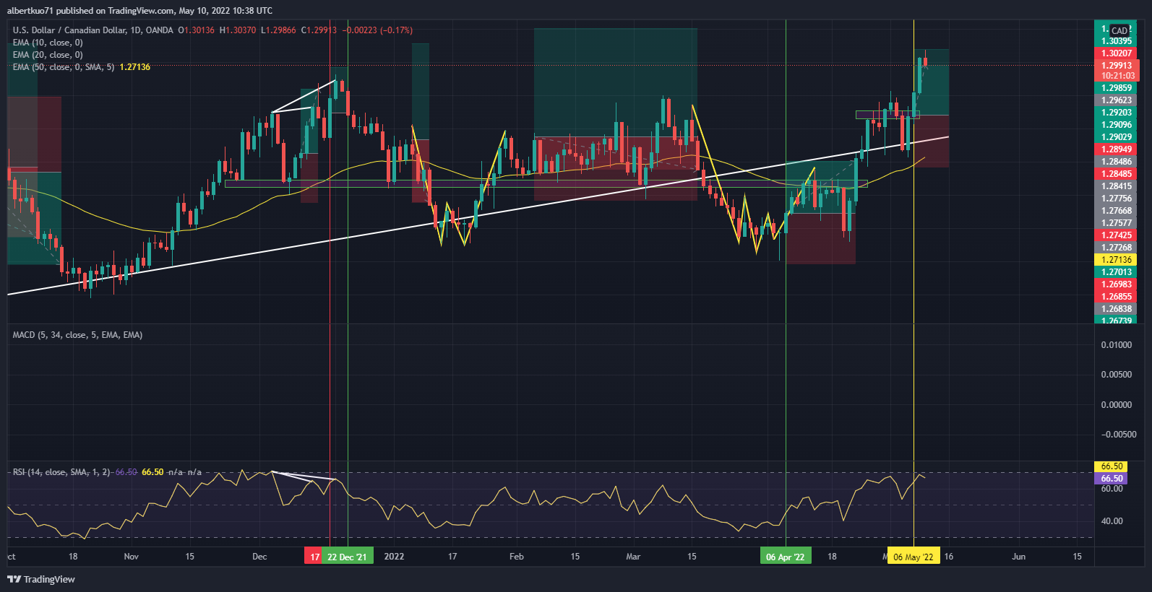
Example
Ex12. USDCAD Daily Chart:

Slide 14
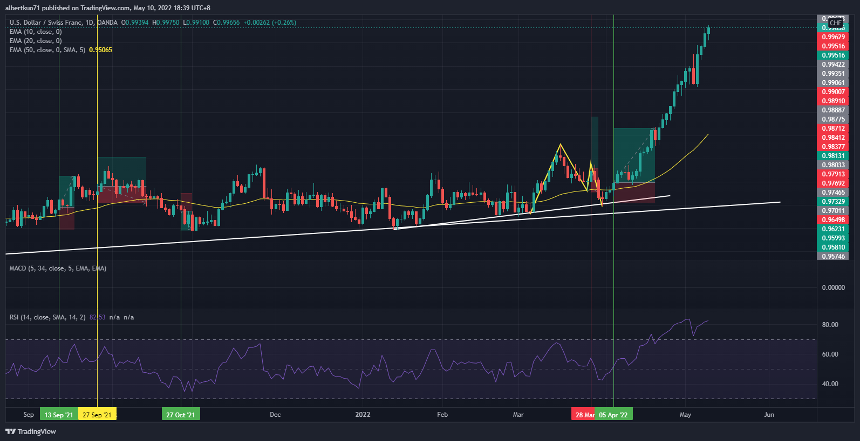
Example
Ex13. USDCHF Daily Chart

Slide 15
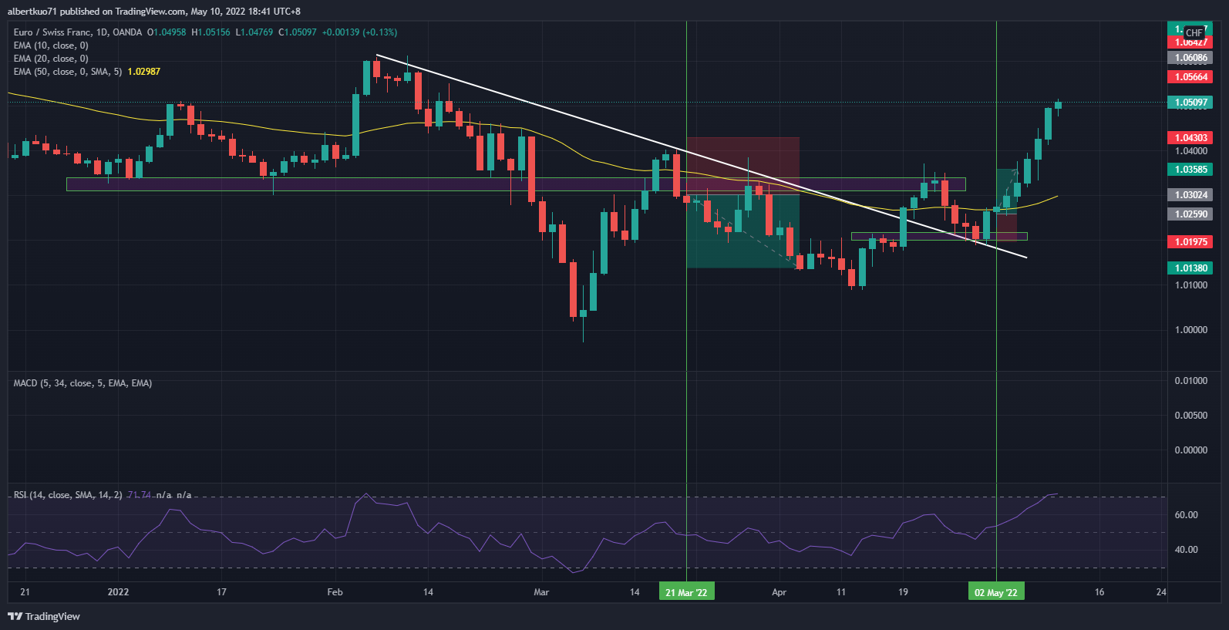
Example
Ex14. EURCHF Daily Chart

Slide 16
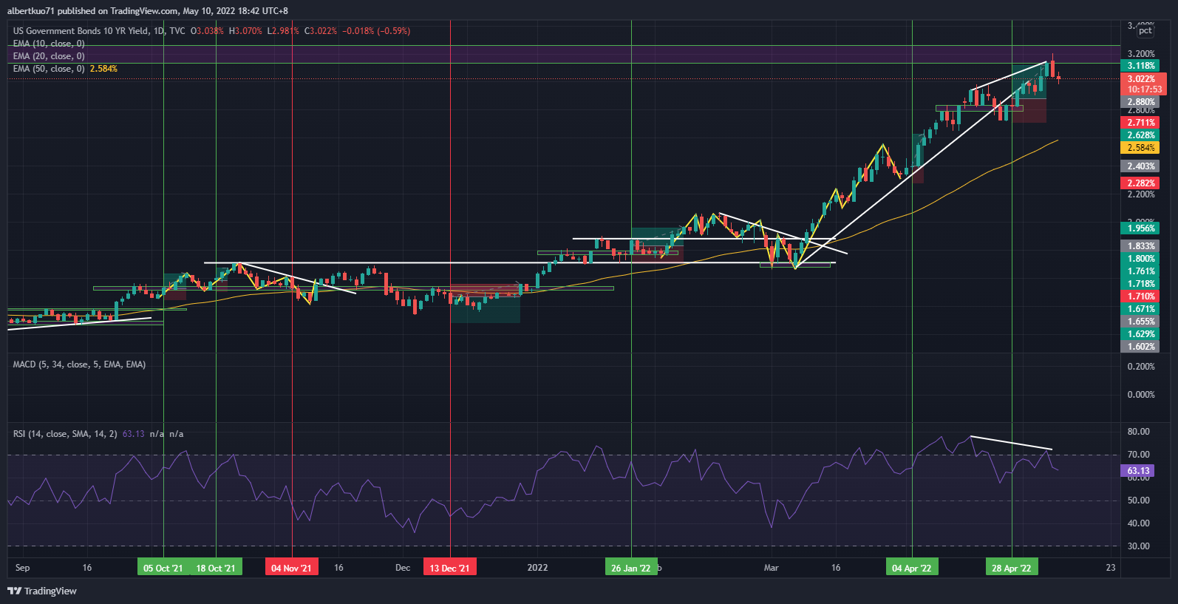
Example
Ex15. US10Y Daily Chart

