Slide 1

US Government Bond
Trading Strategy
僅供內部教育訓練之用，請勿外流

Slide 2
Multiple Targets
Setting R/R ratio equal to 1.0 is too conservative and we can use Multiple Targets method to avoid missing a long trend.
Set Reward/Risk ratio as 1.0
If initial P/T level has been triggered, take profit for half of the position and reset the other half’s S/L equal to its entry price
Use trailing stop as the profit-taking method, which is when the price retests the previous high + ATR(for short) or the previous low – ATR(for long), then take profit.
S/L 1(Entry Price)
S/L 2(Lower High + ATR)
ATR
S/L 3(Lower High + ATR)
ATR
S/L 4(Lower High + ATR)
ATR
Exit Here

Slide 3
Trading Strategies
Use 4-Hour Chart
1. Counter-Trend Trading
Engulfing + RSI(14) Overbought / Oversold
2. Following-Trend Trading
Pull Back Trading Strategy 1&2&3
20EMA Strategy 1&2&3

Slide 4
Counter-Trend Trading
Reversal Strategy(Engulfing + 14RSI)
Short:
(1) (2)
Long:
(1) (2)
Short Here
Short Here
70
70
RSI(14)
RSI(14)
Long Here
Long Here
RSI(14)
RSI(14)
30
30

Slide 5
Following-Trend Trading
*Pull Back Trading Strategy 1(4-Hour Chart)
1. Long Signal:
(1)Prices must be above 200EMA
(2)Prices must make a new higher high
(3)At least 2 bearish candlesticks pull back
(4)Engulfing pattern forms above 200EMA and one of these 2 lower wicks
must be a swing low
(5)Entry candlestick can’t close above the body of the swing high candlestick
(6)R/R ratio is about 1.0~1.5
2. Short Signal:
(1)Prices must be below 200EMA
(2)Prices must make a new lower low
(3)At least 2 bullish candlesticks go up
(4)Engulfing pattern forms below 200EMA and one of these 2 upper wicks
must be a swing high
(5)Entry candlestick can’t close below the body of the swing low candlestick
(6)R/R ratio is about 1.0~1.5

Slide 6
Following-Trend Trading
*Pull Back Trading Strategy 1
Short Signal:
200EMA
1. Bearish Engulfing
2. One of these 2 upper
wicks must be a swing high
Prices
Make a short entry at the close of this bar
Swing Low

Slide 7
Following-Trend Trading
*Pull Back Trading Strategy 2
1. Long Signal:
(1)Prices must be above 200EMA
(2)Prices must make a new higher high
(3)At least 2 bearish candlesticks pull back
(4)Engulfing pattern forms above 200EMA and one of these 2 lower wicks must be
a swing low
(5)Entry candlestick can’t close above the body of the swing high candlestick
(6)Only one candlestick closes below 200EMA before the entry
(7)R/R ratio is about 1.0~1.5
2. Short Signal:
(1)Prices must be below 200EMA
(2)Prices must make a new lower low
(3)At least 2 bullish candlesticks go up
(4)Engulfing pattern forms below 200EMA and one of these 2 upper wicks must
be a swing high
(5)Entry candlestick can’t close below the body of the swing low candlestick
(6)Only one candlestick closes above 200EMA before the entry
(7)R/R ratio is about 1.0~1.5

Slide 8
Following-Trend Trading
*Pull Back Trading Strategy 2
Short Signal:
200EMA
Bearish Engulfing
One of these 2 upper wicks must be a swing high
Only one candlestick closes above 50EMA
Prices
Make a short entry at the close of this bar
Swing Low

Slide 9
Following-Trend Trading
*Pull Back Trading Strategy 3
Follow the rules of Pull Back Trading Strategy 1&2 except rule 5 but the signal
should be valid after the 2nd lower high(for short signal) or higher low(for long
signal) appears.
Short Signal:
New High
1st Lower High
2nd Lower High
Bearish Engulfing
One of these 2 upper wicks must be a swing high
Only one candlestick closes above 50EMA
Prices
200EMA
Make a short entry at the close of this bar
Swing Low

Slide 10
Following-Trend Trading
*Pull Back Trading Strategy 3
Notice: (1)In a downtrend, if the short signal appears with a higher high, ignore
this one. (2)In an uptrend, if the long signal appears with a lower low, ignore
this one. (3)The body of the engulfing candlestick should not be too small.
In a Downtrend:
New High
Higher Than Previous High
1st Lower High
200EMA
Prices
No Entry Here
Swing Low

Slide 11
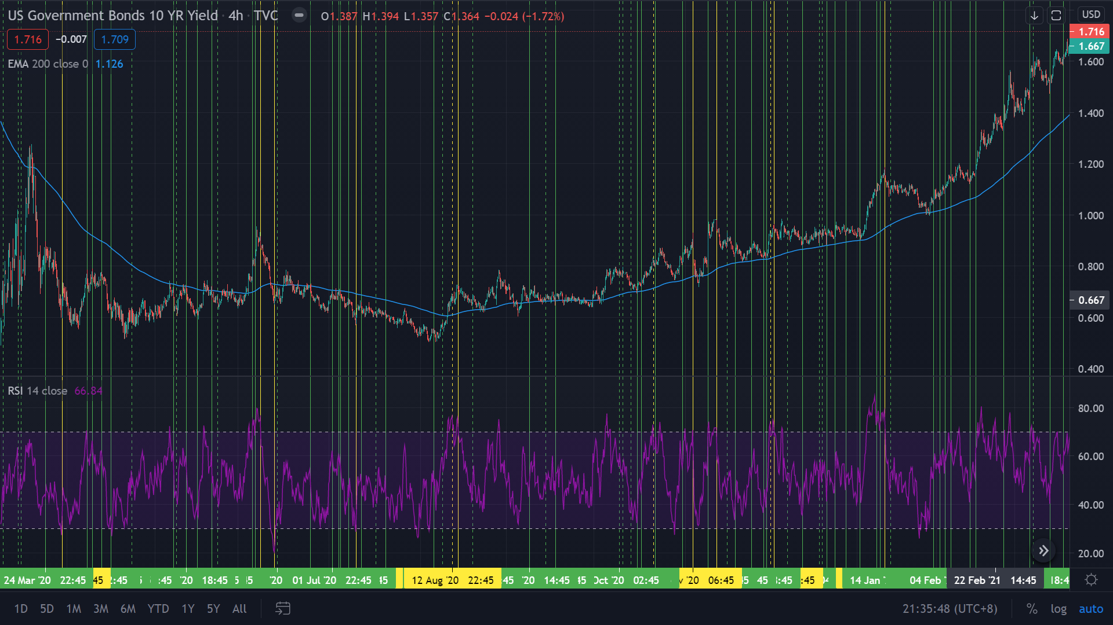
Back Testing(Pull Back Trading Strategy 3 + Reversal Strategy)
US10Y 4-Hour Chart, Green Line=Following-Trend Signal, Yellow Line=Counter-Trend Signal, Solid Line=Gain, Dashed Line=Loss, S/L=Entry Bar Low/High -/+ ATR, R/R Ratio=1, Win Ratio=70.88%

Slide 12
Following-Trend Trading
*20EMA Strategy 1
Look for a break below/above 20EMA. Directly after the break, look for a
shooting star/hammer candlestick in the appropriate direction withing the next
10 candlesticks(including the breaking one)
Long Signal:
Within 10 bars
20EMA
Make a long entry at the close of this bar S/L=Entry Bar’s Low – ATR
R/R Ratio = 1.0
0%
Hammer
38.2%
Shooting Star
38.2%
0%

Slide 13
Following-Trend Trading
*20EMA Strategy 2
Strategy is a cross of 20EMA with just a close of a candlestick followed by a
close below/above previous candlestick withing the next 5 candles(excluding the
crossing one) after the candlestick crossing 20EMA. Then entry candlestick
can’t be the one that crosses 20EMA. The body of the entry candlestick can’t
touch 20EMA.
Long Signal:
Within 5 bars
20EMA
Make a long entry at the close of this bar S/L=Entry Bar’s Low – ATR
R/R Ratio = 1.0
No entry due to the body touching 50EMA

Slide 14
Following-Trend Trading
*20EMA Strategy 3
In an uptrend, if a bullish candlestick touches 20EMA but closes above it, and 20EMA goes up for last 3 intervals consecutively, make a long entry
In a downtrend, if a bearish candlestick touches 20EMA but closes below it, and 20EMA goes down for last 3 intervals consecutively, make a short entry
Long Signal:
20EMA
Make a long entry at the close of this bar S/L=Entry Bar’s Low – ATR
or Recent Low – ATR
R/R Ratio = 1.0
100
98.5
97
98.5
97.5
98

Slide 15
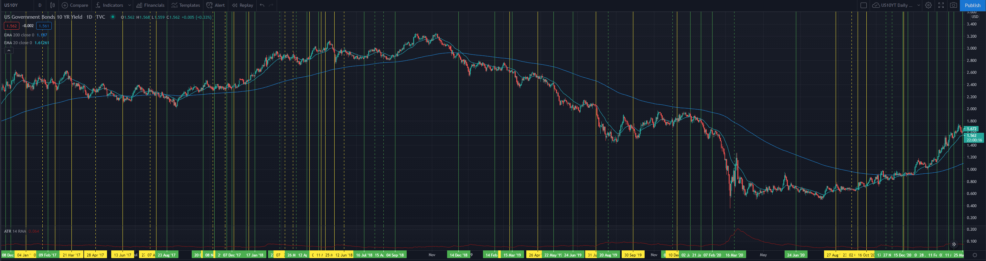
Back Testing(Pull Back Trading Strategy 3 + 20EMA Strategy 3)
US10Y Daily Chart, Green Line=PB3 Signal, Yellow Line=20EMA3 Signal, Solid Line=Gain, Dashed Line=Loss, S/L=Entry Bar Low/High -/+ ATR, R/R Ratio=1, Win Ratio=72.73%

