Slide 1
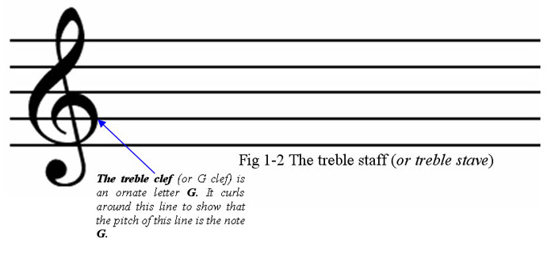
N
o
A
S
i
i
D
o
n
i
a
t
n
f
the use of audio to convey
the information content of
DNA sequence data
c

Slide 2
