Slide 1
Parallel Algorithms for the Assignment Problem
By Mark DiValerio and Sanjaikanth Pillai

Slide 2
The Assignment Problem
The assignment problem is a common software problem that assigns each “agent” to a “task” (with at most 1 agent per task) to minimize cost, or to maximize profit.
There are several algorithms that can solve the Assignment Problem, but the most widespread and common solution is the Hungarian Algorithm.
It can also be used to find the most optimal weighted path in a bipartite graph

Slide 3
History
The Hungarian method is a combinatorial optimization algorithm that solves the assignment problem in polynomial time .
It was developed and published in 1955 by Harold Kuhn.
He gave the name "Hungarian method".
Algorithm was largely based on the earlier works of two Hungarian mathematicians: Dénes Kőnig and Jenő Egerváry.

Slide 4
The Hungarian Algorithm - part 1
(Preparation) - Normalize & Invert
If given an unbalanced n*m matrix, add columns or rows containing the maximum value so that it is a square matrix
If finding the maximum total value (i.e. “profit” instead of the minimum “cost”), multiply every value in the matrix by -1
Subtract the row’s minimum from every value in the row for every row.
Subtract the column’s minimum from every value in the column for every column.

Slide 5
The Hungarian Algorithm - part 2
4. Find the minimum number of horizontal/vertical lines that would cover all the zeros in the matrix.
5. If the number of covering lines < n, Reduce to generate more zeros.
Find the minimum “uncovered” value
subtract the minimum value from all uncovered numbers
Add that minimum value to any intersecting “covered” numbers, the numbers that are covered by 2 lines (one horizontal one vertical)
Repeat steps 4-5 until the number of covering lines == n.
6. Choose n zeros that uniquely covers every row and column. (use their row/column location with the original input matrix to get total cost/profit).

Slide 6
2) Row Reduction
30 25 10 10 20 15 0
15 10 20 - 10 = 5 0 10
25 20 15 15 10 5 0 (In Step 1, it’s an n*n matrix so no “normalization”. We’re also finding the minimum total value so we don’t need to invert the matrix)

Slide 7
3) Column Reduction
20 15 0 15 15 0
5 0 10 = 0 0 10
10 5 0 5 0 0
-
5 0 0

Slide 8
4) Cover Zeros & 5) Shift Zeros
15 15 0 10 10 0
0 0 10 → 0 0 15
5 5 0 0 0 0
2 rows/columns 3 rows/columns
Minimum uncovered = 5
Subtract minimum from all uncovered, add minimum to all intersections.
Repeat until # of lines == n (in this case n=3)

Slide 9
6) Choose solution
10 10 0 30 25 10
0 0 15 → 15 10 20
0 0 0 25 20 15
Choose a set of zeros that will uniquely cover all rows and columns
(if there are multiple, any would work). Use original matrix to get total cost
(0,2) + (1,0) + (2,1) (0,2) + (1,1) + (2,0)
10 + 15 + 20 = 45 10 + 10 + 25 = 45

Slide 10
Parallelizing Hungarian Algorithm
Because almost every step is matrix manipulation, and every manipulation’s inner iterations can be done independently (Step 1’s row reduction subtracts every row with the minimum value of that row), most of Hungarian’s Algorithm can be easily parallelized.
Covering Zeros is tricky as it requires to find the minimum lines that cover the zeros. Also the last step of getting the solution from the zeros, uniquely covering all rows and columns is difficult to parallelize due to each iteration depends on the previous iteration.

Slide 11
Implementation
Programming language in the C# Language version 4.7.2
Visual Studio 2019 version 16.2.4
Parallel.For(<start>, <stop>, (<variable>, <state>) =>{ //parallel code here lock(<obj variable>) { // code utilizing “locked” object } Interlocked.Increment(ref <numericalVariable>); });

Slide 12
Applications
As part of the project we created three applications :
Hungarian Algorithm with unit testing.
Resource Allocator (UI for finding minimum bipartite matching)
Performance Analyser

Slide 13
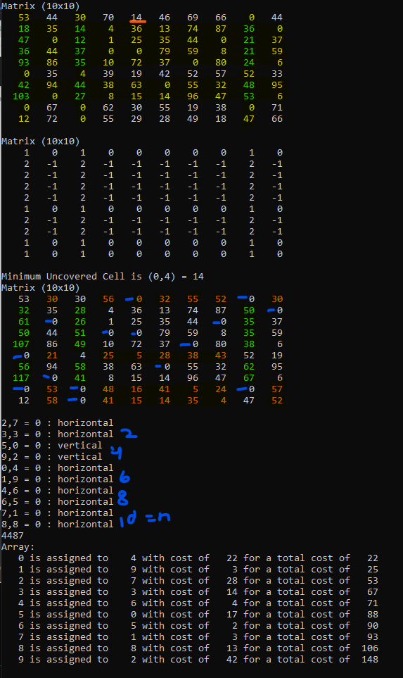
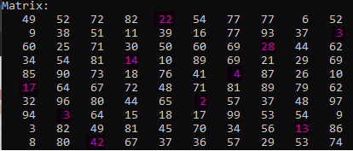
Hungarian Algorithm

Slide 14
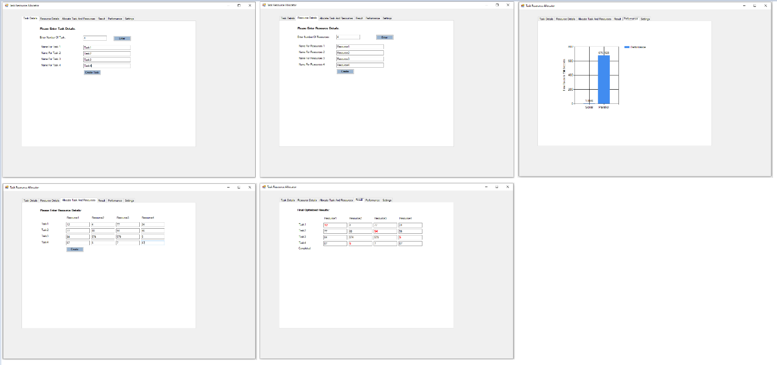
Resource Allocator
Resource Allocator is UI application for finding Minimum Bipartite Matching.

Slide 15
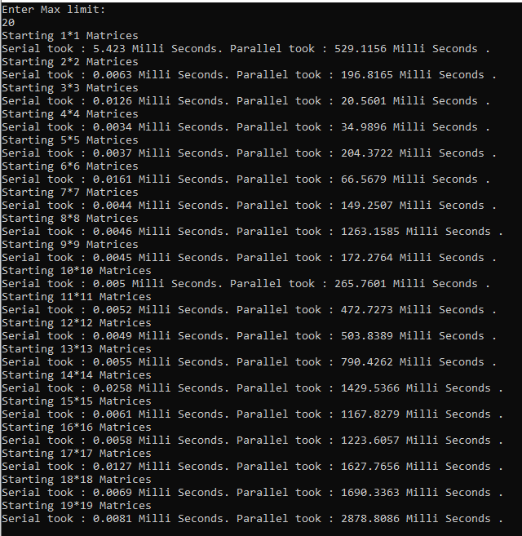
Performance Analyser
Performance Analyser is a console application that compares execution between serial and parallel implementation.

Slide 16
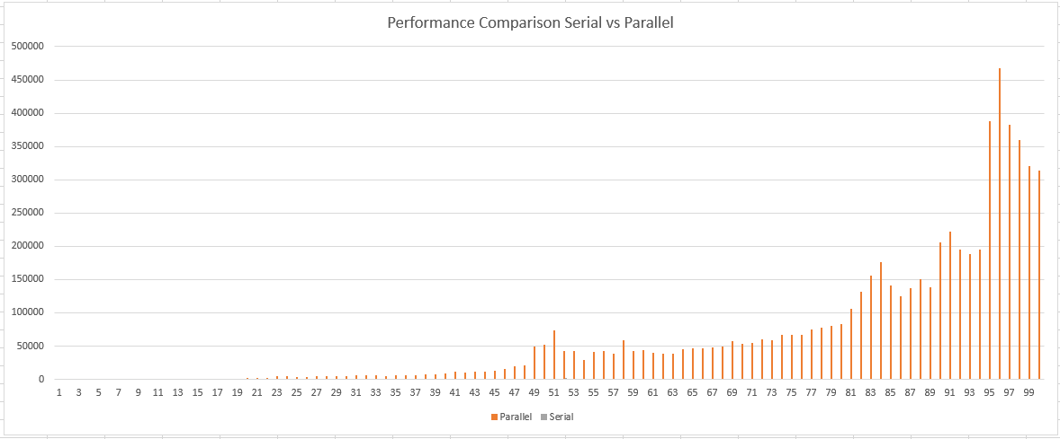
Parallel Hungarian Algorithm Results

Slide 17
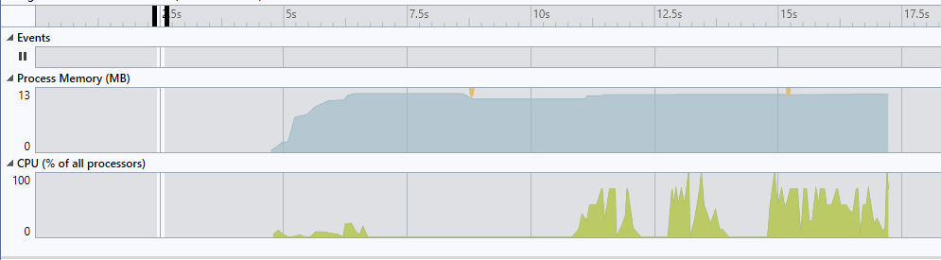
Analyses
Below are the analyses for running Hungarian Parallel implementation:
Max Memory used:12.2 MB.
Max CPU:100%

Slide 18
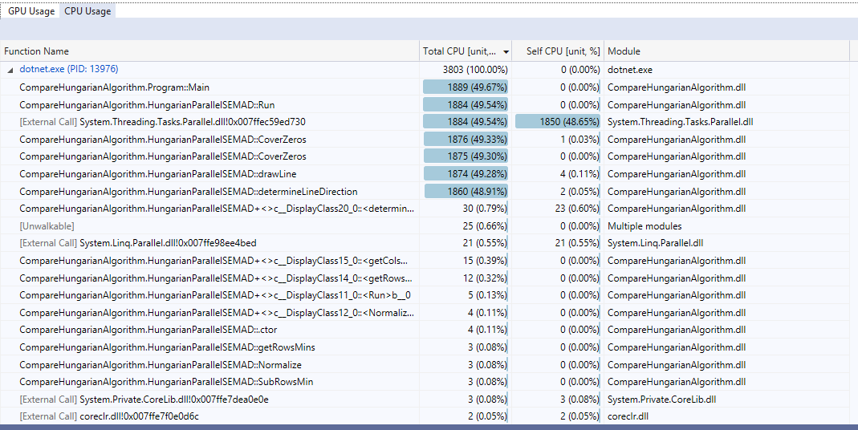
Analyses :CPU Usage
Below are the CPU usage by functions:
CoverZeros() is taking more CPU unit compared to rest of the core functions.

Slide 19
Demo

Slide 20
Questions?

