Slide 1
Geographically Weighted Regression
Mark Green
DASC507 – Advanced Biostatistics II
Analysis Methods for Complex Data Structures

Slide 2
Outline
Linear regression – please not another recap
Spatial non-stationarity – why it matters
Geographically Weighted Regression (GWR)
Spatial kernel
Bandwidth
Criticisms
Case study example

Slide 3

Linear regression – please not another recap
Outcome of interest
Coefficient applied to X
$$y=α+βX+ⅇ$$
Constant
Explanatory variables
Error term

Slide 4
Linear regression – please not another recap
Beta coefficients for explanatory variables give an ‘overall’ or ‘average’ association – helpful for describing an association
This assumes that the influence of a variable on an outcome is consistent across varying contexts
Parameters may not always be ‘stationary’, but may be non-stationary when capturing heterogenous patterns
Time-series is a common form of non-stationarity, as is spatial patterns

Slide 5
Spatial non-stationarity – why it matters
Conceptual reasons
A large body of literature shows that neighbourhoods matter for health (e.g., air quality, access to services)
Neighbourhoods or places imprint local effects (e.g., resilience, community support, local resources, place-unique issues)
Context vs composition matters – but hard to separate out

Slide 6
Spatial non-stationarity – why it matters
Methodological reasons
Global models cannot incorporate local differences between places easily
Local processes/effects/modifiers hard to measure
Non-stationarity may simply just be omitted variables (but still need to account for possibility)
Multi-level models might help but don’t acknowledge space explicitly

Slide 7
Geographically Weighted Regression (GWR)
Extension of linear (OLS) regression model
Allows for spatially varying coefficients
Demonstrates how associations between explanatory variables to an outcome variable may differ by location both in strength of association and direction of relationship
Can be used for individual- and area-level data (must have spatial location for both)
A data-driven approach for estimating parameters

Slide 8
Geographically Weighted Regression (GWR)
GWR works through:
For each observation (individual or area)
Select surrounding/neighbouring observations based on a search window
Run a regression model on just these observations (local regression model)
Repeat process for each data point (i.e., n regression models are run)
Compare to global regression model of all data points
Plot regression coefficients
Smile

Slide 9
Geographically Weighted Regression (GWR)
Our modified OLS equation becomes:
Where i is observation and u is ‘conditioned on place’ (vector of co-ordinates). To estimate β, we use this magic:
Where W is our spatial weights again. This is similar to a weighted least squares global model (just conditioned on location)
$$y_{i}\left(u\right)=α_{i}\left(u\right)+β_{i}\left(u\right)X_{i}+e_{i}$$
$$\hat{β}\left(u\right)={\left(X^{T}W\left(u\right)X\right)}^{−1}X^{T}W\left(u\right)y$$

Slide 10
Geographically Weighted Regression (GWR)
To fit local regression models, we need to define the spatial kernel
Defines how to weight observations
Data located close to the data point being estimated are given greater importance -> remember Tobler’s first law of Geography?
Need to define how weighting changes with distance
Weights sum to 1
Notes:
Image source: https://gistbok.ucgis.org/bok-topics/2020-quarter-04/geographically-weighted-regression-framework

Slide 11
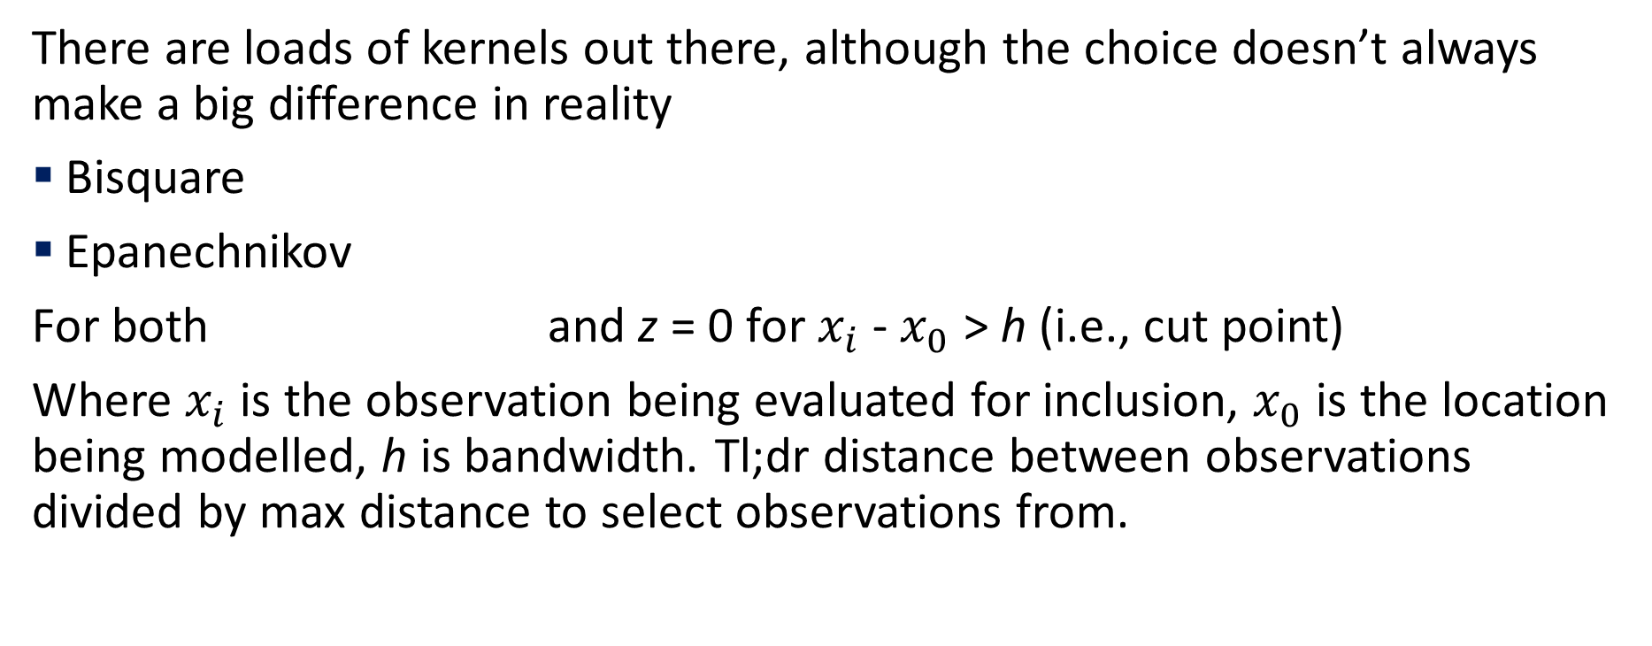
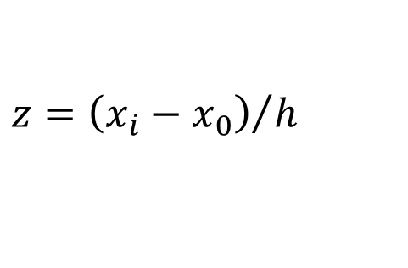


Geographically Weighted Regression (GWR)
There are loads of kernels out there, although the choice doesn’t always make a big difference in reality
Bisquare
Epanechnikov
For both and z = 0 for $x_{i}$ - $x_{0}$ > h (i.e., cut point)
Where $x_{i}$ is the observation being evaluated for inclusion, $x_{0}$ is the location being modelled, h is bandwidth. Tl;dr distance between observations divided by max distance to select observations from.
$$w_{i}\left(u\right)={\left(1−z^{2}\right)}^{2}$$
$$w_{i}\left(u\right)=1−z^{2}$$
$$z={\left(x_{i}−x_{0}\right)}/h$$

Slide 12
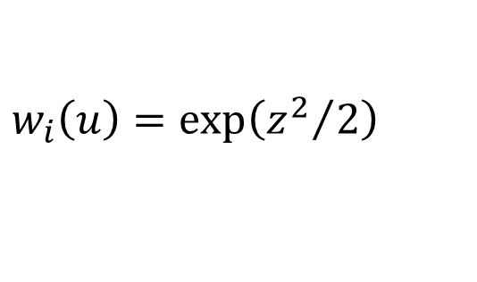
Geographically Weighted Regression (GWR)
Continuous / Gaussian approaches exist. For example
Infinite range
These approaches may not have a cut-point and therefore all data points are used in model estimation (with far away points contributing very little).
$$w_{i}\left(u\right)=\exp\left({z^{2}}/2\right)$$

Slide 13
Geographically Weighted Regression (GWR)
We must also select a bandwidth
Defines extent of observations to be considered for the local regression
Bandwidth defines the area to be covered
Fixed: same distance used for each regression
Adaptive: varying bandwidths are used for each regression, depending on local parameters
Notes:
Image source: https://gistbok.ucgis.org/bok-topics/2020-quarter-04/geographically-weighted-regression-framework

Slide 14
Geographically Weighted Regression (GWR)
Choice of bandwidth is more difficult to get right and can have a large impact on your results. Important trade off between
Bias
Variance
Bandwidths need to be large enough to capture enough data to generate reliable estimates (precision depends on n), but not too large that estimates don’t reflect spatial patterns.
Can be ‘optimized’ using rule-based approaches or cross-validation

Slide 15
Criticisms
Local multicollinearity can be problematic for local coefficients
Simulation studies suggest GWR cannot always detected underlying spatial patterns in data or find patterns when there are none
Difficulty in validating results/models (best as exploratory method)
Model results can be unstable and not always replicable with small samples sizes (try re-running the model in the practical again and again)
Bigger sample sizes help with robustness, but at the expense of computational time
Multivariate models can be difficulty to get enough data points with enough variability in characteristics at smaller bandwidths

Slide 16
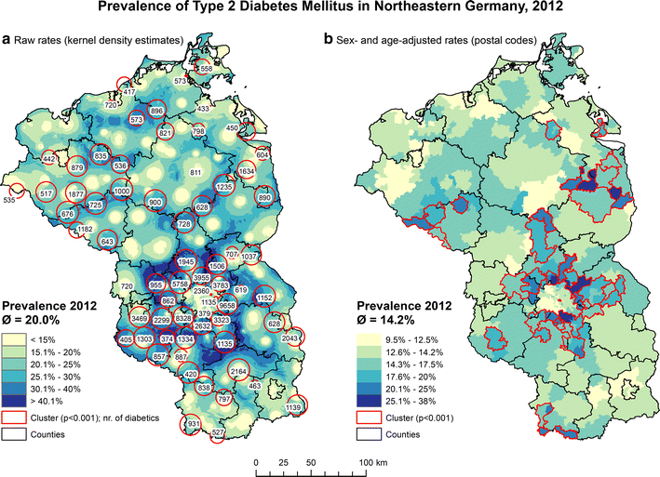
Case Study
Kahul et al. 2016. Do the risk factors for type 2 diabetes mellitus vary by location? A spatial analysis of health insurance claims in Northeastern Germany using kernel density estimation and geographically weighted regression. International Journal of Health Geographics 15: 38.
Berlin

Slide 17
Case Study
Variable | Coefficient | VIF
Intercept | 2.259540***
Persons aged 65–79 (%) | 0.027251*** | 1.656689
Persons aged 80 and older (%) | 0.010704** | 1.650654
Unemployed persons aged 55–65 (%) | 0.013354*** | 2.593295
Employed persons (%) | −0.006181** | 1.602619
Mean income tax | 0.000780** | 2.272369
Non-married couples (%) | 0.014524* | 1.45273
Adjusted R2 | 0.44
AICc | −313
Global Moran’s I of residuals | I = 0.264 (p < 0.001)
Global OLS Regression model

Slide 18
Case Study
Model | AICc | Adjusted R2 | Moran’s I of residuals
Adaptive, Gaussian, AICc | −347 | 0.51 | p < 0.001
Adaptive, Gaussian, AIC | −347 | 0.51 | p < 0.001
Adaptive, Gaussian, BIC | −315 | 0.44 | p < 0.001
Adaptive, Gaussian, CV | −347 | 0.51 | p < 0.001
Fixed, Gaussian, AICc | −385 | 0.62 | p < 0.05
Fixed, Gaussian, AIC | −265 | 0.66 | p > 0.05
Fixed, Gaussian, BIC | −316 | 0.44 | p < 0.001
Fixed, Gaussian, CV | −370 | 0.64 | p > 0.05
Adaptive, bi-square, AICc | −394 | 0.63 | p < 0.001
Adaptive, bi-square, AIC | −374 | 0.66 | p > 0.05
Adaptive, bi-square, BIC | −320 | 0.45 | p < 0.001
Fixed, bi-square, AICc | −385 | 0.62 | p < 0.01
Fixed, bi-square, AIC | 40 | 0.68 | p > 0.05
Fixed, bi-square, BIC | −316 | 0.44 | p < 0.001
Comparing the effects of optimisation, kernel and bandwidth choices, as well as if model residuals remain spatially clustered

Slide 19
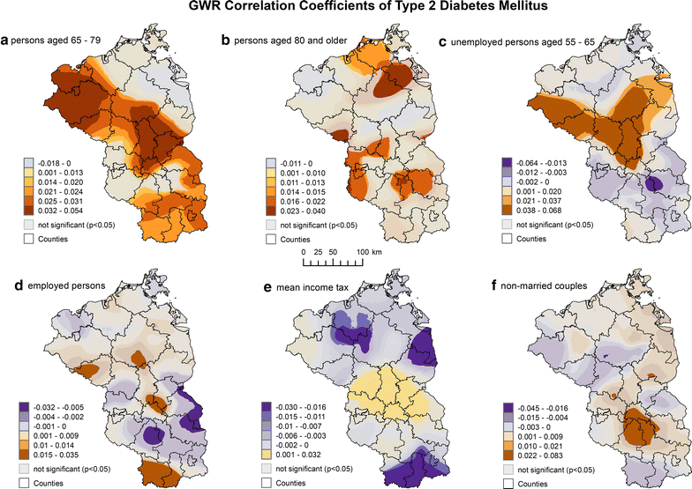
Case Study
Mapping coefficients

Slide 20
Further reading
Brunsdon, C., Fotheringham, A. S., & Charlton, M. E. (1996). "Geographically weighted regression: a method for exploring spatial nonstationarity". Geographical analysis 28(4): 281-298.
Comber, A., et al. (2020). The GWR route map: a guide to the informed application of Geographically Weighted Regression. arXiv https://arxiv.org/abs/2004.06070.
Nakaya, T., Fotheringham, A. S., Brunsdon, C., & Charlton, M. (2005). "Geographically weighted Poisson regression for disease association mapping". Statistics in medicine 24(17): 2695-2717.
Páez, A., Farber, S., & Wheeler, D. (2011). "A simulation-based study of geographically weighted regression as a method for investigating spatially varying relationships". Environment and Planning A 43(12): 2992-3010.

