Slide 1
MLOPS · CHURN PREDICTION · REAL DATA
Subscriber Dropout Detection
A system that predicts which subscribers are about to cancel, explains why, and keeps itself honest in production.
82.8M
8
456
events in a Postgres warehouse
services, one command
tests · 7 CI/CD jobs
Notes:
Subscription businesses lose revenue when people cancel. If you can spot who is about to cancel, you can act while they are still a customer. This system predicts that for a real music-streaming service - but the model is a small part. Most of the work is what keeps a model trustworthy in production: that is MLOps.

Slide 2
THE PROBLEM
Why this is hard: churn is rare
1.5%
1
Predict
the probability each subscriber cancels in the next 30 days
of subscribers cancel in any 30-day window
2
Explain
why, per subscriber, with numbers that add up to the prediction
98.5%
accuracy from a "model" that says nobody ever churns. Accuracy is useless here.
3
Operate
serve it, monitor it, retrain it, and refuse worse models
Notes:
Only about 1.5% of subscribers cancel in a 30-day window, so a model that says nobody churns is 98.5% accurate and useless. That single fact drives the metric choices later. The system has three jobs: predict, explain, operate.

Slide 3
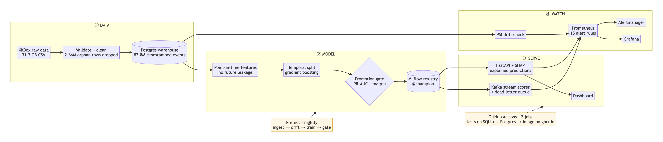
ARCHITECTURE
Four stages, one pipeline
1
Data
2
Model
3
Serve
4
Watch
31.3 GB raw → cleaned → Postgres
leak-free features, gated promotion
API + SHAP, Kafka streaming
drift, 15 alert rules, Grafana
Notes:
Left to right: raw data is validated and cleaned into a Postgres warehouse; point-in-time features train a model that only reaches production through a PR-AUC gate in the MLflow registry; the champion serves through an API and a Kafka stream scorer; Prometheus, Alertmanager and Grafana watch it. Prefect runs the nightly pipeline and GitHub Actions tests and publishes everything.

Slide 4
DATA · KKBOX MUSIC STREAMING
Real data, cleaned on purpose
31.3 GB
1
Dropped 2.66M orphan rows
not invented: a made-up signup date makes old customers look new, and "new" reads as risky
raw CSV: members, transactions, daily listening logs
2
Widened IDs 32 → 64 chars
real IDs are 44 characters; SQLite ignored it, Postgres would have rejected every row
82.8M
3
Normalised prices to monthly
plans run 7 to 410 days, so raw prices were not comparable
rows in Postgres: 6.8M subscribers, 38.2M sessions
4
Stored events, not totals
so any past date can be rebuilt exactly, which is what prevents leakage
Notes:
Show TablePlus: query 1 (82.8M rows), the subscribers table (44-character anonymised IDs), query 4 (one subscriber's full history, instant thanks to indexes), query 5 (the cleaning log). The key decision: 2.66 million transactions belonged to subscribers missing from the members file, and they were dropped rather than given invented signup dates.

Slide 5
FEATURES · POINT-IN-TIME CORRECTNESS
The model never sees the future
Features: 30 days before T
Label: cancels in 30 days after T?
cutoff T
The two windows never overlap, so nothing after T can reach a feature.
Train
Validate
Test
cutoffs Nov + Dec 2016
31 Dec 2016
29 Jan 2017
Notes:
For a cutoff date T, features use only the 30 days before T; the label is whether the subscriber cancels in the 30 days after. The windows never overlap, so the model cannot see the answer. The split is by time, never random: a random split mixes the future into training and measures memory rather than prediction.

Slide 6
METRICS · WHY THE GATE USES PR-AUC
ROC-AUC went up. The model got harder to use.
The finding
Moving to real data, ROC-AUC rose from 0.67 to 0.84 while PR-AUC fell from 0.35 to 0.07.
ROC-AUC barely notices how rare churn is. PR-AUC is dominated by it.
A gate on ROC-AUC would have reported an improvement. So the gate uses PR-AUC, with a 0.005 margin.
Notes:
This is the strongest moment of the talk. When the project moved from synthetic data to real KKBox data, ROC-AUC went up from 0.674 to 0.835 while PR-AUC fell from 0.345 to 0.073. ROC-AUC would have said things improved when the problem had become much harder. That is why the promotion gate uses PR-AUC.

Slide 7
REGISTRY · MLFLOW + PROMOTION GATE
No model reaches production by accident
1
2
3
4
Train
→
@challenger
→
Gate
→
@champion
every run logged: params, metrics, model
registered as a candidate
beats @champion on PR-AUC by ≥ 0.005?
moves the alias; serving follows
Identical challenger → rejected
CI trains the same model twice; the second must fail the gate
Shadow scoring
a challenger scores live traffic silently before it can answer anyone
Idempotent pipeline
running it twice changes nothing; a failed night can be re-run safely
Notes:
Show MLflow: Model training, Experiments, subscriber-dropout, the latest run; then Models, subscriber-dropout-classifier. The live model is whichever version holds the @champion alias. A new model is only promoted if it beats the champion on PR-AUC by at least 0.005 - the margin stops near-identical models swapping on noise. CI proves an identical challenger is rejected.

Slide 8
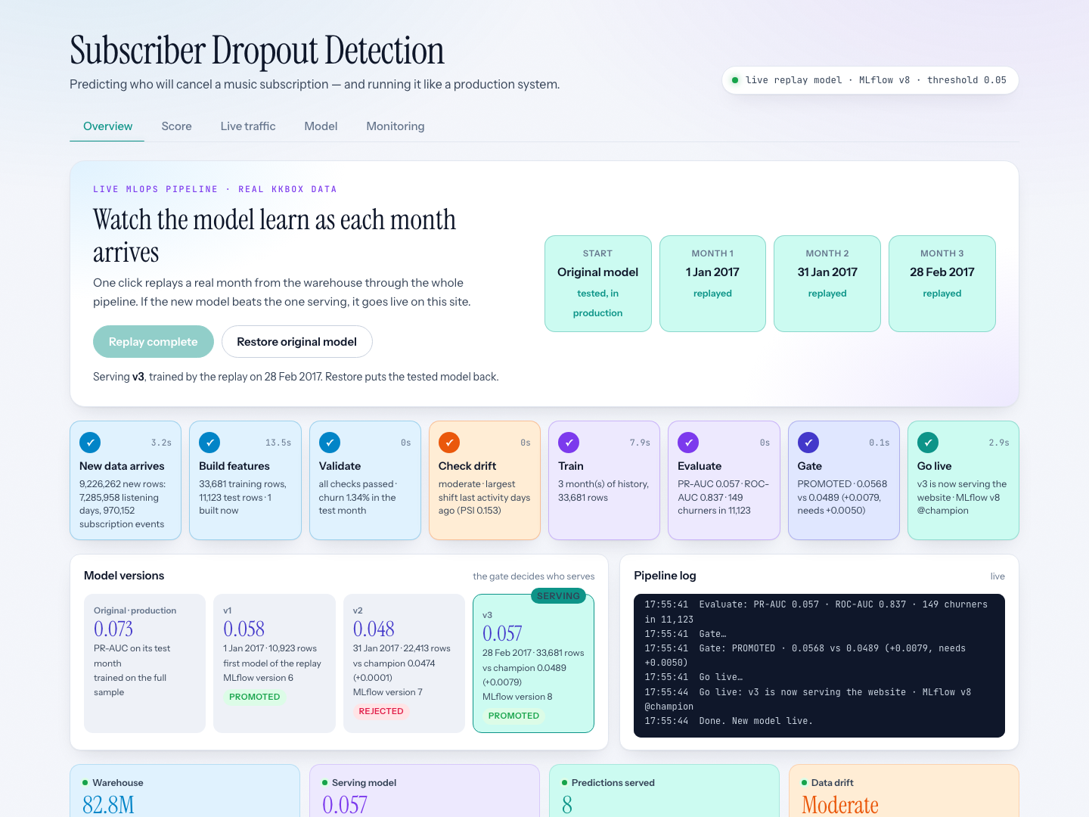
LIVE PIPELINE · RETRAIN, GATE, DEPLOY
Press Run: it retrains on real months
1
Real data, the real pipeline
one click replays three months of KKBox (Jan–Feb 2017) through features, validation, drift, training and evaluation
2
The gate decides, live
month 1 promoted; month 2 rejected (+0.0001, needs +0.005); month 3 promoted (0.0568 vs 0.0489)
3
A win really deploys
the API hot-loads the new model and MLflow moves @champion. Restore puts the tested model back
Notes:
Open the dashboard Overview. Click Run 1 Jan 2017 and talk over the stages as they light up; point at Go live and the header, which now names the live model. Then Run 31 Jan 2017: rejected by the gate. Run 28 Feb 2017 after showing MLflow. Press Restore before the Score tab.

Slide 9
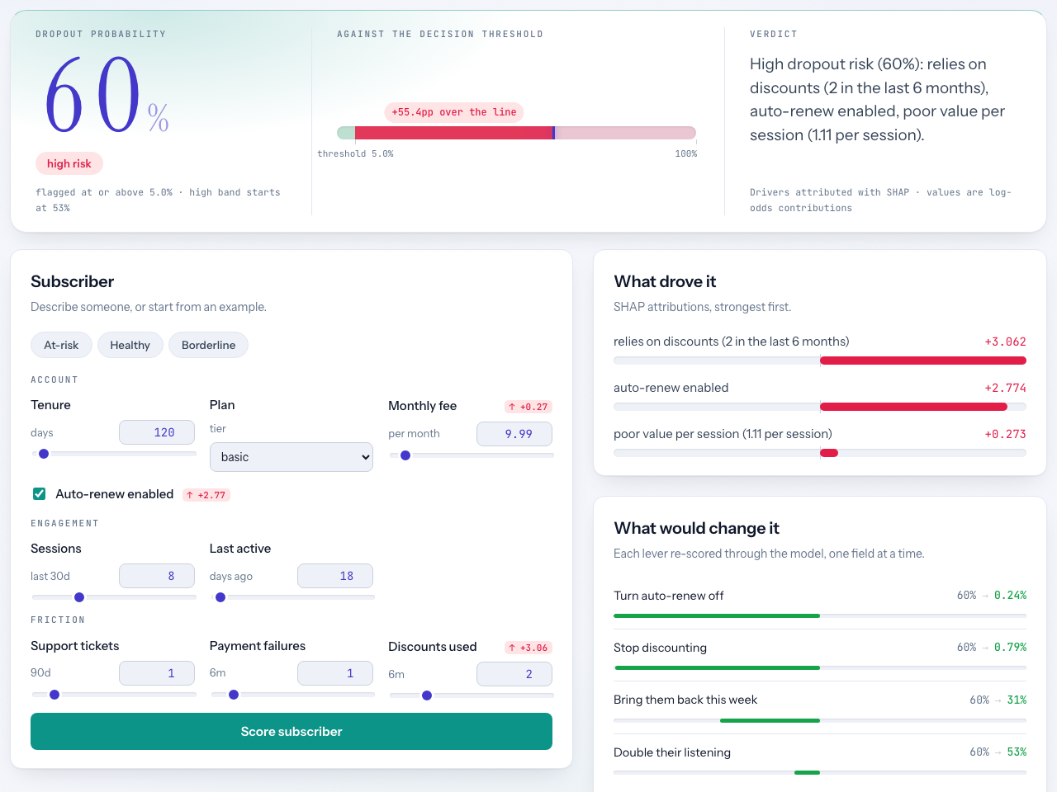
SERVING · FASTAPI + SHAP
Every prediction explains itself
1
SHAP drivers add up exactly
to the prediction, so the reasons cannot disagree with the score
2
"What would change it"
each lever is a real second request with one field changed: auto-renew off takes 60% to under 1%
3
Honest about surprises
auto-renew raises risk on KKBox: it goes with the cheap short plans that churn most. An association, not a cause
Notes:
Show the dashboard Score tab: it has already scored the at-risk example at 60%, high risk. Point at the SHAP drivers, then at What would change it. Click Healthy, then Borderline, and let it re-score live.

Slide 10
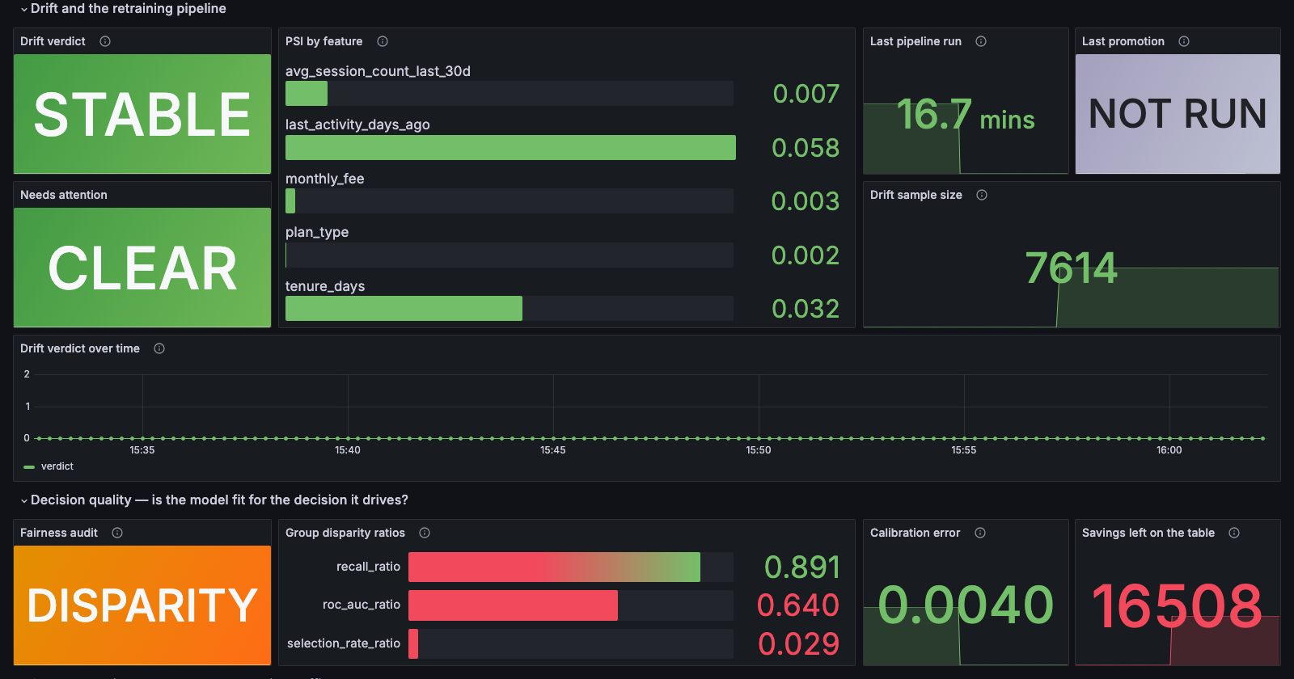
MONITORING · PROMETHEUS, ALERTMANAGER, GRAFANA
Watching the model after it ships
Drift: STABLE
real February 2017 data through Postgres. Every feature's PSI is under 0.06 (significant is 0.25)
The detector works
shift two features on purpose and it ranks exactly those two first
Fairness: DISPARITY
near-random on the standard plan (949 people). Reported and alerted, not hidden
Notes:
Dashboard Monitoring tab: the drift test has already run and ranks exactly the two shifted features. Then Grafana: model loaded, traffic, drift verdict STABLE from a real check on Feb 2017 data. Raise the fairness failure yourself before anyone asks. Then Prometheus alerts: FairnessDisparity is firing, for exactly that reason.

Slide 11
AUTOMATION · 8 GITHUB ACTIONS JOBS ON EVERY PUSH
CI tests the system, not just the code
1
2
3
4
Lint + 457 tests
Train on SQLite
Train on Postgres
Full pipeline
unit, API, leakage, metrics config
temporal split, gate, serve, smoke-test
same run on a real Postgres + all demo queries
idempotent · identical challenger rejected · drift caught
5
6
7
Plus Prefect for the nightly retrain-and-gate flow, DVC for versioned data and parameters.
Streaming
Docker + Kubernetes
Publish (CD)
poison messages go to the dead-letter topic
smoke-tested, then deployed to a kind cluster
on main: image to ghcr.io, tagged with the commit
Notes:
Show the GitHub Actions page and click into the latest green run. Beyond unit tests, CI proves the system behaves: it trains on SQLite and on Postgres, runs the pipeline twice and checks nothing changes, checks an identical challenger is rejected, injects drift and checks it is detected, sends broken messages to the streaming scorer, and on main publishes the image to GitHub's registry.

Slide 12
WHAT THE MODEL ACTUALLY ACHIEVES
Honest results
0.073
16.8%
0.004
PR-AUC: 4.8× better than guessing (0.015)
of churners caught at the 0.05 threshold
calibration error: a predicted 5% means ~5%
Limitations
Modest model: the data has no support or payment-failure signal
Fairness audit fails for the standard plan
Cost figures are placeholders; the cost audit recommends 0.43 over the F1-tuned 0.05
Runs on Docker locally: a 15 GB warehouse fits no free cloud tier
Notes:
Be the first to say the model is modest: about 5 times better than guessing, because the data lacks strong signals. The fairness audit fails for one plan. The cost numbers are placeholders - the audit prefers 0.43, the served 0.05 is the best F1 on validation. And it runs locally, not on a public cloud.

Slide 13
Thank you
Next steps
1
Richer listening features from the full 392M-row logs
2
Real offer costs, so the threshold is set by money, not F1
3
The competition's churn definition, alongside ours
4
A managed Kubernetes deployment
github.com/markandeyavarma3-lab/subscriber-dropout-detection
Notes:
Close briefly, then invite questions: happy to go into any part.

