Slide 1
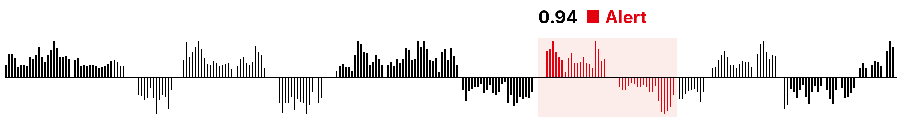
Sherlock
Phones
01
The problem
02
How it works
03
Live demo
Every Swiss German
bank call checked,
not just samples.
TEAM
CASE
EVENT
Marc-André Clénin · Benjamin Lang · Paul Schroff
Inventx × Outcept
sprintd Zurich 2026
Notes:
Welcome to Sherlock Phones

Slide 2

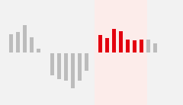
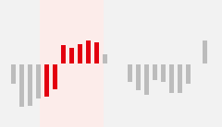


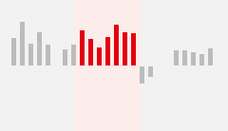
Banks check samples.
Fraud hides in the rest.
01
The problem
02
How it works
03
Live demo
01 THE PROBLEM
Sampled by a reviewer
Fraud nobody heard
Never checked
EACH TILE IS A CALL
Reviewers sample a few, 30–40 s at a time, without what came before. Insider trading and shared access codes slip through, on both ends of the line.
WHY AUTOMATING IT IS HARD
1
Swiss German
2
Context
3
Change
4
Inside the bank
Many dialects, no written standard. Speech models break down beyond Zurich and Bern.
The same sentence can be harmless or fraud. Keywords alone raise false alarms.
Laws and fraud patterns change. Checks must adapt without new code.
Call data can't leave the bank. Every model has to run
self-hosted.
Notes:
0:15–0:50 · Banks record every call for legal reasons, but staff only sample a few, 30–40 s at a time and without context, so insider trading and shared access codes go unnoticed. Automating it is hard for four reasons: Swiss German, context, change, and data that can't leave the bank.

Slide 3
Kev scores, Qwen pinpoints,
rules decide.
01
The problem
02
How it works
03
Live demo
02 HOW IT WORKS
SECURED ENVIRONMENT
Input
Transcription
Detection
Rules & Dashboard
Call recording
.wav upload/sync
Whisper large-v3 (finetuned)
Swiss German → German text
Score table
call × fact
Rules
AND / NOT over scores → alert
HOW A RULE WORKS
Sherpa-onnx
speech segments
Categorized calls
slider · filter · listen · judge
Kev-4B · sliding window
passage per hit
Insider info
0.94
Qwen 3.8 3B
speaker identification
Rule builder
plain words + AI assistant
Buy order
0.91
Kev-4B (finetuned) +
Qwen 3.8 3B · fact check
score 0–1, whole call
Transcript
text · timestamps · speaker
Fact builder
4-eyes, then all calls scored
AND
Alert
Data flow
User customization
Fine-tuned model
Decision
Result
Step
Notes:
0:50–1:30 · Keep this or slide 3 (concept) and delete the other. LLM-based decision model.
A call is uploaded in the dashboard. The transcription API (:8001) runs Nemotron-3 diarization, then Flix Whisper large-v3 per segment. The questions API (:8002) runs Kev-4B: one score from 0 to 1 per question for the whole call, and a sliding window that pins the passage for each hit. Scores are stored per call and question.
Rules combine stored scores with AND / NOT into an alert and a category, so a new or changed rule applies to every call at once, without a new LLM run. Compliance builds rules in plain words with the AI assistant. A new question needs Kev to re-score the whole dataset, so it goes through 4-eyes approval first.
Dashboard: calls sorted by certainty, a slider for less certain hits, a filter by category, the passage to listen to, correct or wrong per finding.
Planned: finetune Kev on the judgments, finetune Whisper on SwissDial synthetic audio.
GPU: models load on first request and unload after 120 s idle; never both at once. Metric: the Analyse-UI (:7861) compares results with the Inventx assessments.

Slide 4
Live demo
01
The problem
02
How it works
03
Live demo
03 LIVE DEMO
01
Core flow
Upload a call, then open the top hit: scores, rule, passage.
02
Tuning
A rule in plain words, live. New questions wait for 4-eyes.
03
Borderline case
A keyword, but no rule fires: no alert.
04
Metric
Results against the Inventx assessments.
Notes:
1:30–5:00 · Live demo in the dashboard:
1) Core flow: upload a call; it is transcribed and scored. Open the top call: question scores, the rule that fired, the passage to listen to.
2) Tuning: build a rule in plain words with the AI assistant (e.g. buy or sell alone → no alert) and show the effect at once. Then show that a new question waits for 4-eyes approval before Kev re-scores all calls.
3) Borderline case: a harmless call that still contains a keyword stays without alert, because no rule fires.
4) Metric: results against the Inventx assessments (Analyse-UI).

