Slide 1
STORY of snapchat
Presented by:
Terante, mark angelo a.
Bsit-4b

Slide 2
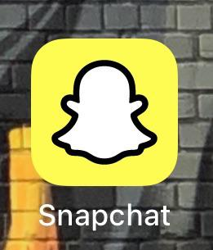
snapchat
In 2011 SNAPCHAT created by Evan Spiegel, Bobby Murphy, and Reggie Brown under the name Picaboo.
Facebook tried to acquire Snapchat for 3 Billion dollars which Evan Spiegel rejected it immediately. In 2012 Facebook already acquired Instagram for 1 Billion dollars and used to purposely to kill the Snapchat. Some of feature of Snapchat are copied by the Instagram such as Instagram stories.
The users of Snapchat are age range from 18 to 34 years old and average of 158 million users active daily.
In September 2016 Snapchat change it’s name into SNAP and month later introduce the spectacles Smart Glasses. In March Snapchat IPO 3 Billion dollars at a valuation of around 20 Billion dollars. Share price immediately rallied giving the company valuation of around 33 Billion dollars at the end of the trading day.

Slide 3

Fall of snAPCHAT
At the end of 2017 due to intense competition of Snapchat, twitter, and Instagram (Instagram stories). Snap announce the redesigned of the application which million of users signed to remove the updates.
The redesigned of Snap cause confusion to its users that lead into slow increase of daily active users. Apparently one of the influencer Kylie Jenner tweeted about ditching Snap, the stock lost 6%, or 1.3 billion dollars in market value.
By the end of 2018 Snap stock price reduce into 60%. Since the competition of Instagram and some of user’s frustration in the updates of snap more active users are stop using the application.

Slide 4

Rise again
In 2019 the stock price of the Snap rice up to 180%. The rice of average active users of snap 218 Million daily.
Snap also introduce the new features that generated avenues for monetization opportunities, Ad-supported gaming platform and an audience network that will allow Snap to place ads in third-party apps. Snap also redesigned the application to capture more costumers and users outside the US. Snap also introduce Snap Originals scripted TV shows made only for Snapchat, to retain the younger audience. Advertise also appreciated Snap’s improved campaign analytics and change in content distribution on the platform.
(Startup Sapience link. https://medium.com/@startupsapience/snapchat-the-rise-and-fall-and-rise-again-20980128be5b)
Youtube video link: https://youtu.be/eRCoGF3mLGo

