Slide 1
DEVELOPING AU MAP LOCATION SYSTEM FOR PHINMA ARAULLO UNIVERSITY-MAIN CAMPUS

Slide 2
INTRODUCTION
In this study, researchers create a map locator at the AU main campus. Assist visitors or students in getting to the correct room or department. You can use technology to easily locate the building. The AU campus is frequently large and congested, with thousands of students and faculty members passing through on a daily basis. With so many buildings, floors, and indoor and outdoor components on campus, it's easy to become disoriented, confused, and frustrated. The question here is how the AU campus can provide relief for faculty and students navigating campus.

Slide 3
INTRODUCTION
The digital tool AU MAP LOCATION can provide additional capabilities such as virtual tours and much more. With the numerous advantages of indoor mapping for the AU campus, let us investigate how successfully implementing a successful campus, this study creates a better experience for everyone on campus. Navigating a large campus like AU MAIN and between multiple buildings can be difficult and even returning students, visitors, and faculty members have difficulty locating the campus's buildings, amenities, and services.

Slide 4
BACKGROUNF OF THE STUDY
Location maps are specialized maps designed for identifying a specific location. They provide the most straightforward route from one place to another as well as information specifically related to a single structure.
The specific locations of all the buildings, rooms, departments, and offices on campus are unknown to new students and visitors. In this project, researchers will display a map or navigation that can be used to pinpoint the precise location of the intended destination.

Slide 5
BACKGROUNF OF THE STUDY
On April 20, 2004, Araullo University became a member of the PHINMA Education Network (PEN), an educational institution that aims to provide quality education at an affordable price. Araullo University expanded its academic offerings and used non-traditional learning methods.
This study will be of great assistance to students and visitors who are unfamiliar with directions or specific locations, as researchers will make it easier to find the correct direction of where the users are going so that no one gets lost. These users can get to their destination faster.

Slide 6
STATEMENT OF THE PROBLEM
The primary goal of this project is to create a system that will assist students who are having difficulty finding their buildings on campus. Students at school frequently ask guards and staff for directions to their destinations; this study will address the question: How can a person avoid becoming lost on campus?

Slide 7
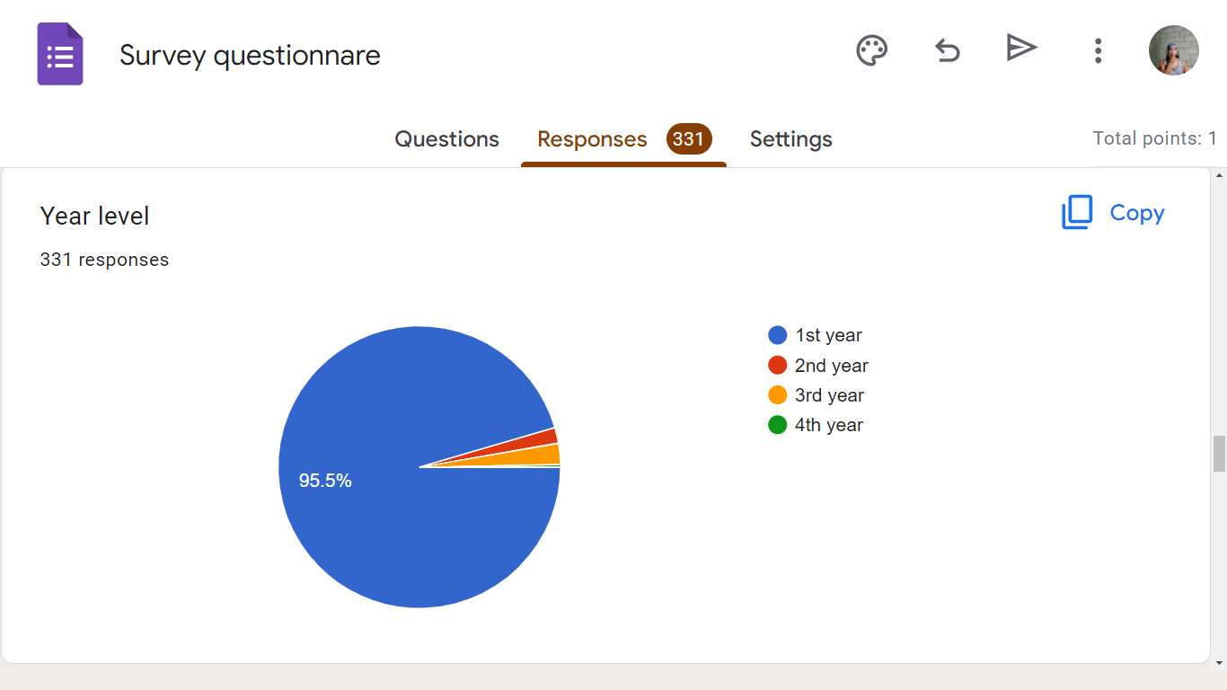

Slide 8
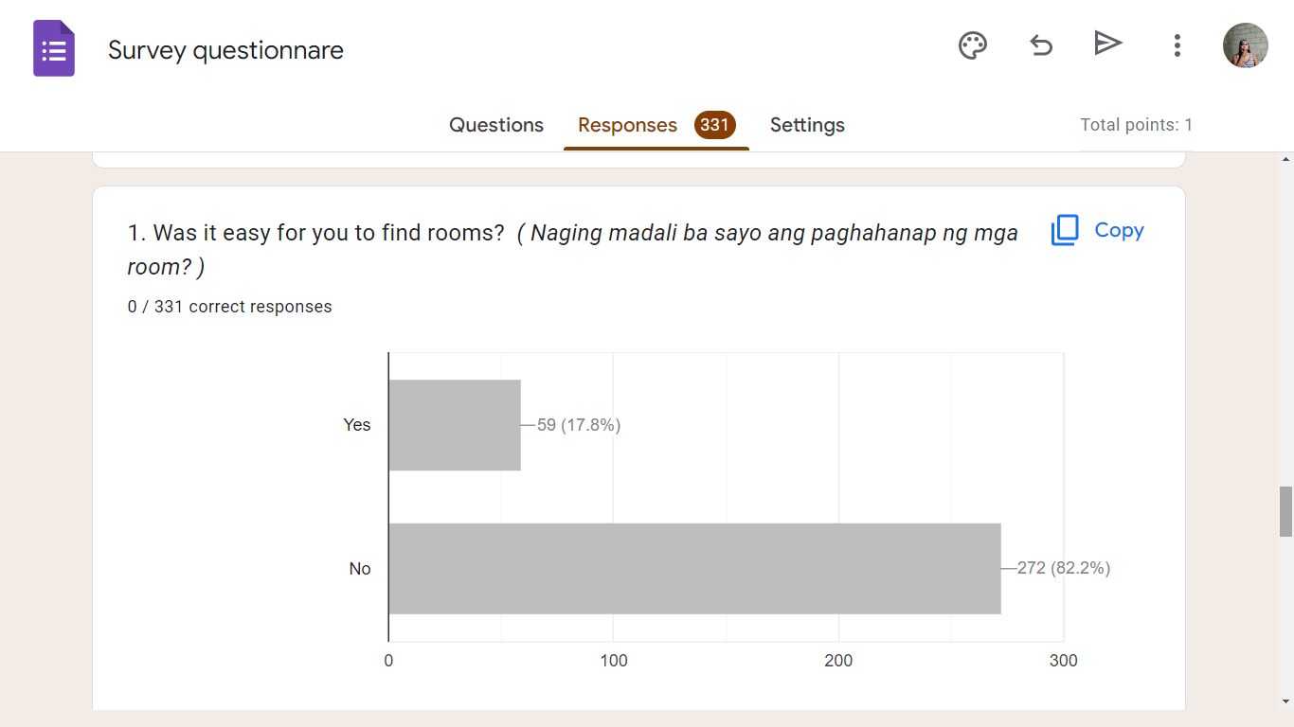

Slide 9
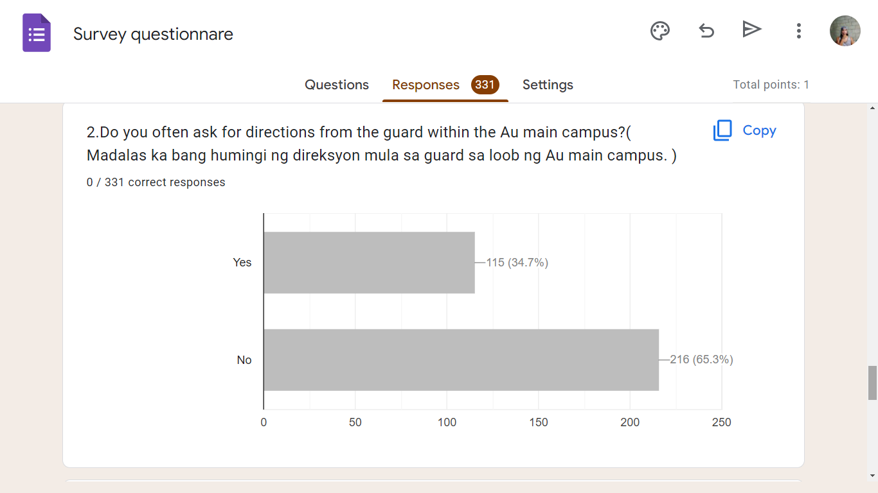

Slide 10
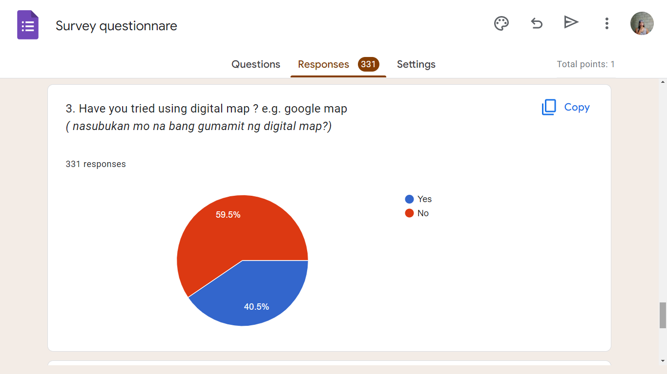

Slide 11
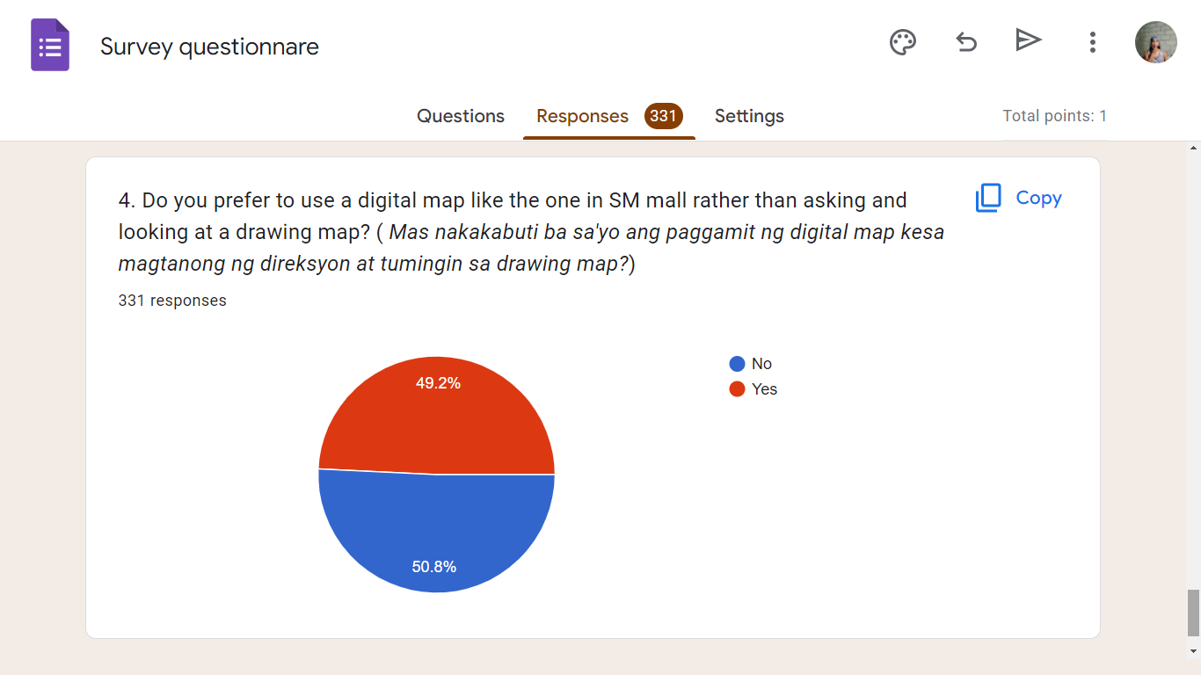

Slide 12
OBJECTIVE OF THE STUDY
The system's main goal is to provide students with an accurate, organized, and detailed navigation system that they can use anywhere in the university that deals with Phinma Araullo facilities and department building information. The project's goal is to digitalize the AU map.

Slide 13
SPECIFIC OBJECTIVE
1. To make it easier for students to navigate the university campus.
2. To reduce the workload of security guards and other personnel.
3. To create a module that can provide turn-by-turn directions of facilities and departments building inside AU main campus.

Slide 14
SIGNIFICANCE OF THE STUDY
The primary beneficiaries of the study are the students, and visitors who want to find the department or building.
Students, it's better if they have help finding their assigned rooms so they can easily find them and avoid being late for class using the map locator.
Visitors it's important to have something they can use when they don't know the direction they're going so that if they're too shy to ask they still get there when they use map locator.
The research or system will serve as a map for all visitors in AU MAIN CAMPUS for take you in exact location. A salient contribution of the Study is impact for all facilitator responsibility and accountability to its visitors.

Slide 15
SCOPE AND LIMITATION
Scope
The proposed system is primarily focused on providing accurate, functional, usable, detailed, and organized navigation within the Araullo University main campus only.
1. The system can find the buildings, rooms, and departments.
2. The system can help the user to know what the specific building and its function.

Slide 16
SCOPE AND LIMITATION
Limitation
But this system could not afford the voice record, we will be more focusing on graphics of the maps and information of each rooms, and buildings. Like numbers, name of the room and buildings. And what floor that room locates.

Slide 17
THANK YOU !

