Slide 1
Group 2 ITE292 - NETWORKING
GROUP MEMBERS:
LAFUENTE, HANNAH JOY M.
QUIRIMIT, MARK ANTHONY u.
CAOILE, IVAN GABRIEL A.

Slide 2
ITE 292
NETWORK PLAN Project Presentation
LABORATORY ROOM – ITS 201

Slide 3
Introduction
Gen Techies Co. is committed to pushing the boundaries of what's possible in the tech industry. Our team of brilliant minds, tech enthusiasts, and visionaries work tirelessly to create solutions that drive progress and shape the future. We specialize in a diverse range of technologies, including artificial intelligence, blockchain, cyber security, cloud computing, and more, offering comprehensive services to cater to the unique needs of our clients.
Objectives
Enhanced Reliability: Ensure that our network operates with minimal downtime to maximize productivity.
Improved Security: Implement security measures to protect our network from cyber threats and data breaches.
Scalability: Design a network that can easily adapt to accommodate our company's growth.
Efficient Resource Utilization: Optimize the use of network resources to reduce operational costs.

Slide 4
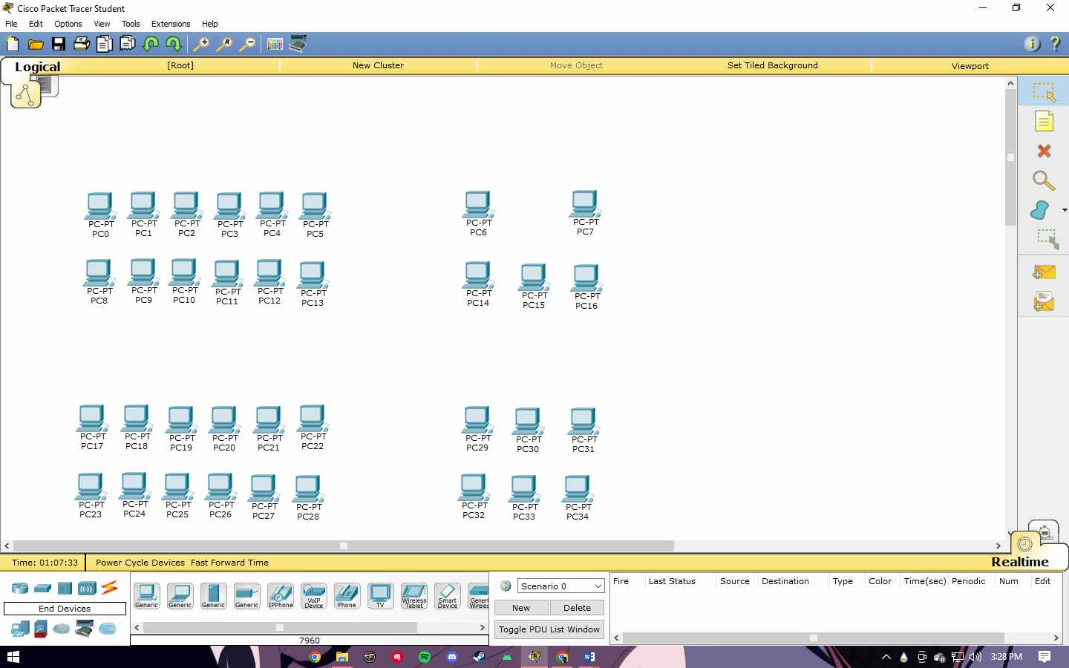
INTRODUCTION – PART 1
Current NETWORK SETUP:

Slide 5
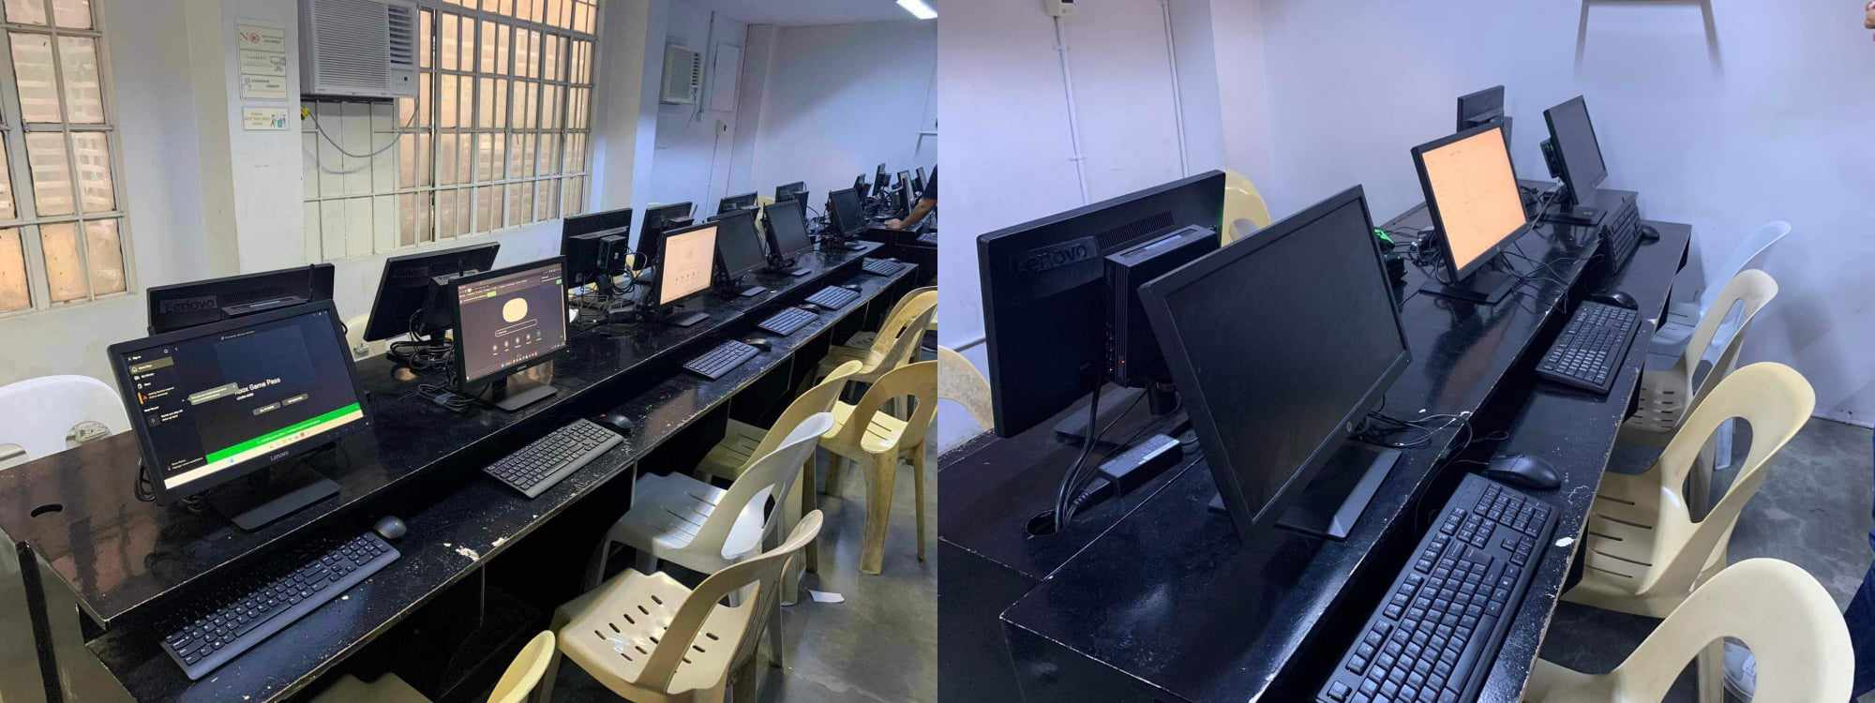
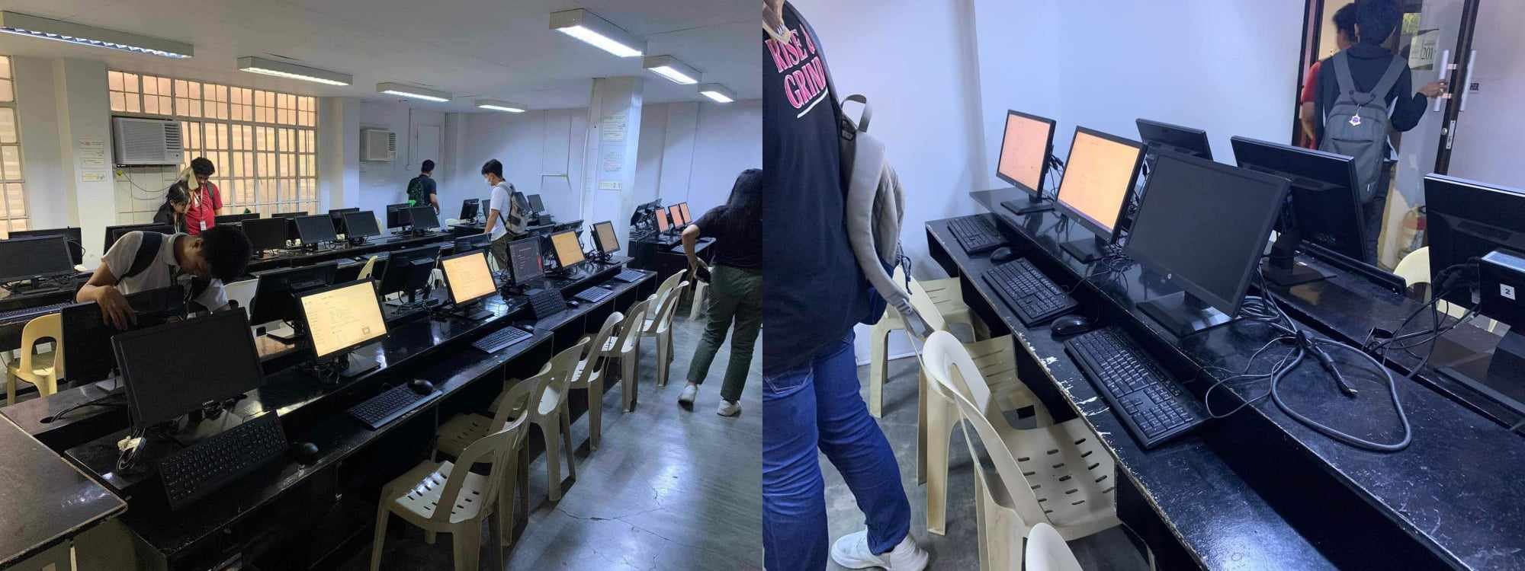

Slide 6
Statement of the Problem
Some of the units aren’t working.
Unstable internet connection.
Difficulties of Mouse sensor.

Slide 7
NETWORK / HARDWARE SPECIFICATIONS
CONNECTION TYPE:
NUMBER OF STATIONED TERMINALS: Working (29), NOT Working (5)

Slide 8
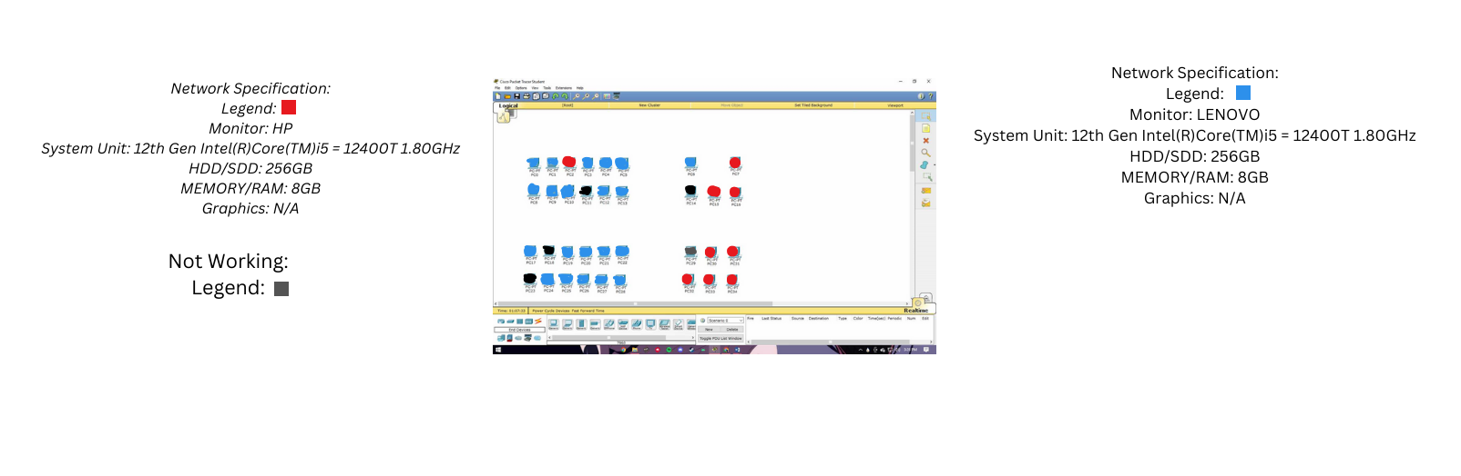

Slide 9
Proposed NETWORK PLAN
NETWORKING PART 2 - ITE 292

Slide 10
SOFTWARE SPECIFICATIONS
Programming Language Software
Utility Software
Multimedia Software

Slide 11
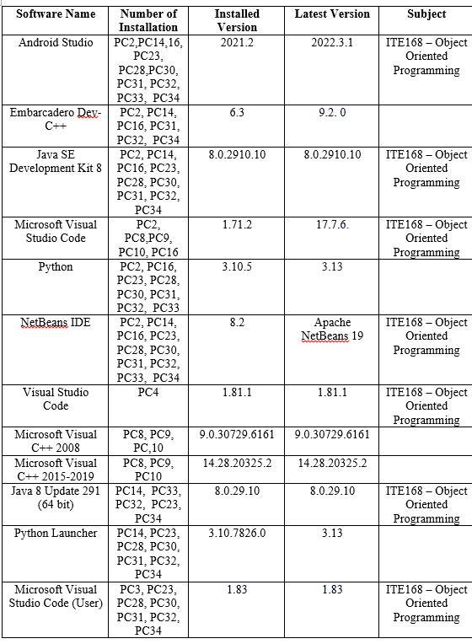
Programming Language Software
LIST OF Programming Language Software installed in computer lab units

Slide 12
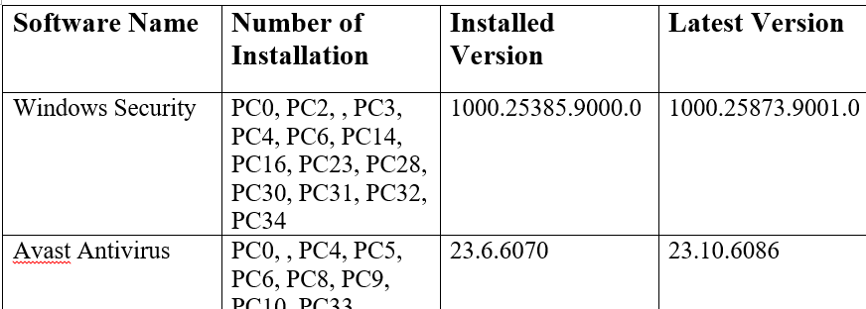
Utility Software
LIST OF Utility software installed in computer lab units

Slide 13
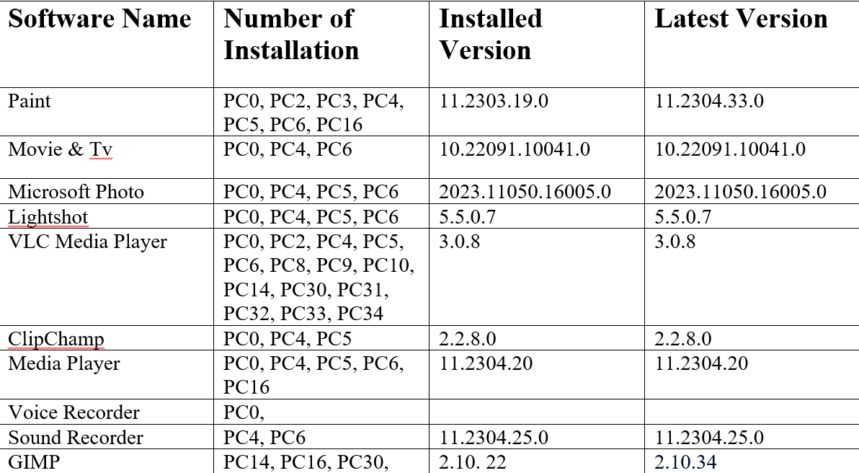
Multimedia Software
LIST OF Multimedia software installed in computer lab units

Slide 14
SOFTWARE RECCOMENDATIONS

Slide 15
1. Eclipse IDE (for Java Programming Language) -
Eclipse IDE, is an integrated development environment used in computer programming. It’s easy to use and has a large feature set, customizable interface and can be extended through a large ecosystem of plugins.

Slide 16
2. AVast Antivirus –
Avast Antivirus is a family of cross-platform internet security applications developed by Avast for Microsoft Windows, macOS, Android, and iOS and for additional protection and security of the computer from the viruses and malware.

Slide 17
3. Adobe Photoshop –
Adobe Photoshop is a critical tool for designers, web developers, graphic artists, photographers, and creative professionals. It is widely used for image editing, retouching, creating image compositions, website mockups, and adding affects.

Slide 18
Proposed NETWORK PLAN
NETWORKING PART 3 - ITE 292

Slide 19
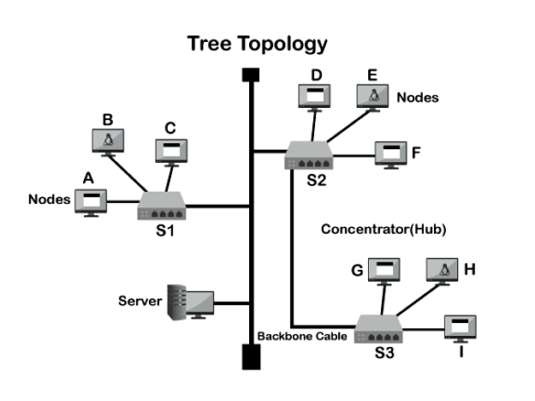
PROPOSED NETWORK LAYOUT (Network Topology)
We will implement a tree topology for our network, in which the central hub is the main that connects various secondary hubs that contain a repeater. This topology can handle more computers using the secondary hub and because of its reliability to connect in a secondary hub.

Slide 20
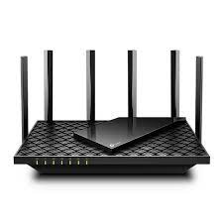
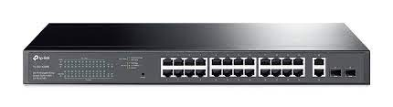

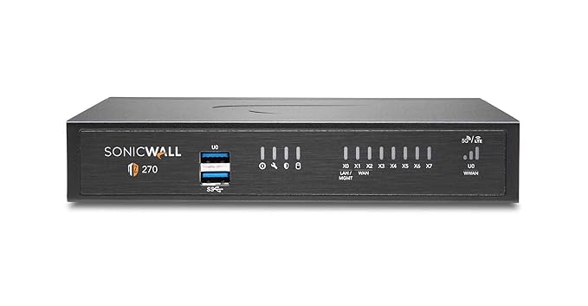
PROPOSED NETWORK AND HARDWARE EQUIPMENTS
Network Devices
Router: Install a high-quality router to manage incoming and outgoing data traffic.
DETAILS: Model - Archer AX73 Brand - TP-Link Specification -5400Mbps Wireless Gigabit Router Dual-band AX5400.
Switches: Utilized managed switches for efficient network traffic control. DETAILS: MODEL - TL-SG1428PE 28-Port Gigabit Easy Smart Switch with 24-Port PoE+.
Access Point Model: Deploy wireless access points for seamless connectivity across the office
DETAILS: MODEL- Unifi U6 Brand - Ubitique Specification - 5GHz (4x4 MIMO) and 2.4 GHz (2x2 MIMO) bands
Firewall: Implement a firewall to protect our network from external threats.
DETAILS: MODEL - SonicWall TZ270 High Availability (02-SSC-6447)

Slide 21
b. Server and Storage
File Server: Set up a dedicated file server for centralized data storage and backup.
Domain Controller: Implement a domain controller for user authentication and network management.

Slide 22
Security Measures
Firewall Configuration: Configure the firewall to restrict unauthorized access and filter incoming traffic.
User Authentication: Implement strong password policies and two-factor authentication for added security.
Regular Updates: Ensure that all network devices and software are regularly updated with security patches.
Data Encryption: Encrypt sensitive data during transmission and storage.
Security Training: Conduct security awareness training for all students/employees to minimize human error.

Slide 23
Scalability
To increase scalability, it is essential to ascertain the present and future needs of the network. By making the network modular, this enables simple extension and the inclusion of additional components as needed. In order to divide network traffic among numerous servers or connections, load balancer routers might be set up. By doing this, bottlenecking within the network is avoided.

Slide 24
Monitoring and Maintenance
Monitoring.
Gen Techies Co. has implemented basic monitoring tools, such as Task Manager (for Windows) and Activity Monitor (for macOS), to keep a constant eye on network performance and security. These built-in tools provide real-time insights into the performance and health of local systems. For instance, if there's a sudden increase in CPU or memory usage on a server or if a system process becomes unresponsive, Task Manager/Activity Monitor immediately generates alerts. This allows the IT team to proactively address performance issues that could impact network stability and user productivity.
Maintenance.
Regular network maintenance is scheduled on a quarterly basis. During these maintenance periods, the IT team carries out several tasks to ensure the network's health:
Firmware Updates: They update the firmware of routers, switches, and other network devices to the latest versions. These updates include bug fixes and security patches, strengthening the network's defenses against vulnerabilities.
Hardware Inspections: The IT team performs physical inspections of network hardware to identify and rectify any issues. They check for overheating, loose connections, or signs of wear and tear, ensuring that all devices function optimally.

Slide 25
Budget
TP-Link AX5400 Dual-Band Gigabit Wi-Fi 6 Router (Archer AX73) - P8,521 x 2 = P17,042
TL-SG1428PE 28-Port Gigabit Easy Smart Switch with 24-Port PoE+ - P10,888
Unifi U6 Brand - Ubitique Specification - 5GHz (4x4 MIMO) and 2.4 GHz (2x2 MIMO) bands – 9,550
SonicWall TZ270 High Availability (02-SSC-6447) - 17,993.20
The estimated budget for this network plan is P55,473.00

Slide 26
Timeline
Planning phase - 1 week for the planning phase, planning how the implementation process will be done.
Acquisition phase - purchasing the proposed equipment will be done 3-4 days looking at different stores.
Implementation and testing phase - 1 week for implementation and testing so the implementation will have an ample time to make sure that the procedure will done properly and test the output.

Slide 27
Conclusion
At Gen Techies Co. we are more than just a technology company; we are architects of the future. Our unwavering commitment to innovation, our dedicated team of experts, and our passion for harnessing technology's potential drive us to continuously redefine what's possible in the digital realm. You'll not only stay ahead of the curve but also help create it. We look forward to collaborating with you, innovating alongside you, and together, unlocking the vast potential of the digital universe.

Slide 28

GROUP 2
ITE 292 NETWORKING
GROUP MEMBERS
Lafuente ,Hannah Joy M.
Quirimit ,Mark Anthony U.
Maoile ,Ivan Gabriel A.
10/27/2023

