Slide 1


Dependency Clustering Across Measurement Scales
Seminar Current Topics in Information-theoretic Data Mining
Martin Kapfhammer
Notes:
Unsupervised Clustering paper by Mrs Claudia Plant
Presented at KDD in Beijing 2012

Slide 2
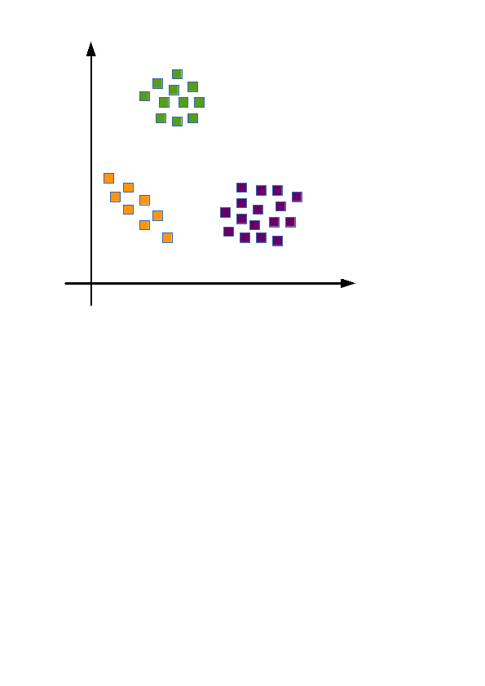
Clustering
A collection of data objects
- similar to one another within the same group
  - dissimilar to the objects in other groups
Unsupervised learning
→ Learning by observations
Notes:
Getting insights, major trends

Slide 3
Attribute types
- Nominal: categories, “names of things”
hair color, occupation
- Binary: Nominal attribute with only two states
gender, medical test
- Ordinal: categories with meaningful order
grades, army rankings
- Numerical: Quantity
temperature, length
- Discrete attributes
- Continuous attributes
How to similar are hair color and size?
Notes:
Ordinal: no magnitude between values
Discrete: finite or infinite countable set of values
Continuous: like length, temperature → floating point number
In our case: discrete categorical and continuous numerical

Slide 4
Clustering challenges
- Heterogeneous data types
Often: either numerical or categorical
- Integrating attribute dependencies
Improve clustering result, important for interpretation
- Interpretable results
Why is a clustering like that?
- No input parameters
Number of clusters, weighting of attributes
Notes:
Ordinal: no magnitude between values
Discrete: finite or infinite countable set of values
Continuous: like length, temperature → floating point number
In our case: discrete categorical and continuous numerical

Slide 5
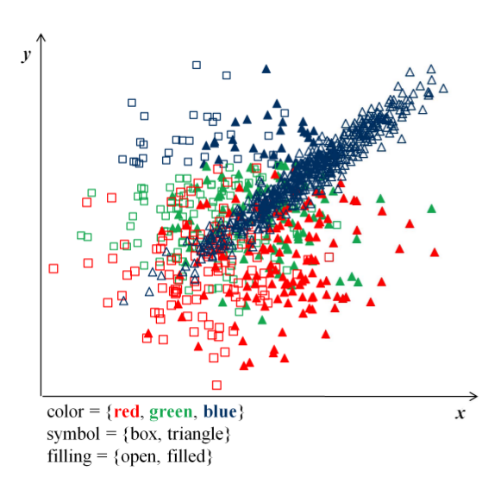
Clustering with Scenic
Heterogeneous data set with 5 dimensions
→ 2 continuous numerical
→ 3 discrete categorical

Slide 6
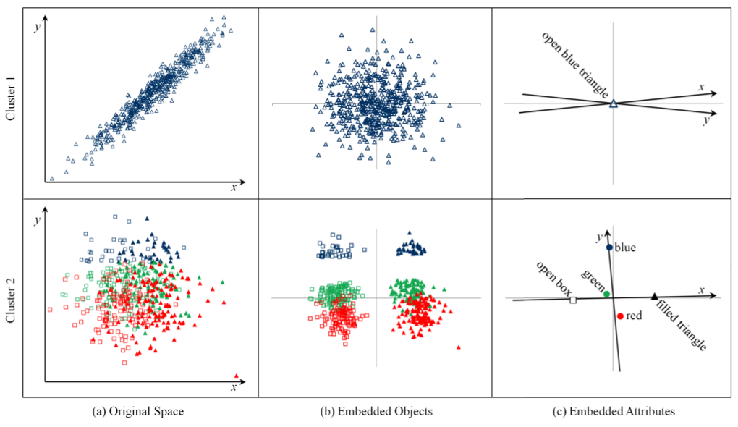
Clusters and the AO space
Results for method 1
Results for method 2
Notes:
Cluster analysis finds two clusters
Why does it find two clusters?
- AO space
. all objects are embedded
. all categories are embedded
. to preserve order and spacing constraints, numerical attributes are embedded as lines
- small angle-> correlation between x and y axis
- attribute dependencies

Slide 7
What is a good AO space?
- Predicting the original object coordinates with high accuracy
Attribute space loses as less information as possible
Danger of overfitting
- Compact model compression
Avoid high model complexity
Balance goodness-of-fit vs. model complexity
→ Minimum Description Length (MDL) principle

Slide 8
MDL principle
Predicting the original object space
→ Minimize the Reconstruction Error (RE)
Compact model compression
→ Minimize the Model Complexity (MC)
Description Length
Clustering objective

Slide 9
Reconstruction Error
Categorical Attributes: Bayes's theorem + Huffman Coding
Numerical Attributes: Multivariate regression with Gaussian error distribution
Notes:
For categorical attributes: foreach a of A, the probability to observe a given the representation pi(x) is defined by bayes theorem
Explain: pi(x) is object x in AO space
p(a) is simple, |A|/n
p(pi(x)|a) = Gaussian PDF with a diagonal covariance matrix, because objects form a gaussian around category in AO space
p(pi(x)) = sum p(pi(x)|a)
For numerical:...

Slide 10
Model Complexity
Model parameters
- encode object representations
- category means + variances
- linear models of numerical attributes
Cluster identifier: Cluster label for each object
Model Complexity:

Slide 11
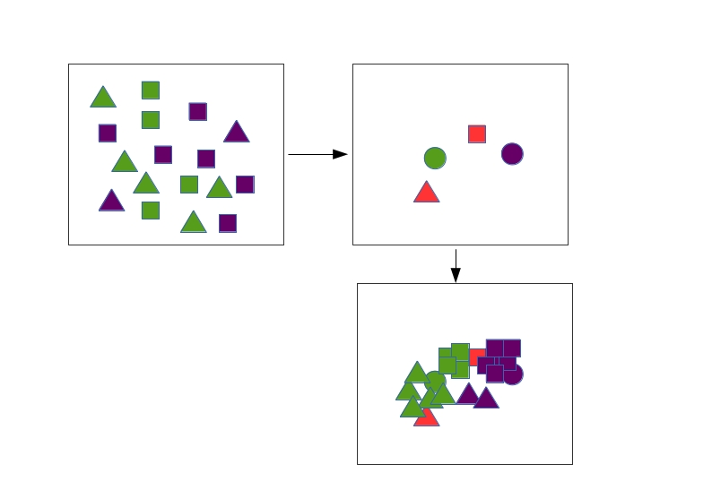
Building a suitable AO space
Algorithm Princals
Attribute coordinates: Mean of all assigned objects
Initialize object coordinates
randomly
Object coordinates: Mean of all category locations the object belongs to
Intuition:
Objects as close to their actual attribute category, as far away from the other categories

Slide 12
Algorithm Scenic
- Top-down recursive splitting algorithm
- cluster is split in two by most different category combination
- split cluster only if MDL of new clusters is smaller
- determine best AO space of clusters with MDL in the end
Runtime:

Slide 13
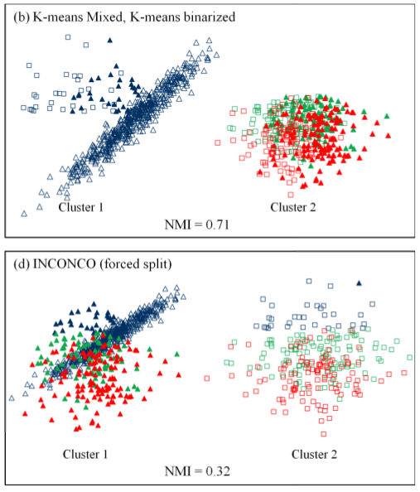
Experiments
- Compare Scenic to K-means mixed, ICONCO
- Three experiments: Scenic shows best results
- Faster than K-means mixed

Slide 14
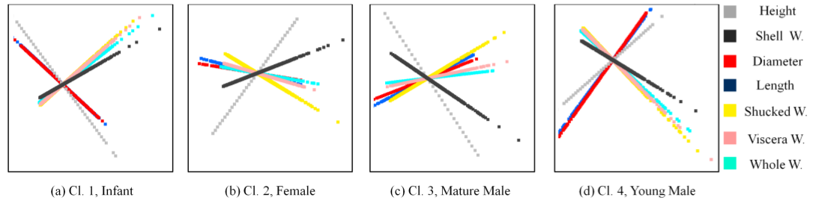
Experiments (contd.)
Real data set: Abalone Data
- Data partitioned by attribute sex
- Different dependency patterns for males

Slide 15
Review
Scenic: Clustering data at different scales
AO space: Good visualization and interpretation of clustering result + attribute dependencies
Parameter-free clustering: MDL principle
Runtime, test environment?
Interpretation of high-dimensional clusters

Slide 16
Thank you

