Slide 1





RED ALGEBRA
EDUDEV
"Master Your Learning Journey with Curated Content, Gamification, and AI-Powered Guidance."

Slide 2



RED ALGEBRA
INTRODUCTION :
In a sea of online courses, learners often feel overwhelmed by the sheer volume and struggle to find high-quality, relevant content. Our platform tackles this by offering curated course recommendations, interactive learning tools, and gamified elements like XP points and clan competitions. With AI-driven personalization and a progress tracking dashboard, we make learning engaging, efficient, and tailored to individual needs. Rewarding skill badges to enhance motivation and recognition and avatar upgradations.

Slide 3



Algebra
Red
PROBLEM STATEMENT
"Overwhelmed by countless online courses, learners often struggle to find high-quality content, stay engaged, track progress, stay engaged and receive personalized recommendations."

Slide 4



LIST OF SOLUTIONS
SORTING THE BEST CONTENT BASED ON THEIR INTEREST
INTERACTIVE LEARNING WITH MUSIC
SKILL BADGES,
PROGRESS TRACKING
One-on-one battles determined by the topics they choose.
GAMIFICATION AND CLAN SYSTEM

Slide 5



LEARN SMARTER-NOT HARDER
CURATED CONTENT AT YOUR FINGERTIPS
GAMIFY YOUR LEARNING EXPERIENCE
STOP SEARCHING START LEARNING

Slide 6

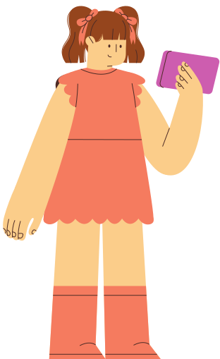


THANK YOU

