Slide 1
Infrastructure as Code
Authoring Azure Resource Manager Templates

Slide 2
Infrastructure as Code But Why?
Google Hint “Folwer Infrastructure as Code”

Slide 3
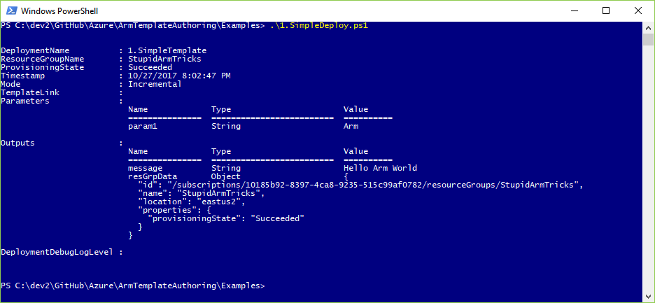

Slide 4
Tools of the Trade
A tale of two visual studios

Slide 5
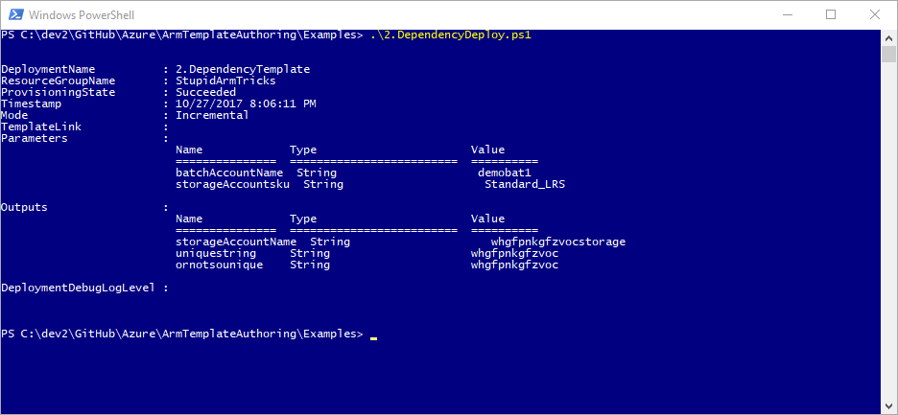

Slide 6
Learn By Example
Google Hint: Azure quickstart templates
https://azure.microsoft.com/en-us/resources/templates/
https://github.com/Azure/azure-quickstart-templates/

Slide 7
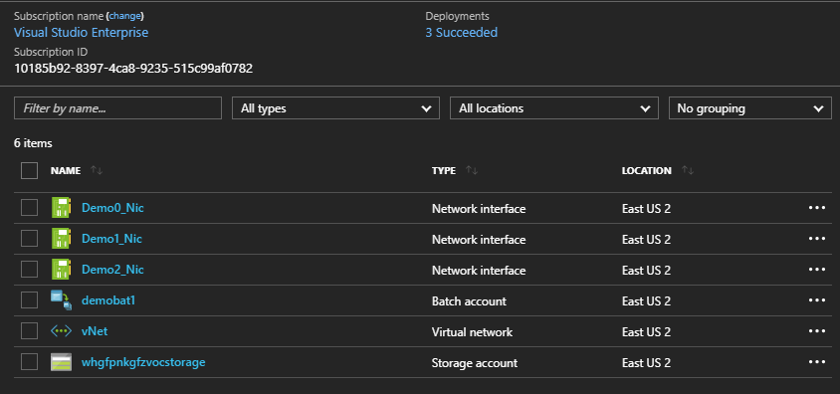
3

Slide 8
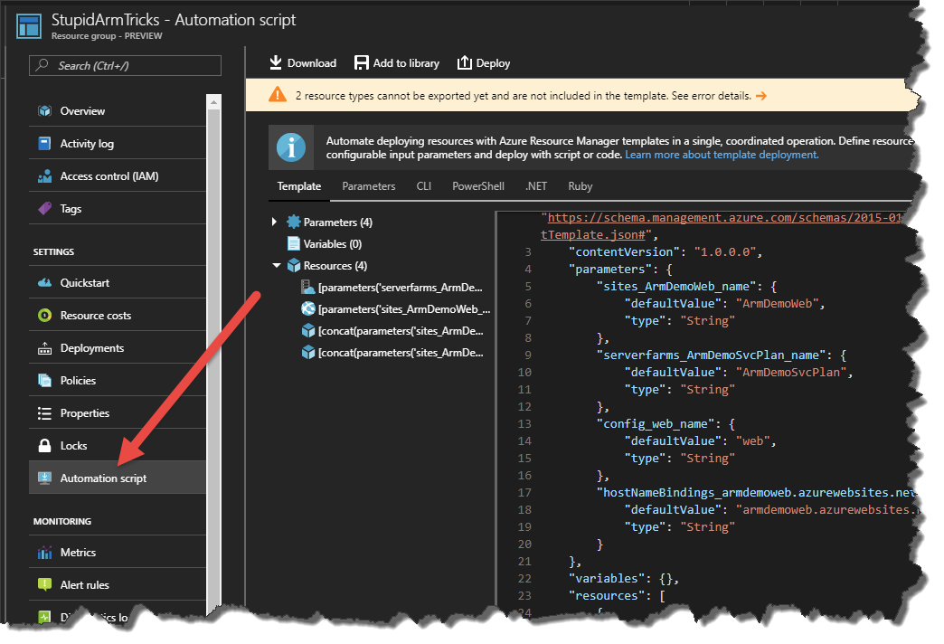
Learn by Doing

Slide 9
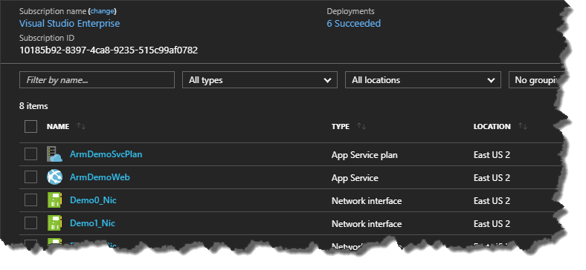
4

Slide 10
Conditions and Logical Functions
The power of ‘if’
https://azure.microsoft.com/en-us/blog/create-flexible-arm-templates-using-conditions-and-logical-functions/

Slide 11
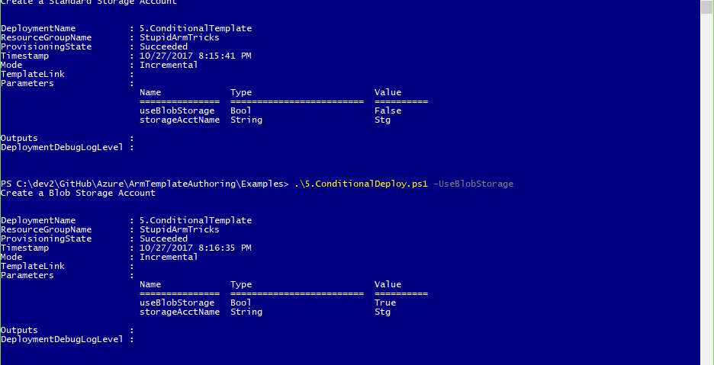

Slide 12
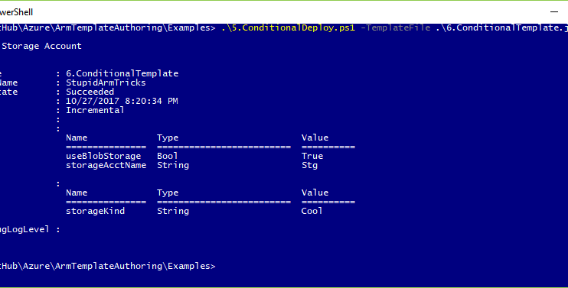

Slide 13
