Slide 1
Infrastructure as Code
Authoring Azure Resource Manager Templates

Slide 2
Infrastructure as Code But Why?
Google Hint “Fowler Infrastructure as Code”
Notes:
Discuss Theory
Run 0.Init
Exec Demo 1.Simple

Slide 3
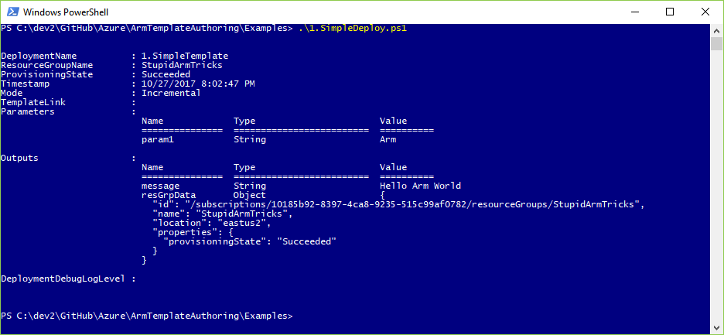

Slide 4
Tools of the Trade
A tale of two visual studios
Notes:
VS Code really needs ARM extension
VS Enterprise has somewhat buggy JSON Outline view
Exec Demo 2.Dependency

Slide 5
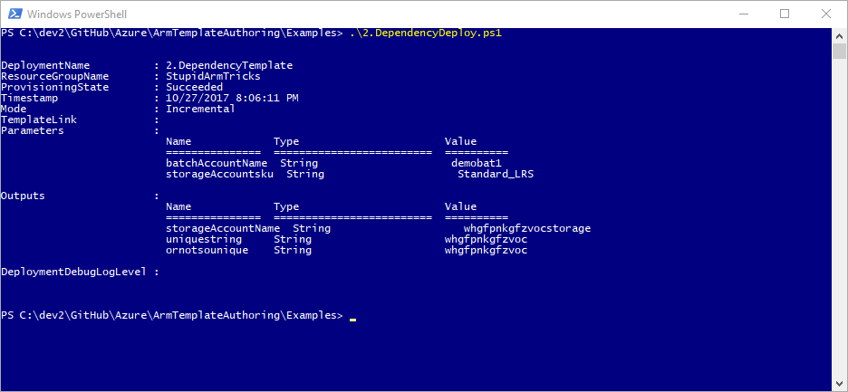

Slide 6
Learn By Example
Google Hint: Azure quickstart templates
https://azure.microsoft.com/en-us/resources/templates/
https://github.com/Azure/azure-quickstart-templates/
Notes:
Show quickstarts
Exec Demo 3.Loop

Slide 7
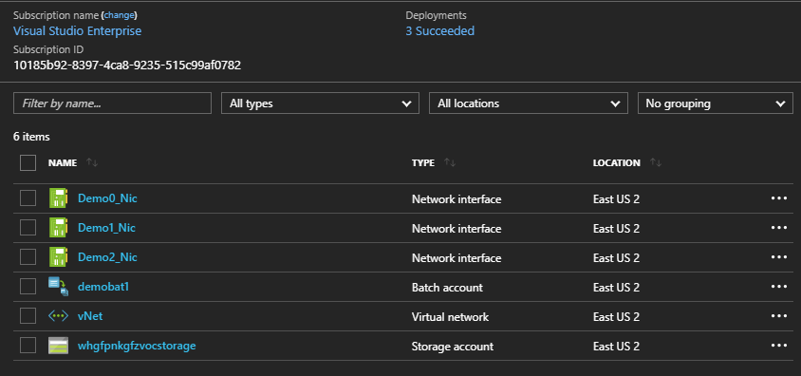
3

Slide 8
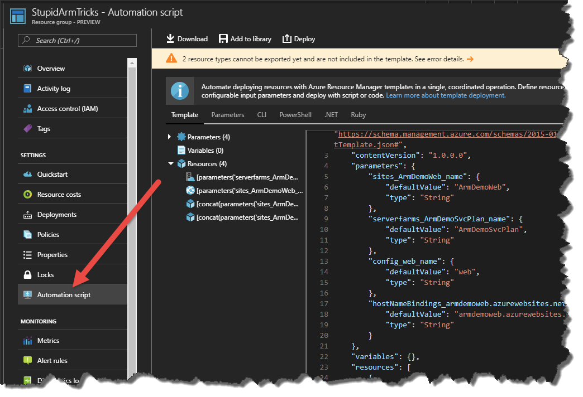
Learn by Doing
Notes:
Show Exported scripts/templates in VS Enterprise.
Exec Demo 4.Linked

Slide 9
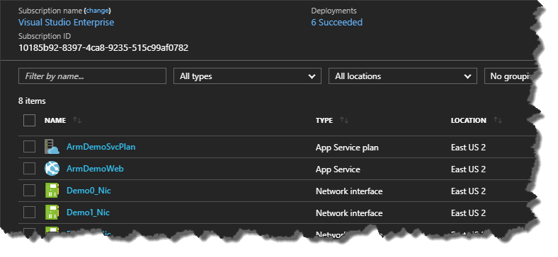
4

Slide 10
Conditions and Logical Functions
The power of ‘if’
https://azure.microsoft.com/en-us/blog/create-flexible-arm-templates-using-conditions-and-logical-functions/
Notes:
If and Condition WOW so exciting!!
Exec Demo 5.Conditional [no params]
Exec Demo 5.Conditional –UseBlobStorage
Show 6.Conditional
Exec Demo 5.Conditional –TemplateFile 6.Conditional

Slide 11
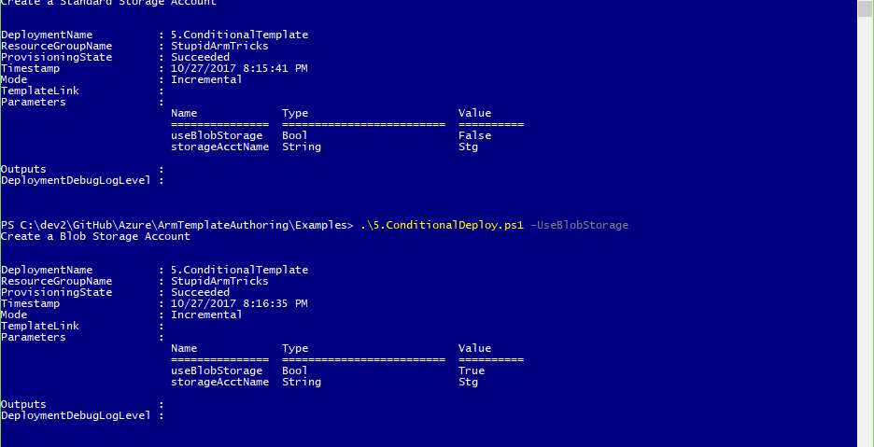

Slide 12
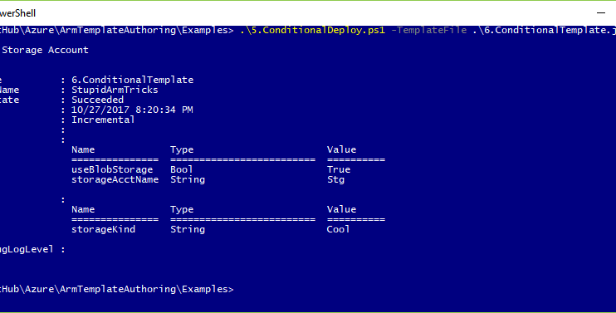

Slide 13
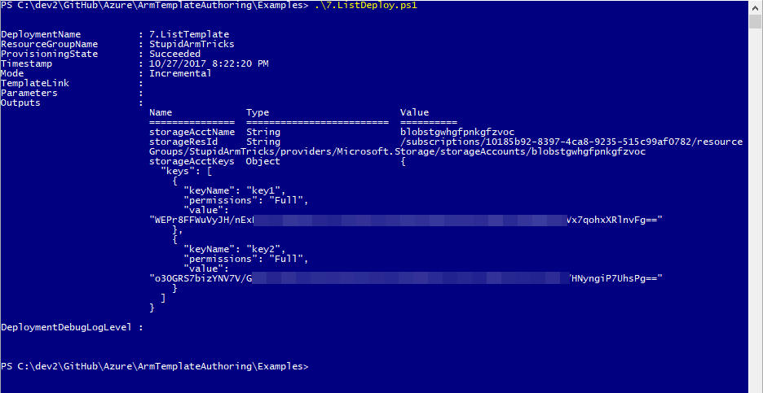

Slide 14
Thank You
Slides and demo scripts available at:
https://github.com/markarnott/ArmTemplateAuthoring
Microsoft Documentation:
https://docs.microsoft.com/en-us/azure/azure-resource-manager/

