Slide 1
Steerable Projector Calibration
Talk for Procams 2005 workshop, 25 June 2005
Mark ASHDOWN
www.mark.ashdown.name
Yoichi SATO
www.hci.iis.u-tokyo.ac.jp/~ysato/
Sato Lab, Institute of Industrial Science, University of Tokyo, Japan
Notes:
I’m a postdoc

Slide 2
Overview
Steerable projectors
Previous work
Overview of algorithm
Calibrating the camera and projector
Obtaining the pan-tilt mirror parameters
Iterative refinement
Performance
Future work
Notes:
A steerable projector is a digital projector whose beam can be moved under computer control to illuminate different objects in its environment. ED work, IBM Research, Claudio Pinhanez, introduced these. Various projects have explored the possibilities of steerable projectors but they have not addressed the calibration of a generalized optical and mechanical system. There is some related work from computer vision that I’ll talk about. We present a method for calibrating a device comprised of a projector and a pan-tilt mirror. It starts by obtaining the internal parameters of a camera and the projector, then the pan-tilt mirror is placed in a series of positions and for each one the reflected projector position is calculated from a pattern projected onto a planar surface. From those readings a coarse version of the steerable projector parameters is obtained, which is then iteratively refined. We describe real results from our physical setup and a range of results from simulated data to characterize the performance of our algorithm.

Slide 3
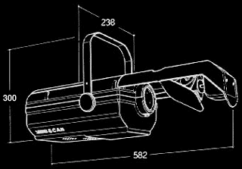
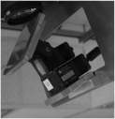
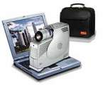
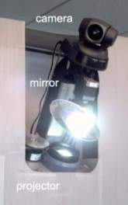
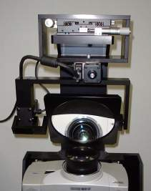
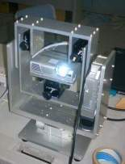
Steerable projector
Can use mirror or moving projector
Projector may or may not rotate about is optical centre
Borkowski, Riff, and Crowley (INRIA Rhone-Alpes), Procams 2003.
Mitsugami et al (Nara Inst. Sci. Tech.), MIRU 2004.
Notes:
There are two ways to make a steerable projector – with a mirror or with a moving projector. The moving ones can have the projector moving around it’s optical centre. Position of optical centre relative to box must be measured, and will change when the zoom and focus are changed.
Procams 2003 paper assumed that projector rotates about its optical centre.
For the mirror case, it definitely won’t rotate about its optical centre.
Sato Lab PTU has axes that converge on the mirror, but the PixelFlex PTU doesn’t.
[Mirror means image can move faster. Moving projector gives greater range of angles]

Slide 4

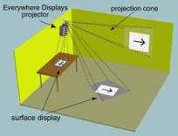

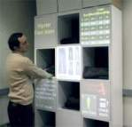
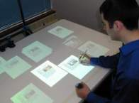
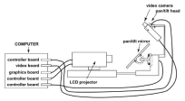

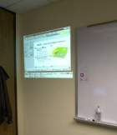


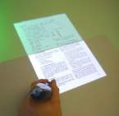
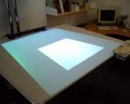
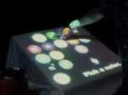
Applications
Butz, Scheinder, Spassova;
SearchLight, Pervasive 2004
Everywhere Display, http://www.research.ibm.com/ed/
Escritoire, http://www.mark.ashdown.name/
Notes:
ED people invented the steerable projector and have done much work on the applications.
Display of documents and presentations on walls and desks
Directions on the floor
Help creating a picture
Store directory
Information about clothes in a shop
They’ve also developed a computer vision system to create steerable interfaces.
The SearchLight project answers queries on physical objects.
Proceedings of Second International Conference on Pervasive Computing
Escritoire could have moving fovea.

Slide 5
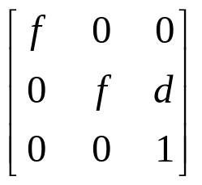
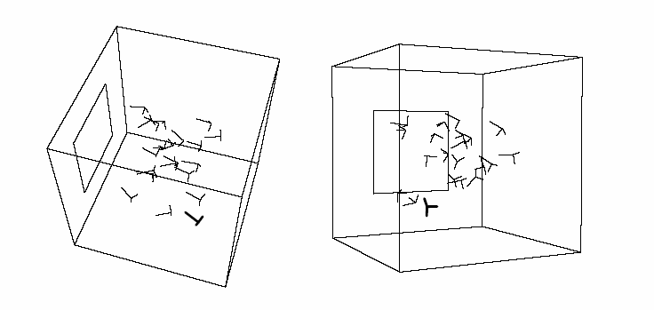
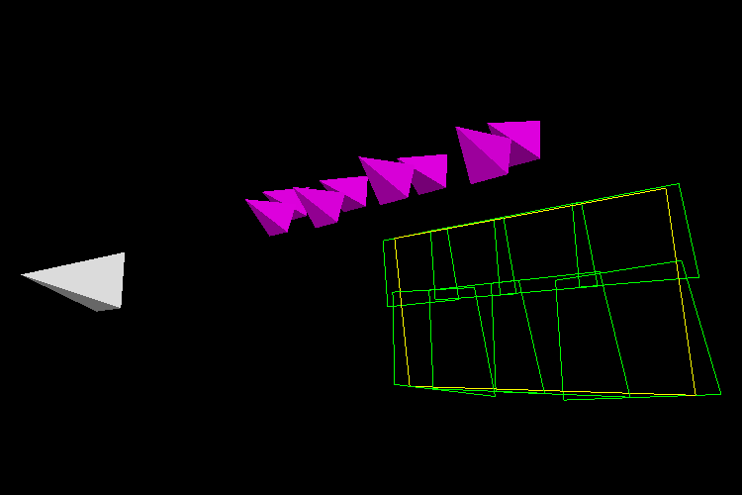
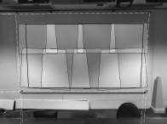
Previous work
Planar homographies, homography trees, non-planar surfaces, continuous registration.
Use calibrated projector to get camera→screen homography
Assume limited projector model to calibrate display wall
Projector rotating around optical centre
Takayuki Okatani and Koichiro Deguchi. Autocalibration of a Projector-Screen-Camera System: Theory and Algorithm for Screen-to-Camera Homography Estimation. In Proceedings of ICCV 2003, 2003.
Andrew Raij and Marc Pollefeys. Auto-Calibration of Multi-Projector Display Walls. In Proceedings of ICPR 2004, 2004.
Notes:
In the paper there are references to Sukthankar’s homography and homography tree papers, and iLamps and RFIGLamps.
Okatani and Deguchi presented a method for getting a screen->camera homography using a ’projector’ made from 4 laser pointers: requires calibrated projector
Raij Pollefeys: requires calibrated camera, and assumes pin-hole model for projector, vertical offset principle point for all projectors, square pixels (one focal length for each projector) and no radial/tangential distortion.
Previous paper (Crowley Procams 2003) on projector rotating around optical centre. They have a camera attached to the projector to find the board to project onto.

Slide 6
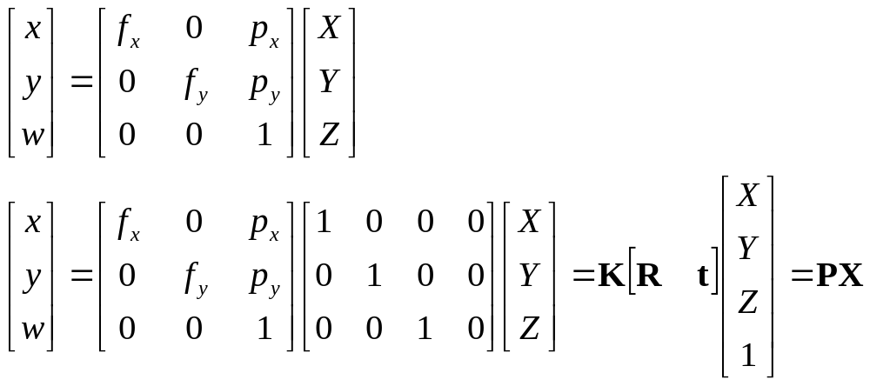
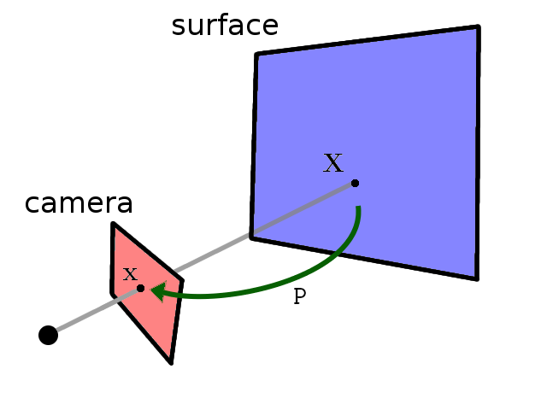
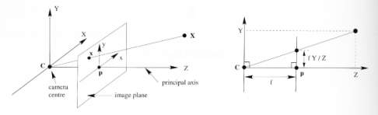
Review of transformations
Homogeneous co-ordinates
2D transformations
Projective camera
Notes:
Simplest case is a normalized camera: Camera at origin, looking down z axis, square pixels of size 1 unit.
I have not shown pixel skew.

Slide 7
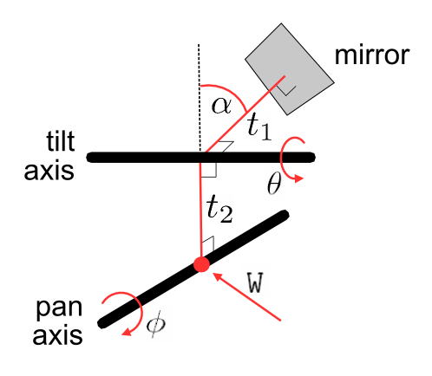
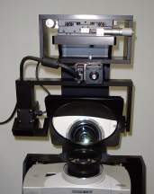
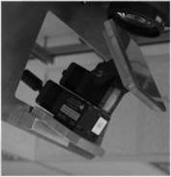
Steerable projector model
Internal projector parameters (8)
Projector pose (6)
Pose of mirror system (6)
Details of mirror system (3)
Notes:
Our current device is about 1m tall, weighs 50kg, but with a small projector and a more compact mirror one could be made that is 60cm tall, and 8kg.
Internal projector parameters includes 4 for radial and tangential distortion.
23 parameters in total
In the current version I’ve assumed that t1 and t2 are known. These are dependent only on the measurements of the PTU which should be specified precisely by the manufacturer, and the thickness of the mirror. The system is unstable with them, but I’d like to include them in future.

Slide 8
Stages of the algorithm
Calibrate camera
Camera
Projector
Pan-tilt mirror
  Projector pose
  Tilt axis
  Pan axis
Refine result
Calibrate projector
Optionally repeat
coarse result
Obtain reflected projector poses
Search for projector pose from
randomized start position
Repeat around
30 times
Cluster projector poses
Repeat for each
φ value
Find pose of tilt axis for fixed φ
Find pose of pan axis and thus
the full calibration
Pick best coarse result
Iteratively refine the result
Notes:
Calibrate three things in this order.
Pan-tilt mirror – stratified approach.

Slide 9
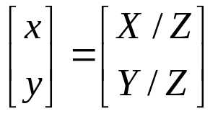
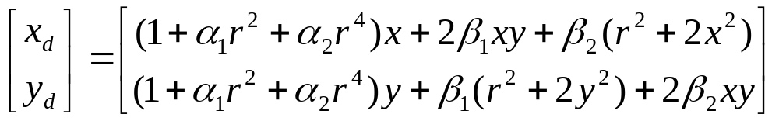
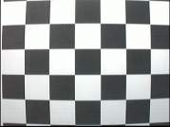
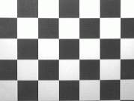
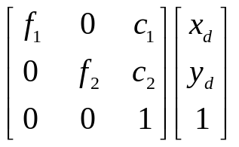
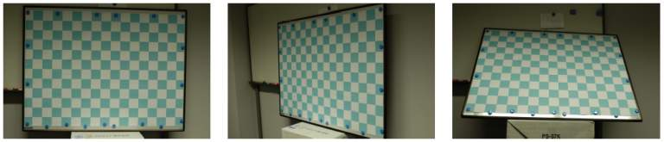
Calibrating the camera
Use Matlab toolbox
Model radial and tangential distortion
Camera Calibration Toolbox for Matlab
http://www.vision.caltech.edu/bouguetj/calib_doc/
Placing the board in various poses to calibrate the camera
Notes:
r^2 = x^2 + y^2
There are eight parameters for the camera.
4 for distortion and 4 for focal length and principle point.
Radial (a_1,a_2) and tangential (b_1,b_2).
A0 checkerboard

Slide 10

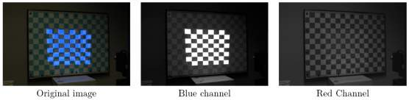
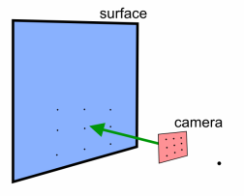
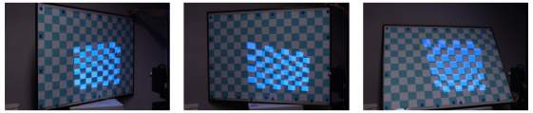
Calibrating the projector
Project pattern onto surface
Extract two images
Get camera→surface homography
Map projected points to surface
Do standard calibration
Reflecting the scene in the mirror does not affect calibration
Separating the image of the surface from the projected pattern
Placing the surface in different poses
Notes:
Use the camera calibration code. The only problem is we can’t measure directly from the projector, we need to use the camera.
We know the location of the points on the surface (70mm checkerboard). The camera has been calibrated so normalized image coordinates are used.
Calculate homography from camera to surface.
I have a bonus slide on calculating planar homographies.

Slide 11
Stages of the algorithm
Calibrate camera
Camera
Projector
Pan-tilt mirror
  Projector pose
  Tilt axis
  Pan axis
Refine result
Calibrate projector
Optionally repeat
coarse result
Obtain reflected projector poses
Search for projector pose from
randomized start position
Repeat around
30 times
Cluster projector poses
Repeat for each
φ value
Find pose of tilt axis for fixed φ
Find pose of pan axis and thus
the full calibration
Pick best coarse result
Iteratively refine the result
Notes:
Calibrate three things in this order.
Pan-tilt mirror – stratified approach.
Move mirror to different positions by varying pan and tilt angles.

Slide 12

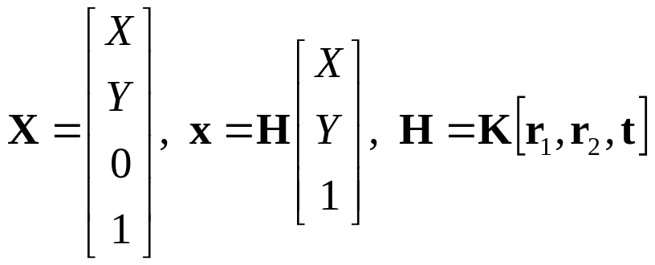

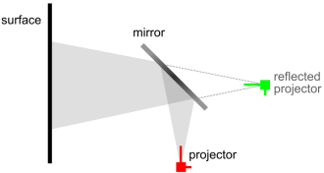
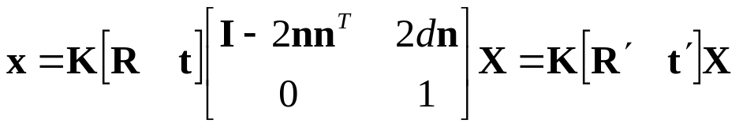
Locating the projector
Obtain projector pose from projector-to-surface homography
When mirror is used:
Notes:
Forget about distortion now because it can be removed.
First imagine there is no mirror. Flat surface. Calculate homography between projector and surface.
R’ gives the orientation of the reflected projector except that the z-axis is reversed – the reflected projector has a left-handed co-ord system.

Slide 13

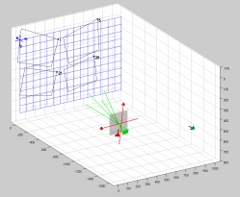
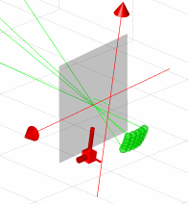
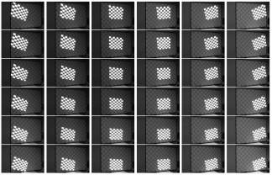
Moving the mirror
As the mirror moves many reflected positions are generated
Mirror has two degrees of freedom: pan and tilt (θ and φ)
Notes:
We can move the mirror around to get many reflected points
[Draw on whiteboard to demonstrate reflection in an arbitrary mirror]
9 dof for mirror: t1, t2, a1, W (6 dof).
6 for extrinsic parameters of projector.
Transformation shows homogeneous matrix for transforming 3D points.
Green points are known. Purple is not, and mirror parameters are not.

Slide 14
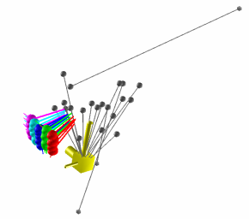
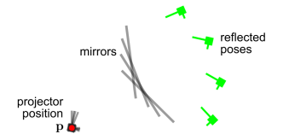
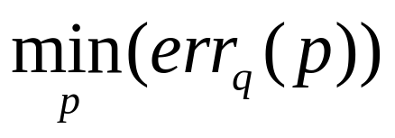
Find projector
We have data points each with a position and orientation
Generate temporary mirror half-way between real projector and reflected projector
Iteratively minimize variance of reflected quaternions
Cluster like RANSAC
Notes:
I found that trying to estimate projector and mirror positions together is unstable, so first I do a search for a projector position and orientation.
Grey lines show start and end points for minimization.
Starting points are randomized around convergence point for principle point rays of reflected projectors
Generate temporary mirror half-way
Reflect projectors (data) in mirrors and create quaternions
Get mean distance of quaternions from their average (like variance). There are various method for representing a rotation e.g. Euler angles, matrix, quaternions.
Minimize (lsqnonlin in MATLAB)
Finally, cluster by looping through the points, pick the one with the lowest median distance, then discard points more than 2.5*median away. The same thing is done with the quaternions to get the orientation of the projector.
Demonstrate RANSAC on the board.

Slide 15
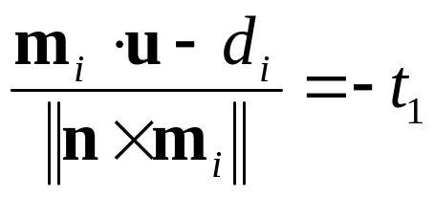
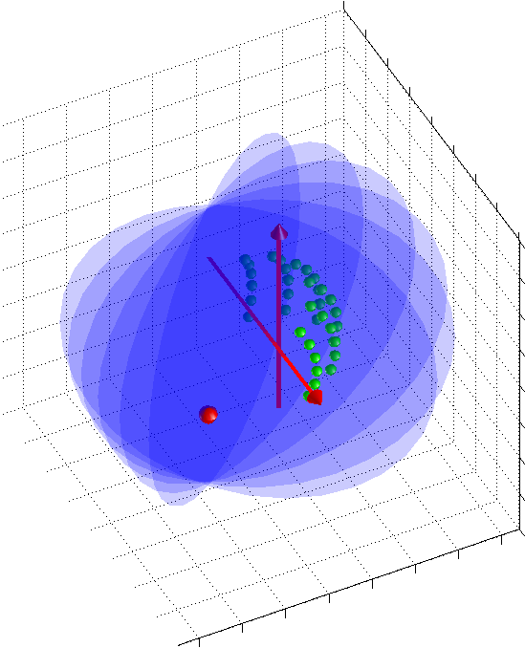
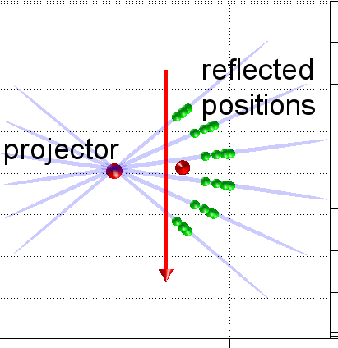
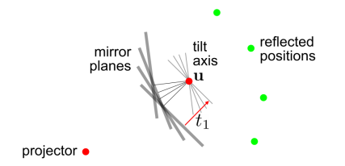
Rotation using θ
Fix φ, then projector and reflections lie in a plane
Assume mirror planes between projector and reflected positions
Define tilt axis by 3D point u
Use linear constraints to get u
Iteratively refine the solution
Notes:
Now we have 14 of the 21 params – camera and projector instrinsics and projector pose. We need 7 more.
Theta is tilt.
Fit plane to reflected locations and projector location. It has a normal and distance.
u should be a distance t1 behind each mirror.
When we have a full 3D mirror system with a single axis of rotation we can Levenberg-Marquardt iteration

Slide 16
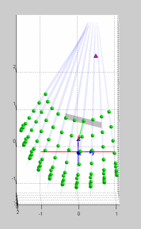
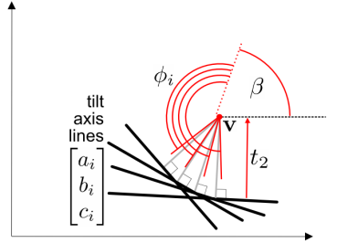
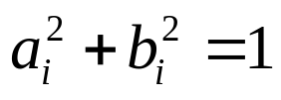
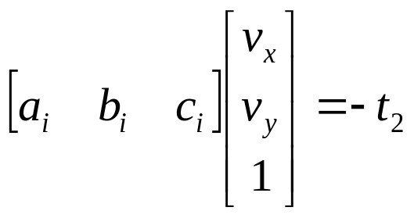
Rotation using φ
Fit plane to previously calculated tilt-axis positions
Calculate offset angle β
Use linear constraints to get axis position v
Notes:
If theta is kept constant the points all lie in a plane, but that’s not true when phi is kept constant.
We want to find the position of the pan axis, and the offset of rotation about that axis. Treat as a 2D problem.
Phi (pan) angles are known, t2 is given, positions of tilt axis were previously calculated.
Aim is to find three unknowns in 2D – position of pan axis v, and offset angle beta.
Express each line in a,b,c form, normalized so a^2+b^2=1, then (a,b) is the normal to the line.
Axis point v should be a distance t2 _behind_ each line.

Slide 17


Full solution is obtained
W matrix and α can be calculated from the positions of the two axes
Finally we obtain the 23 parameters
Notes:
We know projector position, tilt axis positions, and pan axis.
The position of the pan axis, various positions of the tilt axis, and angular offsets are used to calculate W (6 params) and the offset alpha.

Slide 18


Final iterative refinement
Refinement minimizes error in camera image
fminunc in Matlab
Notes:
Use sum of square distances in camera image – it’s computationally expensive, 6*6*7*7 = 1764 camera points, all requiring distortion calculations.
Once all parameters are known the whole system can be simulated.
In figure, blue shows initial result and purple the refined result.
I have found fminunc to be the best.

Slide 19

Performance
Camera is 2000x1312 pixels
Projector is 1024x768
30 degree pan, 10 tilt, 36 positions
Takes about 30 seconds for initial result and 2 minutes for iterative refinement
Camera: 0.25 camera pixels
Projector: 0.47 projector pixels
Steerable projector: 9.4 camera pixels
Notes:
Camera is 2000x1312 pixels
Projector is 1024x768
Checkerboard surface is A0 (about 4x3 feet), and steerable projector is about 1m from it.
Initial result takes about 30 seconds. Iterative refinement takes about 2 minutes.
Iterative refinement usually reduces the error by a factor of about 2 or 3.
9.4 camera pixels is about 8mm on the surface.
In simulation, uniform random noise was added to camera points.
Narrow-30,10 degrees, 36 positions, Wide-60,20 degrees, 64 positions.
Narrow – fits in A0 checkerboard, Wide – would fit on a normal wall. We’d like to extend the method so a checkered pattern on the board is not necessary.

Slide 20



Future work
Increasing accuracy
Completely automate the calibration
Finding pose of steerable projector
Combine with Raij & Pollefeys work
Calibrate focus and zoom settings of projector
Atienza and Zelinsky. A Practical Zoom Camera Calibration Technique: An Application on Active Vision for Human-Robot Interaction. Proc. Australian Conf. Robotics and Automation
Open Source Computer Vision Library (OpenCV) http://www.intel.com/research/mrl/research/opencv/
Notes:
Accuracy: larger range of angles, being more careful about focus
OpenCV incorporates the previously mentioned Matlab camera calibration toolbox, and also a C program to automatically find the checkboard pattern. Separating the red and blue channels should also be easy. Need to control the camera.
The method in this presentation gets the parameters of the steerable projector (relative position of projector and mirror, etc.) We could get the internal parameters of the steerable projector and a 6DOF pose. If we have a 3D model of the room.
Predicting where projected points will appear is like kinematics
Aiming the steerable projector is like inverse kinematics
Calibrate 2D space of focus and zoom settings. For each position get projection matrix (4 params) and distortion coefficients (4). Linear interpolation?
Combining with Raij&Pollefeys will require a simpler projector model with no distortion coefficients.
Applications in augmented reality.

Slide 21
Thanks for listening.
Questions?

