Slide 1
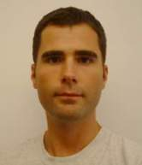
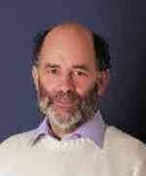



The Escritoire: a personal projected display for interacting with documents
Mark Ashdown
mark@ashdown.name
Peter Robinson
pr@cl.cam.ac.uk
University of Cambridge Computer Laboratory, UK
Notes:
I have just finished a PhD.
Peter is my supervisor.
THALES
636-c.546 BC, pre-Socratic Greek philosopher. Thales seems to be the first known Greek philosopher, scientist and mathematician although his occupation was that of an engineer. He is the first recorded Western philosopher. Thales taught that everything in nature is composed of one basic stuff, which he thought to be water.

Slide 2
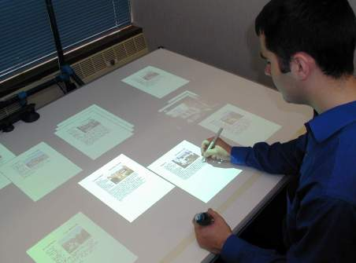
The Escritoire
Life-sized desk display
Exploits peripheral vision
Uses two projectors
Two-handed input
Remote participants can share a task space
Notes:
Escritoire means writing desk.
Multiple desks can be linked to allow remote participants to manipulate the same documents.
SHOW VIDEO – show me using the desk, and the zoomed in map (1min 56s into the video).

Slide 3
Overview
Motivation
Other projects
Personal projected display
Input
User interface
Single-user tests
Networking
Two-user tests
Conclusion
Notes:
Personal project display – setup and calibration. I’ll also talk about the multi-plane calibration, which does involve computer vision.

Slide 4
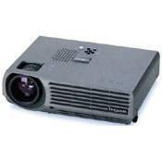
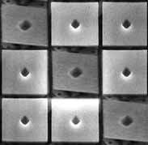
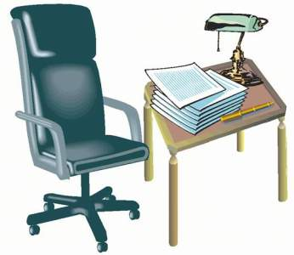
Motivation
Projection technology
Space
Affordances of paper
Input techniques
Collaboration
Notes:
Projection technology -- The Proxima DX3, 245x195x68mm, weight 2.3kg (about 5 lbs), XGA (1024x768) resolution, 1100 lumens, under 2000 euros. Similar projectors are now available that weigh under 1kg (2 lbs).
Space – conventional display fills only a small visual angle and is read without rotating the neck. 9x12-inch desk, thrashing. Weiser’s tabs, pads, and boards.
Affordances of paper – affordances: perceived and actual properties of an object that affect how it’s used. Paperless office hasn’t happened. Papers on the desk are knowledge in the world as opposed to knowledge in the head.
Input techniques – Xerox 8010 (Star) was 1979. Very large display is qualitatively different – can’t reach menus, scroll bars etc. Also bimanual input has proven manual and cognitive benefits (Bill Buxton). Dominant vs non-dominant hand. Frame of reference.
Collaboration -- Person space (videoconferencing) vs task space (Escritoire). Videophones were made in the 60s but video conferencing is still not widely used.

Slide 5
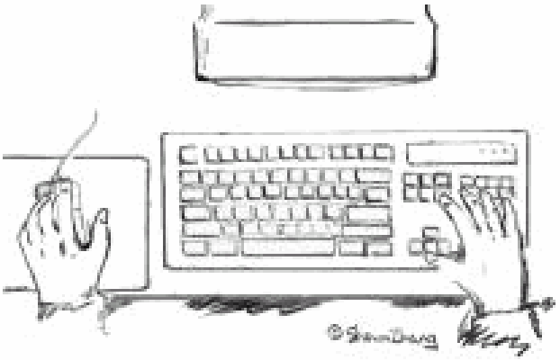


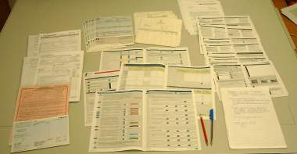
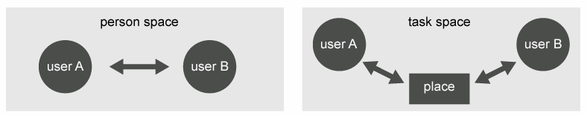
Motivation
Projection technology
Space
Affordances of paper
Input techniques
Collaboration
Notes:
Space – conventional display fills only a small visual angle and is read without rotating the neck. 9x12-inch desk, thrashing. Weiser’s tabs, pads, and boards.
Affordances of paper – affordances: perceived and actual properties of an object that affect how it’s used. Paperless office hasn’t happened. Papers on the desk are knowledge in the world as opposed to knowledge in the head.
Input techniques – very large display is qualitatively different – can’t reach menus, scroll bars etc. Also bimanual input has proven manual and cognitive benefits (Bill Buxton). Dominant vs non-dominant hand. Frame of reference.
Collaboration -- Person space (videoconferencing) vs task space (Escritoire). Videophones were made in the 60s but video conferencing is still not widely used.

Slide 6
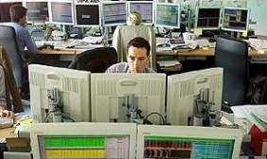
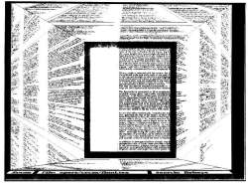
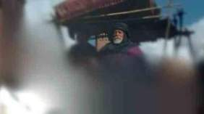
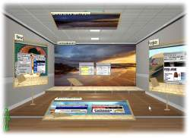
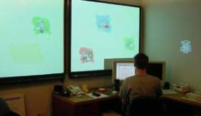
Other projects – visual periphery
Visualization techniques
Multiple monitors
Attentive displays
Head-mounted displays
Notes:
Document lens -- Make the most of a conventional small screen. cf. Fisheye lenses.
Attentive displays – Make the best use of rendering computation.
Kimura -- at GA Tech, papers in UIST 01 and Perv. Comp. 02

Slide 7
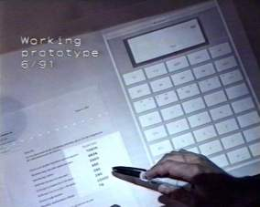
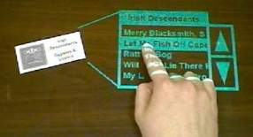
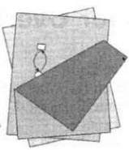
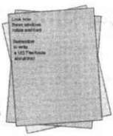
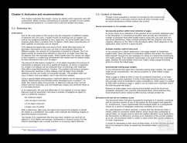
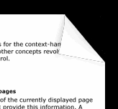
Other projects – paper
DigitalDesk
LivePaper
Dog-eared pages
Rotating and peeling back pages
Notes:
There are two ways to address the unsurpassed affordances of paper – augment real paper, or simulate properties of it.
Projecting onto real paper has problems, especially for remote collaboration because the paper only exists at one end of the link.
Beaudoin-Lafon’s work
Dog ears.

Slide 8
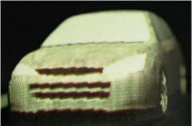
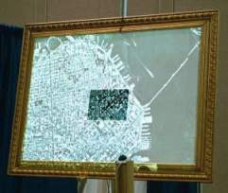
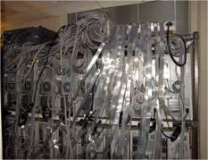
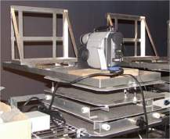
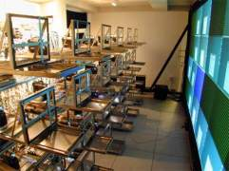
Other projects – projectors
Multi-projector display walls
Focus plus context screen
Augmented objects
Geometric and photometric calibration
Notes:
Multi-projector display walls. Princeton 24 projectors, cluster of PCs, myrinet. Custom-made bases.
Focus+context screen, recent, Patrick Baudisch, Xerox PARC.
Augmented protyping from the Technical University of Delft.
I have made a ‘personal projected display’.
Calibration is required.

Slide 9
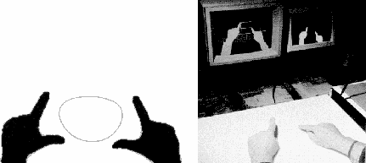
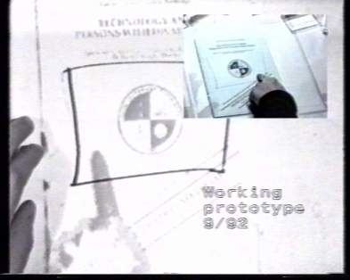
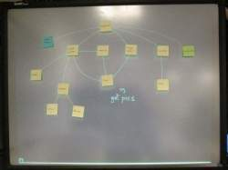
Other projects – collaboration
Krueger’s VIDEODESK
DoubleDigitalDesk
Designer’s Outpost
Notes:
VIDEODESK – around 1970, Myron Krueger
DoubleDigitalDesk
Designer’s Outpost – example of problem with collaboration, notion of transactional inconsistency.

Slide 10
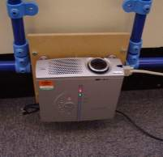
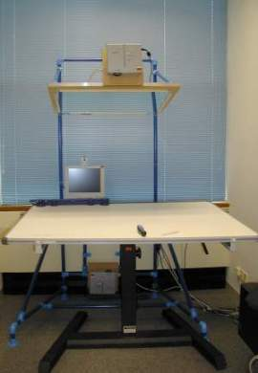
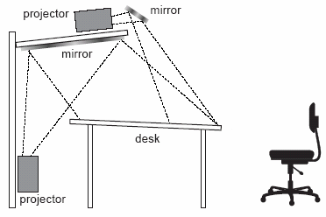
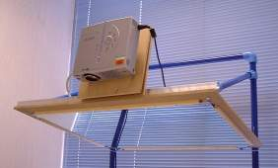
Display – hardware
Foveal display
1024x768 portable projectors
Oblique projection
Use 3D hardware to warp graphics
Notes:
Projectors over 1024x768 are expensive
Sanyo projector shown is about 2000 euros
Standard projectors don’t have high enough resolution to fill a desk and make an A4 sheet readable.
A0 1024x768 periphery is 22 dpi. A3 1024x768 fovea is 62 dpi
My 17” monitor at 1024x768 is 85 dpi
Oblique projection is good because you can lean over the desk.
Assume a pin-hole model. Projective mapping is also called a planar homography.
System is arranged to give best quality in the fovea: fovea has smaller size therefore higher resolution and brightness, front-silvered mirror, the higher resolution projector if available, and as little aliasing as possible.

Slide 11
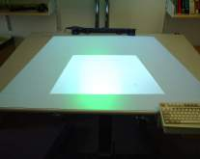
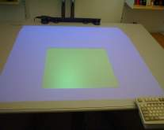
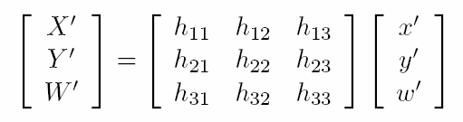
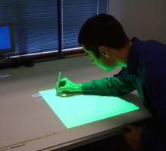
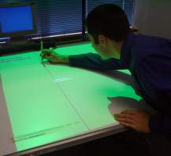
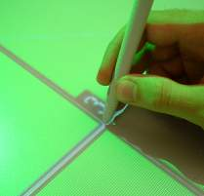
Display – calibration
Use a projective transformation
Obtain point correspondences between projectors and desk
Warp at 30 frames per second for two projectors.
Warping is fast, updating textures requires optimization
Notes:
Obtain point correspondences between projectors and desk (I use 9) – then warp the images by texture-mapping them onto polygons.
Warping is fast – about 0.2ms to draw a 1024x1024 texture on a 1024x768 screen
Updating – only update the parts of the texture that have changed. Coalesce.
In my thesis and the Procams paper I’ve given various tips for exploiting the graphics hardware with DirectX and OpenGL like choosing texture sizes and using homogeneous w values.

Slide 12
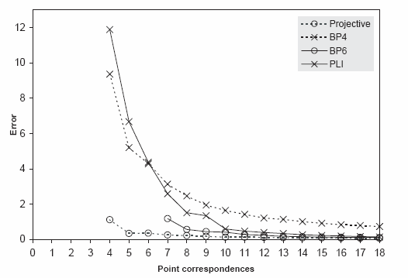
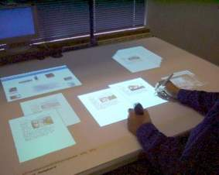
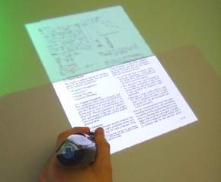
Display – calibration
Projective transformation is a good model
Notes:
Projective mapping = planar homography

Slide 13

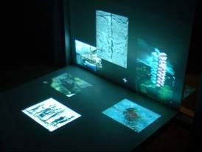
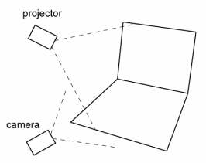
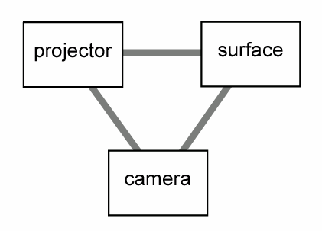
Multiple planes
Work with Rahul Sukthankar
Create an interface spanning multiple surfaces
Uses one projector and a camera
Three main parts to the calibration:
  Find the boundaries between the surfaces
  Find homographies from projector to camera
  Find homographies from camera to surface
Notes:
Segment the image to find the separate plane in the camera image.
Get projector-camera homographies
Get camera-surface homographies

Slide 14
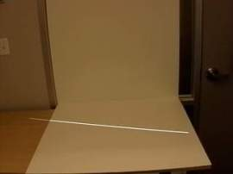
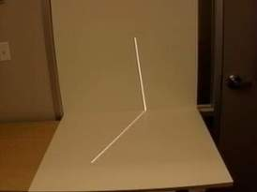
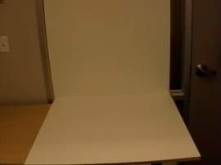
Multiple planes – finding planes
Project lines from the projector
Find ‘kinks’ in the camera image
Fit a line to the
Notes:
Segment the image to find the separate planes.

Slide 15
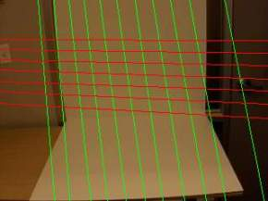
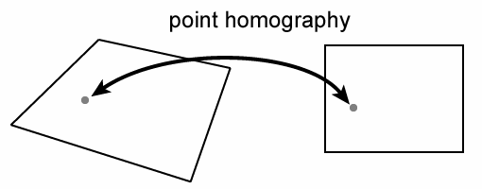
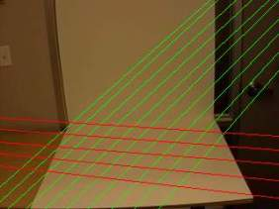

Multiple planes – homographies
Calculate projector-surface homographies from line correspondences
The method should be robust to outliers
Notes:
What you really want is a homography from projector to surface.
Correspondences are available for free in this system.
Use a method like RANSAC – pick random subsets of four line correspondences. Iterate for a set number of goes. With the best subset, classify all correspondences and inliers or outliers, and recompute with all the inliers.

Slide 16




Multiple planes – metric rectification
Calculate camera-surface homography up to a similarity
There is a closed-form solution from images of right-angles
Should be robust
Notes:
We only need the camera to surface homographies up to a similarity (translation, rotation and scaling). They must just correct the shape of projected rectangles. Explained in Hartley & Zisserman.
For robustness, again use random minimal subsets.

Slide 17


Multiple planes
Get final projector-surface homographies
Warp images to appear correctly on the two planes
Use this display for visualizations
Notes:
Question of topology of the surface.

Slide 18





Input
Digitizer pen for dominant hand
Ultrasonic pen for non-dominant hand
Notes:
The Escritroire has simultaneous input from two hands.
Digitizer pen for dominant hand – accurate to 0.25mm
Ultrasonic pen for non-dominant hand
Like difference between fovea and periphery. Resolution, cost, buttons, and grip of pens are different.

Slide 19



User interface - cursors
Cursor may be turned off
Cross hair shows current position
Trace gives a history of past movement
Notes:
In the tests I asked users which they preferred.

Slide 20



User interface – piles
Add, re-order, and remove items
Pile splits for browsing
Like Apple’s pile metaphor
Notes:
Like Apple’s Pile metaphor from about 10 years ago. They will be adding it to Mac OS.

Slide 21


Single user – test
Escritoire has been used for demos
Task 1: highlight spelling mistakes
Task 2: put images in piles
Notes:
7 people – employees of Thales. About 1 hour each in total.
Highlight spelling mistakes – done with the three cursor options.
Put images in piles – 15 images: flowers, animals, and buildings.
Next I’ll describe the reactions of users to the piles and the three cursor options.

Slide 22


Single user - results
People could quickly use the system
Users preferred no cursors
Sensing of pen buttons should be designed carefully
Occlusion was not a problem
Difference in brightness was not a problem
Notes:
People needed only a few minutes of tuition to use the system – impressive compared to keyboard and mouse.
5.5 preferred no cursor, 1.5 cross, 0 trace. “I wasn’t sure if I was drawing or not. In a single-user system with good calibration and low latency there is no need for feedback on present or past pen locations.
Pen worked up to 25mm from the surface and could cause unintended movements in a pile so I added proximity events – which are not present in a conventional mouse interface.
Sensing of pen buttons should be designed carefully – people couldn’t use the buttons on the shaft without pressing the nib button as well.
Pens are ideally held perpendicular to the desk.
No one confused the roles of the pens – They feel very different.
Occlusion not a problem: oblique projection allows the user to lean forward, shadows fall away from the area between the hands, and people are accustomed to their hands shadowing light from above.
People (UNC) are working on photometric calibration but in my case the intensity difference is actually helpful, and the colour difference is not a problem.

Slide 23




Client server
Escritoire software is split into client and server
The client simply displays tiles
Events are passed to the server for processing
Protocol switches between client-pull and server-push
Updates are coalesced at the server
Notes:
SHOW VIDEO – remote collabration
Like X Windows except the client has the display not the server.
Activity will be characterized by periods of thinking, punctuated by periods of activity. Client-pull is good for active periods because the client regulates the flow to what it can handle, and updates are coalesced at the server. Server-push is good for the inactive periods because the client does not have to poll the server.

Slide 24




Two users – test
Standard video conference
Desks for sharing documents
Initially each participant was shown 30 houses
Then two remote participants had to pick the best house from groups of 10
Notes:
Videoconference with MS NetMeeting.
Bill Buxton uses the terms ‘person space’ and ‘task space’ and the desks give a task space.
Three pairs of people.
Participants were given 30 houses to look though and blank sheets to make notes.
I asked the participants some questions at then end.
Whole thing took about 2 hours.
Done over ADSL between Cambridge and Reading about 100 miles away.

Slide 25



Two users - results
No extra training was needed
The trace was preferred
The audio and desk were much more useful than the video
Foveas in different positions
Assignment of functions to pens
Private workspaces would be useful
Notes:
They didn’t need any extra training to use the desk for distributed collaboration.
0 for no cursor, 0.5 for cross hair, 5.5 for trace. It’s not just the result of drawing that is important but the process as well. Example – when you walk up to a board with lots of complex diagrams on. Traces useful for explicitly directing attention, and for general awareness of each other’s actions.
Audio and desk much more useful than the video.
Foveas were in different positions – this should be fixed.
Assignment of roles to hands could be research further – two participants would have liked to browse a pile while writing.
Two participants would have liked private workspaces.

Slide 26
Conclusion
The foveal display provides an affordable desk-sized interface
Fits in a normal office
Participants could use the interface with two pens after only a few minutes of training
Bimanual input over a large area provides a kinaesthetic sense that allows items to be retrieved rapidly
Interaction was possible over a normal ADSL link
A task space can be more useful than a person space
Gesturing is useful for collaborating users
Notes:
Whole setup costs about 10k euros. Main cost is the projectors, which are falling in price. Made from existing hardware components.
Foveal display doesn’t take much more space than the desk, fits under a normal ceiling, can be used under office lighting, and provides a desk-sized display with high resolution where it is needed. It is affordable and uses only a single PC, rather than a cluster.
Only a few minutes of instruction and practice were necessary to learn the interface. A few said it was easier to use than they’d expected.
Continuous input from two hands over a large area can provide a kinaestheic sense so items can be retrieved rapidly.
Interaction was possible over a normal ADSL link – although initial download of the bitmap data took a while.
Traces are useful for collaborating users, but not for a single user.
Task space more useful than person space.
--- A Hierarchy of Interactive Surfaces
In 1946 Jon von Neumann wrote “We are … forced to recognize the possibility of constructing a hierarchy of memories, each of which has greater capacity than the preceding, but which is less quickly accessible.” This concept should be extended to the user interface to construct a hierarchy of interactive surfaces, each of which has greater capacity than the preceding and is more coarsely rendered and controlled.
Mark Weiser’s vision of ubiquitous computing using tabs, pads, and boards.

Slide 27



References
Experiences Implementing and Using Personal Projected Displays, Procams 2003, Nice, France, October 2003
The Escritoire: A Personal Projected Display, Proceedings of WSCG 2003, Pilsen, Czech Republic, February 2003
www.mark.ashdown.name
Notes:
First IEEE International Workshop on Projector-Camera systems. First meeting of all the people working in this area. Procams was part of ICCV.
11th international Conference in Central Europe on Computer Graphics, Visualization, and Computer Vision.
My web page.

Slide 28


Foveal display calibration
There are various 2D co-ordinate spaces
Use projective transformations between co-ordinate spaces
Closed-form least-squares solution from point
Notes:
Obtain point correspondences between projectors and desk (I use 9) – then warp the images by texture-mapping them onto polygons.
Warping is fast – about 0.2ms to draw a 1024x1024 texture on a 1024x768 screen
Updating – only update the parts of the texture that have changed. Coalesce.
In my thesis and the Procams paper I’ve given various tips for exploiting the graphics hardware with DirectX and OpenGL like choosing texture sizes and using homogeneous w values.

