Slide 1
Course Assistant
Design the cluster and serve an app - InferenceOps final project
APP
GATEWAY
ENGINE
Router -> Tutor -> lookup_course
decides what enters and where
decides what runs next
Every decision is proven with scrapes from the real cluster.
Mark | 1 October 2026 | github.com/markat1/course-assistant
Notes:
We built the control plane in front of two engines on one GPU. The gateway decides what enters and where it goes; the engine decides what runs next. Every decision is proven with scrapes from the real cluster.

Slide 2
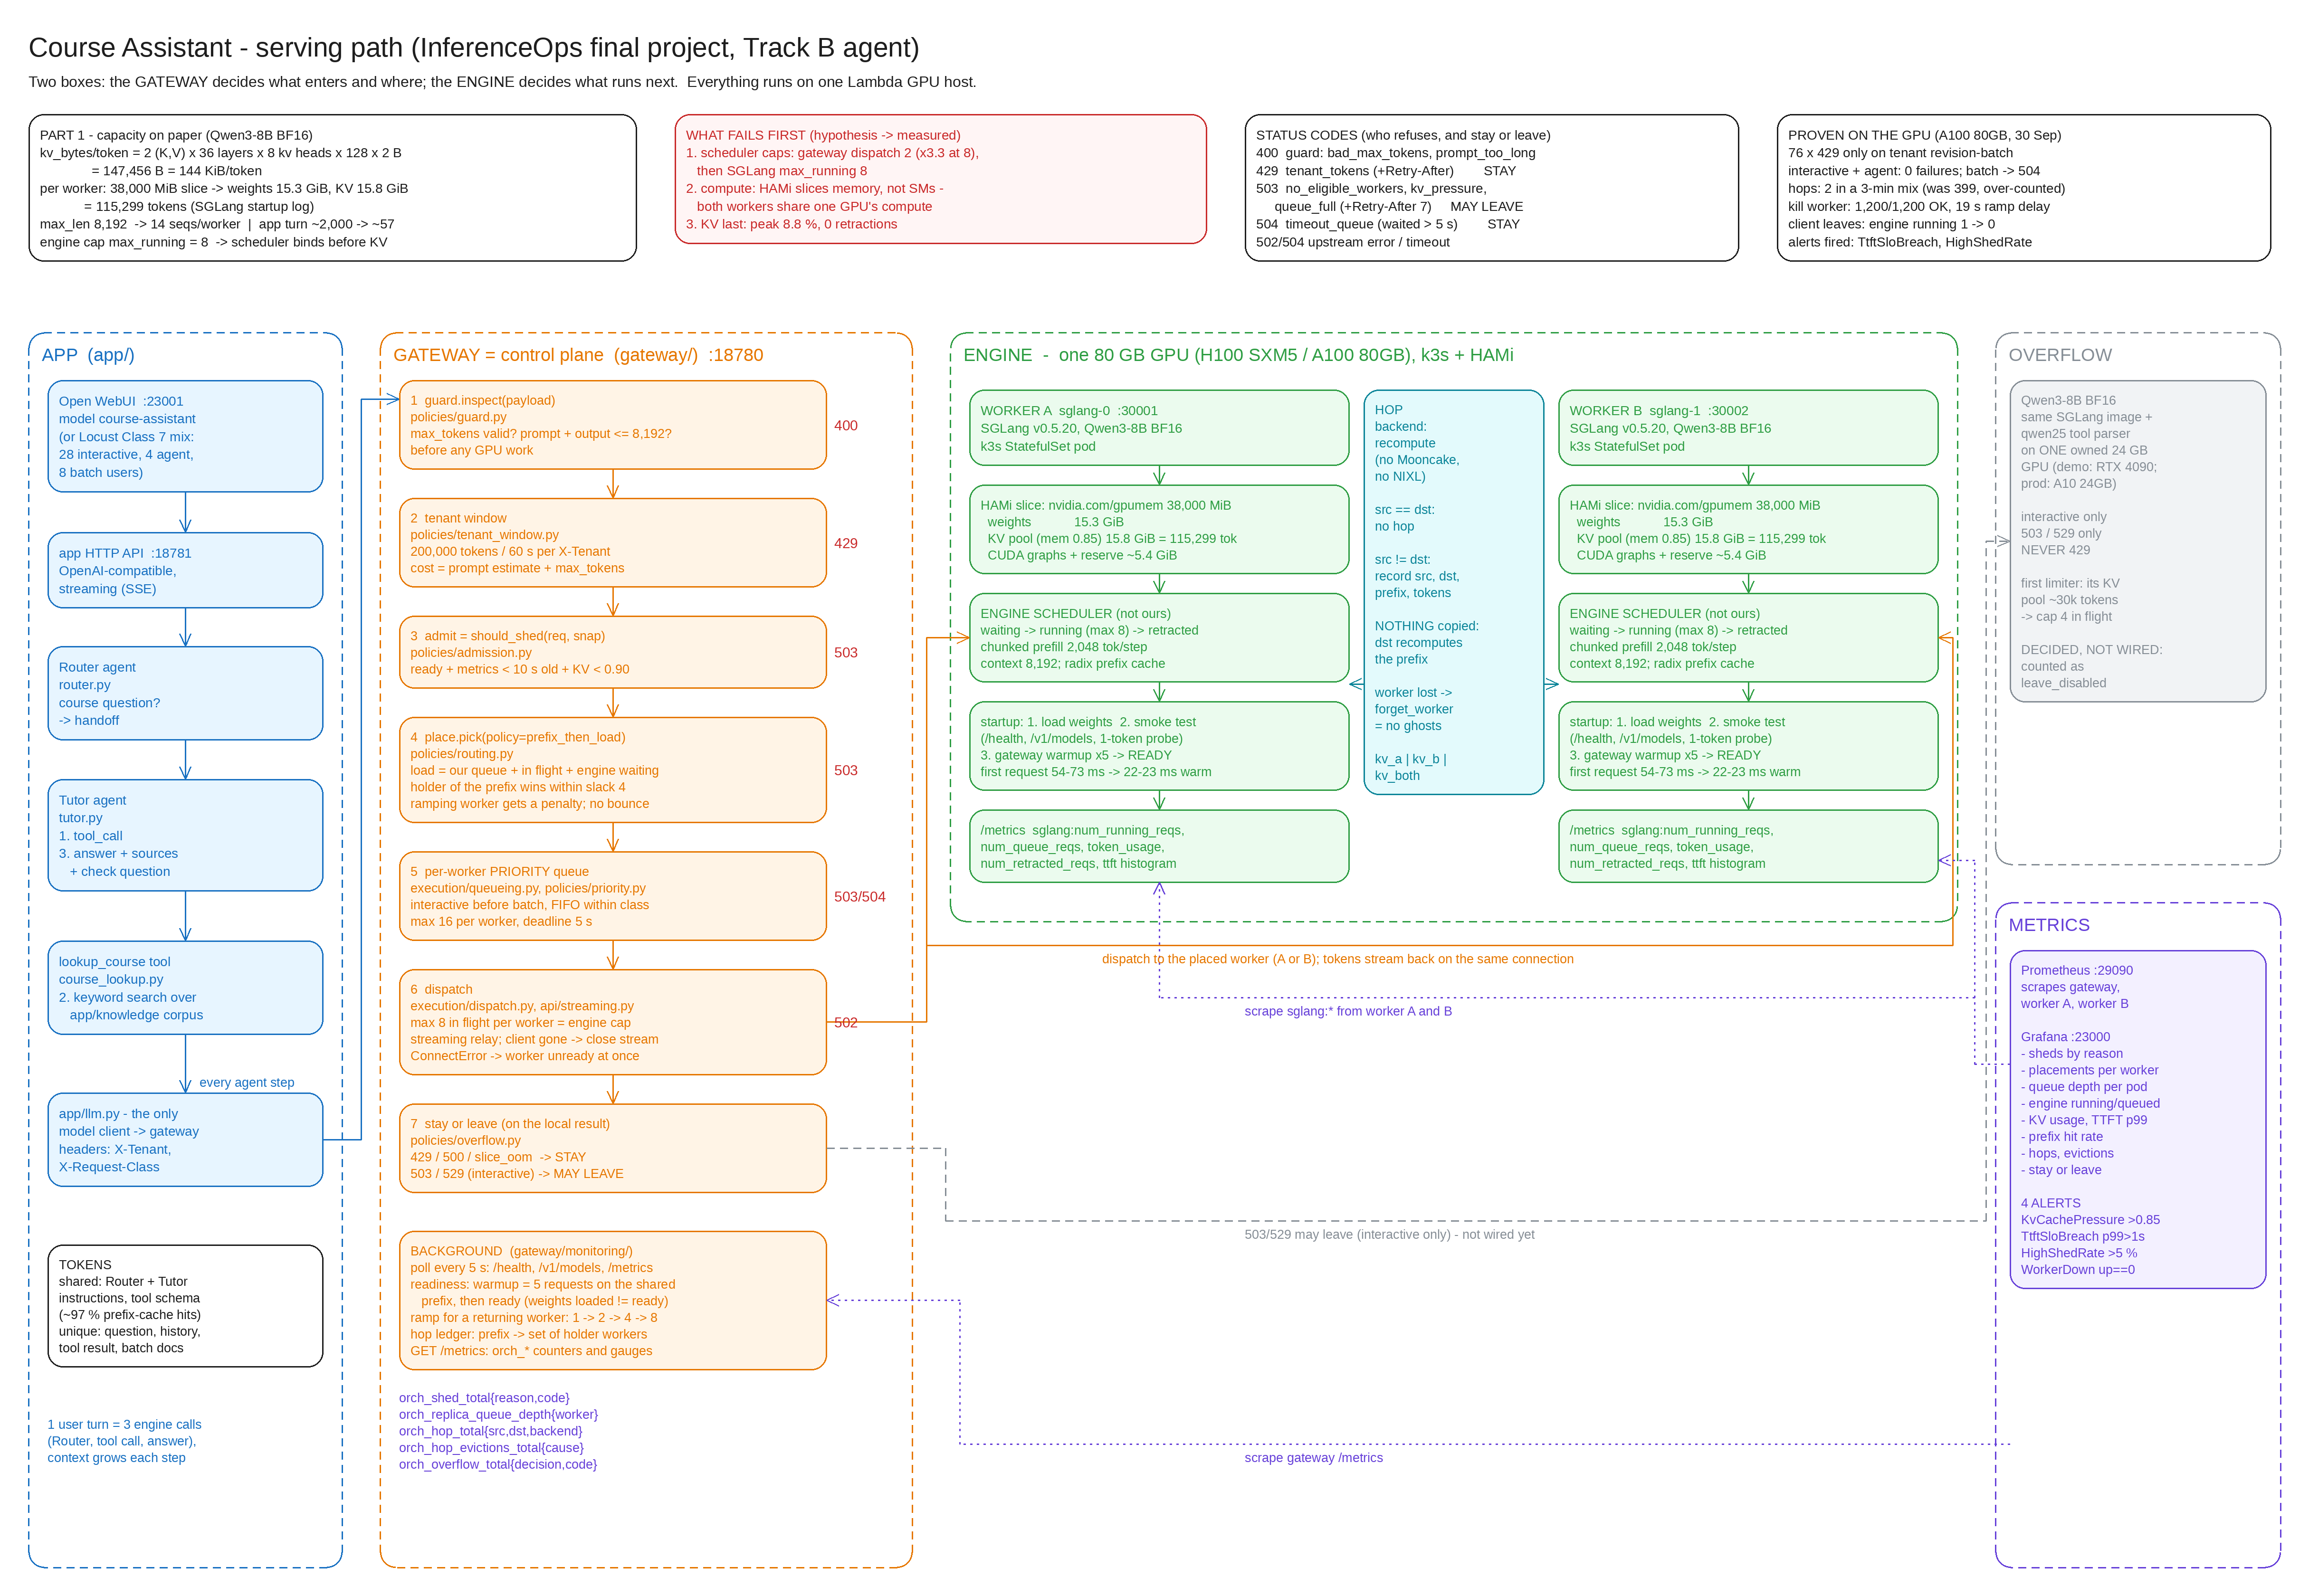
The whole picture
Overview
Gateway (box 1)
Guard, tenant window, admit, place, queue, hop record, warmup, stay or leave.
Engine (box 2)
Two SGLang workers, Qwen3-8B BF16, one 38,000 MiB HAMi slice each on one 80 GB GPU.
Proof
Prometheus scrapes the gateway and both workers. Grafana, four alerts and a notebook for Part 5.
Notes:
Left to right: browser, app, my gateway, the two engines, overflow and metrics. The gateway owns what enters and where; SGLang owns the batch. HAMi splits the memory, not the compute.

Slide 3
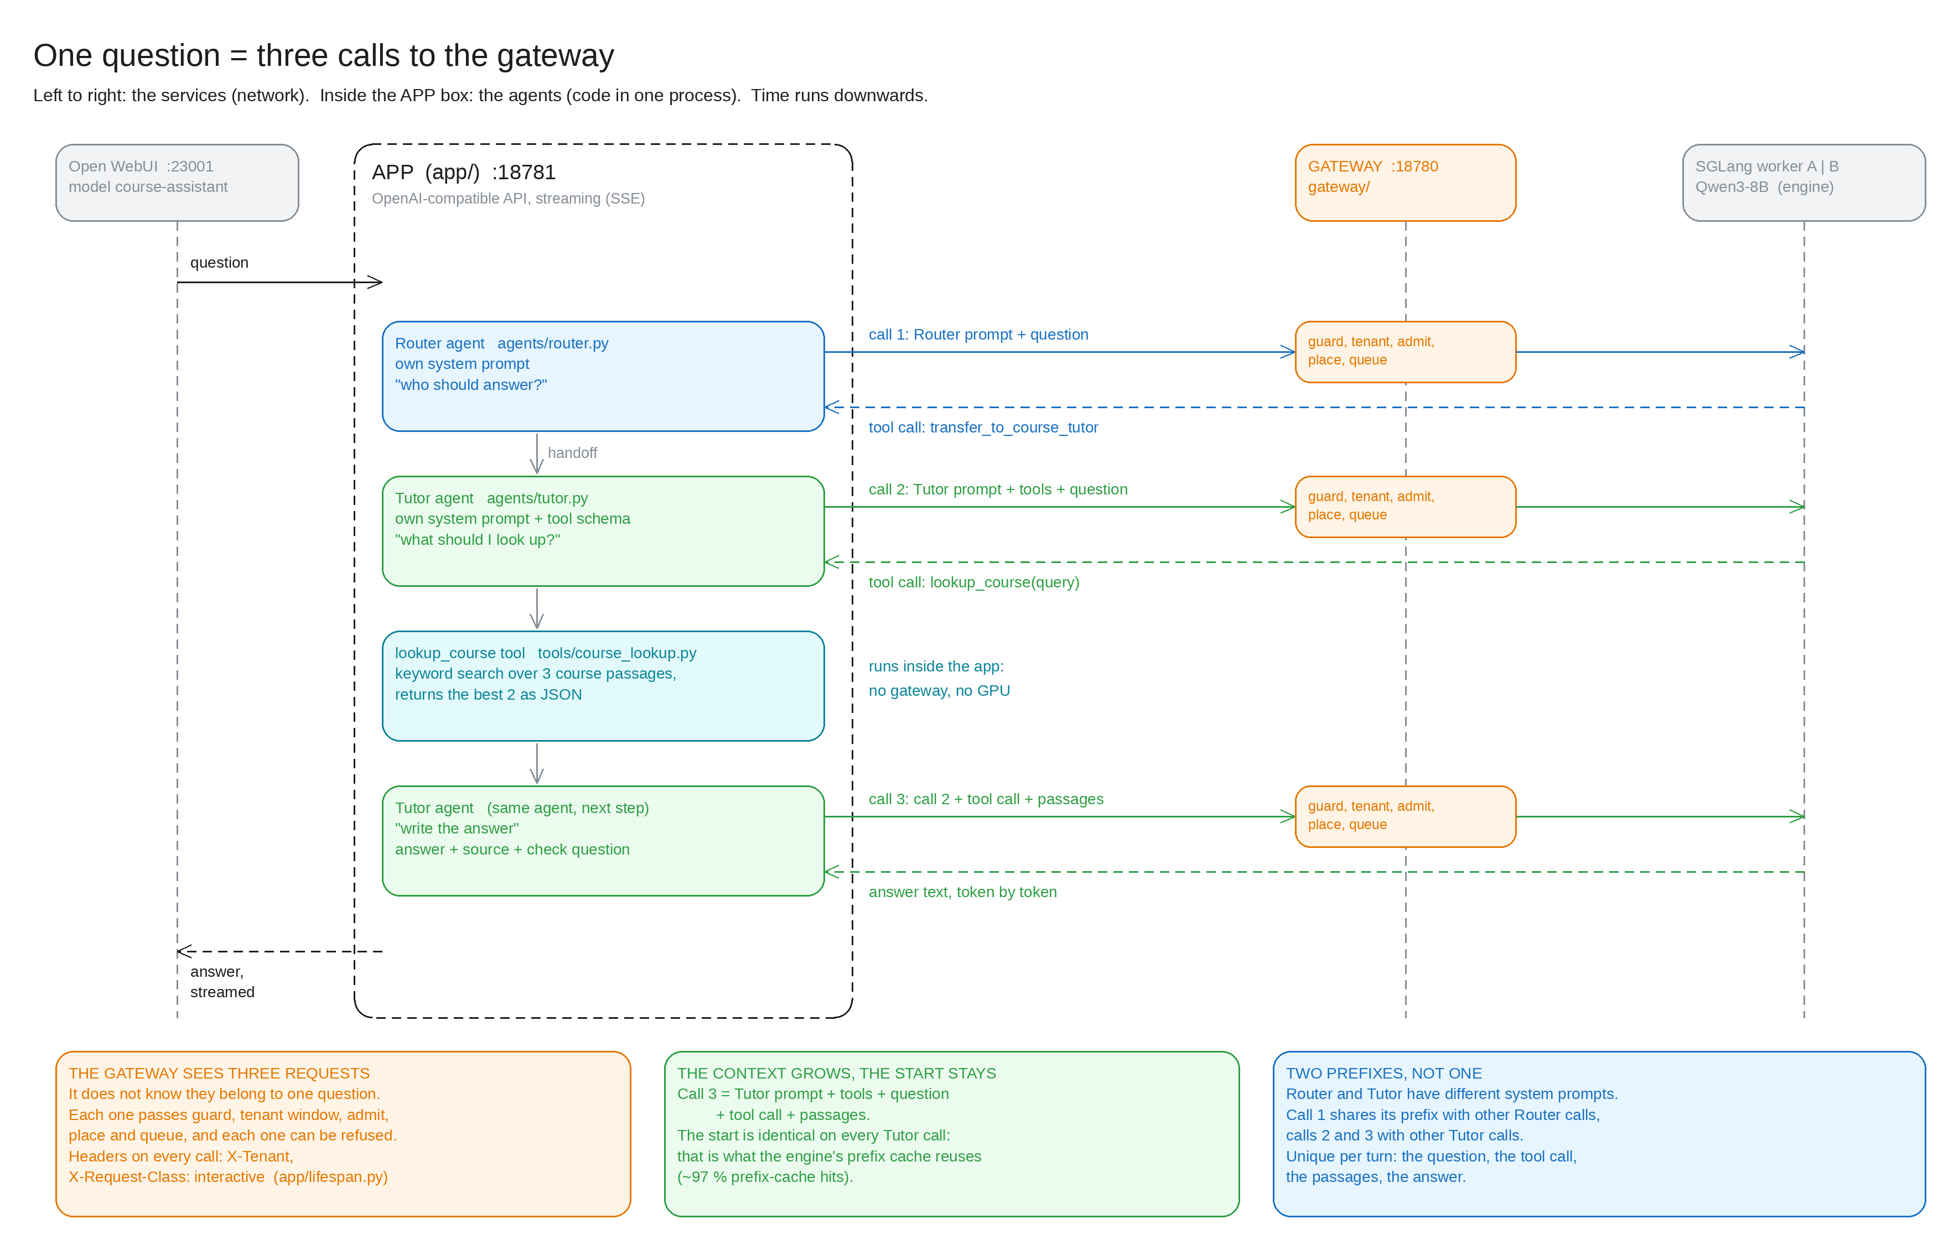
The app: one question = three calls
Part 0 | Q1
Track B agent
Router hands off to Tutor. Tutor calls lookup_course and answers with sources.
Shared vs unique
Shared: system prompts and tool schema (~97 % prefix-cache hits).
Unique: question, tool call, passages, answer.
Interactive vs batch
App sends X-Request-Class: interactive and X-Tenant. Batch = revision-notes sweep from Locust.
Notes:
Every agent step re-sends the whole conversation, so the shared prefix is what I protect and the growing tail is what costs. The gateway sees three requests; it does not know they belong to one question. app/llm.py is the only model client and it points at the gateway.

Slide 4
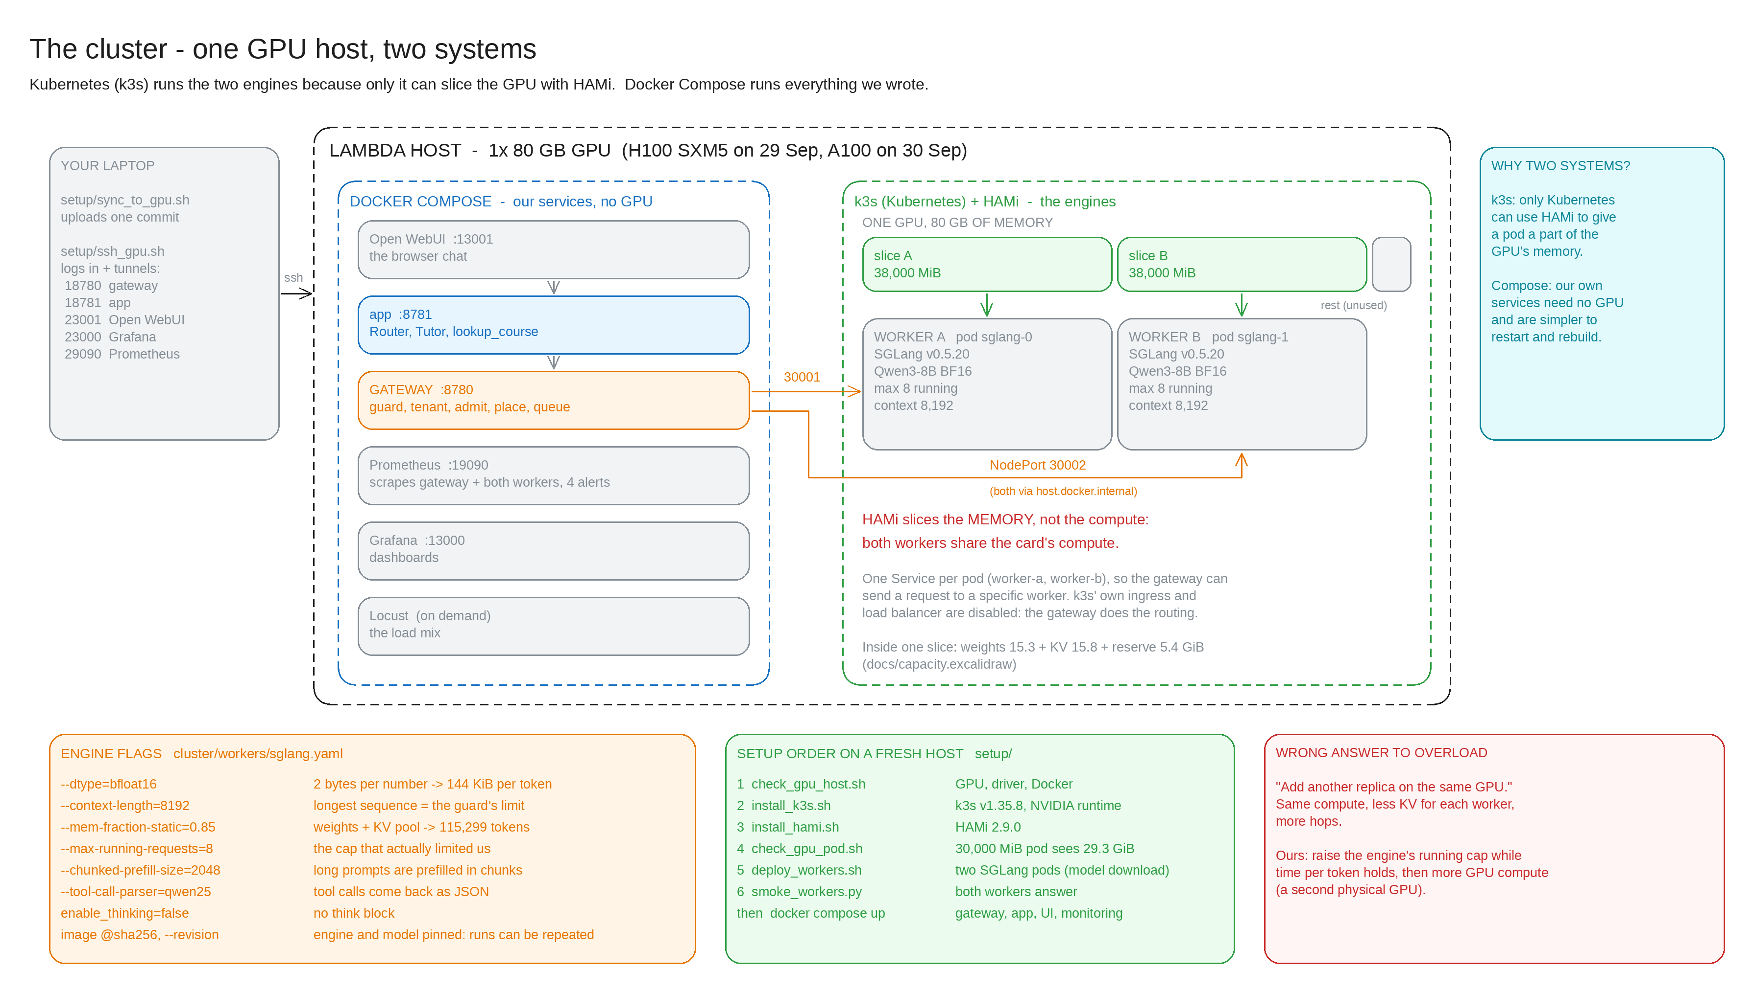
The cluster: one GPU host, two systems
Part 2 | Q9
Notes:
Kubernetes (k3s) runs the two engines because only it can slice the GPU with HAMi. Docker Compose runs everything we wrote. Two boxes: the gateway owns admit, place and queue; the engine owns waiting, KV, preemption and kernels. HAMi slices the memory, not the compute.

Slide 5
Cluster decisions - and what I rejected
Part 2
Decision | Choice | Why | Rejected
GPU | 80 GB: H100 SXM5, A100 80GB | One 80 GB card holds two 8B BF16 replicas with a useful KV pool each | A10 24 GB (one replica), A100 40 GB (~2 GiB KV per slice), GH200 (ARM64)
Model | Qwen3-8B BF16, thinking off | Reliable tool calls with the qwen25 parser; GQA gives 144 KiB per token | No GQA: 4x the KV, 3.5 full sequences per slice
Topology | 2 colocated replicas, HAMi slices 2 x 38,000 MiB | Prefix is cached, decode is the cost; no hop inside a request | Prefill/decode split: a KV move per request
Concurrency | max-running-requests 8, context 8,192, chunked prefill 2,048 | Decode CUDA graphs for 1, 2, 4, 8; protects time per token | Higher cap: not measured yet
Hop backend | recompute (named, counted) | A hop costs ~40-55 ms once; 2 hops per 3 minutes | Mooncake: saves ~0.1 s per 3 min, needs > 5.5 GB/s
Overflow | Qwen3-8B on one owned 24 GB GPU | Same weights and tool parser; we keep KV, warmup, metrics. Limiter: its KV pool | Hosted APIs: no KV, workers or warmup of our own
Scaling | None | If scaling: decode slots are hot, prefill is cached | A same-size replica on the same GPU
Notes:
I need two workers. One 80 GB card holds two Qwen3-8B replicas with a useful KV pool each. Colocated because the shared prefix is cached; with long unique prompts I would split prefill and decode. The overflow recipient is a named model with a named limiter, decided but not wired.

Slide 6
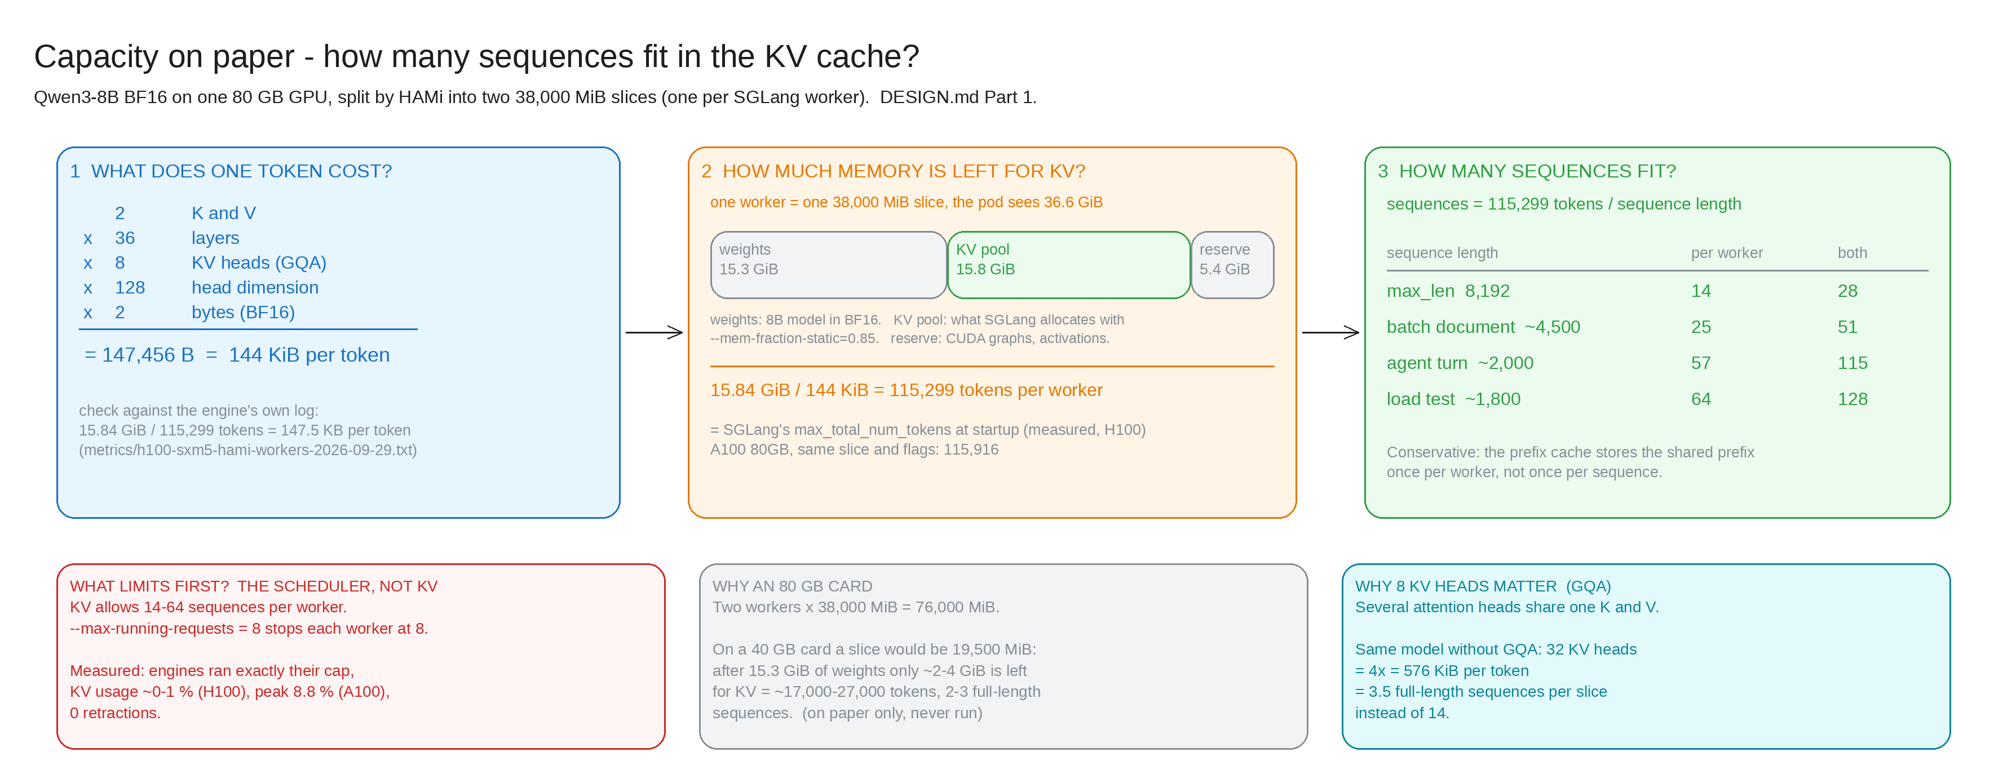
Capacity on paper - and what limited first
Part 1 | Q10
144 KiB / token
115,299 / 115,916
8 < 14-57
2 x 36 layers x 8 KV heads x 128 x 2 bytes
KV tokens per worker, H100 / A100 (SGLang log)
running cap vs what KV allows: the scheduler binds first
Notes:
KV would allow 57 agent turns per worker, we allow 8. The scheduler binds first, and the measurement confirmed it: engines ran exactly 8, KV never went above 8.8 percent. Even earlier, our own gateway cap of 2 bound: raising it to 8 gave 3.3x.

Slide 7
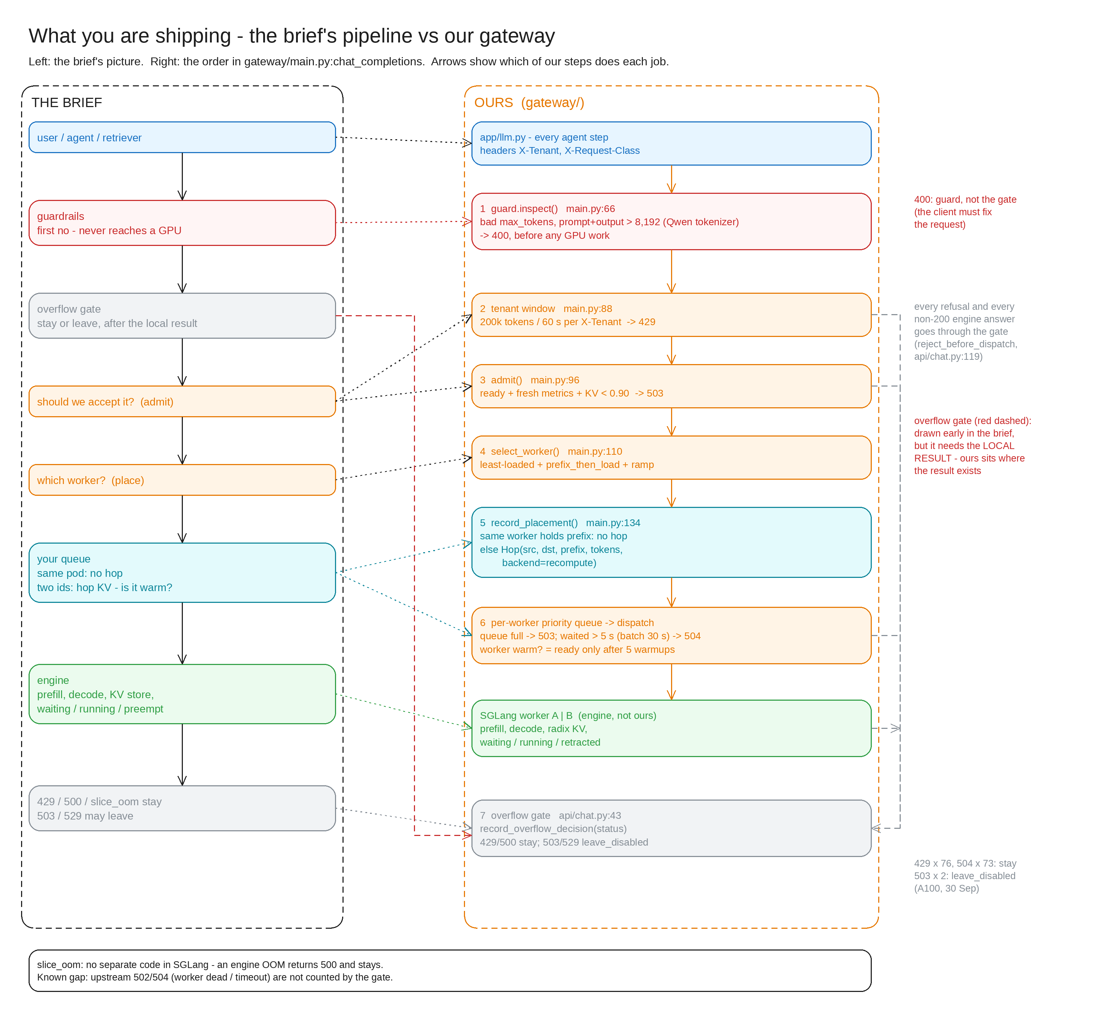
The pipeline: the brief vs our gateway
Part 3, 7 | Q2
What dies where
Stage | Code | Reason
Guard | 400 | bad_max_tokens, prompt_too_long
Tenant window | 429 | tenant_tokens (+Retry-After), stays
Admit | 503 | no_eligible_workers, kv_pressure
Queue | 503 | queue_full (batch: at half the queue)
Queue deadline | 504 | timeout_queue (5 s, batch 30 s)
The overflow gate sits last
The brief draws it early, but it decides on the local result.
Ours runs on every refusal and every non-200 engine answer: 429/500 stay, 503/529 may leave.
Measured: 76 x 429 and 73 x 504 stay, 2 x 503 leave_disabled.
Notes:
Each stage has its own code and reason, and the first stage that says no decides. The order is the order in gateway/main.py:chat_completions. Not the scheduler: I only set engine flags.

Slide 8
Guard, tenant window, stay or leave
Part 3 | Q2 Q6
inspect(payload) -> Guard
Counting tokens: Qwen's tokenizer
First no, before any GPU work or queue slot.
400 bad_max_tokens, 400 prompt_too_long (prompt + output above 8,192).
400 = the client must change the request: no Retry-After, never overflows.
GATEWAY_TOKEN_COUNTER = estimate | tokenizer.
Same prompt: engine 1,673, tokenizer 1,673, characters / 4: 2,088.
6 of 6 prompts match the engine. GPU A/B run still owed.
Tenant window
Stay or leave
200,000 tokens per 60 s per X-Tenant -> 429 + Retry-After.
Measured: 76 x 429, all on tenant revision-batch. 32 students: 0 failures.
A fast 429 beats a slow 200.
429, 500, slice_oom stay. 503 and 529 may leave. A 429 never overflows.
Overflow recipient: Qwen3-8B on one owned 24 GB GPU; first limiter its KV pool (~30k tokens).
Decided, not wired: counted as leave_disabled.
Notes:
The guard refuses what the engine could not run anyway. Rate limiter asks 'are you allowed?', admission asks 'is it possible?' - two questions, two codes. The tokenizer was my weakest point yesterday: the gateway now counts with Qwen's own tokenizer behind a switch; the estimate was 25 percent high on prose.

Slide 9
Place: prefix_then_load
Part 4 | Q7
1
Eligible
5:1 -> 1:1
ready, metrics at most 10 s old
2
Queue room
Ties to the first worker herded traffic onto worker-a. Random tie-break evened it out.
prefer workers whose queue has room
3
Least loaded
our queue + in flight + engine waiting (+ ramp penalty)
399 -> 2 hops
4
Prefix holder
wins if its load is within slack 4; else a hop is recorded
Prefix affinity with a set of holders keeps the shared prefix where it already is (3-minute run).
Queue depth is a scorer, not only an admit input. No bounce: placed once; a full queue sheds 503. p2c equals least-loaded with two workers.
Notes:
I place on the least-loaded worker - my queue plus in flight plus the engine's queue - but a worker that already holds the prefix may be up to 4 requests busier and still win, because a cold prefix costs 54-73 ms against 15-17 ms warm. Slack is my tunable weight.

Slide 10
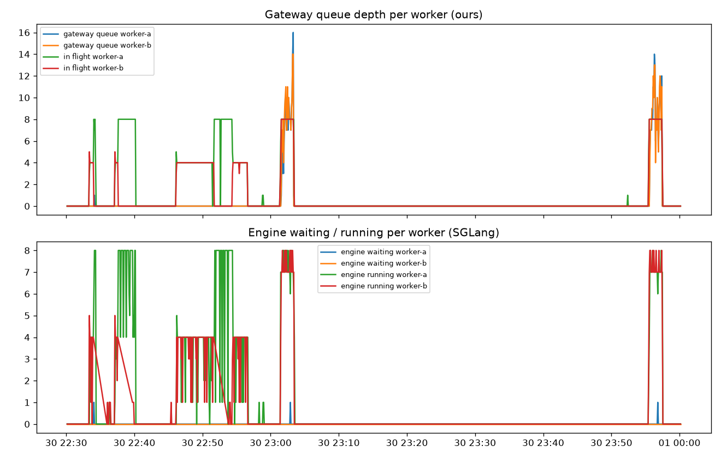
Queue: the backlog sits with us
Part 5 | Q3 Q5 Q9
Ours vs the engine's
Our queue rises to 14-16 per worker, in flight is flat at 8. Engine waiting stays ~0.
Interactive first
Interactive 475/475 and agent 108/108 OK. Batch: 78 x 504.
Deadline per class
Interactive 5 s, batch 30 s; batch refused (503) at half the queue. Tested, not yet measured on the GPU.
notebook/part5_queue.ipynb, live Prometheus, A100 80GB, 30 Sep 22:30-00:00
Notes:
Dispatch cap equals the engine's running cap, so the backlog sits with me, where I can prioritise and shed. Only my queue can say no. Batch starved under one 5 second deadline; it now has its own 30 second deadline and a share of the queue.

Slide 11
Part 5: the nine questions
Part 5
Question | Answer | Scrape / evidence
Our queue vs engine waiting | Ours: admitted, not dispatched. Engine: dispatched, not running | orch_replica_queue_depth vs sglang:num_queue_reqs
Waiting / running / preempted | Running capped at 8; 0 retractions | sglang:num_running_reqs, num_retracted_reqs
Queue depth per pod, which mix | Per worker under the labelled Class 7 mix | plots/part5-queue-depth-by-pod.png
32k RAG vs short decode | 32k never enters (guard). In our queue we order; after dispatch SGLang does | guard 400; chunked prefill 2,048
PagedAttention vs radix | The radix prefix cache saved memory: ~97-100 % hits | plots/part5-shared-prefix-kv.png
Engine flags | max-running-requests 8, chunked-prefill 2,048, context 8,192 | cluster/workers/sglang.yaml
KV full after admit | We admit below 90 %; after that the engine retracts. Never reached | peak KV 8.8 %
Client gone | Gateway closes the stream; SGLang aborts and frees KV | running 1 -> 0 vs control 1.0
Worker returns | Ramp 1 -> 2 -> 4 -> 8 after 5 warmups | 0 user requests for 19 s, then normal share
Notes:
The notebook answers these from a live Prometheus scrape. Do not reimplement the engine: we only order our own queue; batching, chunked prefill and retraction are SGLang's.

Slide 12
Hop and warmup: is it actually warm?
Part 6 | Q7 Q8
54 -> 98 -> 15 ms
22-23 ms
2 hops
fresh worker: cold prefix, prefix cached but still slow, warm
first user request after 5 warmup requests on the app prefix
in a 3-minute run of ~680 requests
The hop record
Why recompute and not Mooncake
src == dst: nothing recorded.
src != dst: Hop(src, dst, prefix, tokens, backend = recompute).
KV hop worker-b -> worker-a prefix=723b... tokens=922 backend=recompute
Not copied: the KV tensors. The destination recomputes the prefix.
Worker lost -> forget_worker, so no ghosts (worker_lost 2).
A hop costs ~40-55 ms, once.
Upper bound of the saving: ~0.1 s per 3 minutes.
The prefix is ~246 MB of KV; a transfer must beat ~5.5 GB/s to win. Over TCP it would be slower.
Pays off for long prefixes or with RDMA. Bandwidths are assumptions.
Notes:
A replica is not warm because the weights are loaded. Even with the prefix cached, the next request took 98 ms. So my gateway sends five warmup requests on the app's own prefix before it declares the worker ready, and I quote the SLO warm only. My hop backend is called recompute: I record every hop and move no bytes.

Slide 13
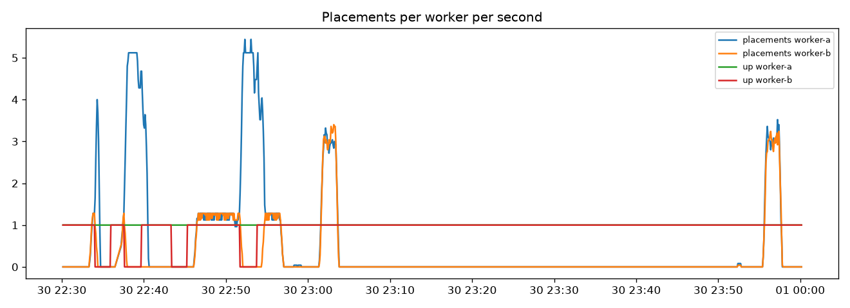
A worker dies and returns; a client leaves
Part 5
Ramp, not slam
No black hole
Client gone
1,200 / 1,200 requests OK. Returning worker: 0 user requests for 19 s, then its normal share.
A refused connection marks the worker unready at once: 735 -> 0 failed requests.
Gateway closes the engine stream: running 1 -> 0. Control with the client staying: 1.0.
Notes:
The red line is worker-b going down four times; worker-a alone takes about 5 placements per second. When b is back it re-enters only after warmup and ramp. Simply returning from the handler does not stop the engine from generating, so I proved the abort.

Slide 14
Proof: five numbers
Part 8
3.3x
8.8 %
76 x 429
22-23 ms
399 -> 2
Our own dispatch cap (2) was the first limiter
Peak KV: never the limiter. 0 retractions
Only on tenant revision-batch. Interactive: 0 failures
First request on a fresh worker, down from 54-73 ms
Hops: the prefix stays on the worker that holds it
The traffic
The evidence
Not compared
Class 7 mix shaped like the app: 28 interactive, 4 agent and 8 batch users (experiments/locustfile.py).
Raw output in metrics/, plots from the cluster in plots/, Part 5 in notebook/part5_queue.ipynb.
Latency on the H100 (29 Sep) and the A100 (30 Sep). Only behaviour is compared across GPUs.
Notes:
These five numbers are the proof. Each one points at a file in metrics/. Latency on the H100 and the A100 is not compared.

Slide 15
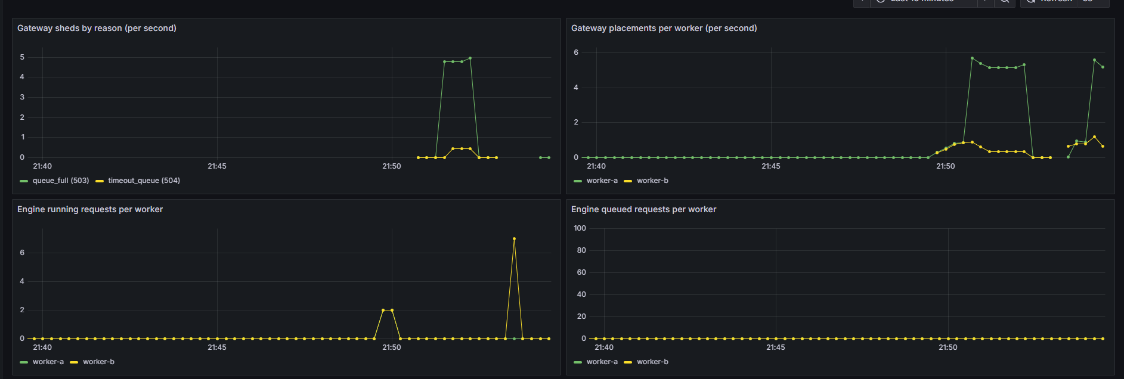
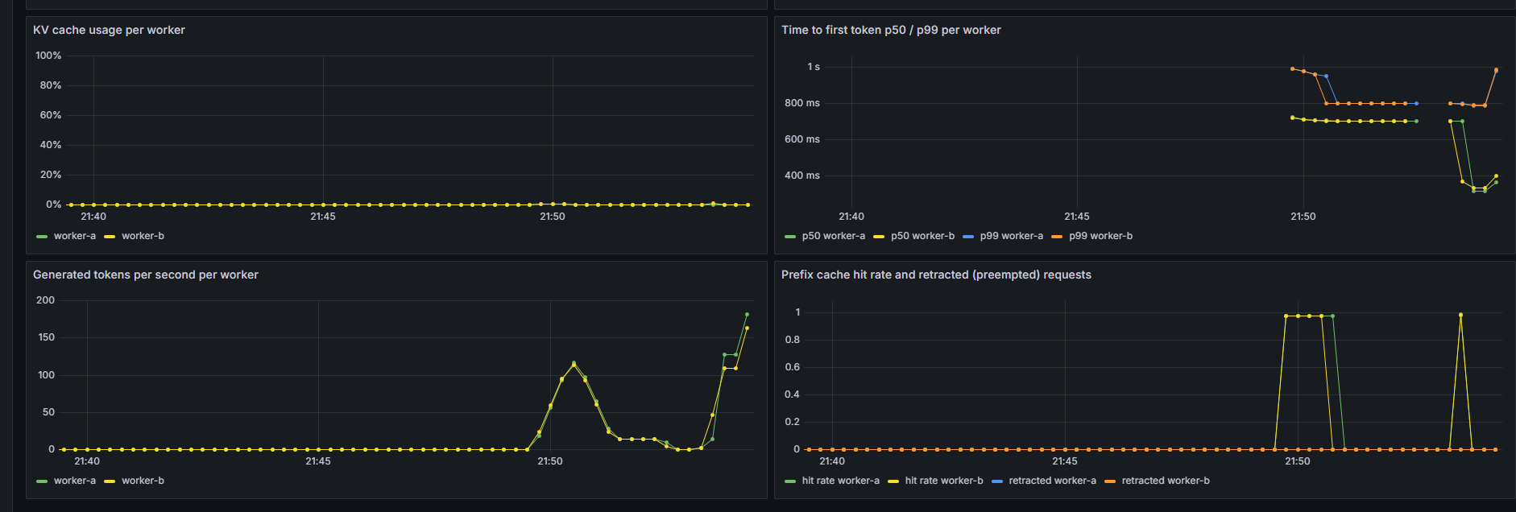
Grafana: what each panel proves
Part 8
Brief | Panel
Cluster | Prometheus scrape status
Success and failures | Sheds by reason (no status panel yet)
Sheds by reason | tenant_tokens, timeout_queue, queue_full
Router | Placements per worker
Queue depth by pod | Gateway queue depth and in flight
vLLM | SGLang running, queued, KV, TTFT
Hop store | KV hops and ledger evictions
Replicas / KEDA | 2 fixed replicas, no scaling
Under 40 users (A100)
Engine running 8, engine queue ~0, our queue 10-11, KV 2-5 %, hit rate ~1.0, TTFT p50 1.5 s.
Screenshots: H100, 29 Sep, dispatch cap 8.
Notes:
Read top-down in Abi's debugging order: admission, then the queue, then routing, then memory. Key point: our queue rises while the engine queue stays near zero. At 40 users TTFT p50 rises to 1.5 s - the price of running at the cap - which is what TtftSloBreach catches.

Slide 16
Four production alerts
Q11
KvCachePressure
TtftSloBreach
KV above 0.85 for 2 min - just under the 0.90 admission limit
Live: Never fired: KV at most 8.8 %
Engine p99 TTFT above 1 s for 5 min
Live: Fired on both workers under load
HighShedRate
WorkerDown
More than 5 % of requests shed, per reason, for 5 min
Live: Fired under the labelled mix
up == 0 for 1 min: capacity halved
Live: Pending: the restart was shorter than 1 min
Rules: monitoring/alerts.yaml, unit-tested with promtool (monitoring/tests/alerts_test.yaml).
Notes:
Queue depth leads, TTFT confirms. Each alert names the layer. Rules are in monitoring/alerts.yaml and unit-tested with promtool.

Slide 17
Scaling and 10x traffic
Q12 Q13
What I would do
Three wrong knobs
Scale decode slots, not prefill: the prefix cache hit rate is ~1.0, the running cap of 8 binds.
1. Keep tenant windows and interactive priority.
2. Wire the overflow for 503 only.
3. Raise max-running-requests while time per token holds.
4. Then a second physical GPU for compute.
Bigger queue or longer queue timeout: hides overload as TTFT.
KV limit toward 1.0: turns sheds into engine retractions.
More HAMi replicas on the same GPU: same compute, less KV each, more hops.
Notes:
Uncached prefill is small; decode slots are hot. More waiting, more memory pressure or more copies on the same GPU all make it worse. No autoscaling today; KEDA would scale on queue depth and KV pressure.

Slide 18
Bad answers - and ours
Part 8
Bad answer in the brief | Our position
Bench latency at batch 8 is the SLO | SLO from the app's own mix through the serve path
Cache full, add a same-size replica | KV peaked at 8.8 %; same GPU = same compute
NCCL/NIXL moves KV tensors | Nothing moves: backend recompute
Ready when the weights are loaded | Ready after 5 warmups on the app prefix
Overflow is another API | Named model (Qwen3-8B, owned 24 GB GPU) and limiter (KV pool)
Reimplemented the scheduler | Engine flags only; we order only our own queue
A 429 that overflowed | 76 of 76 counted stay
The gateway fixed OOM | HAMi limits memory; the gateway only refuses work
RAG is a third phase | Retrieval is a tool call; the engine sees prefill and decode
Wall seconds across models | One model; H100 and A100 latencies not compared
Cold TTFT as the SLO | Warm only: 22-23 ms after warmup
Notes:
None of the instructor's bad answers apply. The three to say freely: nothing moves between workers; ready means warm; a 429 never overflows.

Slide 19
Say it before anyone asks
Open work
Overflow not wired
timeout_queue is reactive
No same-GPU p99 spread
Recipient decided; 503 counted as leave_disabled.
Found after the wait. Next: predict before enqueue.
Protection is measured in failures: users 0, batch pays.
Tokenizer A/B owed
Batch deadline not on GPU
No status panel
6 of 6 without a GPU; the GPU comparison is not run.
30 s + half the queue is tested, not yet on the GPU.
Sheds by reason exist; success by status code does not.
Notes:
These are the honest limits. Each has a next step written in DESIGN.md under Open work.

Slide 20
The 13 questions
Index
# | Question | Answer | Slide
1 | App; shared vs unique tokens | Track B agent; shared = prompts + tool schema, unique = question, tool result | 3
2 | What dies where | guard 400, tenant 429, admit 503, queue 503 / 504 | 7
3 | Prevent work that will time out | Queue deadline before dispatch: 5 s, batch 30 s | 10
4 | Protect KV | Admit below 0.90; dispatch cap = engine cap; guard at 8,192 | 6, 7
5 | Prioritise interactive | Per-worker priority queue: users 0 failures, batch pays | 10
6 | One tenant owning the GPU | Token window per X-Tenant: 76 x 429 on revision-batch | 8
7 | Hop; what is not copied | Recorded at placement; KV is not copied (recompute) | 12
8 | Evict; ghosts | forget_worker + LRU; ghost = dead worker's prefix marked warm | 12
9 | Engine scheduler vs ours | Two boxes; backlog in our queue, engine queue ~0 | 4, 10
10 | What limited concurrency | Gateway cap 2, then engine cap 8; not KV | 6
11 | Four alerts | KvCachePressure, TtftSloBreach, HighShedRate, WorkerDown | 16
12 | Which pool to scale | Decode slots | 17
13 | 10x; three wrong knobs | Priority, overflow, compute; not queues, KV limit or replicas | 17
Notes:
Use this slide during questions to jump to the right slide. Full answers with files are in DESIGN.md and docs/PRESENTATION.md.

Slide 21
The gateway decides what enters and where.
The engine decides what runs next.
Every decision is proven with scrapes from the real cluster.
github.com/markat1/course-assistant
DESIGN.md | notebook/part5_queue.ipynb | docs/PRESENTATION.md
Notes:
Questions.

