Slide 1
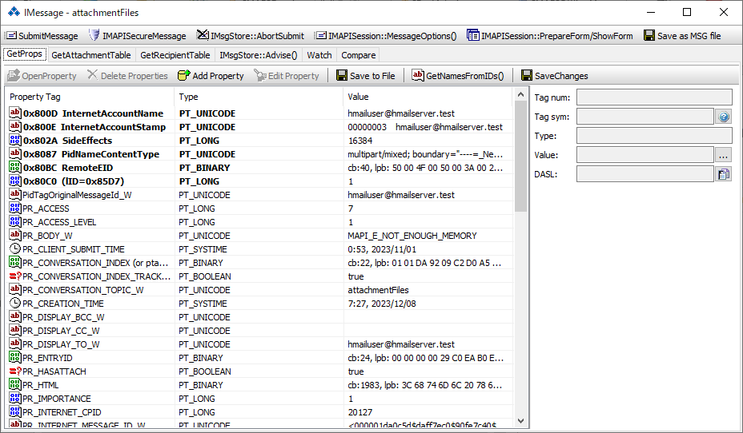
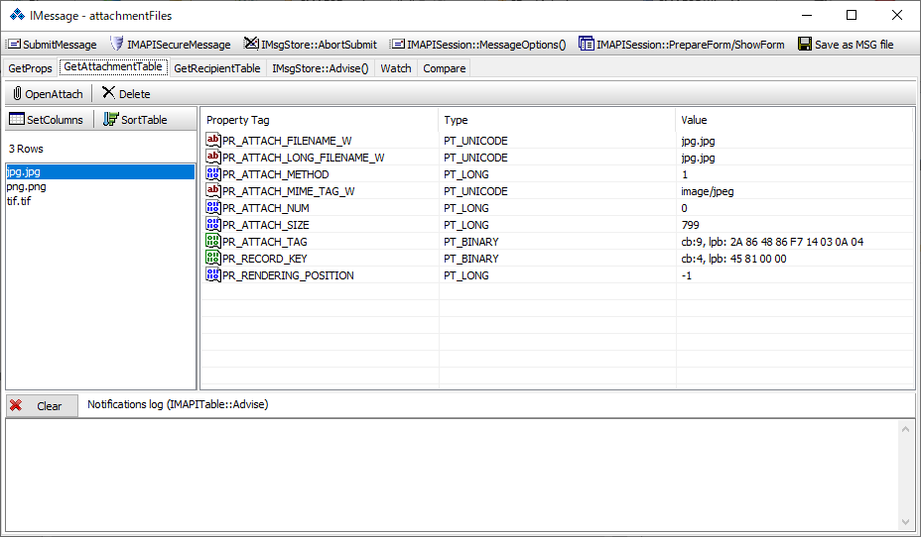
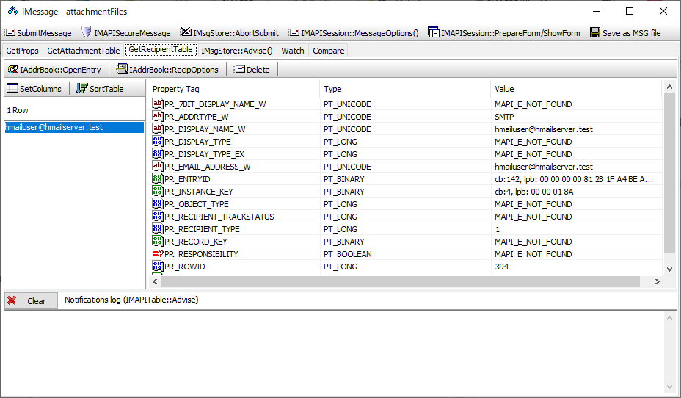
NDB Node Database (NDB) Layer
Messaging Messaging layer
LTP Lists, Tables, and Properties (LTP) layer
Messaging Messaging layer
LTP Lists, Tables, and Properties (LTP) layer
CFB Compound File Binary (CFB) Layer
Parser
Generation
PST
MSG

