Slide 1

Player Position Cards
4-1-1
1
5 6
2 4 3
9

Slide 2
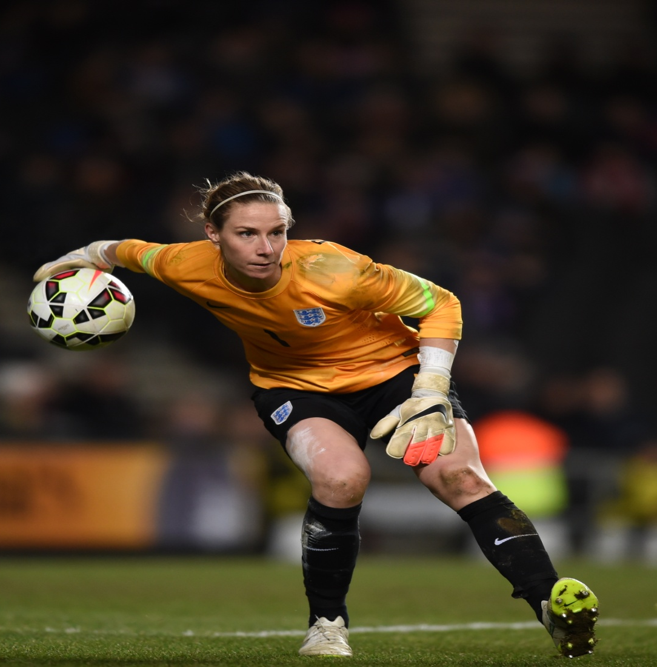
1 Goalkeeper
Our Team Have the Ball
Try to throw accurately to teammates when opposition drop off
Try to start the counter attack if the opposition are out of position
Try to be available if your teammates ever need to pass to you
Our Team Without the Ball
Be a ‘sweeper keeper’
Try to organise your team quickly if we lose the ball
Try to make good decisions e.g. punch/parry/catch
Vocal, Brave, Agile

Slide 3
Player Position Cards
4-1-1
1
5 6
2 4 3
9

Slide 4
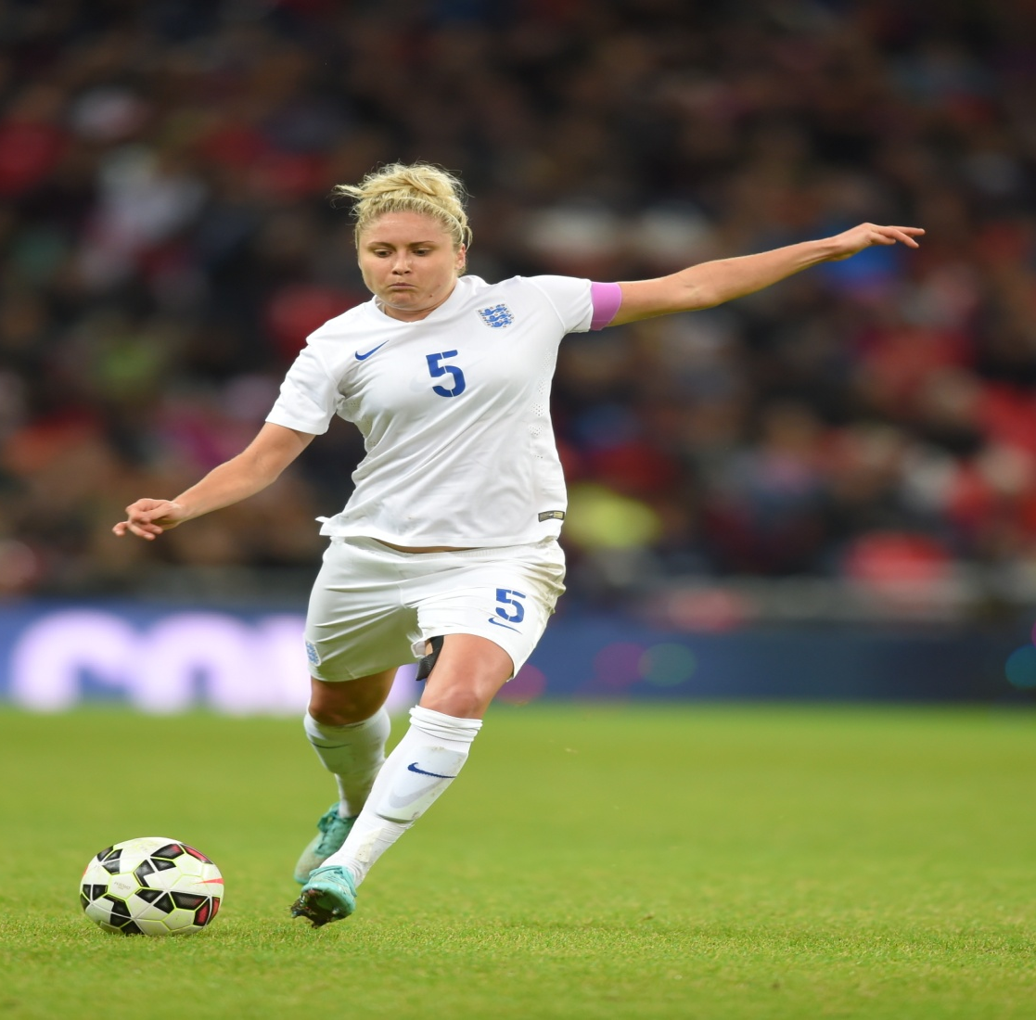
5 & 6 Centre Back
Our Team Have the Ball
Try to be composed in possession
Recognise when to pass into midfield and when to play wide
Recognise when to clear danger and when to keep possession
Our Team Without the Ball
Practice trying to intercept the ball into the player you are marking
Work together with your partner to cover each other
Be strong and dominant
Commanding, Strong, Composed

Slide 5
Player Position Cards
4-1-1
1
5 6
2 4 3
9

Slide 6
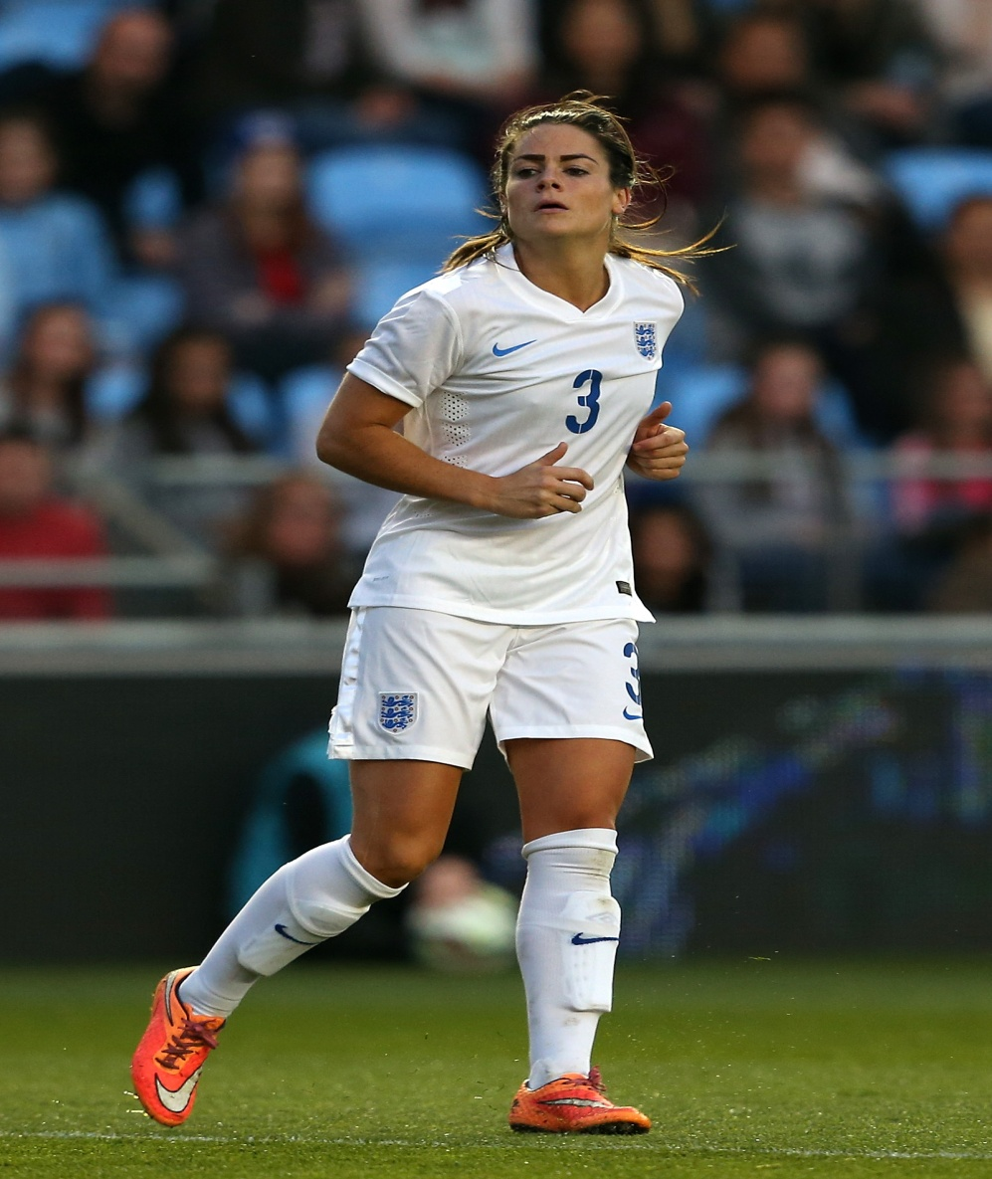
2 & 3 Full Backs
Our Team Have the Ball
Try to maintain width to receive the ball from the GK
Try top get forward when we have the ball
Recognise when to cross/dribble and when to pass be exciting
Our Team Without the Ball
Try to recover goal side of the ball within 6 seconds to regain our team ‘shape’
Try to provide cover and balance to Centre backs when ball is on the other side of the pitch.
Try to have good body shape so you can see as much pitch as possible
Athletic, Positive, 1v1 Attacking & Defending

Slide 7
Player Position Cards
4-1-1
1
5 6
2 4 3
9

Slide 8
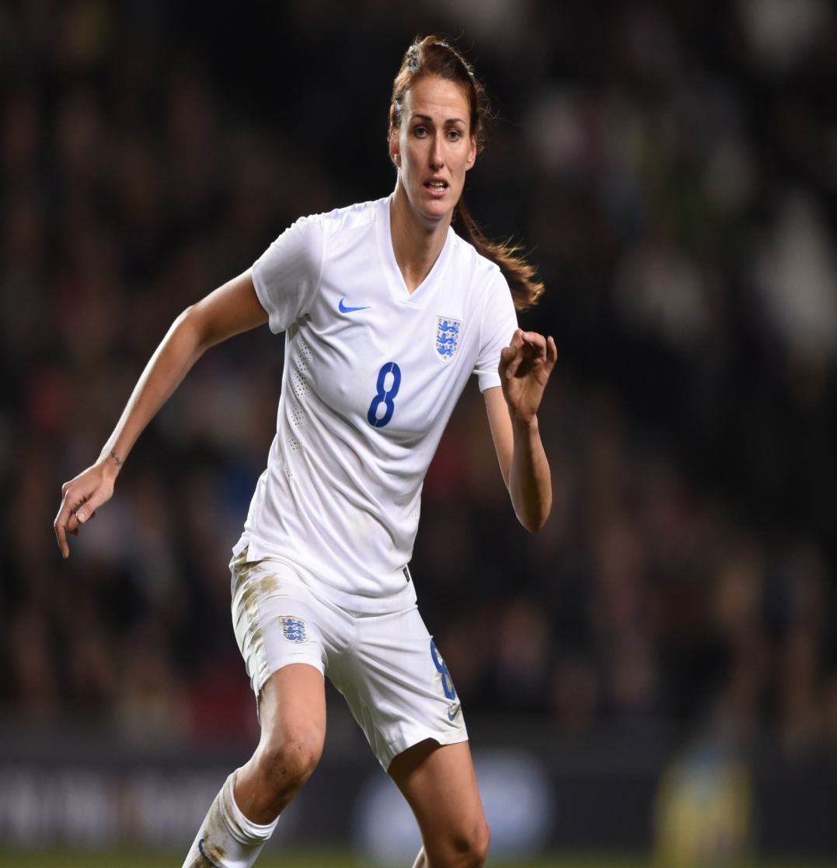
4 Holding Midfielder
Our Team Have the Ball
Try to find clear passing lines to allow defenders to pass you the ball
Try to play forward as much as possible and quickly to set up counter attacks
Try to offer support for attacking players if they need ‘recycle’ in the final 3rd
Our Team Without the Ball
Try to get goal side of the ball to support defenders within 6 seconds
Be aware of ‘danger players’ you might need to track runners
Identify when to press the ball to try win it back
Anticipation, Available, Leadership

Slide 9
Player Position Cards
4-1-1
1
5 6
2 4 3
9

Slide 10
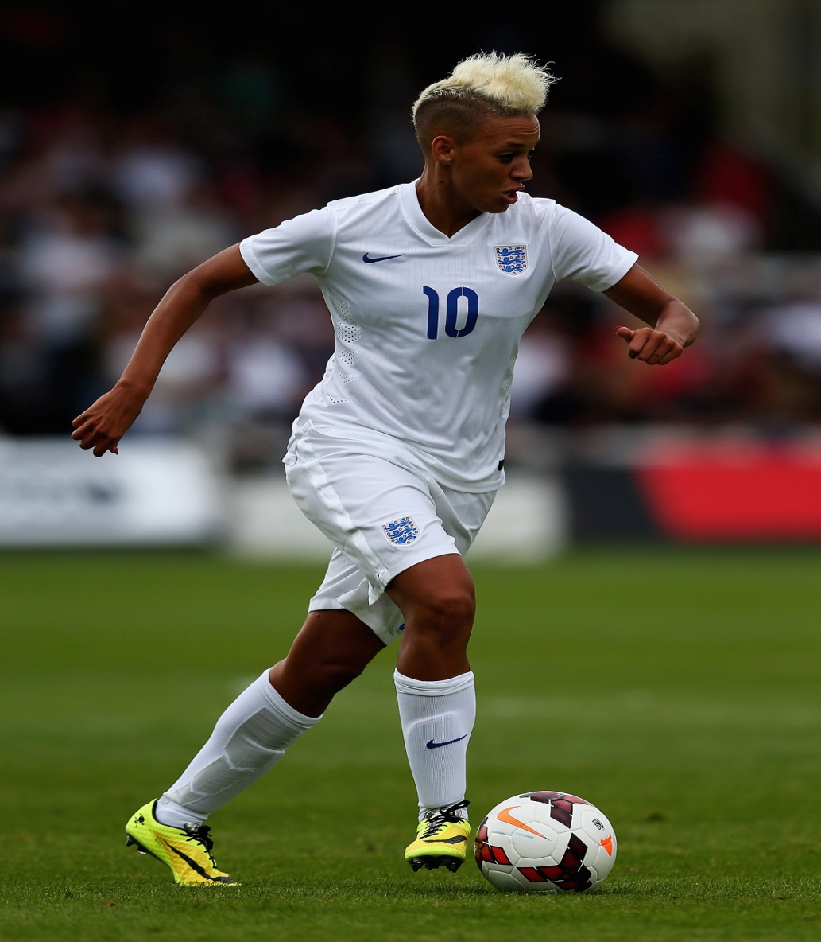
9 Centre Forward
Our Team Have the Ball
Try to make runs in behind the defence,
Try to control and combine with other midfielders/full backs
Try to hit the target with every shot
Our Team Without the Ball
Try to screen passing lines stopping defenders playing out from the back
try win the team the ball back within 6 seconds.
Try to find a position to counter attack when your team win the ball back
Skillful, Creative, Goalscorer

Slide 11

TEAM OBJECTIVES
Our Team Have the Ball
Try to combine with team mates when going forwards
Express yourself when beating players be ‘EXCITING’
Be ‘BRAVE’ in possession of the ball in tight areas
Always try to get on clear passing lines to support your team mates
Our Team Without the Ball
Recongnise when/who presses the ball
Try to be hard to pass between
Be aware of other teams players and the danger they pose

