Slide 1



Networking 2002
Pisa Italy
The Post-PC Era:
It’s All About Services
Randy H. Katz
The United Microelectronics Corporation Distinguished Professor
Computer Science Division, EECS Department
University of California, Berkeley
Berkeley, CA 94720-1776 USA
randy@cs.Berkeley.edu

Slide 2
Traditional View of Networking
All about protocols and the OSI seven layers
  Protocol details: link-state vs. distance vector, TCP
  Protocol layering
  Multiaccess technology
  Switching and routing
  Naming
  Error control
  Flow control & scheduling
  Special topics like multicast and mobility

Slide 3
The New Opportunity
New things you can do inside the network
Connecting end-points to “services” with processing embedded in the network fabric
Not protocols but “agents,” executing in places in the network
Location-aware, data format aware
Controlled violation of layering necessary!
Distributed architecture aware of network topology
No single technical architecture likely to dominate: think overlays, system of systems

Slide 4
Distributed Service Architectures for Converged Networks
Converged Networks
  Public Switched Telephone Network (PSTN)
  Internet/Public Switched Data Network (PSDN)
  Mobile Internet
  Converged Structure?
Distributed Service Architecture
  Services
    “-Ility” connectivity
    Rich call: new call “features”
    Infrastructure services: proxies, search, commerce
    Enablers for distributed apps: event & content distribution

Slide 5
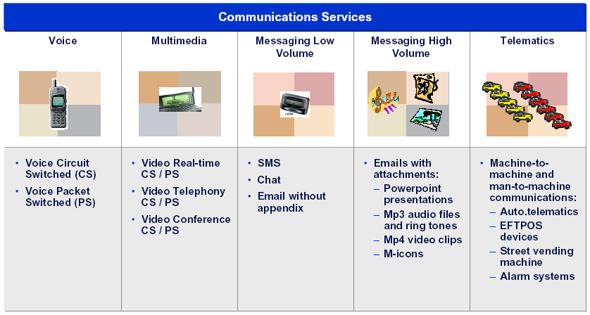
Services in Converged Networks

Slide 6
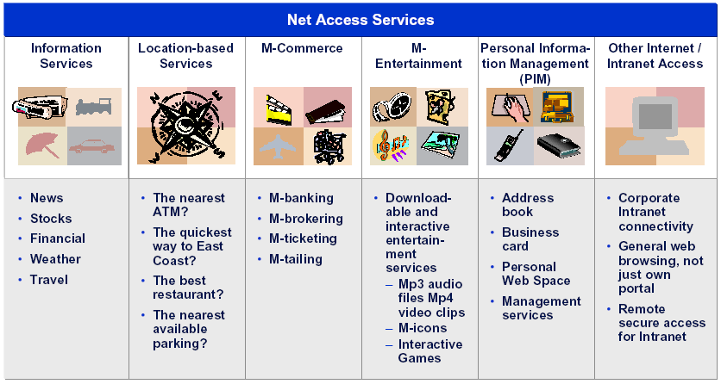
Services in Converged Networks

Slide 7
New Kind of Communications-Oriented Service Architecture
Emerging, still developing, in a highly heterogeneous environment
  Rapid development/deployment of new services & apps
  Delivered to radically different end devices (phone, computer, info appliance) over diverse access networks (PSTN, LAN, Wireless, Cellular, DSL, Cable, Satellite)
  Exploiting Internet-based technology core: clients/server, applications level routers, TCP/IP protocols, Web/XML formats
  Beyond traditional “call processing” model: client-proxy-server plus application-level partitioning
  Built upon a new business model being driven by the evolution of the Internet: traditional “managed” networks and services versus emerging “overlay” networks and services structured on top of and outside of the above
  Composition via cooperation or brokering to achieve enhanced performance and reliability

Slide 8
Some Potential Disruptive Ideas About Network Architecture and Design*
Where should intelligence in the network reside?
End-to-end model right conceptual framework?
How can faults be better isolated and diagnosed?
Abstractions of topology and performance
Overlay approach to deploy disruptive technologies
* From “Looking over the Fence at Networks: A Neighbor’s View of Networking Research”
Computer Science Technical Board, National Research Council, USA

Slide 9
Presentation Outline
Necessity for Heterogeneity
Connectivity, Processing, Resiliency
Overlays, Peering, Cooperation, Composition
A New Research Agenda

Slide 10
Presentation Outline
Necessity for Heterogeneity
Connectivity, Processing, Resiliency
Overlays, Peering, Cooperation, Composition
A New Research Agenda

Slide 11
“X-Internet” Beyond the PC
Internet Computers
93
Million
Today’s Internet
Internet Users
407 Million
Automobiles
663 Million
Telephones
1.5 Billion
X-Internet
Electronic Chips
30 Billion
Forrester Research, May 2001

Slide 12
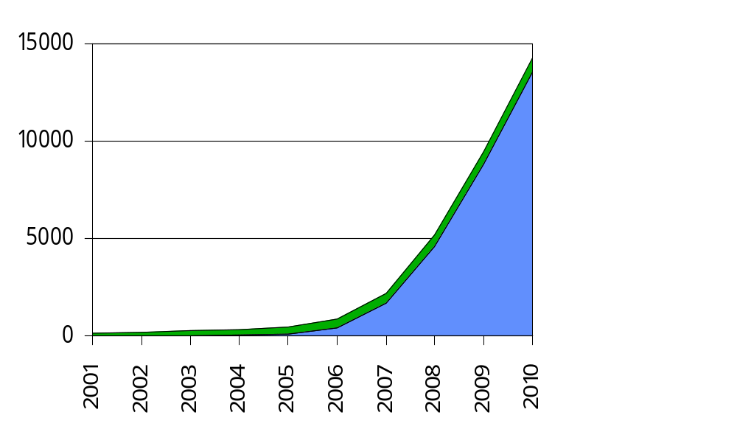
“X-Internet” Beyond the PC
Millions
PC
Internet
X
Internet
Year
Forrester Research, May 2001

Slide 13
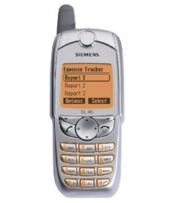
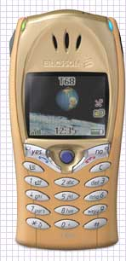
The Shape of Things NOW!
Ever More Sophisticated Phones
Phone w/voice command, voice dialing, intelligent text for short msgs
MP3 player + headset, digital voice recorder
“Mobile Internet” with a built-in WAP Browser
Java-enabled, over the air programmable
Bluetooth + GPRS
Enhanced displays + embedded cameras
Siemens SL45i
Ericsson T68

Slide 14
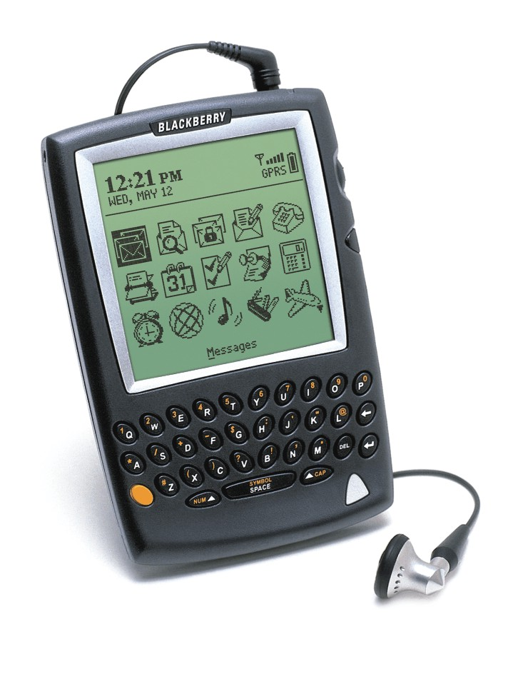
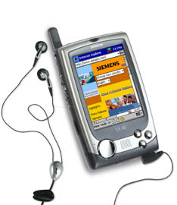
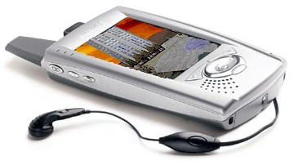
The Shape of Things NOW!
Phone + Messenger + PDA Combinations
  E.g., Blackberry 5810 Wireless Phone/Handheld
    Integration of PDA + Telephone
    PLUS Gateway to Internet and Enterprise applications
    1900 MHz GSM/GPRS (Euroversion at 900 Mhz)
    SMS Messaging, Internet access
    QWERTY Keyboard, 20 line display
    JAVA applications capable
    8 MB flash + 1 MB SRAM

Slide 15

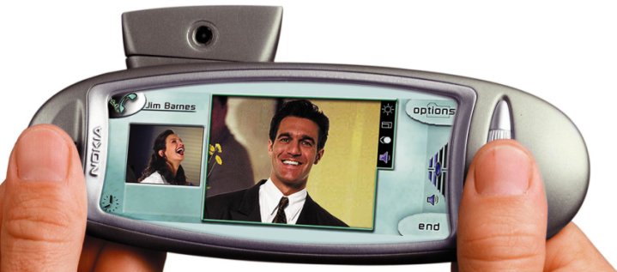
The Shape of Things to Come
Danger “Hiptop”
  Full-featured mobile phone w/Internet Access
  Email + attachments/instant messaging + PIM
  Digital camera accessory
  End-to-end integration of voice + data apps
  Media-rich UI for graphics + sound
  Large screen + QWERTY keyboard
  Data nav: keyboard or push wheel
  Affordable (under $200)
  MIDI synthesizer for quality sound
  Multi-tasking of user actions
  Customizable ring tones and alerts
  to personalize hiptop experience

Slide 16

The Shape of Things to Come
Not just terminal equipment …
  End-to-end mobile applications platform with backend services; remote application and device management
  Carriers license/customize h/w from CE manufacturers
  Customizable to carrier's needs, allowing targeting of specific audiences
  Complete set of data apps and allows for more apps and functionality over time
  Over-the-air updates for improvements, innovations, delivery of services w/o burden/cost of manual updates
  Platform for Third-Parties: Device + backend infrastructure enable carrier-specific apps

Slide 17
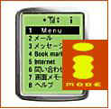
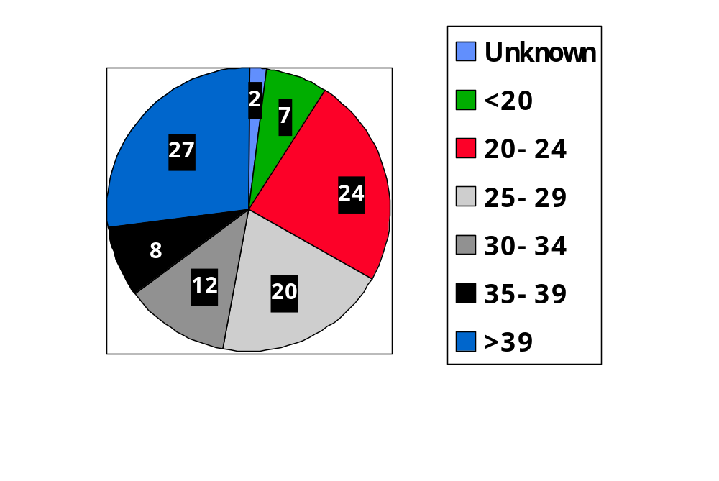
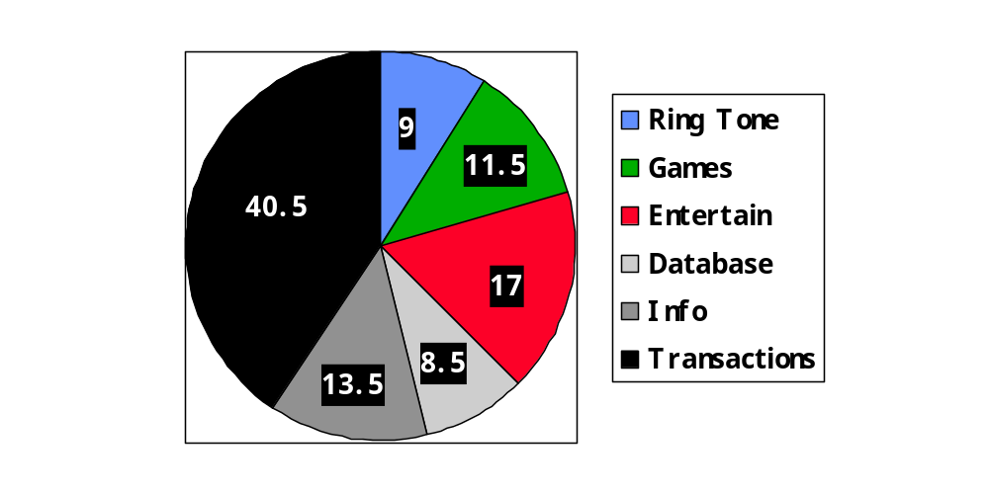
The iMode Story:
It is About Services
32M Internet-capable cell phone sub-scribers (4/02); 50K iMode Web Sites
World’s largest ISP, first to deploy 3G
“Freedom of Multimedia Access” (FOMA)
Not just about Japanese teenagers
Applications Used
User Ages
Economist Magazine, 13 Oct 2001

Slide 18
After the PC …
True “Convergence”
Not just about gadgets or access technologies
About services and applications, and how the network can best support them
Increasing, not decreasing, diversity
Bottlenecks moving from core towards edge
Enabled by computing embedded in communications fabric: wide-area, topology-aware, distributed computing

Slide 19
Presentation Outline
Necessity for Heterogeneity
Connectivity, Processing, Resiliency
Overlays, Peering, Cooperation, Composition
A New Research Agenda

Slide 20




Connectivity and Processing
Cable
Modem
Access
Networks
Premises-
based
LAN
Transit Net
LAN
Private
Peering
LAN
Premises-
based
Core Networks
WLAN
Transit Net
WLAN
WLAN
NAP
Internet
Datacenter
Analog
Public
Peering
Transit Net
Operator-
based
RAS
DSLAM
Regional
Wireline
Regional
Cell
H.323
Data
Cell
Data
H.323
Cell
PSTN
Voice
Voice

Slide 21
Presentation Outline
Necessity for Heterogeneity
Connectivity, Processing, Resiliency
Overlays, Peering, Cooperation, Composition
A New Research Agenda

Slide 22
Problems and Solutions
“The Network Effect”
Creating and deploying new services
  Development and deployment expense
    Cost of 3G licenses and networks
    “Even if I had $1 billion and set up 1000s of locations, I could never in my network have a completely ubiquitous footprint.”—Sky Dayton, founder of Boingo
    Composition, cooperation, overlays
Achieving desirable end-to-end properties
  Control of the end-to-end path
  Cooperation, peering, overlays (brokering)
Evolving network services
  Difficult to change global operational infrastructure
  Overlays, cooperation

Slide 23

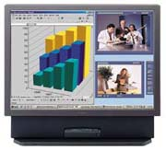
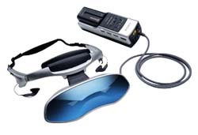
Resource Composition:
Connectivity, Processing, Services
Applications
(Portals, E-Commerce,
E-Tainment, Media)
Appl Infrastructure Services
(Distribution, Caching,
Searching, Hosting)
AIP
ISV
Application-specific Servers
(Streaming Media, Transformation)
ASP
Internet
Data Centers
Application-specific
Overlay Networks
(Multicast Tunnels, Mgmt Svrcs)
ISP
CLEC
Internetworking
(Connectivity)
Global Packet Network

Slide 24
Peering
Policy-Based Routing
Multi-homing
  Reliability of network connectivity
  Traffic discrimination
Primary
Transit
Network
End Network
Berkeley
Campus
Dorm
Traffic
New Primary
Transit
Alternative
Transit
Network
Research
Traffic
Fail-over
Peer
Network
Peer
Network
Peer
Network
CalREN
Peer
Networks

Slide 25
Peering, Cooperation, Composition for GPRS Transit
Operator A
Operator C
BG
DNS
GGSN
GPRS Peering Network
DNS
GPRS Peering Network
BG
R
R
SGSN
GRX
GRX
R
R
DNS
.gprs
R
R
DNS
R
R
DNS
GRX
DNS
Operator C
Operator B
R
GRX
R
BG
BG
R
R
DNS
DNS
R
DNS
SGSN
SGSN
eXchanges
  Aicent, Belgacom, Cable & Wireless, Carrier1, Comfone/Infonet, Deutsche Telekom, Ebone, Energis, France Telecom, Global Crossing, KPNQwest, Sonera/Equant, Telecom Italia, Telenor, Telia, Telecommunications Services Inc, WorldCom
Per Johannson, Ericsson Research

Slide 26
Interconnected World:
Agile or Fragile?
Baltimore Tunnel Fire, 18 July 2001
  “… The fire also damaged fiber optic cables, slowing Internet service across the country, …”
  “… Keynote Systems … says the July 19 Internet slowdown was not caused by the spreading of Code Red. Rather, a train wreck in a Baltimore tunnel that knocked out a major UUNet cable caused it.”
  “PSINet, Verizon, WorldCom and AboveNet were some of the bigger communications companies reporting service problems related to ‘peering,’ methods used by Internet service providers to hand traffic off to others in the Web's infrastructure. Traffic slowdowns were also seen in Seattle, Los Angeles and Atlanta, possibly resulting from re-routing around the affected backbones.”
  “The fire severed two OC-192 links between Vienna, VA and New York, NY as well as an OC-48 link from, D.C. to Chicago. … Metromedia routed traffic around the fiber break, relying heavily on switching centers in Chicago, Dallas, and D.C.”

Slide 27
Interconnected World:
Agile or Fragile?
Ohio Train Derailment, 25 April 2002
  UUNet is primary casualty when derailment cuts crucial fiber optic cables
  Worldcom and Sprint networks very seriously affected
  Sprint network connection to UUNet lost for 4 minutes during high traffic period of middle of the day
  Triggers peering failures that affect many other ISPs
  Too much traffic traveling over too few routes
  Phenomenology: BGP dynamics problems? Configuration mistakes?
Network behavior/dynamics still not understood, even for basic reachability!

Slide 28
Overlays
Creating New Interdomain Services
Deploy new services above the routing layer
  E.g., interdomain multicast management and peering
  E.g., alternative connectivity for performance, resilience
Isolated
Intra-cloud
service
Administrative
domain
Administrative
domain
Traditional
unicast
peering
Admin
domain
Admin
domain
Admin
domain
Steve McCanne

Slide 29

Overlays
Brokered Resources for Applications
Examples:
  Multicast management and peering at application level
  Implement performance qualities at overlay level
Steve McCanne

Slide 30
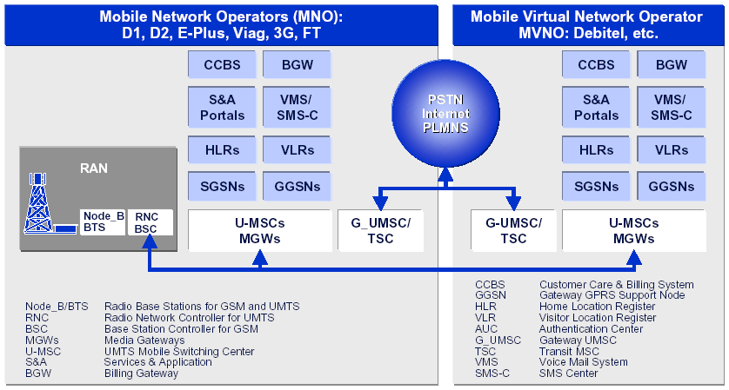
Composition and Cooperation:
Mobile Virtual Network Operator
MVNO has everything but its own physical network

Slide 31
Composition:
Wireless ISPs (wISPs)
T-Mobile Wireless Broadband (MobileStar), WayPort
  Traditional network ISP, subscription-based services in public places
  Hotels (Wayport), airports (Wayport @ SJ airport), airport clubs (T-Mobile @ AA Admirals Club), and cafes (T-Mobile @ Starbucks)
  Diverse billing models: e.g., 24-hour subscription at a hotel
Boingo, Joltage, hereUare, NetNearU
  “Aggregator” of access, e.g., Boingo aggregates Wayport, hereUare
  Client s/w including network sniffer/location finder, back-end authentication/secure VPN/settlement services
  Revenue sharing with micro ISPs/single local network (SLN)
  Diverse billing models: subscriptions as well as pay per use
Sputnik
  Cooperative wireless neighbor-to-neighbor networks
Ipass, GRIC
  Secure remote access for mobile employees
  Simplify connection establishment and login, wireless VPN support

Slide 32

Composition of Wireless Infrastructure Services
VPN Operator, Client-Software
WISP Aggregator
Private Brand Net
Operator (MVNO)
Single Sign-on
Unified Billing
SLN Aggregator
Billing, ECommerce
Authentication
Inter-site Mobility
Revenue
Sharing
Single Location
Network Operator
(SLN)
Full Service
Network
Operator
Full Service
Network
Operator
Single Location
Network Operator
(SLN)
Full Service
Network
Operator
Premises-based
Access
Single Location
Network Operator
(SLN)
Cooperative
Networking

Slide 33
Presentation Outline
Necessity for Heterogeneity
Connectivity and Processing
Overlays, Peering, Cooperation, Composition
A New Research Agenda

Slide 34
Open Issues/Questions
Overlay Networks
  Server (“Application Level Router”) Placement
    For scaling, reliability, load balancing, latency
    Where? Network topology discovery: WAN Core, Metro/Regional, Access Networks
  Choice of Inter-Server “Paths”
    For server-to-server latency/bandwidth/loss rate
    Predictable/verifiable network performance (intra-ISP SLA)
  Redirection Mechanisms
    Random, round-robin, load-informed redirection
    Net vs. server as bottleneck

Slide 35
Open Issues/Questions
Performance-constrained Service Placement
  Separation of Service, Server, Service Path
    Assume “Server Centers” known, can be “discovered” (how does OceanStore deal with this?), or register with a Service Placement Service (SPS)
    How is Service named, described, performance constraints expressed, and registered?
    How is app/service-specific performance measured and made known to Service Placement Service?
  Brokering between Server Centers and Service Creator, Path Provider and Service Creator
If core network bandwidth becomes infinite and “free”, does it matter where services are placed?
  Latency reduction vs. economies of centralized management

Slide 36
Open Issues/Questions
Converged Networks
  Not about specific Information Appliances
  Services spanning access networks, to achieve high performance and manage diversity of end devices
  Building on New Internet: multiple application-specific “overlay” networks, with new kinds of service-level peering
  Pervasive support for applications services within “intelligent” networks
  Examples:
    Automatic replication
    Document routing to caches
    Compression & mirroring
    Data transformation

Slide 37
Implications for the
Future of the Internet
Huge diversity of interconnected devices
Bottlenecks move towards the edges
Services spanning access networks, to achieve high performance/manage device diversity
Builds on the New Internet
  Opening up of the connectivity “cloud”
  Embedding computing in the communications fabric
  Managed peering of services
  Separation of services from connectivity via overlays
Pervasive support for “intelligent” services
  Near you for faster access, more personalized, more localized
  Scalable to deal with surges in demand as needed

Slide 38
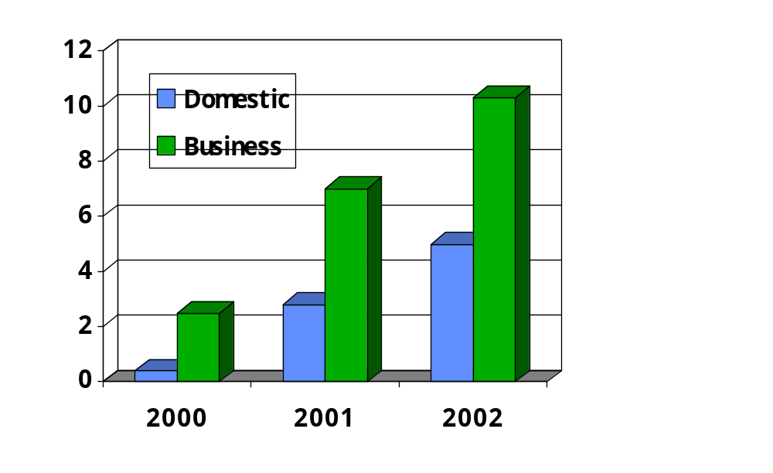
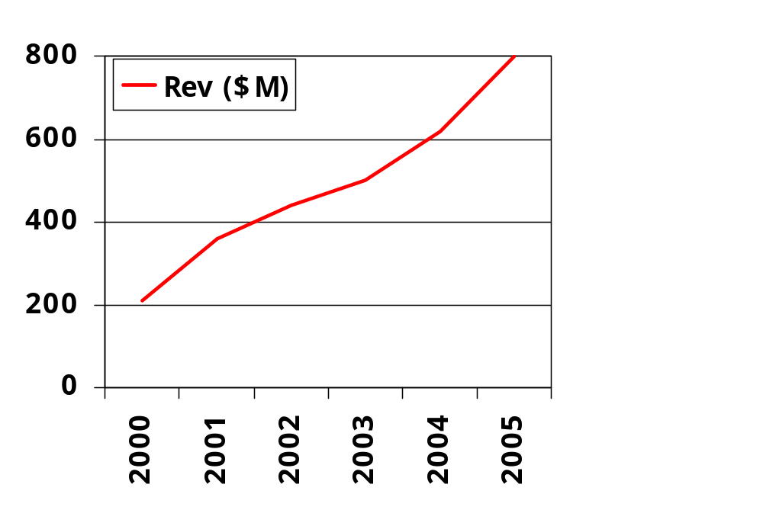
Public Space Wi-Fi Networks:
Challenge or Augment to 3G?
Hardware units sold worldwide
802.11 technology (millions)
WirelessLan Revenue
Western Europe
Voicestream Wireless (Deutsche Telekom)
Telia
Sonera
BT
FT, 13 Apr 02

