Slide 1


Telecommunications
Chapter 6
Updated January 2009
XU Zhengchuan
Fudan University

Slide 2

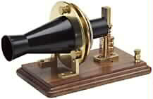
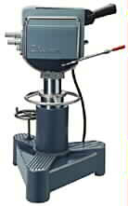


Telecommunications
From Chapter 1:
  Data communications
  Telecommunications: Voice and Video Communications
Notes:
In Chapter 1, we saw the difference between data communications and telecommunications.
Telecommunications involves voice and video transmission.
Data communications involves packet transmission for e-mail, database, and other applications.
Traditionally, telecommunications and data communications used different transmission technologies, but they are beginning to converge.

Slide 3
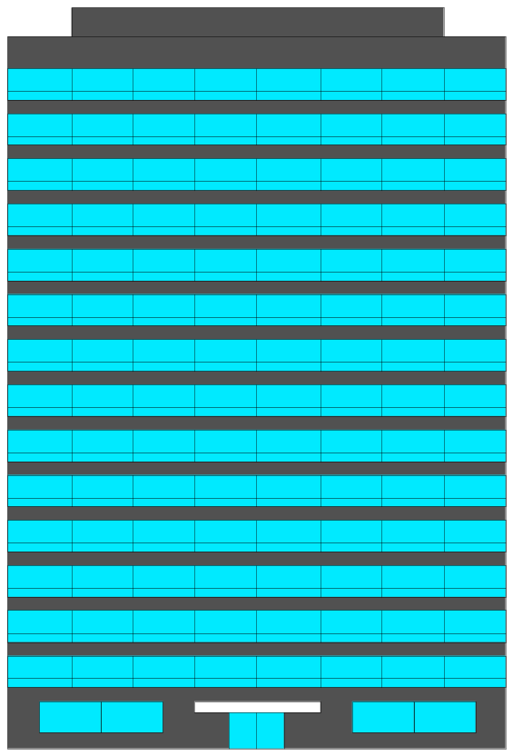
Building Telephone Wiring (布线)
Multi-floor
Office Building

Slide 4
Figure 6.2: Internal PBX-Based Telephone Network
Private Branch eXchange 专用(分组)交换机
5. PBX
Internal Telephone
Switch
7. Vertical
Riser
Space
4. Termination
Equipment
3.
Entrance
Facility
2. To
Telcos
6. Wire
Bundle
(Many Pairs)
1. Equipment Room (Usually in Basement)

Slide 5
Figure 6.2: Internal PBX-Based Telephone Network
Vertical
Distribution
4-Pair UTP Cords
5. Horizontal Distribution
4. Cross-Connect Device
3. Telecommunications
Closet on Floor
2. Wire Bundles

Slide 6
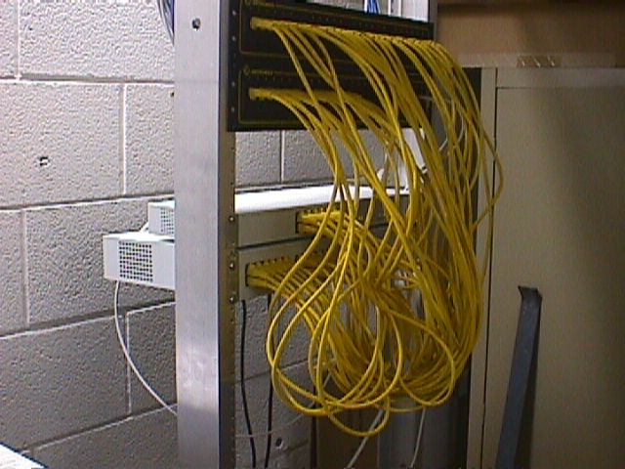
Patch Panel
Patch Panel
接线板
Rack-Mounted
Switches
装入机架的交换机
19” Equipment Rack
19吋设备机架

Slide 7
Figure 6.2: Internal PBX-Based Telephone Network
2. Final Distribution
Along or Through Wall
3. Patch Cord
1. Horizontal Distribution
One 4-Pair UTP Cord

Slide 8
Figure 6.3: LAN Building Wiring
3. Entrance
Facility with
Termination
Equipment
6. Vertical
Riser
Space
5. Core
Switch
(Chassis 机箱)
4. Router
2. To
WAN
1. Equipment Room (Usually in Basement)

Slide 9
Figure 6.3: LAN Building Wiring
Vertical
Distribution
5. Horizontal Distribution
4. Workgroup Switch
3. Telecommunications
Closet on Floor
2. Optical Fiber
One Pair per Floor

Slide 10
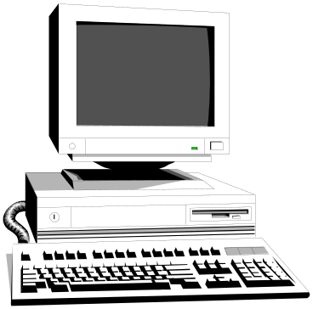
Figure 6.3: LAN Building Wiring
Horizontal and Final Distribution
are the Same as in Telephony
Workgroup
Switch in
Telecoms
Closet
1. Horizontal Distribution
One 4-Pair UTP Cord

Slide 11
Building Cabling Management
Structured Cabling (电缆敷设) Plans
Testing
  Inexpensive just to test whether wires are connected properly
  More expensive to test for signal quality
Documentation and Neatness
  Critical to avoid chaos in wiring

Slide 12
The Public Switched Telephone Network (PSTN) 公共交换电话网

Slide 13
Figure 6.4: Public Switched Telephone Network (PSTN)
Switching Office
Central Office
End Office
Access Line (接入线)
Local Loop (本地回路)
Single Twisted Pair
Of Low Quality
Customer Premises
客户驻地
(Residential)
Customer Premises
(Business)

Slide 14
Figure 6.4: Public Switched Telephone Network (PSTN)
Class 3
Switching
Hierarchy
Trunk Line
(干线)
Digital
Class 4
Class 5
End
Office
Class 5
End
Office

Slide 15
Figure 6.5: Trunk Line Technologies
Connect Pairs of Switches
Trunk Line
Speed
North American Digital Hierarchy
56 kbps (DS0 Signaling)
56 kbps (sometimes 64 kbps)
T1 (DS1 Signaling)
1.544 Mbps
T3 (DS3 Signaling)
44.7 Mbps
CEPT Multiplexing Hierarchy
64 kbps
64 kbps
E1
2.048 Mbps
E3
34.4 Mbps
Note: CEPT, Conference of European Postal and Telecommunication
我国采用此标准。

Slide 16
Figure 6.5: Trunk Line Technologies
Trunk Line
Speed
SONET/SDH*
OC3/STM1
156 Mbps
OC12/STM4
622 Mbps
OC48/STM16
2.5 Gbps
OC192/STM64
10 Gbps
OC768/STM256
40 Gbps
Notes: SONET, Synchronous Optical NETwork, 同步光纤网
SDH, Synchronous Digital Hierarchy,同步数字系列
SONET and SDH speeds are multiples of 51.84 Mbps.
OCx is the SONET designation.
STMx is the SDH designation.

Slide 17
Figure 6.6: SONET/SDH Dual Rings
Telephone
Switch
Telephone
Switch
SONET/SDH Ring
Telephone
Switch
Rings can be
Wrapped if a
Trunk line
Is Broken
(Ch. 5)
Telephone
Switch
SONET/SDH Ring

Slide 18
Figure 6.7: Circuit Switching 线路交换
2. Across
Multiple
Access Lines,
Switches, and
Trunk Lines
1. Circuit
End-to-End Connection
Subscriber-Subscriber
3. Circuit Switching:
Circuit Reserved for
Duration of Call

Slide 19
Technical Elements of the Public Switched Telephone Network
Notes:
The worldwide telephone network is called the Public Switched Telephone Network or PSTN.
In the next few slides, we will go through the technical elements of the PSTN.

Slide 20
Figure 6-1: Elements of the Public Switched Telephone Network (PSTN)
1. Customer Premises
Equipment
1. Customer Premises Equipment
Notes:
Customer premises equipment, as the name suggests, is equipment on the customer’s site—residential homes and apartments and business buildings.
This equipment is owned by the customer.
[Actually, until the 1970s and 1980s, the telephone company owned the telephones and wires in homes and business buildings.]

Slide 21
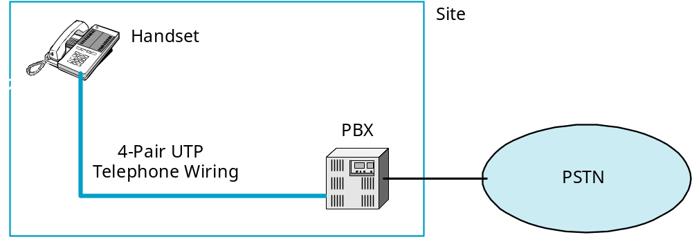
Figure 6-2: Customer Premises Equipment
A typical business site.
The private branch exchange is an internal switch for the site.
4-pair UTP was created for business premises telephone wiring
Company is essentially its own telephone company that connects to the outside PSTN
Notes:
In businesses, there are three customer premises equipment technical elements that companies must install and operate.
The handset is the equipment on a person’s desk.
The PBX is basically an on-site telephone switch. It connects all of the handsets in the buildings and connects the site to the PSTN.
A PBX is about the size of a home refrigerator or a dorm room refrigerator
Business telephone wiring uses our old friend, 4-pair UTP.
Although we first saw UTP in the context of LANs, 4-pair UTP has been the standard for building telephone wiring for many years.
Its widespread use made 4-Pair UTP an obvious candidate for LAN use.

Slide 22
Figure 6-1: Elements of the Public Switched Telephone Network (PSTN)
The Access System consists of
the access line to the customer
(called the local loop)
and termination equipment at the end office
(nearest telephone office switch).
2.
Access Line
(Local Loop)
2.
Access Line
(Local Loop)
2. & 3. End Office
Switch (Class 5)
Notes:
<Read the text in the box.>

Slide 23
Figure 6-1: Elements of the Public Switched Telephone Network (PSTN)
3. Transport Core
3.
Switch
3. Trunk
Line
The Transport Core connects end office
switches and core switches.
Trunk lines connect switches.
Notes:
<Read the text in the box.>

Slide 24
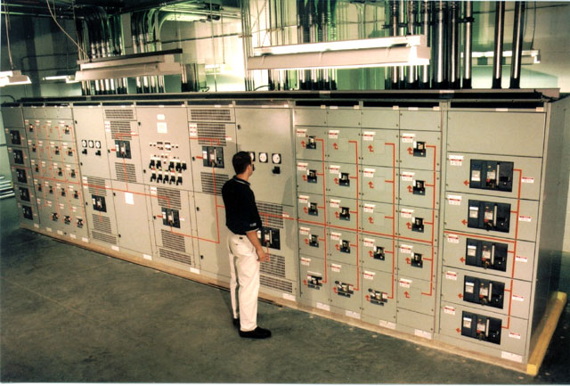
Figure 6-1: Elements of the PSTN
Telephone Company Switch
Notes:
Here is a picture of a telephone company switch.

Slide 25
Figure 6-1: Elements of the Public Switched Telephone Network (PSTN)
4. Signaling System
Transport is the actual transmission of voice.
Signaling is the control of calling
(setup, teardown, billing, etc.).
SS7 in the United States
C7 in Europe
Notes:
Here is a distinction that students tend to forget easily.
<Read the text in the box.>

Slide 26
Page 281
Test Your understanding
2
3 b
4 a,c,d
5 b

Slide 27
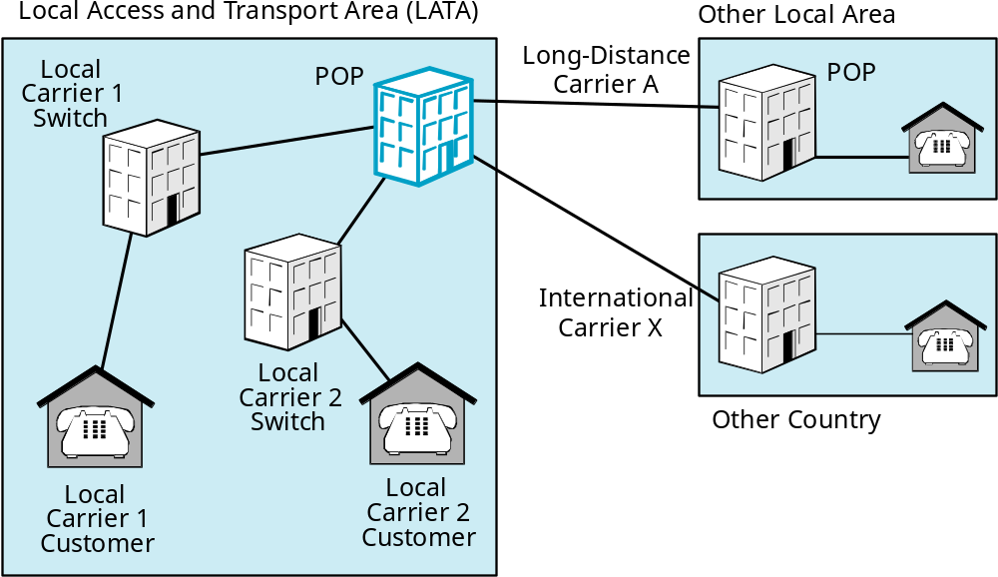
Figure 6-3: Points of Presence (POPs)
In the U.S., competing
carriers connect at
points of presence (POPs).
Notes:
<Read the text in the box.>

Slide 28
Page 282
Test Your understanding
6 b

Slide 29
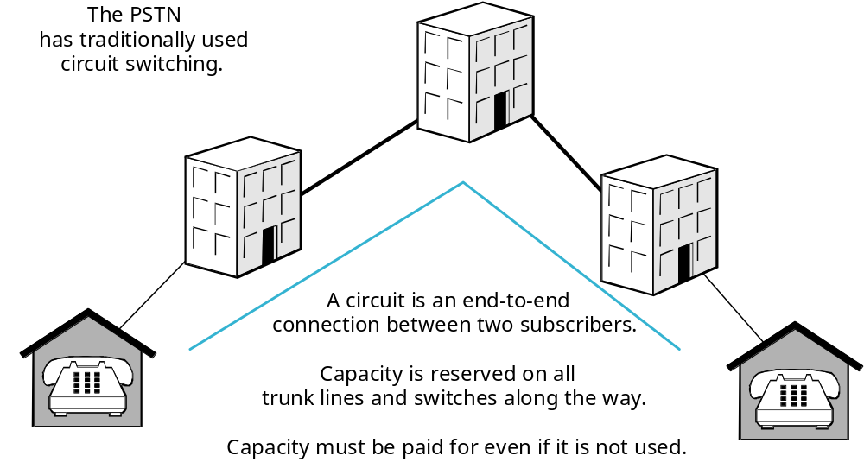
Figure 6-4: Circuit Switching
Notes:
<Read the text in the upper-left.>
<Then read the text in the lower-middle part of the slide.>
This is very different from the packet switching technology used in data networks.

Slide 30
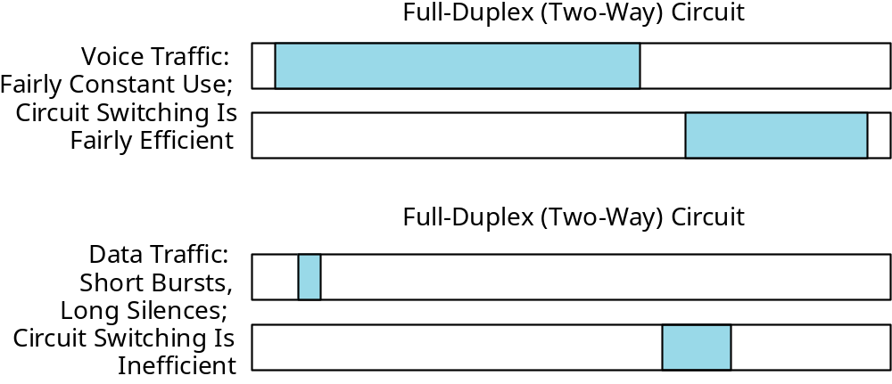
Figure 6-5: Voice and Data Traffic
The reserved capacity of circuit switching
is OK for voice, but not for bursty data transmission.
Notes:
<Read the text in the box.>
<Show in the upper portion of the figure that voice uses transmission capacity most of the time, so reserved capacity makes sense.
In data traffic, however, there are short data bursts separated by long periods of nonuse. This is very wasteful of reserved capacity. Packet switching was created to avoid this wasted capacity.>

Slide 31
Figure 6-6: Dial-Up Circuits Versus Leased Line Circuits
Dial-Up Circuits
Leased Line Circuits
Operation
Dial-Up. Separate
circuit for each call.
Permanent circuit,
always on.
Speed for Carrying
Data
Up to 56 kbps
Residence can only
Send up to 33.6 kbps
56 kbps to gigabit
speeds
Number of Voice
Calls Multiplexed
One
Several due to
multiplexing
There are two types of circuits between customer premises:
ordinary dial-up circuits and leased line circuits.
Notes:
<Read the box in the bottom; then go through the table rows by row.>

Slide 32
Page 285
Test Your understanding
8 b

Slide 33
Figure 6-7: Local Loop Technologies
Technology
Use
Status
1-Pair Voice-Grade
UTP
Residences
Already installed
2-Pair Data-Grade
UTP
Businesses for
Lowest-speed
access lines
Must be pulled to the
customer premises
(this is expensive)
Optical Fiber
Businesses for
higher-speed
access lines
Must be pulled to the
customer premises
(this is expensive)
Residential 1-pair voice-grade UTP is already installed.
This makes it inexpensive to use
Business 2-pair data-grade UTP and fiber for leased lines
must be installed; this is expensive.
Notes:
<Read the text in the bottom box. Then go through the table row-by-row.>
<Question: Do carriers use 4-Pair UTP in the local loop? Answer: No.>
<Question: Where is 4-Pair UTP used in telephony? Answer: The customer premises.>
<Question: Why is it desirable to use residential 1-pair UTP for data?
Answer: It is already installed, so it is expensive to use.>

Slide 34
Page 286
Test Your understanding
9 a,b,c

Slide 35
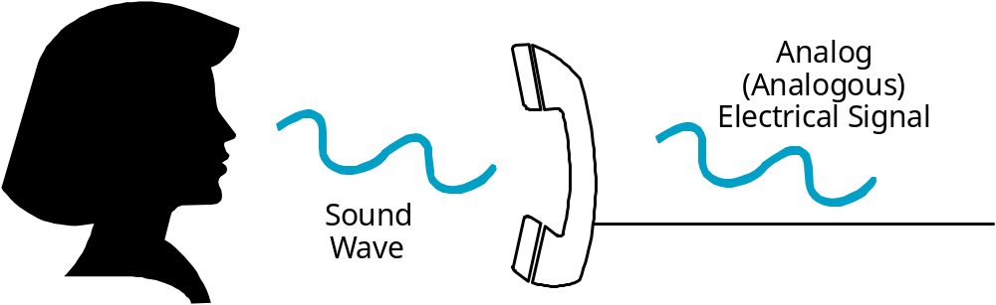
Figure 6-8: Analog Telephone Transmission
Analog signals rise and fall in intensity with the human voice.
No resistance to errors as there is in digital transmission.
Initially, the entire PSTN was analog.
Notes:
<Read the text in the box.>

Slide 36
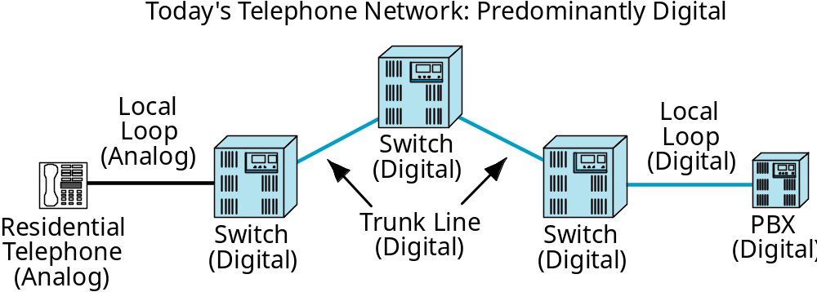
Figure 6-9: The PSTN: Mostly Digital with Analog Local Loops
Today, everything is digital except for the
local loop access line and residential telephones.
The actual local loop line can carry either analog or digital signals,
but the equipment at both ends is analog.
Notes:
<Read the text in the box.>

Slide 37
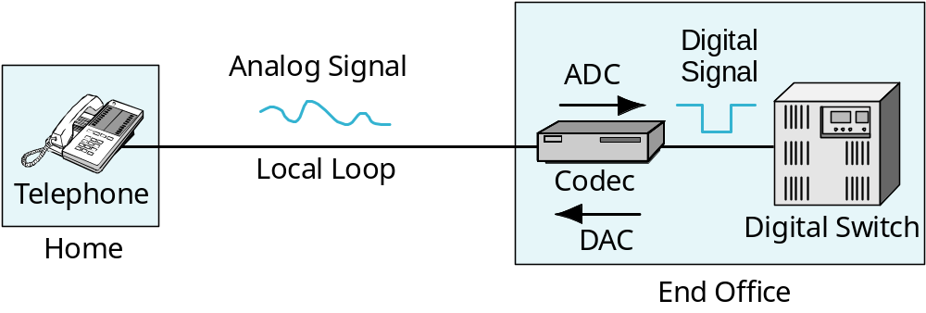
Figure 6-10: Codec at the End Office Switch
A codec at the end office translates between
residential analog and PSTN digital signaling.
ADC = analog to digital conversion
DAC = digital to analog conversion
Notes:
<Read the text in the box.>
<Then go through the figure from left to right.>

Slide 38
Page 288
Test Your understanding
11 a,b,c

Slide 39
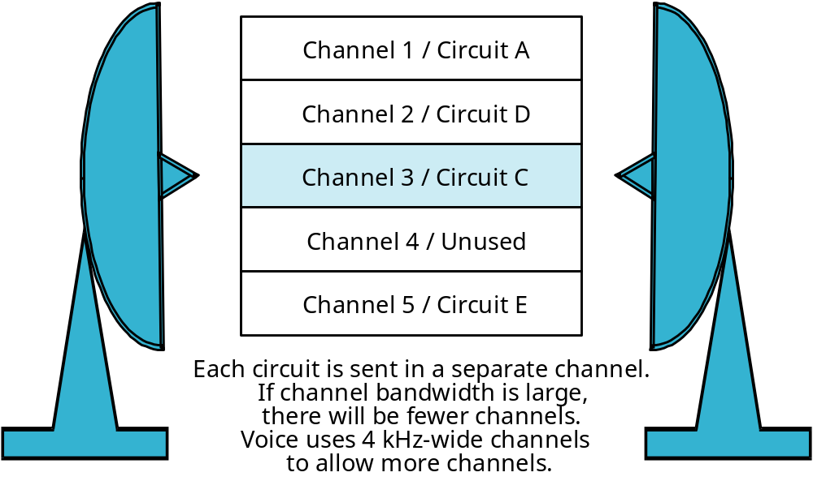
Figure 6-11: Frequency Division Multiplexing (FDM) in Microwave Transmission
Box:
Codec Operation
Microwave uses
radio transmission
for PSTN trunk lines
Notes:
<Read the text in the upper-left box.>
<Then read the text box at the bottom.>
<Then go through the channels and the circuit that each carries.>

Slide 40
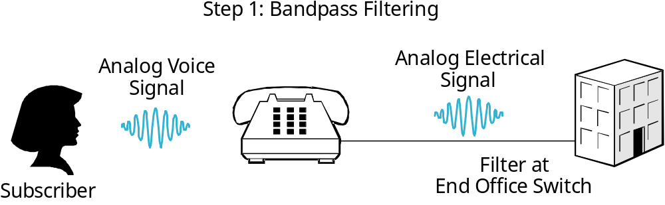
Figure 6-12: Analog-to-Digital Conversion (ADC): Bandpass Filtering and Pulse Code Modulation (PCM)
Box:
Codec
Operation
Filter at
End Office Switch
At the end office, the voice signal is bandpass-filtered
to limit its bandwidth to 4 MHz.
This permits more calls to be multiplexed on trunk lines
Notes:
<Read the text in the box.>

Slide 41
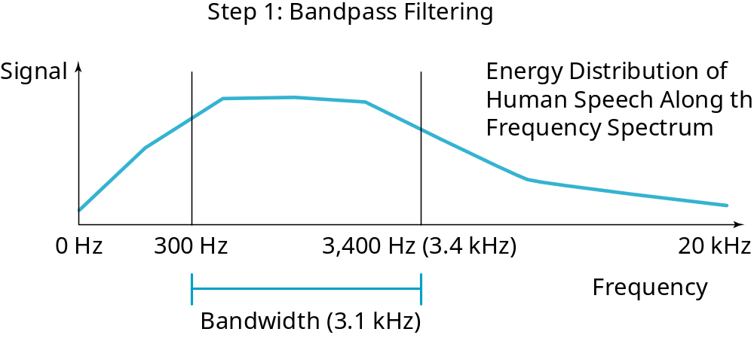
Figure 6-12: Analog-to-Digital Conversion (ADC): Bandpass Filtering and Pulse Code Modulation (PCM)
Box:
Codec Operation
Actually, to provide a safety margin, the signal
is filtered to between about 300 Hz and 3.4 kHz
instead of from 0 Hz to 4 kHz.
Notes:
<Read the text in the box.>
Although the human ear can hear up to 20 kbps, most voice energy is in lower ranges. Therefore, little intelligibility is lost by only sending a quarter of the frequency range.
[Question: Why cut off everything below 300 Hz? Answer: This avoids 50 Hz and 60 Hz electrical power signal interference.]

Slide 42
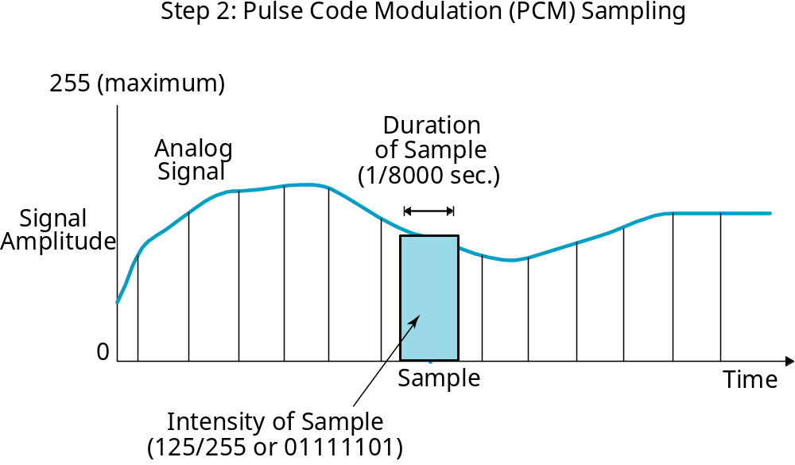
Figure 6-12: Analog-to-Digital Conversion (ADC): Bandpass Filtering and Pulse Code Modulation (PCM)
Box:
Codec Operation
Notes:
<Read the text in the box.>

Slide 43
Figure 6-12: Analog-to-Digital Conversion (ADC): Bandpass Filtering and Pulse Code Modulation (PCM)
In each sampling
period, the intensity
of the signal is
measured.
In pulse code
modulation, the
signal is measured
as one of 256
intensity levels.
One byte stores
one sample.
Box:
Codec Operation
Notes:
<Read the text in the box.>

Slide 44
Figure 6-12: Analog-to-Digital Conversion (ADC): Bandpass Filtering and Pulse Code Modulation (PCM)
Pulse Code
Modulation (PCM)
produces
8,000 one-byte
samples per second.
This is 64 kbps
of data.
Box:
Codec Operation
Notes:
<Read the text in the box.>

Slide 45
ADC Recap
Box:
Codec Operation
First, Bandpass-Filter the Incoming Signal to 4 kHz
  Really about 300 Hz to 3.4 kHz
  To reduce transmission requirements
The Codec then Uses PCM for the Conversion
  Samples at twice the highest frequency (4 kHz so 8,000 samples/second)
  Loudness is recorded with 8 bits per sample (to give 256 loudness levels)
  Generates 64 kbps of traffic (8 bits/sample times 8,000 samples per second)
Notes:
<Read the text in the box.>

Slide 46
Figure 6-13: Digital-to-Analog Conversion (DAC)
Box:
Codec Operation
One 8-Bit
Sample
One 8-Bit
Sample
00000100 00000011 00000111
To Customer:
Generated “analog” signal
(Sounds smooth because
the sampling rate
is very high)
DAC
at End
Office
Switch
From digital PSTN network:
Arriving digital signal
from the PSTN Core
(8,000 Samples/Second)
Notes:
<Read through this slide from RIGHT to LEFT.>
<Note that the final “analog” signal is not really smooth. However it sounds smooth to the human ear because of sampling at 8,000 samples per second.>

Slide 47
Page 292
Test Your understanding
12 a,b (if only 16 possible level),d

Slide 48
对PCM编码有无改进可能？
  降低数据传输速率要求
  保证一定的通话质量

Slide 49
１．１ 利用语音信号的相关性
１．２ 利用人耳的听觉特性
１．３ 静音压缩

Slide 50
Figure 6-16: Speech Codes
Codec Transmission Rate
G.711 64 kbps (pulse code modulation)
G.721 32 kbps (adaptive PCM)
G.722 46, 56, or 64 kbps
G.722.1 24, 32 kbps
G.723.1A 5.3, 6.3 kbps
There are several codec standards.
They differ in transmission rate, sound quality, and latency.
Both sides must use the same codec standard.
Notes:
<Read the text box.>

Slide 51
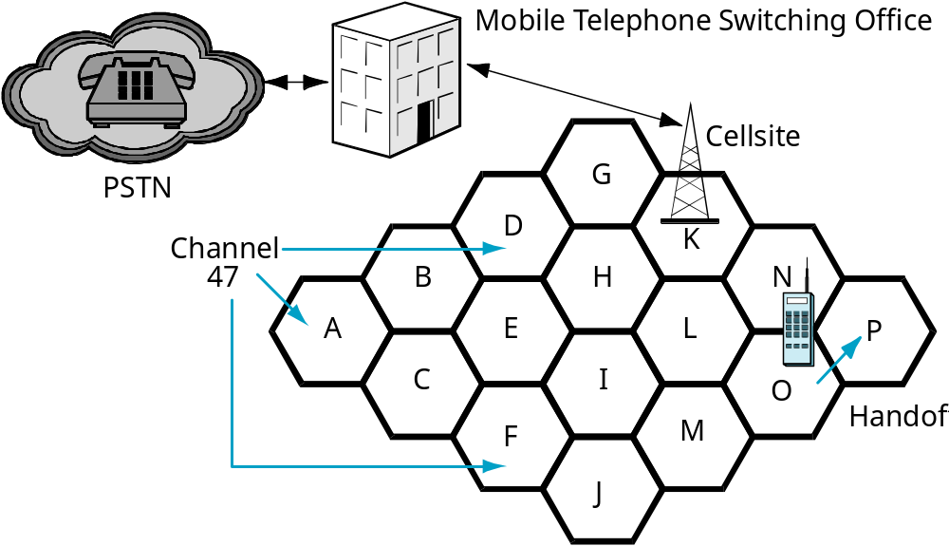
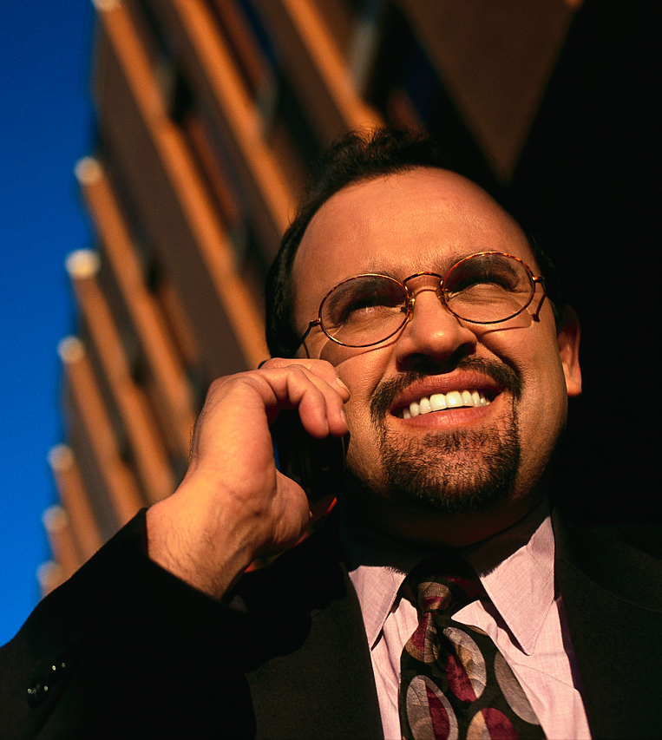
Figure 6-14: Cellular Telephony
In cellular technology, the region
is divided into smaller cells.
In each cell, a cellsite serves
cellphones in the cell.
Notes:
<Read the text in the box.>

Slide 52
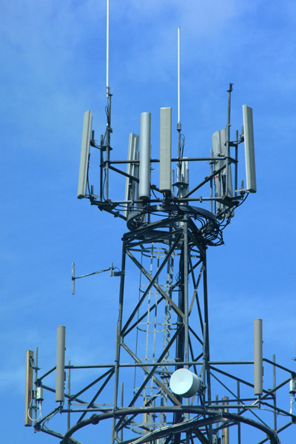
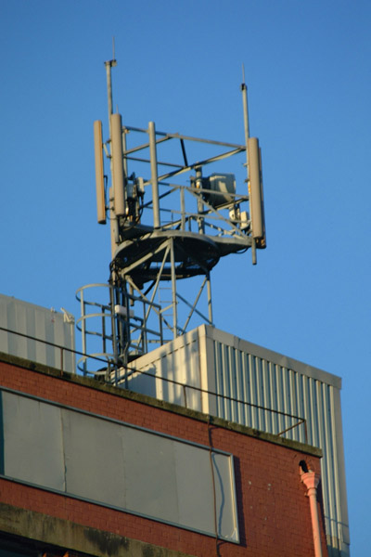
Figure 6-14: Cellular Telephony
Cellsites
Notes:
Here are some pictures of cellular telephone towers.

Slide 53
Page 293
Test Your understanding
13 b, c, d

Slide 54
Figure 6-14: Cellular Telephony
Channels can be reused in different cells.
Channel reuse supports more customers.
This is the reason for using cells.
(Channel 47 is reused in cells A, D, and F)
Notes:
<Read the text in the box.>

Slide 55
Figure 6-14: Cellular Telephony
When a subscriber moves from one
cell to another in a cellular system,
this is called a handoff.
When a subscriber moves from
one city to another, this is roaming.
(In WLANs, handoffs and roaming
mean the same thing.)
Notes:
<Read the text in the box.>

Slide 56
Page 294
Test Your understanding
14 a

Slide 57
Figure 6-14: Cellular Telephony
The Mobile Telephone
Switching Office (MTSO)
coordinates the cellsites and
implements signaling and handoffs.
The MTSO also connects
cellphones to the PSTN
(called the wireline network).
Notes:
<Read the text in the box.>

Slide 58
Page 295
Test Your understanding
15

Slide 59
见手机通信补充材料

Slide 60
Cellular Technologies
GSM is the worldwide standard for cellular voice
  Uses time division multiplexing (TDM)
  Uses 200 kHz channels
  Divides each second into many frame periods
  Divides each frame into 8 slots
  Gives same slot in each frame to a conversation
Time Frame 1
Frame 2
Slot 1
Conversation
A
Slot 2
Conversation
B
Slot 8
Conversation
H
Slot 1
Conversation
A
……
Notes:
<Read through the slide. For the last three points, refer to the figure at the bottom.>

Slide 61
Cellular Technologies
Cannot use the same channel in adjacent cells
  So can only reuse a channel about every 7 cells
  For example, suppose there are 50 cells
    Channel can be reused 50 / 7 times
    This is 7 (not precise, so round things off)
    So each channel can support 7 simultaneous customers in these 7 cells
Notes:
<Read the slide.>

Slide 62
Cellular Technologies
Code Division Multiple Access (CDMA)
  Also used in the United States
  A form of spread spectrum transmission
  Unlike traditional spread spectrum technology, multiple users can transmit simultaneously
  1.25 MHz channels
  Can support many users per channel
Can use the same channel in adjacent cells
  So can only reuse a channel in every cell
Notes:
<Read the slide.>

Slide 63
Page 296
Test Your understanding
16 c

Slide 64
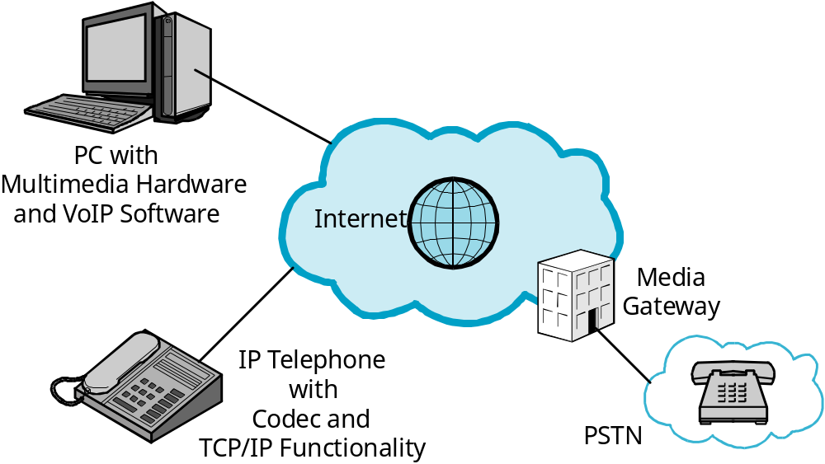
Figure 6-15: Voice over IP (VoIP)
VoIP carries telephone calls over
LANs and the Internet
With IP, there is no wasted capacity
as there is with circuit switching.
This reduces cost.
Notes:
<Read the text box.>

Slide 65
Figure 6-15: Voice over IP (VoIP)
Stations can be special IP telephones
with IP functionality
Or a PC with multimedia hardware
and VoIP software
IP phones need a codec to convert
voice analog signals from the microphone
into digital IP signals
Notes:
<Read the text box.>
可以问同学们,应该如何实现IP Phone

Slide 66
Figure 6-15: Voice over IP (VoIP)
A media gateway connects a
VoIP network to the PSTN
Handles transport and signaling differences
Notes:
<Read the text box.>

Slide 67
Page 298-299
Test Your understanding
18 d
19 a, b

Slide 68
Figure 6-16: Speech Codes
Codec Transmission Rate
G.711 64 kbps (pulse code modulation)
G.721 32 kbps (adaptive PCM)
G.722 46, 56, or 64 kbps
G.722.1 24, 32 kbps
G.723.1A 5.3, 6.3 kbps
There are several codec standards.
They differ in transmission rate, sound quality, and latency.
Both sides must use the same codec standard.
Notes:
<Read the text box.>

Slide 69
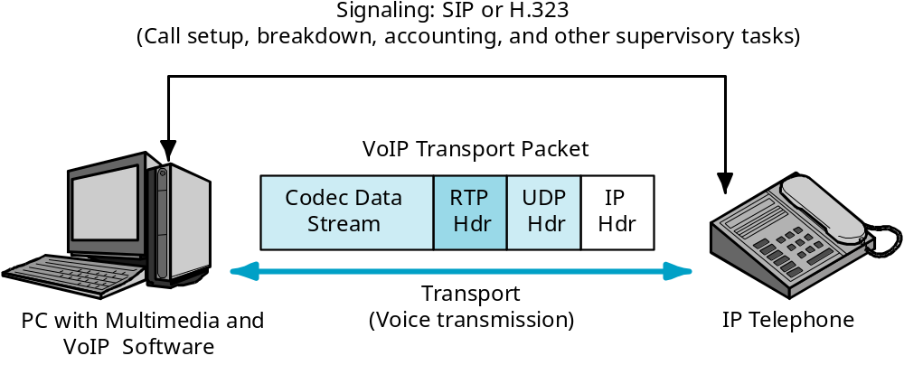
Figure 6-17: VoIP Protocols
Transport is the transmission of voice
(carries codec data).
Signaling is call supervision.
Notes:
<Read the text box.>

Slide 70

Figure 6-17: VoIP Protocols
1. VoIP transport packets use UDP at the transport layer.
(There is no time for retransmissions to repair errors.)
The receiver puts in fill sounds for lost packets.
3.
The application
message is a
codec data
stream
2. The UDP header is followed by a
Real Time Protocol (RTP) header, which contains
a sequence number and timing information.
Receiver uses timing information to smooth out sound playback.
Notes:
<Read the text boxes, in numerical order.>

Slide 71
Figure 6-17: VoIP Protocols
Signaling is call supervision.
The H.323 signaling standard came first for VoIP signaling.
SIP is simpler and now dominates VoIP signaling
Notes:
<Read the text box.>

Slide 72

Video over IP
The Other VoIP
  It’s not just voice over IP
  Video Telephones
  Video Conferencing
    PC to PC
    Multiparty
    Sometimes room-to-room
  Video Downloads on Demand
Notes:
<Read the text box.>

Slide 73
Page 299-301
Test Your understanding
20 b, c
21 a, c
22 b

Slide 74
Figure 6-18: Residential Internet Access Services
Note:
Speeds and Prices
Change Rapidly
Telephone Modems
Broadband Internet Access
Asymmetric Digital Subscriber Line (ADSL)
Cable Modem Service
3G Cellular Data Service
WiMAX (802.16d and 802.16e)
Broadband over Power Lines
Fiber to the Home (FTTH)
Notes:
A major traditional use of the PSTN has been to provide Internet access to residences.
Today, there are several different ways to get Internet access from home.
Here is a list of the residential Internet access technologies we will see in this chapter.

Slide 75
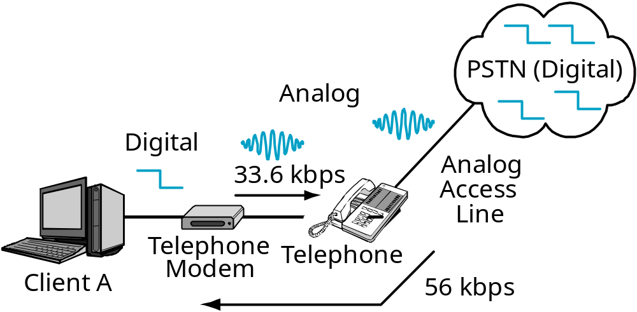
Figure 6-19:
Telephone Modem Connection to an ISP
Telephone modems
convert digital computer
signals to analog
telephone signals.
Notes:
<Read the text box.>
<Then walk through the slide left-to-right.
Client A transmits a digital signal, which goes to the telephone modem.
The telephone modem coverts the signal into an analog signal capable of sending 300 Mbps.
The telephone local loop carries this analog signal to the PSTN.>
[Of course, the codec at the end of the local loop translates the analog signal back to digital signals.]

Slide 76
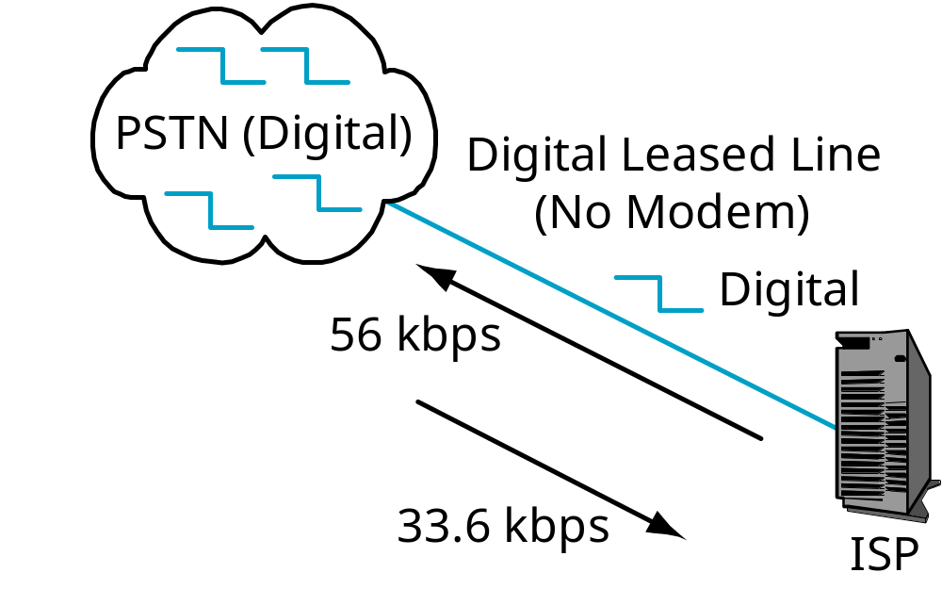
Figure 6-19:
Telephone Modem Connection to an ISP
ISP does not have a modem.
It has a digital leased line so
can send at 56 kbps.
(There is no bandpass
filtering on digital leased lines.)
Notes:
<Read the text box.>

Slide 77
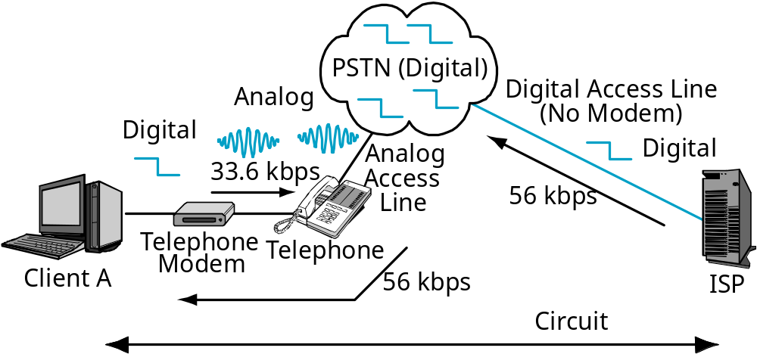
Figure 6-19:
Telephone Modem Connection to an ISP
33.6 kbps
Dial-up circuits connect the client with the ISP.
56 kbps downstream, 33.6 kbps upstream
Notes:
<Read the text box.>

Slide 78
Telephone Modem Limitations
Very low transmission speeds
  Long delays in downloading webpages
Subscriber cannot simultaneously use the telephone line for voice calls
Still used by 30% to 40% of Internet users.
Notes:
<Read the slide.>

Slide 79
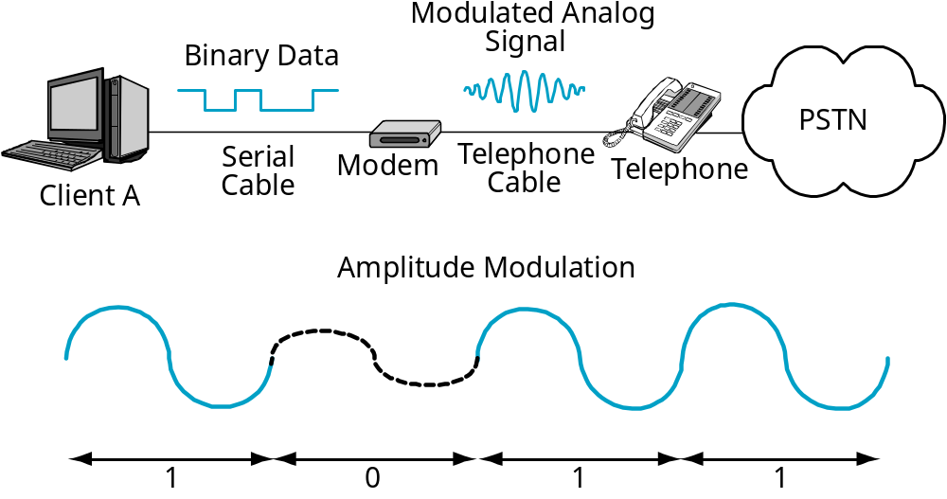
Figure 6-20: Amplitude Modulation
Modulation is the conversion of binary computer signals
into analog signals that can travel over an ordinary access line.
Demodulation, at the other ends, converts the modulated
signals back to digital computer signals.
Notes:
<Just read the text box,
pointing to the computer, binary signal, modem, modulated analog signal, and PSTN.

Slide 80
Figure 6-20: Amplitude Modulation
In amplitude modulation, there are
two amplitude (loudness levels)—
one for 1 and one for 0
1011 is loud-soft-loud-loud
Notes:
<Read the text boxes, top first.>

Slide 81
Page 303-304
Test Your understanding
23 f

Slide 82
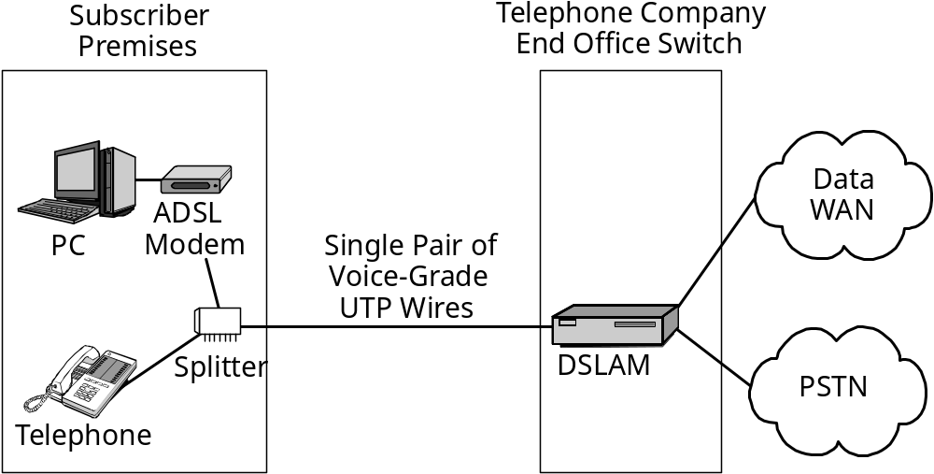
Figure 6-21: Asymmetric Digital Subscriber Line (ADSL)
ADSL ALSO uses the existing residential local loop technology.
Inexpensive because no need to pull new wires, but
1-pair voice-grade UTP is not designed for high-speed transmission.
Notes:
Another residential Internet access technology is asymmetric digital subscriber line (ADSL).
<Read the text box.>

Slide 83
Figure 6-21: Asymmetric Digital Subscriber Line (ADSL)
1.
Subscriber needs an ADSL modem.
Also needs a splitter for each
telephone wall outlet.
2.
Telephone carrier needs a digital subscriber line
access multiplexer (DSLAM) to separate the two signals.
Notes:
<Read the boxes in the build.>

Slide 84
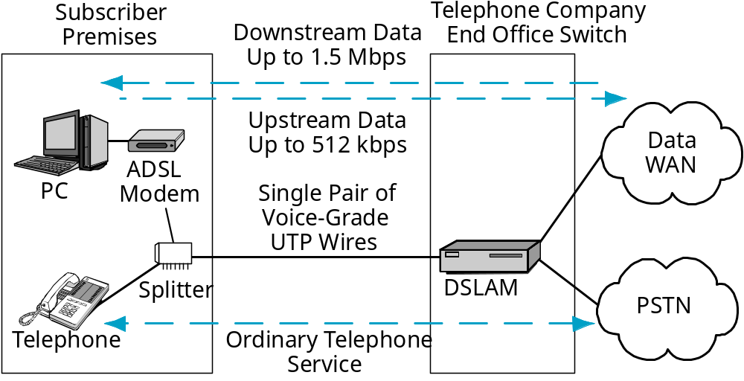
Figure 6-21: Asymmetric Digital Subscriber Line (ADSL)
Downstream Data
Up to 3 Mbps
Unlike telephone modems, ADSL service
provides simultaneous voice and data transmission.
Notes:
<Read the text box.>

Slide 85
Figure 6-21: Asymmetric Digital Subscriber Line (ADSL)
Downstream Data
Up to 3 Mbps
Speed is asymmetric
Faster downstream than upstream
(Up to 3 Mbps versus up to 512 kbps)
Ideal for Web access
Acceptable for e-mail
Good for residential use
Notes:
<Read the text box.>

Slide 86
Page 303-304
Test Your understanding
24 c, e, f

Slide 87
Figure 7-5: Business-Class Symmetric Digital Subscriber Line (DSL) Services
HDSL
HDSL2
SHDSL
Uses Existing 1-Pair Voice-Grade
UTP Telephone Access Line to
Customer Premises?*
Yes*
Yes*
Yes*
Downstream Throughput
768 kbps
1.544 Mbps
384 kbps –
2.3 Mbps
Upstream Throughput
768 kbps
1.544 Mbps
384 kbps –
2.3 Mbps
*By definition, DSL always uses 1-pair VG UTP
Many firms use HDSL and HDSL2 lines instead of T1 and fractional T1 speeds
Notes:
We have been looking at leased lines, which require either new 2-pair UTP or optical fiber installations for each customer.
By definition, DSL always uses 1-pair VG UTP, which is already installed; this avoids the cost of running a new line to the customer, making business-grade DSL lines more expensive.
The most popular business DSL lines are HDSL, HDSL2, and SHDSL.
HDSL is half as fast as a T1 line.
HDSL2 is as fast as a T1 line.
SHDSL offers flexible speeds up to the speed of an E1 line.
Many firms are now replacing T1 and fractional T1 lines with business-grade DSL lines.
Many carriers that install “T1” lines are really providing HDSL2 service.

Slide 88
Figure 7-5: Business-Class Symmetric Digital Subscriber Line (DSL) Services
HDSL
HDSL2
SHDSL
Target Market
Businesses
Businesses
Businesses
Symmetrical Throughput?
Yes
Yes
Yes
QoS Throughput Guarantees?
Yes
Yes
Yes
Businesses need symmetrical throughput and QoS
Notes:
Businesses have different needs than residential customers, so businesses do not use ADSL, which we saw in the last chapter.
First, businesses need symmetrical throughput because they are used primarily for site-to-site traffic, which has symmetrical traffic needs.
Second, businesses want QoS guarantees for minimum throughput.
This makes business-oriented DSL lines considerably more expensive than ADSL lines of similar speeds.

Slide 89
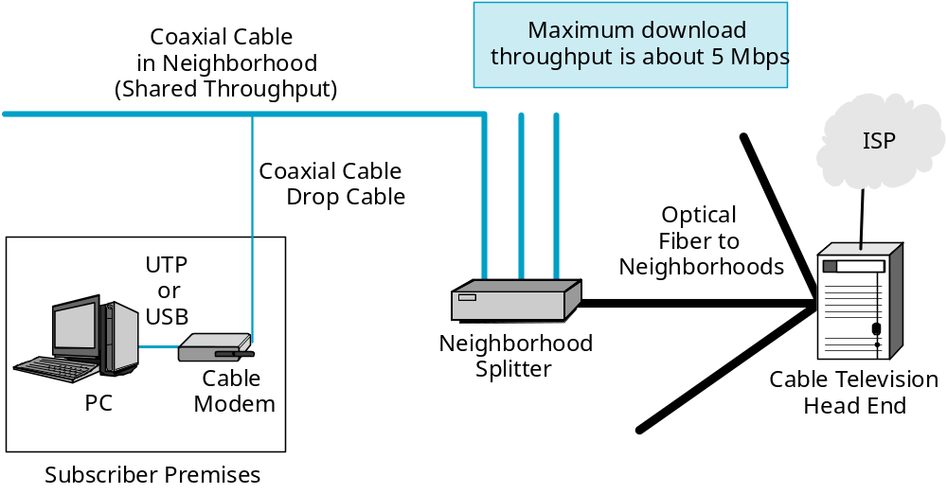
Figure 6-22: Cable Modem Service
Cable modem service brings high-speed
optical fiber lines to the neighborhood.
Notes:
<Read the text box.>

Slide 90
Figure 6-22: Cable Modem Service
In the neighborhood,
thick coaxial cable
brings service to
households.
This bandwidth is
shared by
everyone in the
neighborhood.
A thin coax line
goes to each
home’s
cable modem.
Thick Coaxial Cable
in Neighborhood
(Shared Throughput)
Thin
ISP
Coaxial Cable
Drop Cable
Optical
Fiber to
UTP
Neighborhoods
or
USB
Neighborhood
Cable
Splitter
Cable Television
PC
Modem
Head End
Subscriber Premises
Notes:
<Read the text box on the right.>

Slide 91
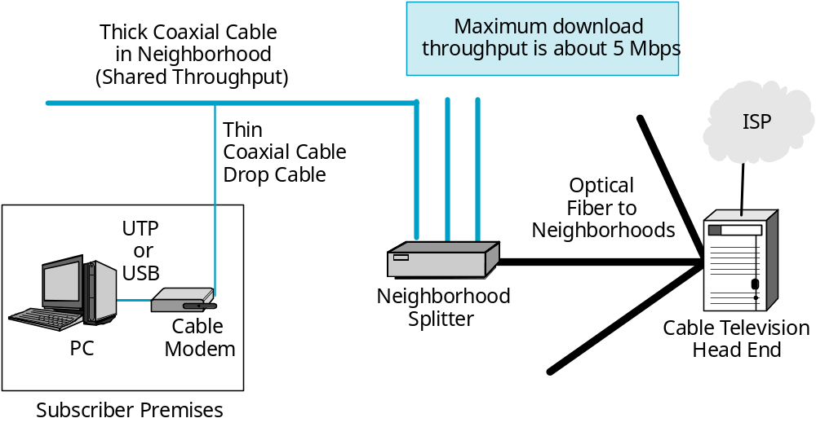
Figure 6-22: Cable Modem Service
Downstream speeds up to 5 Mbps.
Upstream speeds up to about 1 Mbps.
Notes:
<Read the text box.>

Slide 92
ADSL versus Cable Modem Service
Do Not Over-Stress the Importance of Sharing
  Cable modem service usually is still faster than ADSL service
  DSLAM sharing can slow ADSL service too
The Bottom Line Today:
  Cable modem service usually is faster
  ADSL service usually is cheaper
    ADSL offers more speed-price options
Both are improving rapidly in terms of speed and (sometimes) price
Notes:
<Read the slide.>

Slide 93
Page 305-306
Test Your understanding
25 a,c
26

Slide 94
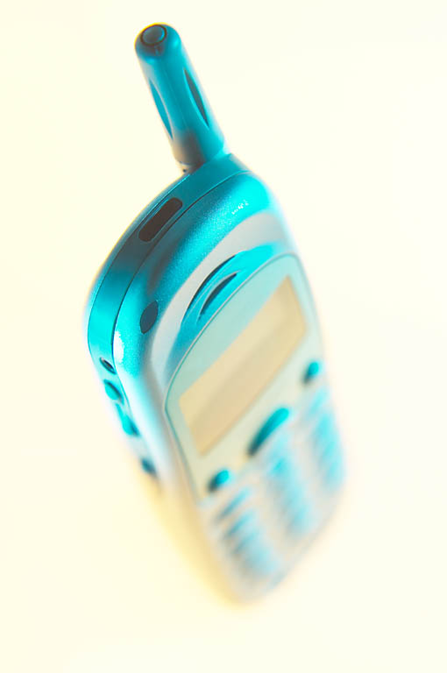
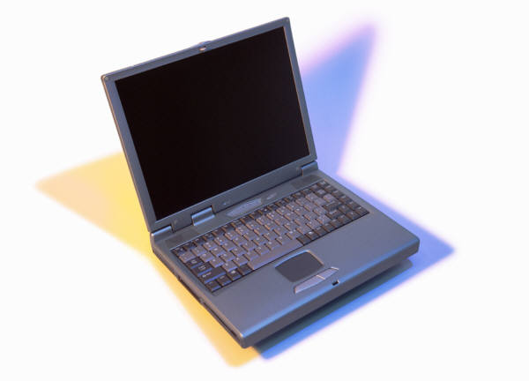
Figure 6-23: Third-Generation (3G) Cellular Data Services
Cellphone connects to computer via a cellphone modem or USB
Traditional GSM and CDMA
  Limited to only about 10 kbps
  Far too slow for usability
Notes:
<Read the text box.>

Slide 95

Figure 6-23: Third-Generation (3G) Cellular Data Services
Both GSM and CDMA are evolving
Second Generation (now dominant)
  Only 10 kbps data transmission
Third Generation
  Low end: comparable to telephone modem service
  High end: comparable to low-speed DSL service
Future
  Speeds comparable to high-end DSL or cable modem service
  100 Mbps or more (fast enough for good video)
Notes:
Both GSM and CDMA are getting faster
The dominant cellular technology today is second-generation technology
<It started in the 1990s.
<The first generation, starting in the 1980s, was analog instead of digital>
It only supports speeds of 10 kbps—about a third of telephone modem throughput
This is painful
New third generation technology is emerging that is providing higher speed
<Currently on the market, although expensive>
At the low end, services is about as fast as telephone modem service
At the high end, speed is about as fast as slower DSL lines
In the future, we should see two trends
Very soon, we should see speeds about as fast as high-end DSL or cable modem service
Eventually, we should see cellular data speeds of 100 Mbps or more (This is called 4G service)
This will be fast enough for good video service

Slide 96
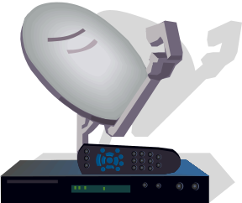

Figure 6-18: Residential Internet Access Services
WiMax (802.16)
  Wireless Internet access for metropolitan areas
  Basic 802.16d standard: ADSL speeds to fixed locations
    Will use dish antennas
    Just reaching the market
  802.16e will extend the service to mobile users
    Will use omnidirectional antennas
Notes:
Another wireless technology for Internet access is beginning to appear. This is WiMAX (802.16)
<Read the text box.>

Slide 97

Figure 6-18: Residential Internet Access Services
New
Satellite Internet
Access
  Very expensive
  Often needed to
  serve rural areas
Notes:
An uncommon residential internet access technology is satellite internet access.
<Read the slide.>

Slide 98
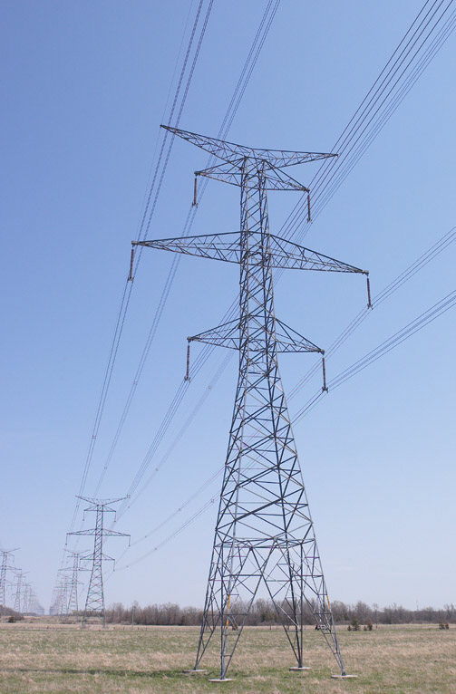
Figure 6-18: Residential Internet Access Services
Broadband over Power Lines
  Broadband data from your electrical company
  It already has transmission wires and access to residences and businesses
  It can modulates data signals over electrical power lines
  It works, but has very limited availability and is slow
  Especially promising for rural areas
Notes:
<Read the slide.>

Slide 99
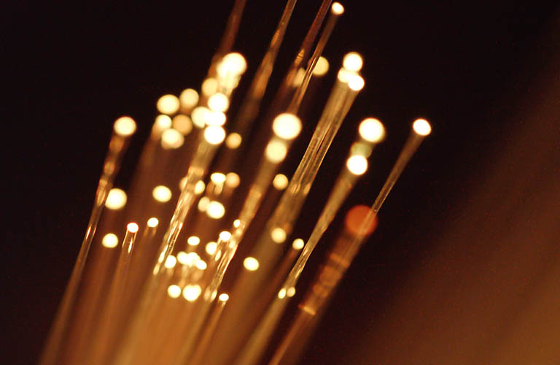
Figure 6-18: Residential Internet Access Services
Fiber to the Home (FTTH)
  Carrier runs fiber to the home
  Provides speeds of tens of megabits per second for high-speed video, etc.
    Less if fiber only goes to the curb (FTTC)
    Or to the neighborhood (FTTN)
  Much faster than other residential internet access services
  Could dominate residential (and business) Internet access in the future
Notes:
<Read the slide.>

Slide 100
Internet Access and VoIP
Most ISPs are Planning to or Already Provide VoIP Telephone Service
  An alternative to the local telephone company service
  Media gateways will interconnect with the PSTN
  Should be less expensive that traditional phone service
  Questions remain
    Voice quality and reliability
    911 and 911 location discovery
    Regulation and taxation
    Laws that require wiretapping with warrants

Slide 101
Page 308
Test Your understanding
29 b
30

Slide 102
Topics Covered

Slide 103
Telecommunications
Data Communications versus Telecommunications
The PSTN’s Technical Elements
  Customer premises equipment (PBX and 4-pair UTP)
  Access system (local loop)
  Transport core
  Signaling (call setup and management)
POP to interconnect carriers

Slide 104
Telecommunications
Access Lines
  For residences, 1-pair voice-grade UTP
    DSL uses existing residential access lines to carry data by changing the electronics at each end (DSL modem in the home and DSLAM at the end office switch)
    DSL is cheap because 1-p VG UTP is already in place
  For businesses,
    2-pair data-grade UTP for speeds up to a few Mbps
    Optical fiber for faster speeds
    Usually must be pulled into place, so expensive
  Eventually, fiber to the home (FTTH), FTTC, FTTN

Slide 105
PSTN Transmission
Circuit Switching
  Reserved capacity end-to-end
  Acceptable for voice, but not for bursty data transmission
  Dial-up and leased line circuits
Analog and Digital Transmission
  Analog signals on the local loop
  ADC and DAC at the end office switch
  ADC: bandpass filtering and sampling for 64 kbps
  DAC: sample values are converted to sound levels

Slide 106
Cellular Telephony
Cells Allow Channel Reuse
  Channel reuse allows more customers to be served with a limited number of channels
GSM: most widely used technology for cellular telephony
CDMA for greater channel reuse
Handoffs and Roaming

Slide 107
VoIP
To allow voice to be carried over data networks
Converge voice and data networks
Phone needs a codec
Transport: UDP header followed by RTP header
Signaling: H.323 and SIP
Video over IP

Slide 108
Residential Internet Access Services
Telephone Modems
Asymmetric Digital Subscriber Line (ADSL)
Cable Modem Service
3G Cellular Data Service
WiMAX (802.16 and 802.16e)
Broadband Over Power Lines
Fiber to the Home (FTTH)

