Slide 1
Cloud Computing
M.A.Doman 2011

Slide 2
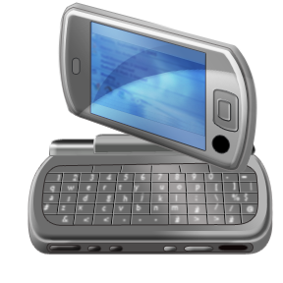
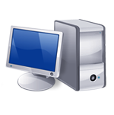
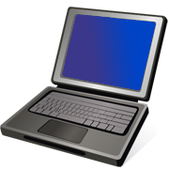
Short video intro

Slide 3
Defining the Cloud
Model for enabling the delivery of computing as a SERVICE.

Slide 4
Essential Characteristics NIST Definition
On-demand self-service
Broad network access
Resource pooling
Rapid elasticity
Measured service

Slide 5
Service Models
Software as a Service
Platform as a Service
Infrastructure as a Service
SaaS
PaaS
IaaS
NIST Definition

Slide 6
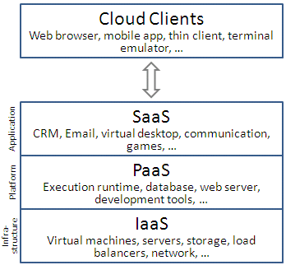
Cloud computing layers
http://en.wikipedia.org/wiki/Cloud_computing

Slide 7
Deployment Models
Public Cloud
Private Cloud
Hybrid Cloud
Community Cloud
NIST Definition

Slide 8
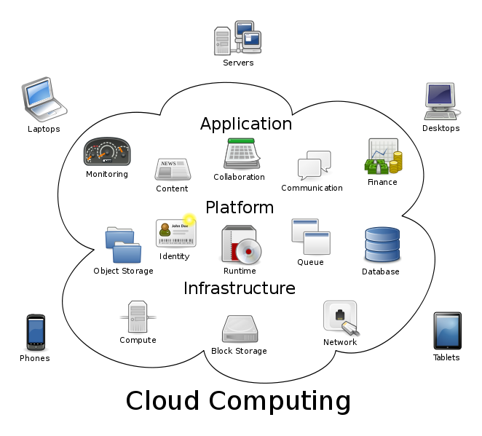

Slide 9
IaaS
Infrastructure Management
IaaS is the delivery of computer hardware as a service
Servers
Networks
Storage
Think of IaaS as the maturation of ISP model.
Including:
Virtualization
Migration
Well-defined self-service management

Slide 10
IaaS
Virtualization
VIM: Virtualization Infrastructure Management
Manage the physical and virtual resources in a holistic fashion.
Rapidly and dynamically provision resources to applications
H
HOST
Web Server
DB
Email Server
Facebook app
DB
Java
App A
App B
App C
Window
Linux
Guest OS
Virtual Machine Monitor (Hypervisor)
HARDWARE

Slide 11
Client
Cloud Interface
VM6
VM1
VM 4
VM5
VM7
VM 2
VM3

Slide 12
Migration Services
Migration services is the process of moving a virtual machine from one host server or storage location to another.
Used to:
Make adjustments to resource priorities to match demand conditions
Service upgraded
?????
IaaS

Slide 13
Migration Services
All key machine’s components, CPU, storage disks, networking and memory are completely virtualized. This facilitates the entire state of the virtual machine that must be captured and moved.
Various techniques:
Live (hot or real time) migration : VM is powered on
Regular (cold) migration: VM is powered off
Live Storage migration
IaaS

Slide 14
Networking
Switch
Virtual LAN
Virtual LAN
Host A
Host B
Bridge
Bridge
02:01:0A:00:01:01
10.0.1.1/24
02:01:0A:00:02:01
10.0. 2.1/24
02:01:0A:00:01:03
10.0.1.3/24
02:01:0A:00:02:02
10.0.2.2/24
vm
vm
vm
vm
vm
02:01:93:60:51:f1
157.96,81,241/24
Bridge
Virtual LAN
PUBLIC ACCESS
Internet
IaaS
From Cloud Computing: Principles and Paradigms

Slide 15
PaaS
PaaS: Platform as a Service
There isn’t one approach to PaaS.
The line between Iaas and Paas is blurred
Common PaaS Characteristics:
Offers development environment
Development lifecycle, language
Ability to develop, test and deploy applications
Customer uses this to add value
Support well-defined interfaces for:
Composite applications
Portals
Mashups (brings together 2 or more business apps)
Based on multi-tenancy architecture

Slide 16
PaaS
Integrated Lifecycle Platforms
Provides customer a full environment for creating an application without buying individual tools.
Often includes
Workflow engine
Development tools
Testing environment
Database integration
Third party tools and services
Examples: Google App Engine, Microsoft Asure

Slide 17
PaaS
Anchored Lifecycle Platforms
Contain most of the same characteristics as integrated lifecycle platform
AND
Include a packaged business solution at the core.

Slide 18
PaaS
Enabling Technologies
Provides a specialized capability, such as a tool or tool set
Ex. Amazon’s Simple DB and Simple Query Service

Slide 19
SaaS
SaaS: Software as a Service
30 years ago…… Time-sharing systems …..
SaaS model today motivated by
Faster, ubiquitous networked communications
Software costs and complexities
IT costs

Slide 20
SaaS
Packaged Software
Focus on a specific process, such as performance reviews, financial management…
Moved to the cloud because customers are finding the platforms hard to manage
Characteristics
Designed with a specific business processes build in
Modifiable by customers
Examples: Intuit, SAP, Oracle On Demand

Slide 21
SaaS
Collaborative Software
Driven by
Ubiquitous availability of networking
Distributed teams
Provide collaborative services include project planning, Web conferencing, instant messaging

Slide 22
SaaS
Enabling and Management Tools
Support the development and deployment of SaaS
Includes
Testing as a service
Monitoring and management as a service
Development as a service
Security as a service
Compliance and governance as a service

Slide 23
Considerations for Cloud Computing

Slide 24
STORAGE
A central challenge of cloud computing is providing scalable, secure, self-managing, and fault-tolerant data storage for long-running services.
What data models are supported by existing cloud-based storage systems?
How do application developers choose a particular storage system?
How does one design cloud-based storage systems to ensure that a user's data survives for 100 years, even as companies come and go?

Slide 25
Data Consistency and Replication
Most current cloud-resident storage systems replicate data but have chosen to relax consistency in favor of increased performance (and availability).
What consistency guarantees that lie somewhere between strong serializability and weak eventual consistency might appeal to cloud applications?
How can they be provided for cloud-based services that serve a globally distributed user population?

Slide 26
Programming Models
Cloud computing platforms offer computing on demand but differ in the flexibility and functionality that they provide to programmers.
How should computational resources in the cloud be presented to application developers, as virtualized hardware or application-specific platforms or something in between?

Slide 27
Virtualization
Cloud computing currently relies heavily on virtualized CPU and storage resources to meet elastic demands.
What is the role of virtualization in cloud-based services? Are current virtualization technologies sufficient?

Slide 28
Provisioning and Monitoring
Cloud datacenters consist of thousands of machines and disks that must be allocated (and later reallocated) to particular applications, with machines failing regularly and demand constantly changing.
How do cloud providers monitor and provision services?
How is machine learning being used to automatically detect and repair anomalies in cloud services

Slide 29
Communications
High-speed, scalable, reliable networking is required for transferring data within the cloud and between the cloud and external clients.
What networking protocols are suitable?
Are our current protocol sufficient for the work done between extensive virtual machines.

Slide 30
Privacy and Trust
Cloud computing is viewed as risky for various reasons, especially as cloud storage systems are increasingly used to store valuable business data and intensely private data, and even mix data from different individuals on the same servers.
When all of a person's (or business') data is stored in the cloud, what steps can be taken to ensure the privacy of that data and to reassure users that their data will not be inadvertently released to others?
What explicit steps can cloud providers take to overcome fears of data leakage, outages, lack of long-term service viability, and an inability to get data out of the cloud once placed there?

Slide 31
Security
Clouds have the same security issues as server technologies.
Some other issues:
Browser Security
Flooding
Reputation Fate Sharing
Loosing control over data
Dependence on the internet
See paper: “Who can you trust in the cloud?” Roberts, Al-Hamdani
Privacy and Trust

Slide 32
Service Level Agreements
The service level guarantees from cloud services are imprecisely specified, often only in the minds of the users.
Are best effort guarantees good enough?
As cloud-based services mature, how should they provide more specific service level agreements and what sorts of guarantees will be desired by their clients?

Slide 33
Service Level Agreements
Document of understanding between the cloud provider and user/client/customer
Contract that stipulates the type of service required and penalties that would result from unexpected business interruption
Typically include
Response times
Availability on any given day
Overall uptime target
Agreed-on response times and procedures in the event a service goes down
SECURITY understanding
IaaS

Slide 34
Power Management
A sizeable percentage of power consumed in the U.S. goes into datacenters.
How can datacenters intelligently manage resources to save power?
What can be done to reduce the energy demands of cloud-based services?

Slide 35
Mobile Clients
Increasingly, the clients of cloud-based services are not desktop PCs but rather mobile devices, such as cell phones and portable media players.
How do mobile devices at the edge of the network interact with cloud-based services to effectively manage data and computation on behalf of users?
How does a user's location factor into the design of cloud-based services

Slide 36
VM Provisioning/Availability
Defines the server’s configuration based on the organization requirements, such as hardware and software components
Provisioning software lets you manually adjust the virtualized environment.
Create new VMs
Modify existing VM to add or reduce resources
Essential to managing workloads and to moving applications and services from one physical environment to another
IaaS

Slide 37
VM Provisioning/Availability
Steps to Provision VM
Common and normal steps of provisioning a virtual server
Select a server from a pool of available servers (physical servers with enough capacity) along with the appropriate OS template you need to provision the virtual machine
Load the appropriate software (OS, device drivers, middle ware, etc.)
Customize and configure the machine (e.g. IP address) to configure an associate network and storage resources
IaaS

