Slide 1
Chapter 6
Telecommunications and Networks

Slide 2
I. Networking the Organization
Merging computing and communications yields computer networks which are more than the sum of their parts.
    Metcalf’s Law – the utility (use) of a network equals the square of the number of users

Slide 3
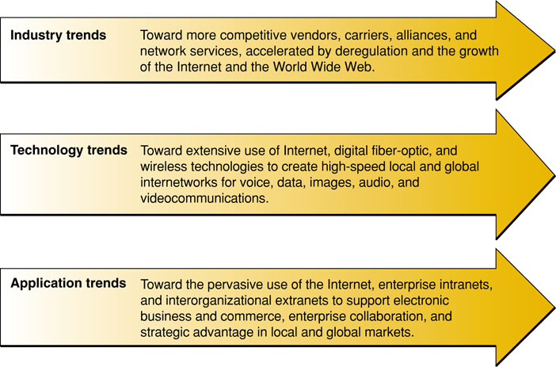
III. Trends in Telecommunications

Slide 4
IV. The Business Value of Telecommunications Networks
Cut costs, shorten lead/response times, improve collaboration, support e-commerce
  The Internet Revolution – a “network of networks”, the largest and most important network, constantly expanding
  Internet Service Providers (ISP) – provides easy access to the Internet
  Internet Applications – browsing the Net, email, instant messaging
  Business Use of the Internet – the Internet adds value to every prt of the business cycle
  The Business Value of the Internet

Slide 5
V. The Role of Intranets
Intranet – a private internal network using Internet technologies
  The Business Value of Intranets – an enterprise information portal supporting communications and collaboration
  Communications and Collaboration – improved by Intranets
  Web Publishing – developing and publishing hyperlinked multimedia documents
  Business Operations and Management – develop/deploy critical applications supporting operations and managerial decision making
  Intranet Portal Management – managed by IS/IT professionals

Slide 6
VI. The Role of Extranets
Extranet – A private network using Internet technologies (intranet) opened to select external entities for purposes of communications
Purpose – interconnect the business with its suppliers/customers/business partners

Slide 7
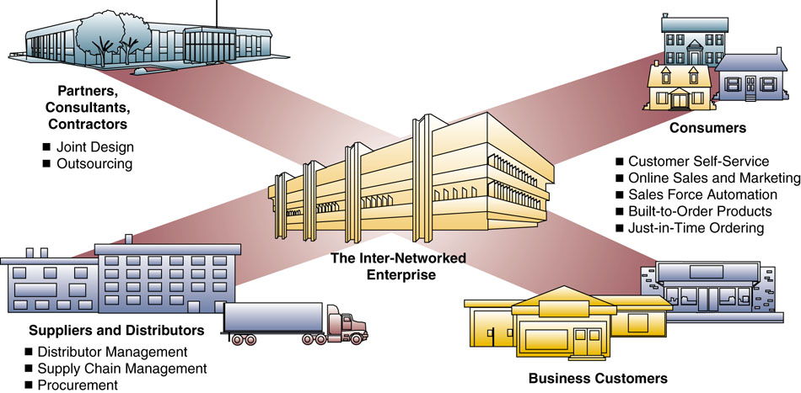
VI. The Role of Extranets
Extranets connect the internetworked enterprise to customers, suppliers, and trading partners

Slide 8
III. Types of Telecommunications Networks
A Network is defined by its geographic area and who owns the equipment
  Wide Area Networks (WAN) – between cities/large geographic areas, LANs connected by common carrier or leased lines
  Metropolitan Area Networks (MAN) – LANs connected over a specific geographical area
  Local Area Networks (LAN) – equipment owned by the firm, short distances, usually within a single building (or room)

Slide 9
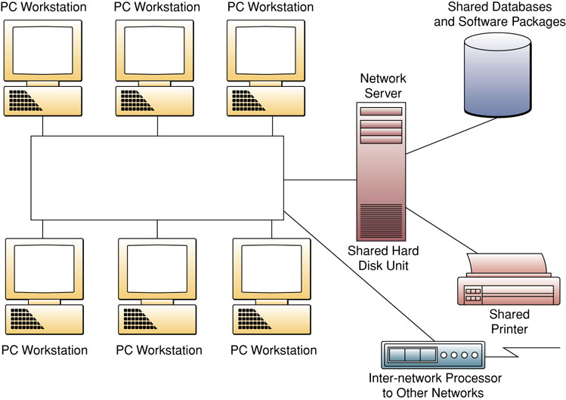
III. Types of Telecommunications Networks
A LAN allows sharing of resources

Slide 10
III. Types of Telecommunications Networks
  Virtual Private Networks (VPN) – a network using the Internet as a backbone but incorporating security for privacy
  Client/Server Networks – a powerful, central computer (server) providing information and processing (services) to multiple end-user computers (clients)
  Network Computing – a minimally-powered browser-based computer obtains its data and processing from the Internet

Slide 11
III. Types of Telecommunications Networks
  Peer-to-Peer Networks (P2P)
    Central Server Architecture – P2P software connects a PC to the central server with a directory of all other users (peers)
    Pure Peer-to-Peer – PCs connected without any central server

Slide 12
IV. Digital and Analog Signals
Analog (continuous) – any value between the maximum/minimum value is possible (e.g., any frequency between 20hz and 20K hz)
Digital (discrete) – only certain values are permitted (e.g., 0 and 1)

Slide 13
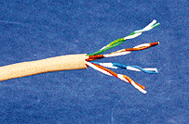
Telecommunications Media
Twisted-pair wire:
  Ordinary telephone wire
  Copper wire twisted into pairs
Source: Phil Degginger/Getty Images.
Notes:
Twisted pair transmission speeds range from 2 million bits per second (unshielded) to 100 million bits (shielded)
Coaxial cable from 200 million bits to over 500 million bits per second
Fiber optic cable as high as trillions of bits per second. Uses light elements instead of electricity

Slide 14

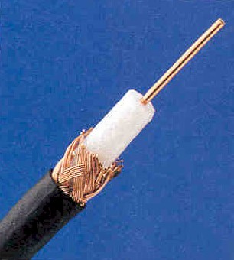
Telecommunications Media
Coaxial cable:
  Sturdy copper or aluminum wire wrapped with spacers to insulate and protect it
Source: Ryan McVay/Getty Images.
Notes:
Twisted pair transmission speeds range from 2 million bits per second (unshielded) to 100 million bits (shielded)
Coaxial cable from 200 million bits to over 500 million bits per second
Fiber optic cable as high as trillions of bits per second. Uses light elements instead of electricity

Slide 15
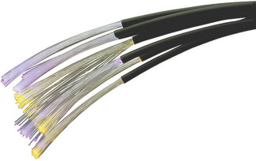
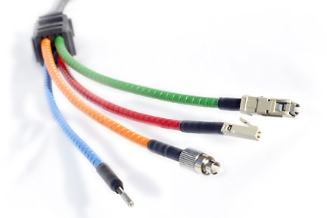
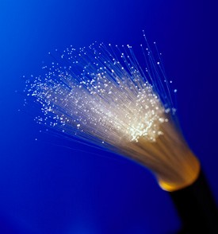
Telecommunications Media
Fiber-optic cable:
  One or more hair-thin filaments of glass fiber wrapped in a protective jacket
Source: CMCD/Getty Images.
Notes:
Twisted pair transmission speeds range from 2 million bits per second (unshielded) to 100 million bits (shielded)
Coaxial cable from 200 million bits to over 500 million bits per second
Fiber optic cable as high as trillions of bits per second. Uses light elements instead of electricity

Slide 16
Last Mile Problem
Although a telecomm provider puts the latest technology to your door, your home/office is still wired with old fashioned technology, so all the provider’s efforts do not help once the signal reaches your location and you are constrained (limited) by the technology in your own home/office

Slide 17
VI. Wireless Technologies
Terrestrial Microwave
Communications Satellites
Cellular technologies
Wireless LANs
Bluetooth

Slide 18
VII. Telecommunications Processors
Modems – Modulate/Demodulate – change digital signals to analog and analog to digital to use common carrier (voice lines) between computers; most common processor
Inter-Network Processors – connects networks; switches, routers, hubs
Multiplexor – allows a single channel to carry multiple signals at one time

Slide 19
VIII. Telecommunications Software/IP address
Network Management – network operating systems and telecommunications monitors
IP (version 4) address: 15.62.233.193
Every number ranges from 0 to 255
Around 4 billion addresses, companies are now slowly moving to IP version 6.

Slide 20
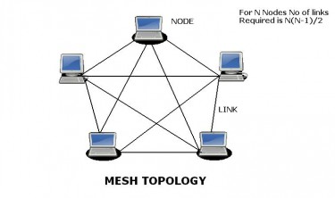
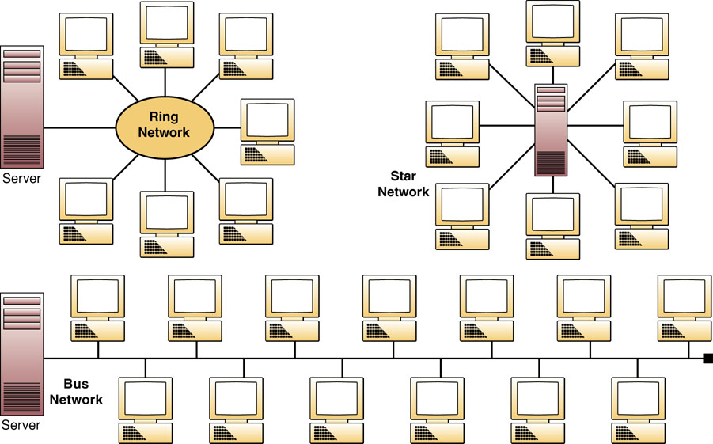
IX. Network Topologies

Slide 21
Networking Technologies
Voice Over IP – Internet telephony, replaces public-switched service
Video conferencing
Software using data packets

Slide 22
View How the Internet Works Video

